Slide 1

OMICS International
OMICS International through its Open Access Initiative is committed to make genuine and reliable contributions to the scientific community. OMICS International signed an agreement with more than 1000 International Societies to make healthcare information Open Access.
Contact us at: contact.omics@omicsonline.org

Slide 2

OMICS Journals are welcoming Submissions
OMICS International welcomes submissions that are original and technically so as to serve both the developing world and developed countries in the best possible way.
OMICS Journals are poised in excellence by publishing high quality research. OMICS International follows an Editorial Manager® System peer review process and boasts of a strong and active editorial board.
Editors and reviewers are experts in their field and provide anonymous, unbiased and detailed reviews of all submissions.
The journal gives the options of multiple language translations for all the articles and all archived articles are available in HTML, XML, PDF and audio formats. Also, all the published articles are archived in repositories and indexing services like DOAJ, CAS, Google Scholar, Scientific Commons, Index Copernicus, EBSCO, HINARI and GALE.
For more details please visit our website: http://omicsonline.org/Submitmanuscript.php

Slide 3
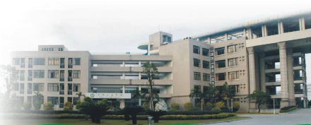
The role of Nrf2/ARE system and epigenetic in the neurotoxicity
Huangyuan LI （Ph.D, M.D.，Professor）
fmulhy@163.com
School of Public Health
Fujian Medical University
Fuzhou, China
Notes:
Mr. Chairman, ladies and gentlemen. Thank you very much, Prof. A, for your very kind introduction.
I am delighted to be here.
First of all, I would like to thank organizational committee for the invitation, and providing the wonderful opportunity to discuss about Nrf2/ARE pathway activation by manganese , and share some of our research results in this topic.

Slide 4
Outline
Ⅰ. Introduction to the research fields of Epeigenetic
Toxicology in our team.
Ⅱ. The role of Nrf2/ARE system in the neurotoxicity
induced by environmental chemical, deltamethrin (DM),
manganese (Mn) and paraquat (PQ).
Ⅲ. The role of non-coding RNA (ncRNA) in the neurotoxicity
induced by paraquat (PQ).
Ⅳ. The role of Histone acetylation in the neurotoxicity induced by manganese (Mn) .

Slide 5
Part Ⅰ.
Introduction to the research fields of Epeigenetic Toxicology in our team.
Notes:
表观遗传学
中文名称： 表观遗传学
英文名称： epigenetics
学科分类： 遗传学
注 释： 研究基因的核苷酸序列不发生改变的情况下，基因表达了可遗传的变化的一门遗传学分支学科。表观遗传的现象很多，已知的有DNA甲基化（DNA methylation），基因组印记（genomic impriting），母体效应（maternal effects），基因沉默（gene silencing），核仁显性，休眠转座子激活和RNA编辑（RNA editing）等。目前，国际上表观遗传学已经构成了系统遗传学研究的一个重要方面。
别名：实验胚胎学、拟遗传学、表遗传学、外遗传学以及后遗传学
比较通俗的讲表观遗传学是研究在没有细胞核DNA序列改变的情况时，基因功能的可逆的、可遗传的改变。也指生物发育过程中包含的程序的研究。在这两种情况下，研究的对象都包括在DNA序列中未包含的基因调控信息如何传递到（细胞或生物体的）下一代这个问题。在西方文字中epigenetics即指在DNA包含的遗传信息以外附加的（希腊文前缀epi-）。
In biology, the term epigenetics refers to changes in gene expression that are stable between cell divisions, and sometimes between generations, but do not involve changes in the underlying DNA sequence of the organism. The idea is that environmental factors can cause an organism's genes to behave (or "express themselves") differently, even though the genes themselves don't change.Epigenetic changes in eukaryotic biology are most elegantly illustrated by the process of cellular differentiation where pluripotent stem cells become the various cell lines of the embryo. This process becomes stable by mechanisms which may include silencing of some genes, removal of silencing marks on some other genes and permanently inactivating still other genes.
表观遗传学是与遗传学(genetic)相对应的概念。遗传学是指基于基因序列改变所致基因表达水平变化，如基因突变、基因杂合丢失和微卫星不稳定等；而表观遗传学则是指基于非基因序列改变所致基因表达水平变化，如DNA甲基化和染色质构象变化等；表观基因组学(epigenomics)则是在基因组水平上对表观遗传学改变的研究。所谓DNA甲基化是指在DNA甲基化转移酶的作用下，在基因组CpG二核苷酸的胞嘧啶5'碳位共价键结合一个甲基基团。正常情况下，人类基因组“垃圾”序列的CpG二核苷酸相对稀少，并且总是处于甲基化状态，与之相反，人类基因组中大小为100—1000 bp左右且富含CpG二核苷酸的CpG岛则总是处于未甲基化状态，并且与56％的人类基因组编码基因相关。人类基因组序列草图分析结果表明，人类基因组CpG岛约为28890个，大部分染色体每1 Mb就有5—15个CpG岛，平均值为每Mb含10．5个CpG岛，CpG岛的数目与基因密度有良好的对应关系[9]。由于DNA甲基化与人类发育和肿瘤疾病的密切关系，特别是CpG岛甲基化所致抑癌基因转录失活问题，DNA甲基化已经成为表观遗传学和表观基因组学的重要研究内容。

Slide 6
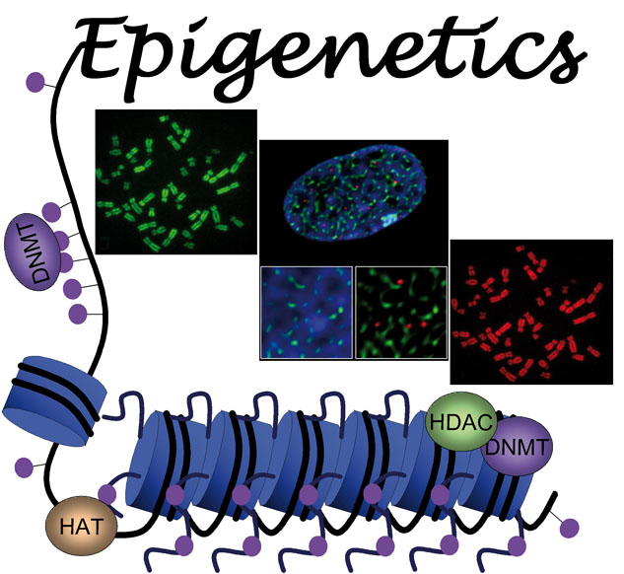
Epigenetics refers to heritable alterations in gene expression that do not entail changes in nucleotide sequence.
Notes:
表观遗传学
中文名称： 表观遗传学
英文名称： epigenetics
学科分类： 遗传学
注 释： 研究基因的核苷酸序列不发生改变的情况下，基因表达了可遗传的变化的一门遗传学分支学科。表观遗传的现象很多，已知的有DNA甲基化（DNA methylation），基因组印记（genomic impriting），母体效应（maternal effects），基因沉默（gene silencing），核仁显性，休眠转座子激活和RNA编辑（RNA editing）等。目前，国际上表观遗传学已经构成了系统遗传学研究的一个重要方面。
别名：实验胚胎学、拟遗传学、表遗传学、外遗传学以及后遗传学
比较通俗的讲表观遗传学是研究在没有细胞核DNA序列改变的情况时，基因功能的可逆的、可遗传的改变。也指生物发育过程中包含的程序的研究。在这两种情况下，研究的对象都包括在DNA序列中未包含的基因调控信息如何传递到（细胞或生物体的）下一代这个问题。在西方文字中epigenetics即指在DNA包含的遗传信息以外附加的（希腊文前缀epi-）。
In biology, the term epigenetics refers to changes in gene expression that are stable between cell divisions, and sometimes between generations, but do not involve changes in the underlying DNA sequence of the organism. The idea is that environmental factors can cause an organism's genes to behave (or "express themselves") differently, even though the genes themselves don't change.Epigenetic changes in eukaryotic biology are most elegantly illustrated by the process of cellular differentiation where pluripotent stem cells become the various cell lines of the embryo. This process becomes stable by mechanisms which may include silencing of some genes, removal of silencing marks on some other genes and permanently inactivating still other genes.
表观遗传学是与遗传学(genetic)相对应的概念。遗传学是指基于基因序列改变所致基因表达水平变化，如基因突变、基因杂合丢失和微卫星不稳定等；而表观遗传学则是指基于非基因序列改变所致基因表达水平变化，如DNA甲基化和染色质构象变化等；表观基因组学(epigenomics)则是在基因组水平上对表观遗传学改变的研究。所谓DNA甲基化是指在DNA甲基化转移酶的作用下，在基因组CpG二核苷酸的胞嘧啶5'碳位共价键结合一个甲基基团。正常情况下，人类基因组“垃圾”序列的CpG二核苷酸相对稀少，并且总是处于甲基化状态，与之相反，人类基因组中大小为100—1000 bp左右且富含CpG二核苷酸的CpG岛则总是处于未甲基化状态，并且与56％的人类基因组编码基因相关。人类基因组序列草图分析结果表明，人类基因组CpG岛约为28890个，大部分染色体每1 Mb就有5—15个CpG岛，平均值为每Mb含10．5个CpG岛，CpG岛的数目与基因密度有良好的对应关系[9]。由于DNA甲基化与人类发育和肿瘤疾病的密切关系，特别是CpG岛甲基化所致抑癌基因转录失活问题，DNA甲基化已经成为表观遗传学和表观基因组学的重要研究内容。

Slide 7
Environmental Exposure
Environmental endocrine disruptors
cadmium
n-hexane
bis(2-ethylhexyl)phthalate
Neurotoxic chemical
paraquat (PQ)
manganese (Mn)
Gene
Expression
Pattern
Alteration
Reproductive
toxicity
Neurotoxcity
Cancer
Epeigenetic
Modification
Alteration
Notes:
邻苯二甲酸二(2-乙基己)酯（英语：bis(2-ethylhexyl)phthalate 或di(2-ethylhexyl) phthalate，缩写分别为BEHP与DEHP），

Slide 8
Part Ⅱ.
The role of Nrf2/ARE system in the neurotoxicity induced by environmental chemical, deltamethrin (DM), manganese (Mn) and paraquat (PQ).

Slide 9
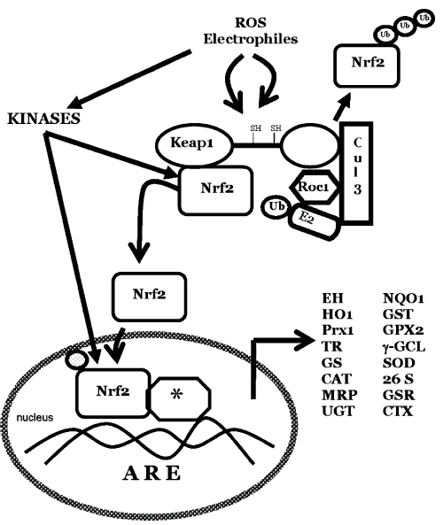
1. Introduction
Nrf2: Nuclear factor E 2(NF-E2) p45-related factor 2
a member of the NF-E2 family of nuclear basic leucine zipper transcriptional activators
Keap1: Kelch-like ECH-associated protein 1
a cytoplasmic protein homologous to the Drosophila actin binding protein Kelch
ARE: Antioxidant Response Element
Possible protective mechanism of Nrf2/ARE pathway on cell from cytotoxicity
Notes:
I would like to give a big picture about Nrf2-Keap1/ARE pathway.
NF-E2-related factor 2 (Nrf2) and Kelch-like-ECH-associated protein 1 (Keap1) are key proteins in the coordinate transcriptional induction of various antioxidant-metabolizing enzymes.
Nrf2 is a member of the NF-E2 family of nuclear basic leucine zipper transcriptional activators, and Keap1 is a cytoplasmic protein homologous to the Drosophila actin binding protein Kelch.
Under normal physiological conditions, Nrf2 is largely bound to Keap1 and retained in the cytoplasm. On disruption of the Nrf2–Keap1 complex by inducers, Nrf2 undergoes rapid translocation to the nucleus. After translocation into the nucleus, Nrf2 recognizes and binds to antioxidant response elements (ARE) in the promoter regions of its target genes and induces phase II detoxification enzymes and antioxidant proteins, such as: heme oxygenase-1 (HO-1) . Nrf2/ARE pathway has been considered to play a protective role in several central nervous system diseases.
Activation of mitogen-activated protein kinase (MAPKs),PI3K, PKC signaling may activate Nrf2–ARE-dependentent transcriptional activation.
Furthermore, Nrf2 was shown to have a protective effect against apoptosis induced by Fas signaling and mitochondrial toxins
Neurons lacking Nrf2 are highly sensitive to oxidative stress, and are rescued by transfecting with a functional Nrf2 construct.
In addition, Nrf2 knockout mice are more sensitive to kainate toxicity, as evidenced by hippocampus neurons damage and mortality. Activation of the Nrf2 /ARE pathway in astrocytes by tert-butylhydroquinone (tBHQ), an Nrf2 activity inducer, is able to protect neurons from oxidative stress.

Slide 10
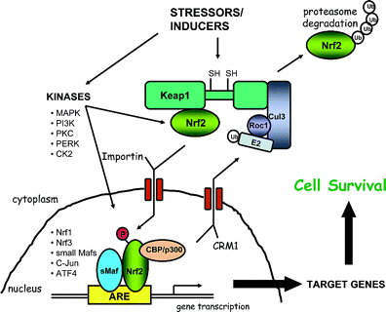
Finding 1
deltamethrin
ROS↑
Nrf2
Nrf2
P
↑
Cytoplasm
nucleus
HO-1 ↑
GCL ↑
Transcription factor Nrf2 activation by deltamethrin in PC12 cells: Involvement of ROS
Toxicology Letters,2007,171(1-2):87-98.
Toxicol Ind Health ,2011, 27(7):579-590.

Slide 11
Deltamethrin
exposure
superoxide oxygen,nitrogen-centered free radicals
or carbon-centered semiquinone free radicals ↑
Nrf2
Nrf2
P
↑
Cytoplasm
nucleus
HO-1 ↑
A schematic diagram to show that the pesticide deltamethrin increases free radical production and promotes nuclear translocation of Nrf2 in rat brain.
Toxicol Ind Health ,2011, 27(7):579-590.

Slide 12
Finding 2
tBHQ
Nrf2
deltamethrin
Nrf2
P
↑
ROS↑
[Ca^{2＋}]i↑
Cytoplasm
nucleus
－
－
HO-1 ↑
Nrf2 activation and HO-1 induction by tBHQ protect against deltamethrin mediated oxidative stress
Chemical Research in Toxicology,2007,20 (9):1242–1251.

Slide 13
Finding 3
tBHQ
Mn
MAPKs
ROS
Apoptosis and death
Archives of Toxicology, 2011, 85:901-910
Journal of Applied Toxicology,2011,31:690-697.

Slide 14

Finding 4
tBHQ
Paraquat
HO-1 ↑
neurodegeneration
Archives of Toxicology,2013, 86(11):1729-1740.

Slide 15
Conclusion
Nrf2 protects from neurotoxicity in cell models and laboratory models.
The Nrf2/ARE pathway as a potential therapeutic target in neurotoxicity resulted from environmental chemical.

Slide 16
Part Ⅲ.
The role of non-coding RNA (ncRNA) in the neurotoxicity induced by PQ.

Slide 17
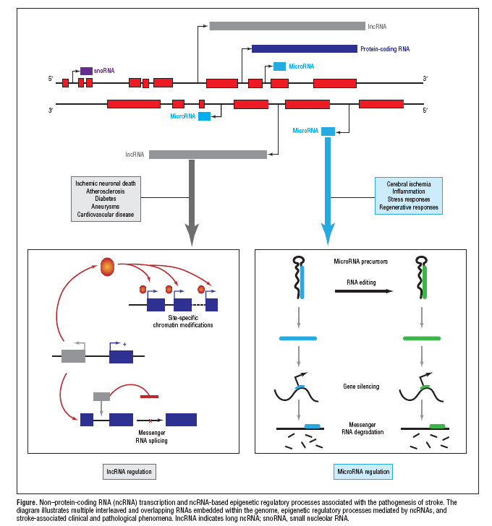

Slide 18
Finding 5
In vitro, PQ can increase the rate of apoptosis of cells and change miRNA expression profiling, which maybe one of the mechanism of neurotoxicity induced by PQ.
In vitro, MPTP can also change miRNA expression profiling. It is different from but related to that of PQ.
Unpublished data
Notes:
18

Slide 19
Finding 6
In vivo，PQ can change miRNA/lncRNA expression profiling, which maybe one of the mechanism of neurotoxicity induced by PQ.
In vivo, MPTP can also change miRNA/lncRNA expression profiling. It is different from but related to that of PQ.
There are some specific miRNAs/lncRNA related to the transcription factor Nrf2, interaction of miRNA/lncRNA and Nrf2 may involve in neurotoxicity induced by PQ or MPTP.
Unpublished data
Notes:
19

Slide 20
Part Ⅳ.
The role of Histone acetylation in the neurotoxicity induced by manganese.

Slide 21
Neuronal acetylation homeostasis
Pentagons on the balance beam
represent the protein level (dose) of HATs and HDACs, while compasses
represent their activity. Enzymatic activity within the green arc of the compass is
physiologically optimum.
(a) In neurons under normal conditions, the dose and
activity of HATs and HDACs are poised in a fine balance where they counteract
each other to ensure physiological homeostasis.
(b) During neurodegeneration,
critical loss of HAT protein level ensue a rebated HAT dose and activity. This
reclines the acetylation balance towards excessive deacetylation of target
moieties

Slide 22
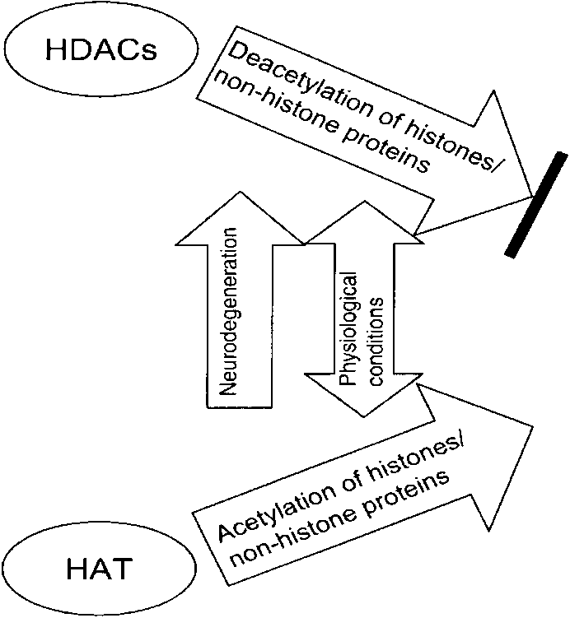
Accessibility of target genes
Increased transcription of neuroprotective genes
Binding of transcription factors

Slide 23
Shi Nian
Wu Siying
Lin wei, Wang Zhangjin
You Junyi, Zhou wenhua,Lian Shuangqing, Zhang chenzhi, Huang bin
Wang qingqing, Wang lijun, Guo zhenkun

Slide 24
National Natural Science Foundation in China
(Grant NO.81172715 ,30800936, 30371225 )
Fujian Province Funds for Distinguished Young Scientists (2012J06018)
Natural Science Foundation of Fujian province (Grant C0610020)
Program for New Century Excellent Talents in Fujian Province University (NCETFJ, JA11103)

Slide 25

Journal of Environmental & Analytical Toxicology
Related Journals
Journal of Environmental Analytical Chemistry
Journal of Pollution Effects & Control

Slide 26

Journal of Environmental & Analytical Toxicology
Related Conferences
International Summit on Past and Present Research Systems of Green Chemistry
International Summit on Toxicology & Applied Pharmacology

Slide 27
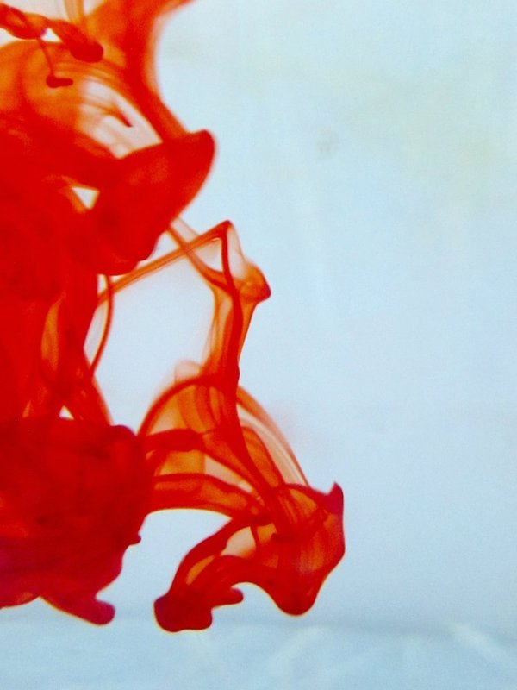

OMICS International Open Access Membership
OMICS International Open Access Membership enables academic and research institutions, funders and corporations to actively encourage open access in scholarly communication and the dissemination of research published by their authors.
For more details and benefits, click on the link below:
http://omicsonline.org/membership.php

