Slide 1
OMICS Group
OMICS Group International through its Open Access Initiative is committed to make genuine and reliable contributions to the scientific community. OMICS Group hosts over 400 leading-edge peer reviewed Open Access Journals and organizes over 300 International Conferences annually all over the world. OMICS Publishing Group journals have over 3 million readers and the fame and success of the same can be attributed to the strong editorial board which contains over 30000 eminent personalities that ensure a rapid, quality and quick review process. OMICS Group signed an agreement with more than 1000 International Societies to make healthcare information Open Access.
Contact us at: contact.omics@omicsonline.org

Slide 2
OMICS Journals are welcoming Submissions
OMICS Group welcomes submissions that are original and technically so as to serve both the developing world and developed countries in the best possible way.
OMICS Journals are poised in excellence by publishing high quality research. OMICS Group follows an Editorial Manager® System peer review process and boasts of a strong and active editorial board.
Editors and reviewers are experts in their field and provide anonymous, unbiased and detailed reviews of all submissions.
The journal gives the options of multiple language translations for all the articles and all archived articles are available in HTML, XML, PDF and audio formats. Also, all the published articles are archived in repositories and indexing services like DOAJ, CAS, Google Scholar, Scientific Commons, Index Copernicus, EBSCO, HINARI and GALE.
For more details please visit our website:
http://esciencecentral.org/journals/haematology-thromboembolic-diseases.php

Slide 3
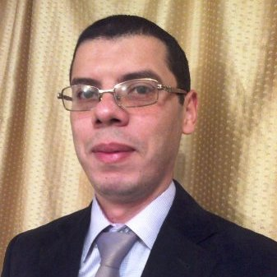
BIO-sketch of Adel Gouri

Slide 4
Biography
Adel Gouri has completed his Pharm.D and Clinical Biochemistry Specialization in 2008 from Badji-Mokhtar University, School of Medicine (Annaba, Algeria).
He is currently working as Head of Laboratory of Medical Biochemistry in Ibn Zohr Public Hospital, Guelma.
As associate lecturer in College of Medicine, Annaba.

Slide 5
Research training
Based on this research and training in cancer biology and cardiovascular biology he has received several awards and honors, and is serving one of the active members of the ;
Diabetes and Cardiovascular Disease EASD Study Group, European Association for the Study of Diabetes (EASD),

Slide 6
Research training
The Working Group on Myocardial Function, European Society of Cardiology (ESC),
The Working Group on Atherosclerosis and Vascular Biology, European Society of Cardiology (ESC),
The American Society of Clinical Oncology (ASCO)

Slide 7
Research Interest
Chairman of the "International Board of Biochemistry, Clinical Chemistry, Pathobiochemistry chez World Academy of Medical Sciences (WAMS)
Executive Board Membership of the " International Medical Research Council (IMREC) chez World Academy of Medical Sciences (WAMS)

Slide 8
Research Interest
Cancer Biology and Research of new Biomarkers of cancers,
Cardiovascular Biomarkers, Atherosclerosis and diabetes-related research,
Biomarkers and Cardiovascular Diseases in Hemodialysis patients,
Biomarkers in Early Diagnosis of Hematologic malignancies

Slide 9
Publications
He has authored more than 20 research articles, 01 books/chapters
A. GOURI, A. DEKAKEN, A.A. BENTORKI, M CHEFROUR A. YAKHLEF, M BELLEILI et al. Hematologic Malignancies Therapy and Cardiotoxicity: New Biomarkers. J Hematol Thrombo Dis 2014, 2:e110.
A. GOURI, A. DEKAKEN, A.A. BENTORKI, A. YAKHLEF, M BELLEILI, F MEHIDDINE et al. New Insights into Diagnosis of Monoclonal Gammopathy of Undetermined Significance: Emerging Role of Micro RNAs. J Hematol Thromb Dis 2014, 2, 126.

Slide 10
Publications cont…
A. GOURI, A. DEKAKEN, A.A. BENTORKI, A. YAKHLEF. TE-MPN-Thrombotic events in myeloproliferative neoplasms: JAK2V617F mutation as a predictive marker. 2013, J Blood Disord Transfus 4 (5), 95. (Abstract)
A. GOURI, A. DEKAKEN, A.A. BENTORKI, A TOUAREF, A. YAKHLEF, F SEKKACHE , N. KOUICEM. Serum Uric Acid Level and Cardiovascular Risks in Hemodialysis Patients: An Algerian Cohort Study. Pak. J. Biol. Sci. 2013,16 (17), 852-858. (Original Article)

Slide 11
Publications cont…
A. GOURI, A. DEKAKEN, A. YAKHLEF, A.A. BENTORKI, NM ABDELHAMID. Polycythemia Vera and Acute Coronary Syndromes: Pathogenesis, Risk Factors and Treatment. J Hematol Thrombo Diseases 2013, 1: 107. (Review)
A. GOURI, A. YAKHLEF, A. DEKAKEN, A.A. BENTORKI. Acute myocardial infarction revealing a polycythemia Vera. Ann Biol Clin (Paris). 2012 Jul- Aug;70(4):489-91. (Case report).

Slide 12
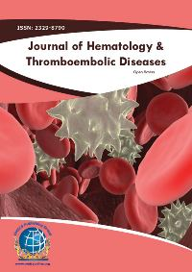
Related journals
Journal of Blood & Lymph
Journal of Blood Disorders & Transfusion
Journal of Leukemia

Slide 13
Related Conference

Slide 14
OMICS Group Open Access Membership
OMICS publishing Group Open Access Membership enables academic and research institutions, funders and corporations to actively encourage open access in scholarly communication and the dissemination of research published by their authors.
For more details and benefits, click on the link below:
http://omicsonline.org/membership.php

