Slide 1
OMICS Journals are welcoming Submissions
OMICS International welcomes submissions that are original and technically so as to serve both the developing world and developed countries in the best possible way.
OMICS Journals are poised in excellence by publishing high quality research. OMICS International follows an Editorial Manager® System peer review process and boasts of a strong and active editorial board.
Editors and reviewers are experts in their field and provide anonymous, unbiased and detailed reviews of all submissions.
The journal gives the options of multiple language translations for all the articles and all archived articles are available in HTML, XML, PDF and audio formats. Also, all the published articles are archived in repositories and indexing services like DOAJ, CAS, Google Scholar, Scientific Commons, Index Copernicus, EBSCO, HINARI and GALE.
For more details please visit our website: http://omicsonline.org/Submitmanuscript.php

Slide 2
Identifying Novel Targets for Melanoma Treatment
Alan Tackett, PhD
University of Arkansas for Medical Sciences
Professor of Biochemistry and Pathology
Proteomics Facility Director

Slide 3
Tackett Laboratory at UAMS
Project 1: We develop new tools and assays for determining how proteins interact with each other to drive cancer phenotypes
Project 2: We take a translational research approach for using patient skin biopsies archived at UAMS for the identification of new targets for melanoma prevention and therapy

Slide 4
Melanoma
Melanoma: a cancer that develops in melanocytes and is the most deadly of all skin cancers
1 person diagnosed every 8 min with melanoma
Melanoma claims the life of one American every 62 minutes
The mean age for diagnosis of melanoma is 50
Many other cancers it is 65 to 70 years old
Most common form of cancer for young adults 25- to 29-years-old
65% cases attributed to UV exposure
Risk Factors for Melanoma
Fair skin
Light hair and eye color
Moles
Dysplastic nevi
Personal and/or family history
Non-melanoma skin cancer
Weakened immune system
Severe sunburns
Exposure to UV
Age

Slide 5
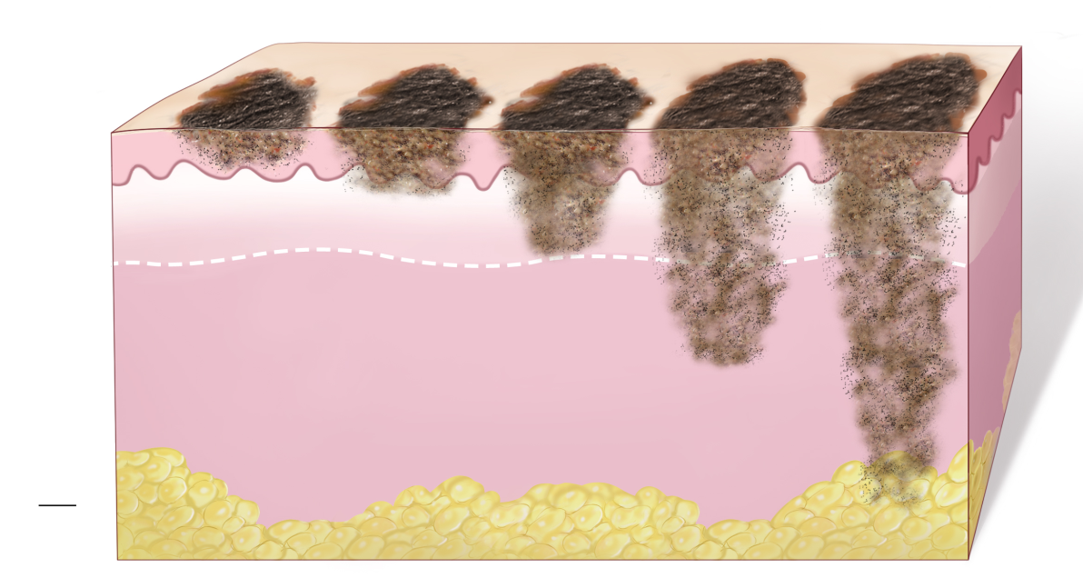
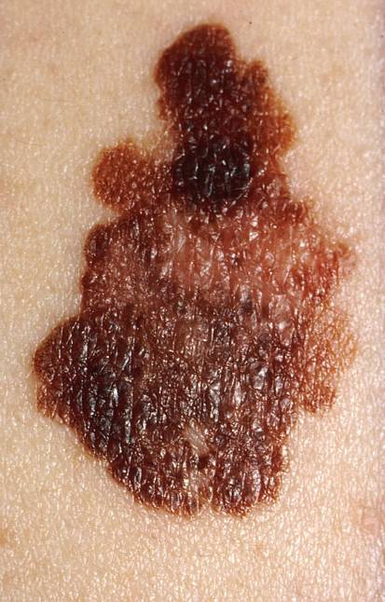
Melanoma
Mole
Melanoma
Melanoma
-123,590 cases in 2011
-8,790 deaths in 2011
-Accounts for 75% of skin cancer deaths

Slide 6
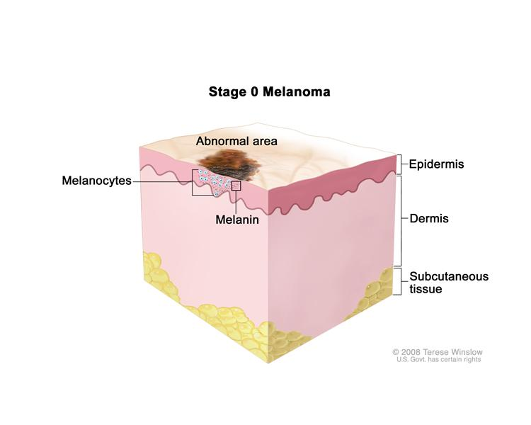
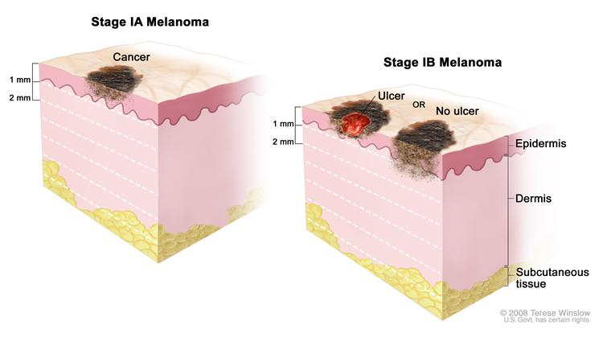
Stages of Melanoma: Stage 1
Stage | Description
0 | Superficial, little danger of spreading if surgically removed
1a | Tumor ≤1mm, no ulcer
1b | Either ≤1mm w/ ulcer OR ≤2mm w/o ulcer
Melanoma in situ
National Cancer Institute
Balch et al 2001
Notes:
6

Slide 7
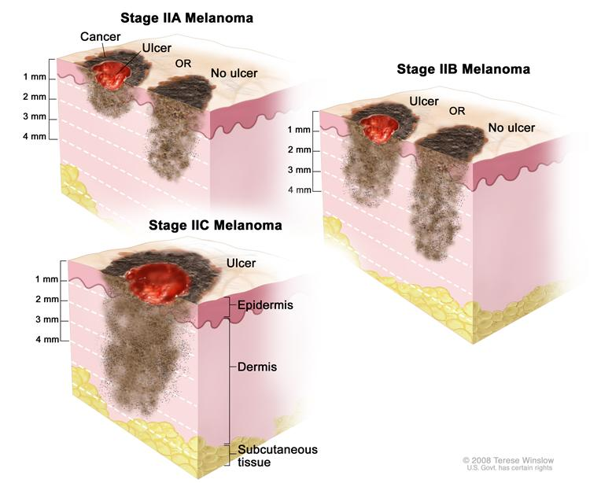
Stages of Melanoma: Stage 2
Stage | Description
2a | Tumor >1 but ≤2mm w/ ulcer OR >2 but ≤4mm w/no ulcer
2b | Tumor >2 but ≤4mm w/ulcer OR >4 w/o ulcer
2c | Tumor >4mm w/ ulcer
National Cancer Institute

Slide 8
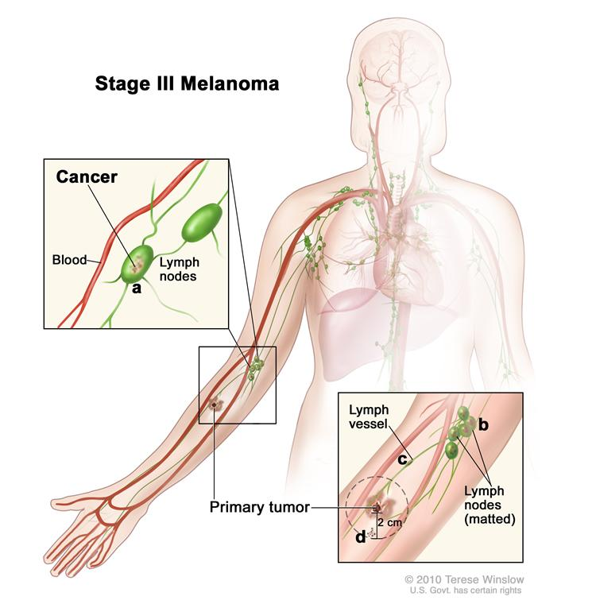
Stages of Melanoma: Stage 3
Stage | Description
3 | Tumor can be any thickness, w/ or w/o ulceration, cancer has spread to 1 or > lymph nodes, cancer is present in lymph vessel
Prognosis is bleak, little response to chemotherapy or radiation treatments
National Cancer Institute

Slide 9
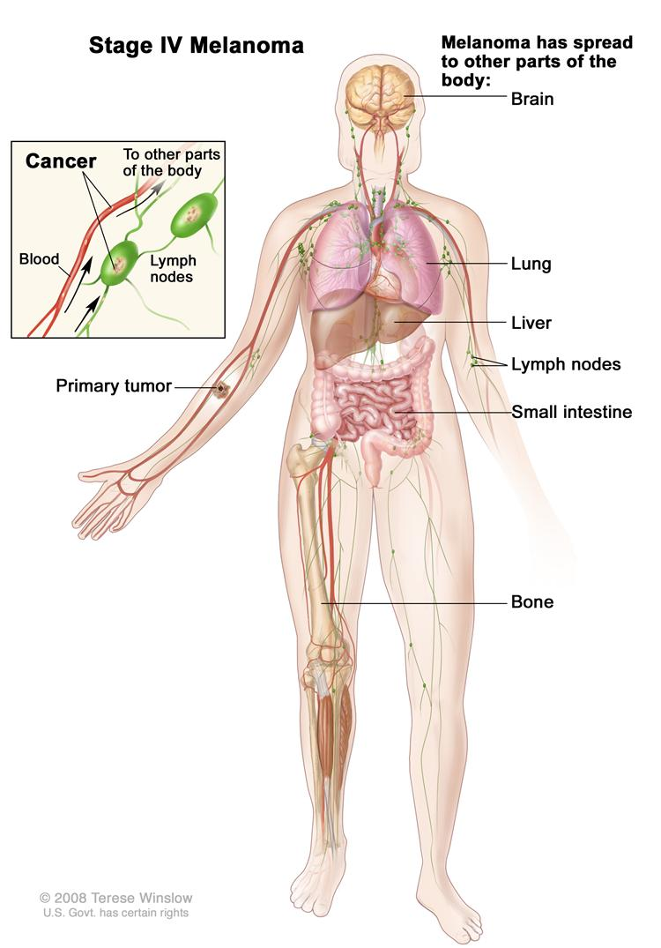
Stages of Melanoma: Stage 4
Stage | Description
4 | Cancer has spread into other tissues such as: brain, kidneys, bone, lung, liver, soft tissue or GI tract
Prognosis is bleak, little response to chemotherapy or radiation treatments
National Cancer Institute

Slide 10
Melanoma survival by stage
Stage | 5-year survival (%)
IA | 97
IB | 92
IIA | 81
IIB | 70
IIC | 53
IIIA | 78
IIIB | 59
IIIC | 40
IV | 10

Slide 11
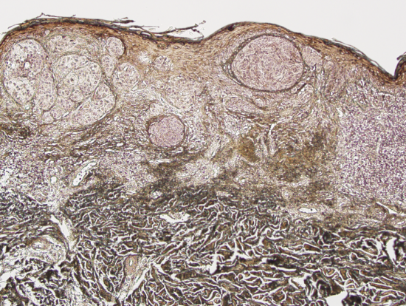
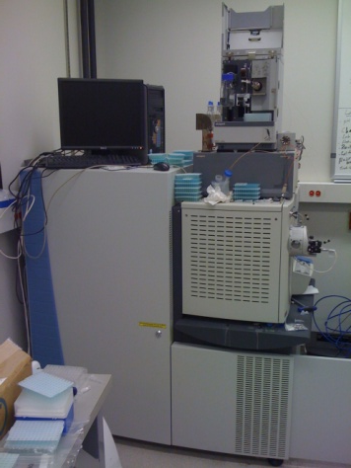
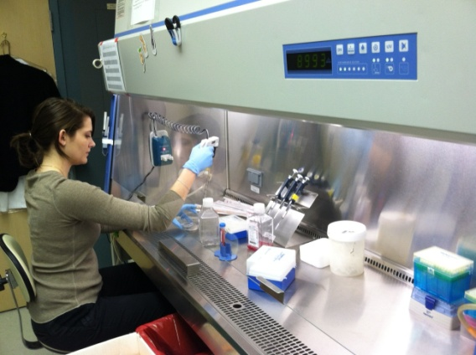
Our Approach
Exploit the extensive archive of patient melanoma biopsies at UAMS
Utilize the state of the art Proteomics Facility assembled by Dr. Tackett to find biomolecules in these samples to improve diagnosis, prognosis and treatment
Bring our findings back into Dr. Tackett’s research laboratory to understand how these biomolecules activate the cancer phenotype (study melanoma cells directly)

Slide 12
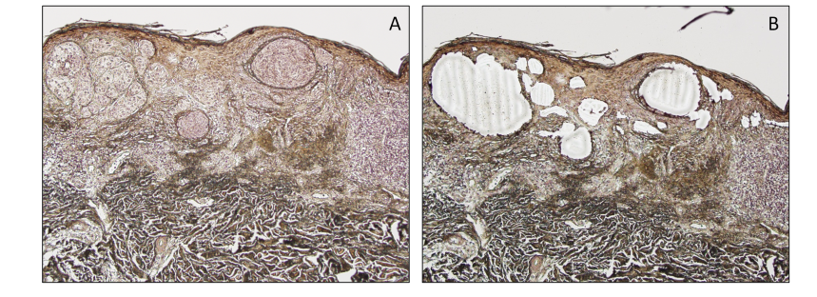
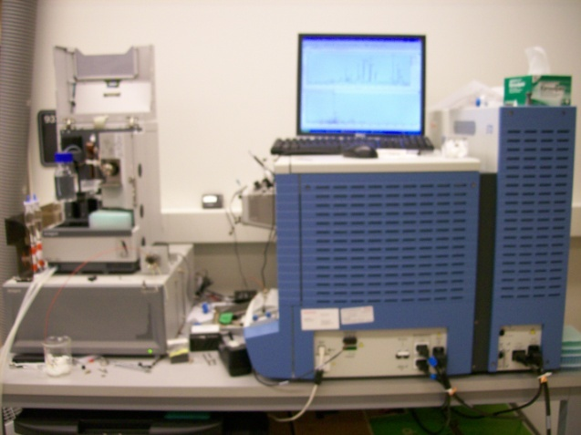
Proteomics of FFPE Human Melanoma
Laser microdissection of melanoma cells
Normalized Spectral
Abundance Factor
GeLC-MS/MS
Thermo LTQ-XL

Slide 13
Candidate Biomarkers for Melanoma Diagnosis and Prognosis
} M
} N
-1.2
1.7
390 Proteins Differentially Regulated in Melanoma

Slide 14
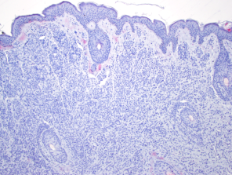
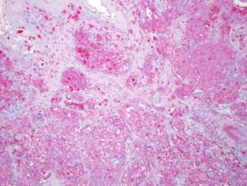
SILV is Up-regulated in Melanoma
Benign melanocytic nevus
Malignant melanoma
100X

Slide 15
What about these low molecular weight proteins?
Histones

Slide 16
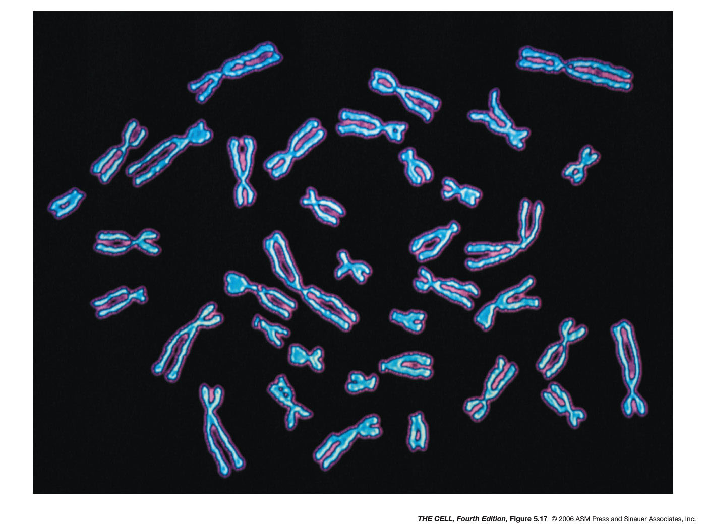
DNA Wraps Around Histones to Form Chromosomes

Slide 17
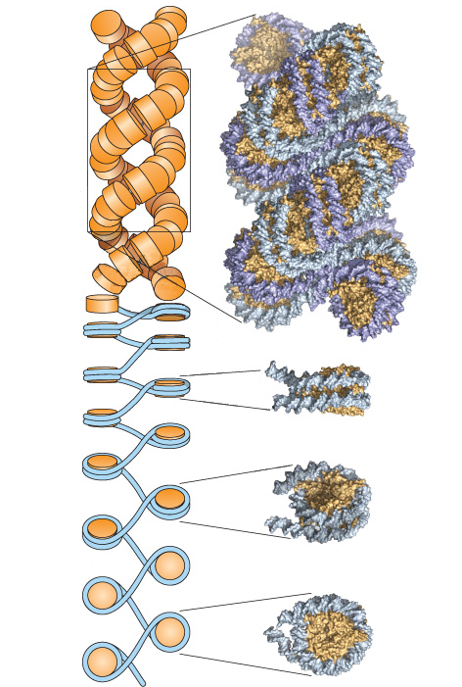
Unraveling a Chromosome

Slide 18
Natural Modifications to Histones Regulate Gene Expression

Slide 19
Modifications of Histones in Patient Melanoma

Slide 20
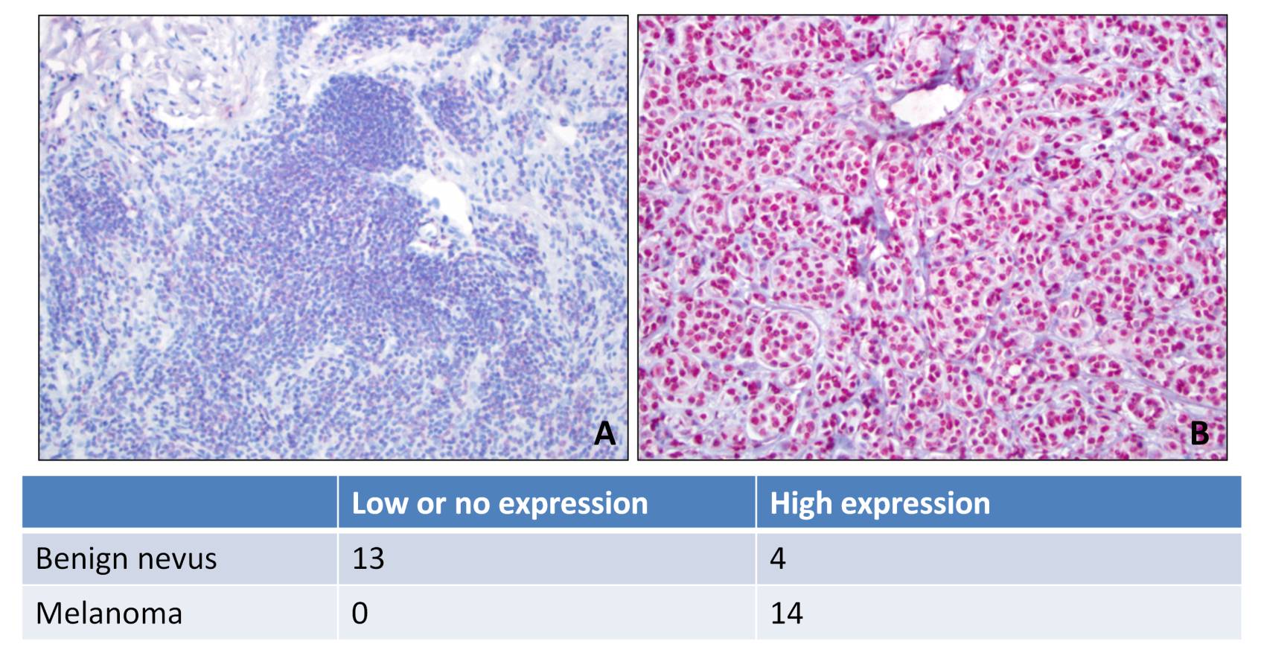
H3K27me3 is Up-regulated in Melanoma
Benign melanocytic nevus
Malignant melanoma
200X

Slide 21
Maintaining an Epigenetic Mark
WRITER
ERASER
H3K27 methylation

Slide 22
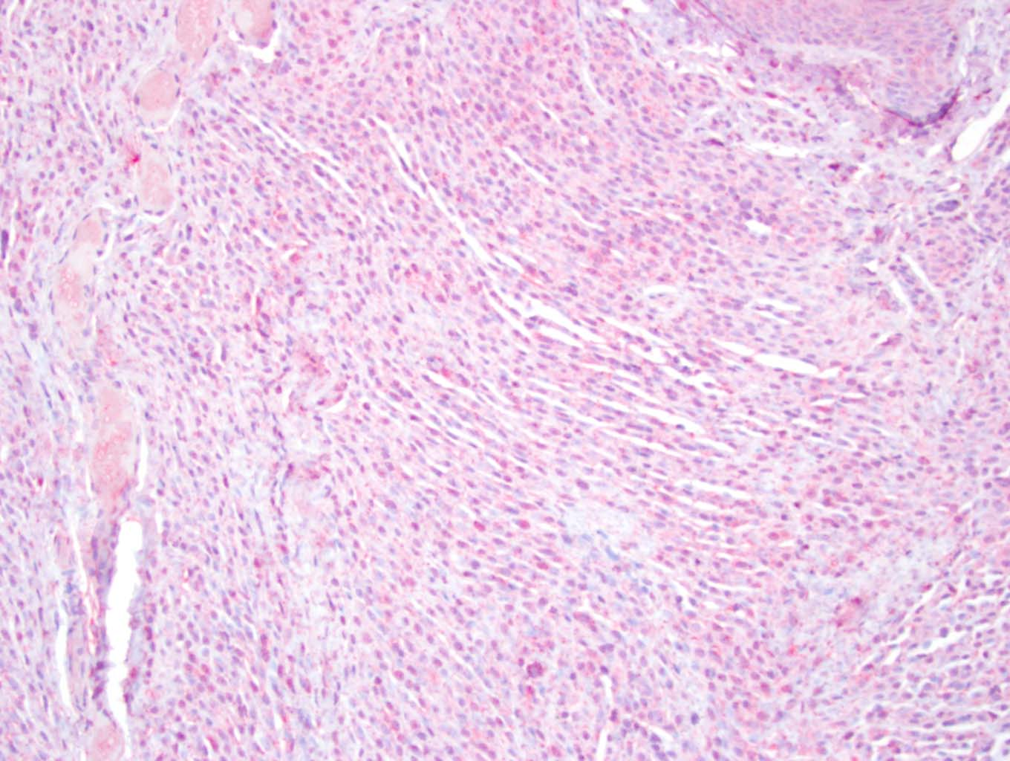
H3K27me3 “WRITER” is Over-expressed and “ERASER” is Repressed in Melanoma
JMJD3 “ERASER”
Benign melanocytic nevus
Malignant melanoma
Tissue microarrays show JMJD3 “eraser” and EZH2 “writer” are differentially
expressed (p<0.0001)

Slide 23
A Cell Culture Model for Studying Melanoma in the Lab
Primary melanoma tumor cell line
Metastatic melanoma cell line
EZH2 “WRITER”
JMJD3 “ERASER”
K27me3 “THE MARK”
H3 control

Slide 24
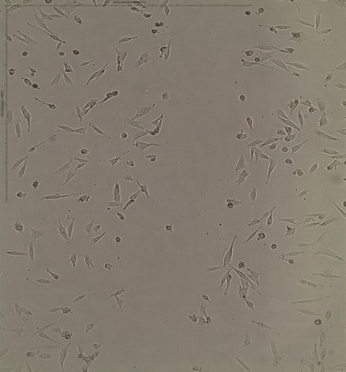
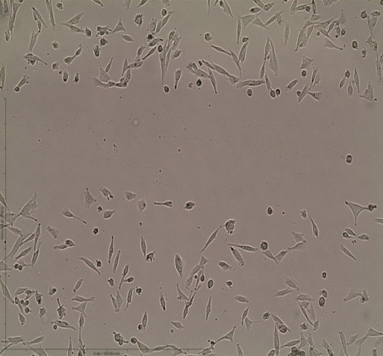
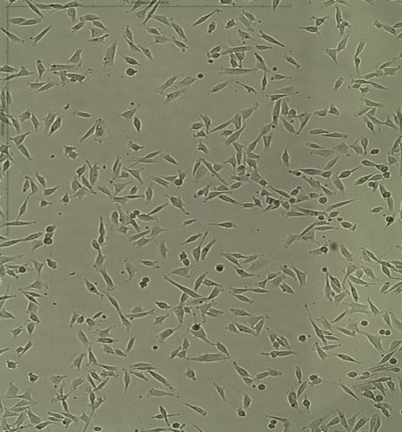
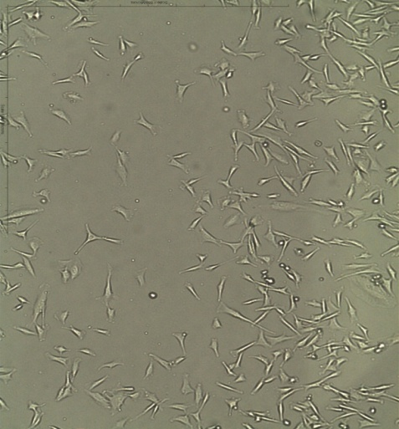
The “WRITER” is Necessary for Melanoma Cells to Migrate
Removal of the WRITER
Control
siEZH2
Metastatic Cell Line
T = 0hrs
control
WT
WRITER
T = 15hrs

Slide 25
A Novel Epigenetic Program Activated in Melanoma
PRC2
HDAC
JARID2
EZH1/2
PHF1
Metastatic Melanoma
Early Stage Melanoma
AEBP2
SET
SUZ12
EED
RBAP46/48
H3K27 methylation
OFF
ON
ASH2L
WDR5
H3K27 methylation
MLL
H3K4 methylation
RBBP5
JMJD3
H3 Acetylation
Trithorax

Slide 26
Summary
Described a translational research approach for identifying novel targets for melanoma diagnosis, prognosis and treatment
Extensive archive of patient skin biopsies at UAMS
Cutting-edge Proteomic technologies
A laboratory model to determine mechanism
Uncovered 390 putative melanoma biomarkers that will move to the validation stage
Found an epigenetic program involving proteins that WRITE and ERASE the H3K27me3 mark
Important for the migration phenotype of melanoma cells
Moving forward in elucidating how this epigenetic program “sets” the cancer “clock”

Slide 27
Journal of Proteomics & Bioinformatics Related Journals
Transcriptomics: Open Access
Journal of Pharmacogenomics & Pharmacoproteomics
Journal of Data Mining in Genomics & Proteomics

Slide 28
For more details on Conferences Related
Journal of Proteomics & Bioinformatics please visit:
http://www.conferenceseries.com/biochemistry-meetings

Slide 29
Open Access Membership with OMICS International enables academicians, research institutions, funders and corporations to actively encourage open access in scholarly communication and the dissemination of research published by their authors.
For more details and benefits, click on the link below:
http://omicsonline.org/membership.php

