Slide 1
Journal of Molecular Imaging and Dynamics
Alexander A. Kamnev

Slide 2
OMICS GROUP
OMICS Group International through its Open Access Initiative is committed to make genuine and reliable contributions to the scientific community. OMICS Group hosts over 400 leading-edge peer reviewed Open Access Journals and organizes over 300 International Conferences annually all over the world. OMICS Publishing Group journals have over 3 million readers and the fame and success of the same can be attributed to the strong editorial board which contains over 30000 eminent personalities that ensure a rapid, quality and quick review process. OMICS Group signed an agreement with more than 1000 International Societies to make healthcare information Open Access.

Slide 3
OMICS Journals are welcoming Submissions
OMICS Group welcomes submissions that are original and technically so as to serve both the developing world and developed countries in the best possible way.
OMICS Journals are poised in excellence by publishing high quality research. OMICS Group follows an Editorial Manager® System peer review process and boasts of a strong and active editorial board.
Editors and reviewers are experts in their field and provide anonymous, unbiased and detailed reviews of all submissions.
The journal gives the options of multiple language translations for all the articles and all archived articles are available in HTML, XML, PDF and audio formats. Also, all the published articles are archived in repositories and indexing services like DOAJ, CAS, Google Scholar, Scientific Commons, Index Copernicus, EBSCO, HINARI and GALE.
For more details please visit our website: http://omicsonline.org/Submitmanuscript.php

Slide 4
Emission Mössbauer spectroscopy: novel applications for probing structural organisation of metalloenzyme active centres
Saratov
Alexander A. KAMNEV
Laboratory of Biochemistry,
Institute of Biochemistry and Physiology of Plants and Microorganisms,
Russian Academy of Sciences,
Saratov, Russia

Slide 5
Test object:
glutamine synthetase (GS; doped with ⁵⁷Co²⁺), a key enzyme of nitrogen metabolism in many organisms
(isolated from Azospirillum brasilense, a plant-growth-promoting N₂-fixing rhizobacterium)
Methodology:
⁵⁷Co emission Mössbauer spectroscopy (in rapidly frozen aqueous solutions)

Slide 6
Emission (⁵⁷Co) Mössbauer spectroscopic study
of ⁵⁷Co²⁺-doped GS active centres
(Kamnev A.A. // J. Mol. Struct. 744 (2005) 161.)

Slide 7
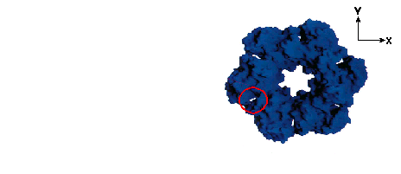
Characterisation of bacterial GSs

Slide 8
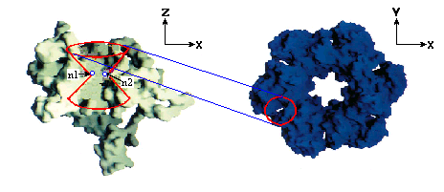
Characterisation of bacterial GSs
Distance between the cation-binding sites: n1 ← 6 Å → n2 (no bridging residues): the two sites are ‘spectroscopically independent’

Slide 9
Emission (⁵⁷Co) Mössbauer spectroscopic study
of ⁵⁷Co²⁺-doped GS active centres
PREREQUISITES:
1. Possibility to remove strongly bound cations from the native enzyme
( treatment with 5 mM EDTA → reversible loss of activity )
2. Possibility to insert Co²⁺ into the active centres
( addition of Co²⁺ → regain of activity )
3. Specific [⁵⁷Co²⁺]:[GS] molar ratio (12 ≤ x ≤ 24)
( to avoid multiple binding of ⁵⁷Co²⁺ beyond active centres )

Slide 10
⁵⁷Co Emission Mössbauer Spectroscopy:
Probing the structure of cation-binding sites at the active centres
Glutamine synthetase from Azospirillum brasilense
Macromolecule
(side and top views)
⁵⁷Co emission Mössbauer spectrum
Active centre:
2 cations
in sites 1 & 2
Sites 2
1
Kamnev A.A. // J. Mol. Struct. 744 (2005) 161.
Kamnev A.A. (2013) In: Sharma V. e.a. (Eds.) Mössbauer Spectroscopy: Applications in Chemistry, Biology, and Nanotechnology, Wiley, N.Y., Chapter 17, pp. 333-347.

Slide 11
Emission Mössbauer spectroscopy: novel applications for probing structural organisation of metalloenzyme active centres
Basic conclusions:
EMS allows different cation-binding sites in ⁵⁷Co-doped metalloproteins to be characterised.
EMS data on ⁵⁷Co²⁺-doped bacterial glutamine synthetase (GS) reveal two different cation-binding sites at each GS active centre.
Isostructural substitution of ⁵⁷Co²⁺ for other cations (e.g. for Zn²⁺) expands the EMS applicability and importance.

Slide 12
Thank you

