Slide 1





OMICS International
OMICS International through its Open Access Initiative is committed to make genuine and reliable contributions to the scientific community. OMICS International signed an agreement with more than 1000 International Societies to make healthcare information Open Access.
Contact us at: contact.omics@omicsonline.org

Slide 2


OMICS Journals are welcoming Submissions
OMICS International welcomes submissions that are original and technically so as to serve both the developing world and developed countries in the best possible way.
OMICS International are poised in excellence by publishing high quality research. OMICS Group follows an Editorial Manager® System peer review process and boasts of a strong and active editorial board.
Editors and reviewers are experts in their field and provide anonymous, unbiased and detailed reviews of all submissions. The journal gives the options of multiple language translations for all the articles and all archived articles are available in HTML, XML, PDF and audio formats. Also, all the published articles are archived in repositories and indexing services like DOAJ, CAS, Google Scholar, Scientific Commons, Index Copernicus, EBSCO, HINARI and GALE.
For more details please visit our website: http://omicsonline.org/Submitmanuscript.php

Slide 3
Spectroscopic Signature of Perylene π-Stacking
Alexander D.Q. Li
Department of Chemistry Washington State University Pullman, WA 99164
July 30, 2014

Slide 4
Motivation for Understanding π-Stacking
Signature of π-stacking reveals intramolecular folding that involves conjugate structures.
  Folding is the key mechanism that nature uses to create catalytic reaction centers, along with other functions.
Signature of π-stacking also reveals
molecular self-assembly intermolecularly?
  Self-assembly generates diverse structures and thus imparts novel phenomena.

Slide 5
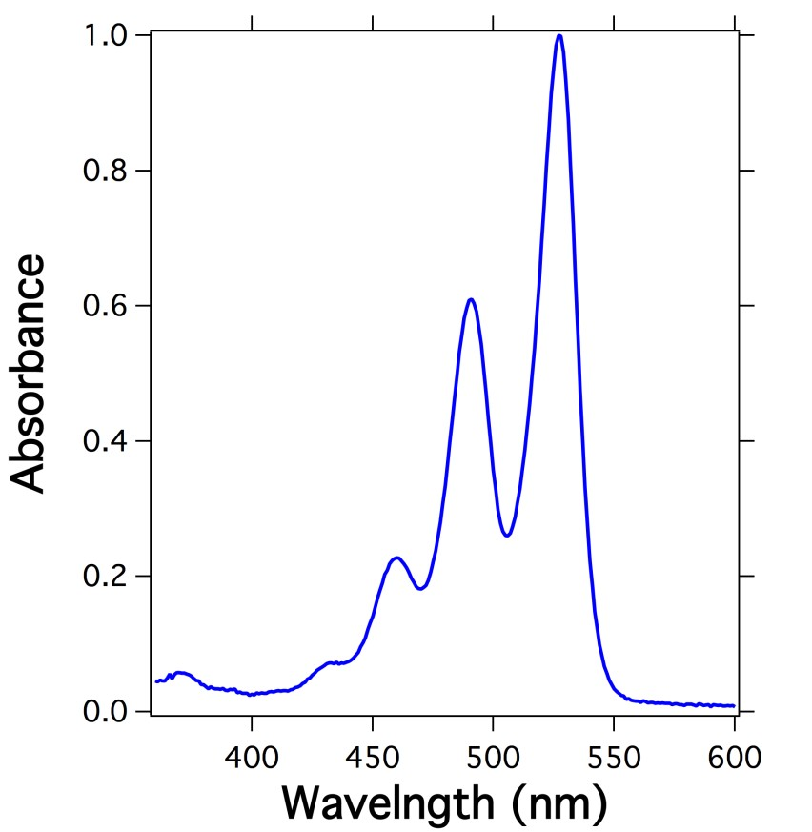

A Free Molecule
HO
O O
O _{O} N_{O}
0→0
0→1
0→2
O _{N}O
O O O
0→3
OH
Gives absorption spectrum with A(0→0) >> A(0→1) >>A(0→2) etc. A progressively reduction in intensity as wavelength decreases.

Slide 6
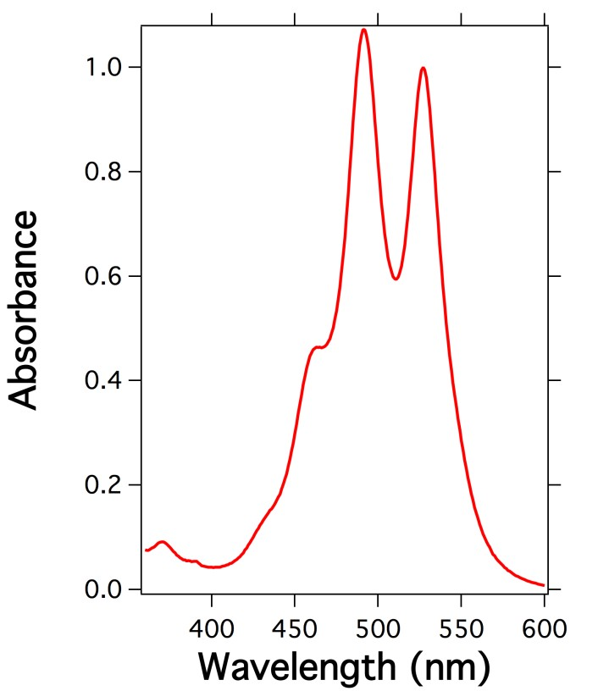
A Stacked Dimer
O
O P O O
CN
0→1
0→0
O
O
O
O
O
O
O ^{N}O_{O} N_{O}
0→2
0→3
O _{N}O
O O
O
O N^{O} O
O
O
Bz O
OH
Yields a dramatic intensity reversal: A(0→0) < A(0→1, a signature of π-stacking.

Slide 7
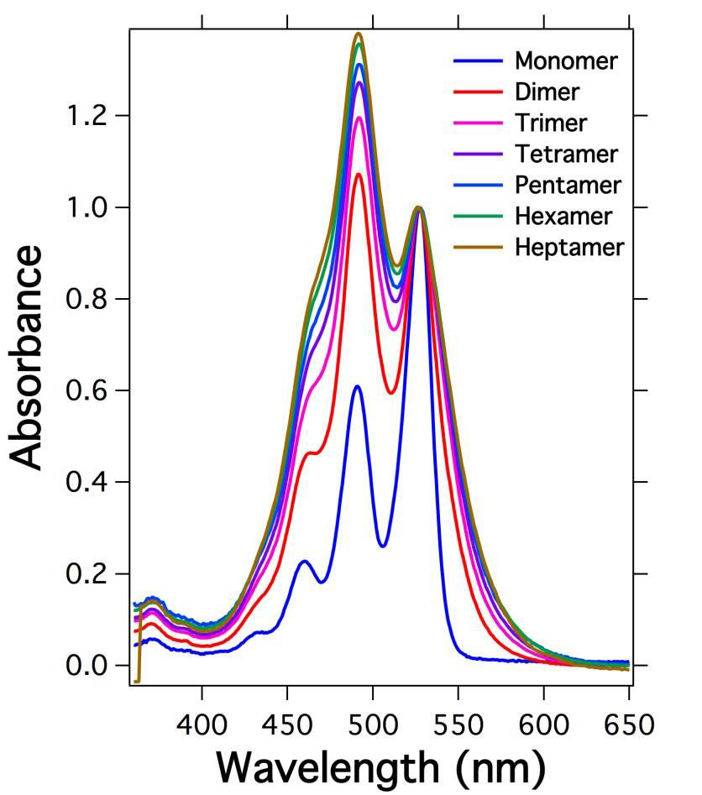
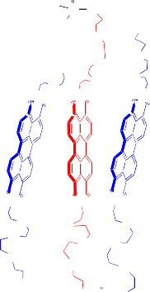
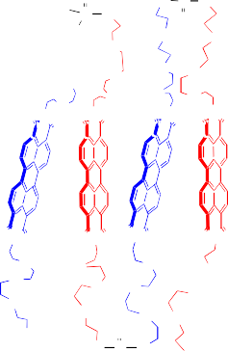
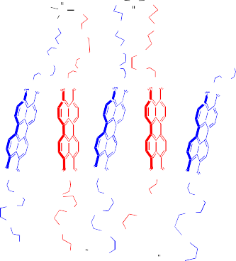
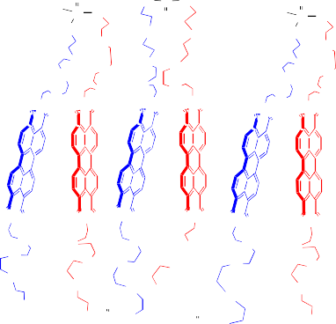
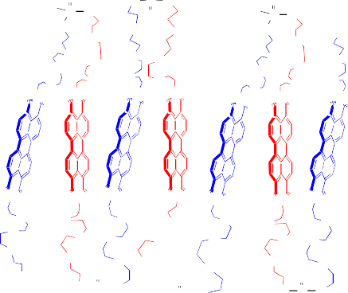
How about Stacked Trimer, Tetramer, Pentamer, Hexamer, Heptamer
O RO _{P O}
O
OH
O RO _{P O}
O
RO
O P O O
O O
O
RO
RO
O P O O
O O
O
O
P O
HO
O O
O O
O N_{O}
O O
O O
O
O
O O
O O
O
O
O
O
O
O
O
O
O
O
O
O
O
O
O N ^{O} O N O
O N ^{O} O N O
O N_{O} O N O
O N_{O} O N O
O N_{O} O N O
O N ^{O}
O
O
O
ON _{O} O
O
O
O N O^{O N}O
ON _{O} O
O
O
O N O^{ON}O
O N O
ON_{O} O
O
O
O N O^{O N}O
O N O O N_{O}
O
O
O
O
O
O
O
O
O
O O O
O O O
O
O O
O
O
O
BzO
O
O
BzO
O
O
O
BzO
O
O
O
O
O
O P O RO
O P O RO
OH
O P O RO
O P O RO
O RO _{P O}
O
RO
O P O O
O O
O RO _{P O}
O
O RO _{P O}
O
RO
O P O O
O O
O RO _{P O}
O
OH
O O
O O
O O
O O
O O
O O
O
O
O
O
O
O
O
O
O
O
O
O
O O N
O
O
O
O
O
O
O N ^{O} O N O
O N_{O} O N O
O
O
N_{O} O N O
O N ^{O} O N O
O N_{O} O N O
O
O
N_{O} O N O
O
O
O
ON_{O} O
O
O
O N O^{ON}O
O N O ON_{O}
O N O O
O
O
ON_{O} O
O
O
O N O^{ON}O
O N O ON_{O}
O N O^{ON} O
O
O
O
O
O
O
O
O
O
O
O O O
O
O
O O O
O
O
O O O
BzO
O
O
O
O
O
BzO
O
O
O
O
O
O
O
O P O RO
O P O RO
OH
O P O RO
O P O RO
O P O RO
Universal Signature: The ratio A(0→1)/A(0→0) gradually increases as the stack grows longer.

Slide 8
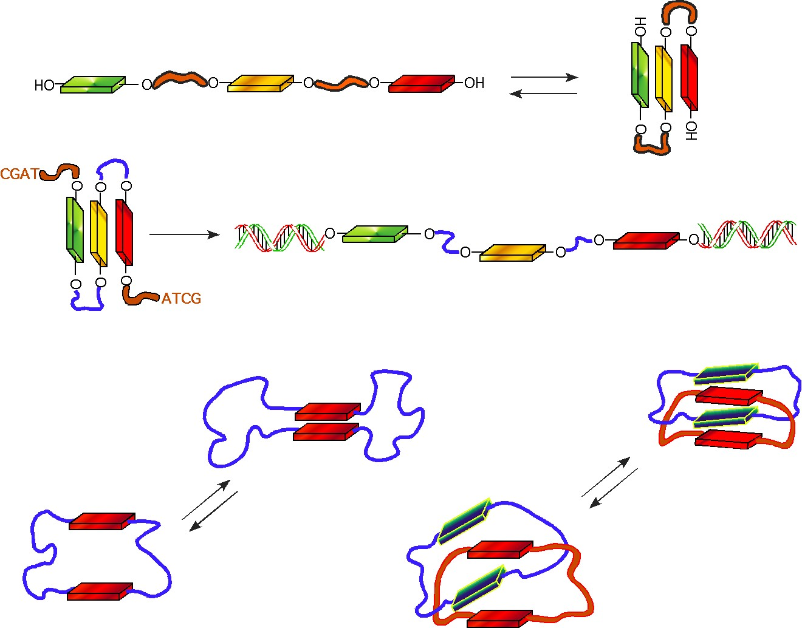
This general rule applies to all foldable oligomers and polymers
Linear Foldamer
stretchable foldamer
AFM
circular
foldamers
concatenated foldamers

Slide 9
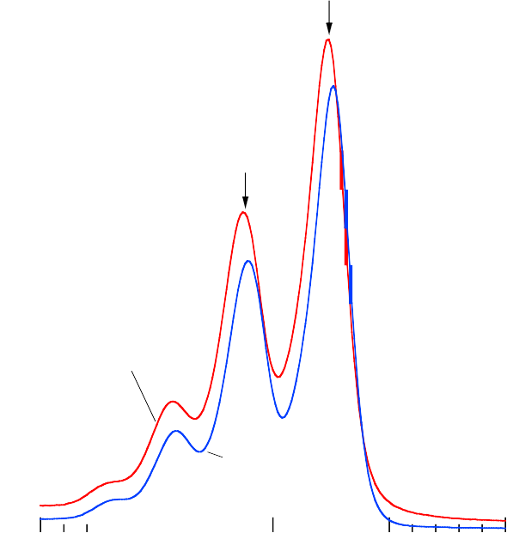
Free Monomer Signature
(Free molecules are those not interacting with itself typically found in dilute solutions)
SAc O
O O
O N O
0→0
O
O
O O
N
O
0→1
macrocyclic monomer ring
S S
and
O O
O N O O
O O
SAc
linear monomer
400 450 500 550 600
Wavelength (nm)
O O
N O
Free monomers, cyclic or not, have the same absorption pattern.

Slide 10
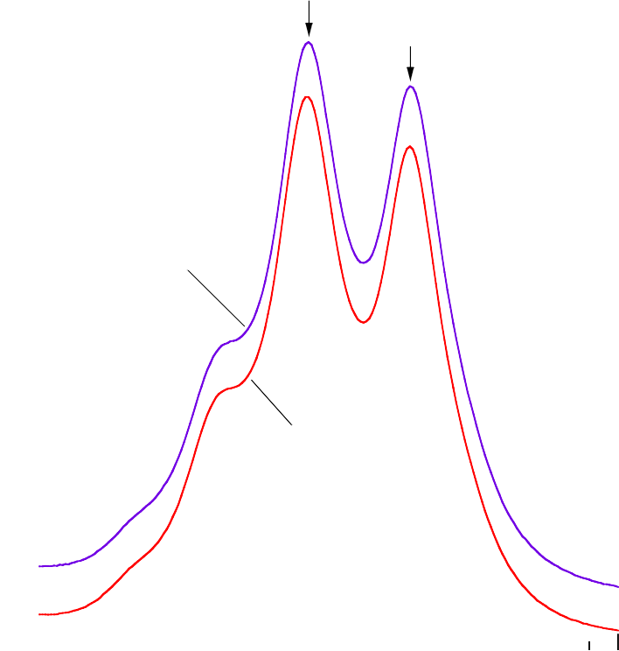
Stacked Dimer Signature
O
O P O OR
0→1
S S
0→0
O
O
O O
O N O
O
O
O O
O N O
O
O
O
O
macrocyclic dimer
ring
O N O
O N O
and
O N O
O N O
O N O
O N O
O
linear folded dimer
O
O
O
O
O
O
O
O
O
O
O
BzO
OH
S S
400 450 500 550 600
Wavelength (nm)
Linear folded dimer or macrocyclic dimer has the same pattern

Slide 11
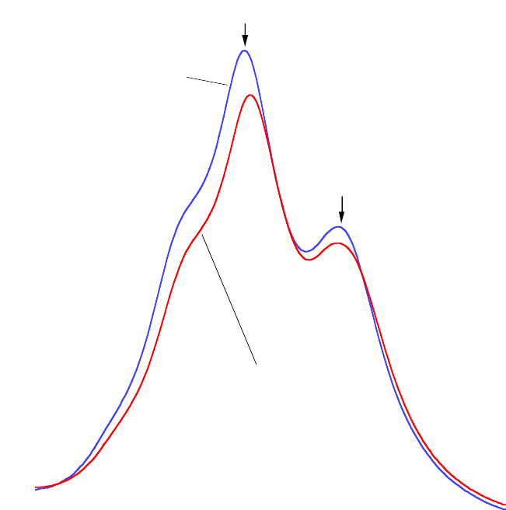
Stacked Tetramer Signature
0→1
RO
O P O O
S S
dimer-dimer catenane
RO
O
P O
O
O
_{O} S S _{O}
O
O O
O
O
O
O
O
O
0→0
O
O O
O O
O O
O
O
O
O N ^{O} O N O
^{O} N _{O} O ^{N} O
O
O
O N _{O} O N O
^{O} N _{O} O N O
and
linear folded tetramer
O _{N O}
O
O
O
O N O ^{O N} O
O N O
O _{N O}
O O
O N O ^{O N} O
O N O
O
O
O
O
O
O
O
O
O
O
O
O
O
O
O
O
S S
O
BzO
O
O P O
RO
O
O
400 450 500 550 600
Wavelength (nm)
OH
S S
Linear folded tetramer and concatenated tetramer have the same characteristics.

Slide 12










How about Dynamic Stacking
HO
HO
OH
HO
HO
HO
HO
HO
HO
OH
O
OH
O
HO
O
O O
O
OH
O
HO
O
HO
O O
O _{O} N_{O}
O
O
O
O
O
O
O
O
O O
O O
O
O
O
O
O
O
O
O
O
O O
O
O O
O O
O N_{O}
O N_{O}
O _{O} N_{O}
O _{O} N_{O}
O N_{O}
O O
O
O
_{O N} O
_{N} O
N
O ^{N}O
_{O} N_{O}
_{N} O
_{N} O
N
_{O} N
O
O
O
O
O O
O
O
etc
O N O
O
O
O N O
O
O
O N^{O}
O N^{O} O
O
O N O
O
O
O N O
O
O
O _{N}O
O O O
O _{N}O
O O
O
O _{N}O
O O
O
O O
O O
O _{N}O
O O O
O _{N}O
O O
O
O _{N}O
O O O
N
O O O
O _{N}O
O O
O
O _{N}O
O O O
O
O
O
O
O
O
OH
HO
OH
HO
OH
OH
HO
OH
_{OH} OH
HO
OH
OH
OH
OH
Self-Assembled Oligomers
In solution, molecular self-Assembly is dynamic

Slide 13
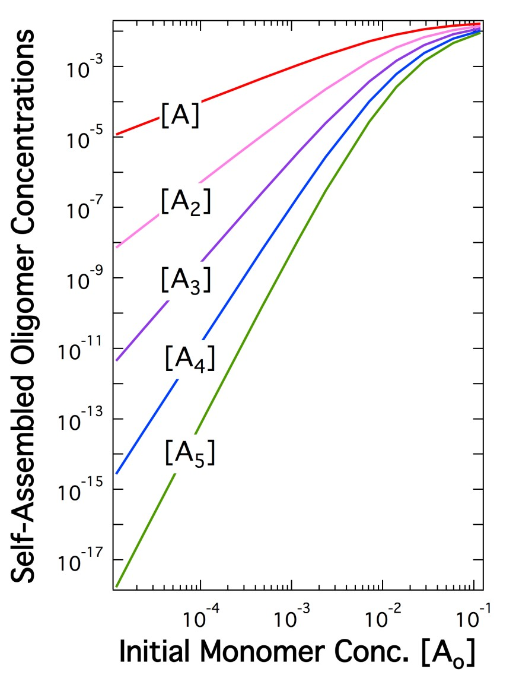
Distribution of Self-Assembled Oligomers
Factors Driven Assembly:
Solvent
Temperature
Concentration
When solvent and temperature are fixed, concentration of the molecule becomes the major factor that drives the formation of self-assembled dimer, trimer, tetramer, pentamer, and etc. The resulting distribution pattern of the self-assembled oligomers is shown here.

Slide 14
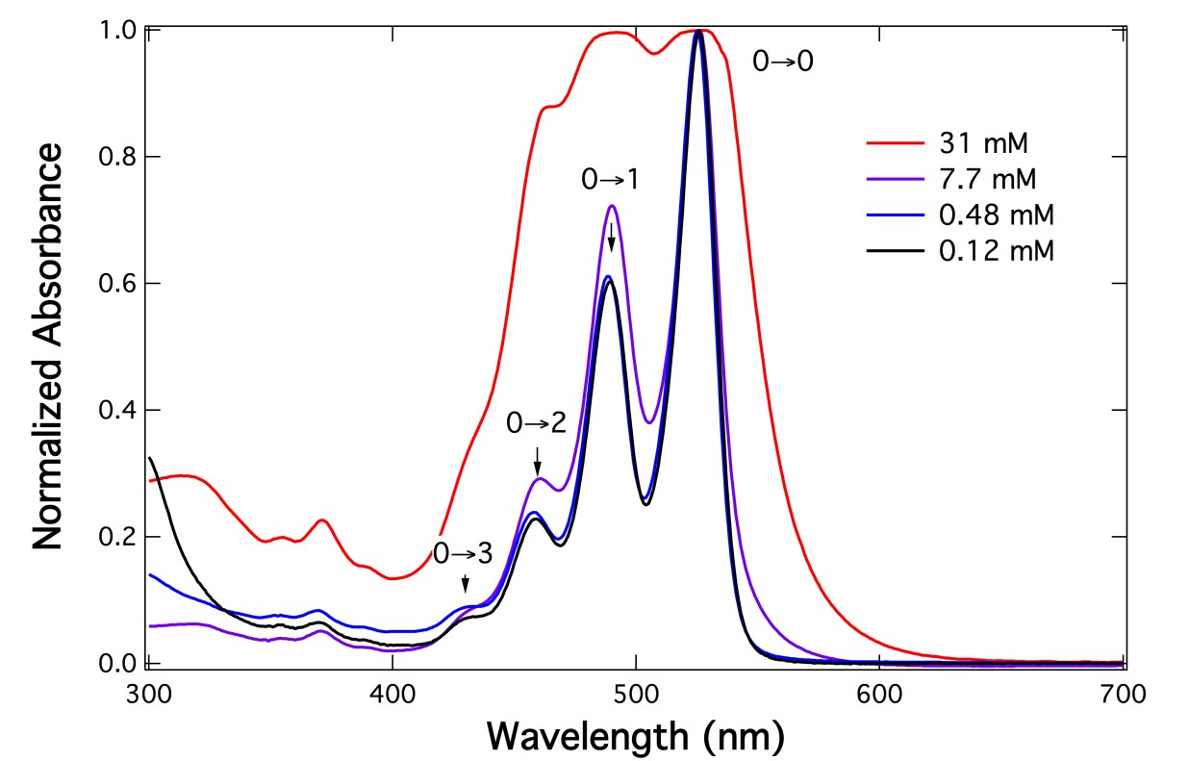
The Observed Absorbance Is the Sum of Individual Contributions by All Oligomers
_{A}obs
= A^{monomer} x [monomer]% + A^{dimer} x [dimer]% + A^{trimer}
x [trimer]% + A^{tetramer} x [tetramer]% + etc

Slide 15
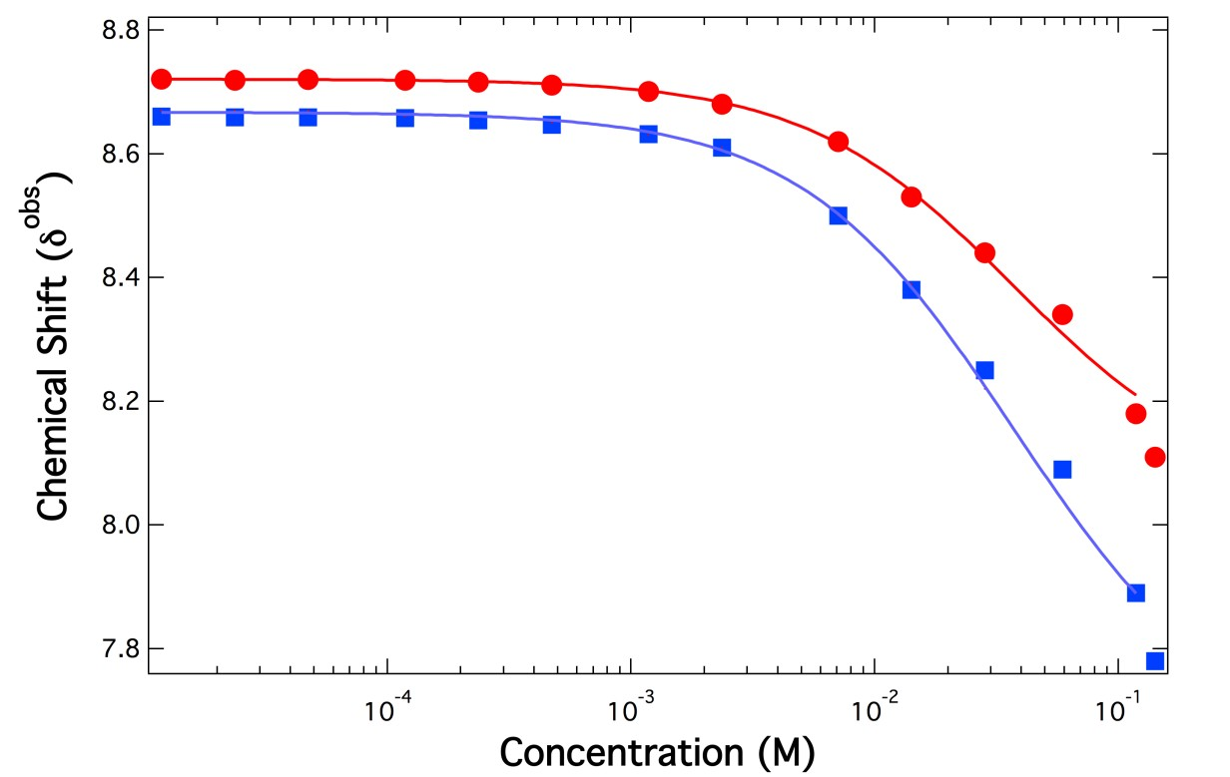

There Is a Critical Concentration for Molecules to Self-Assemble
Measured physical properties such as absorbance values or NMR chemical shifts can be used to monitor the dynamic self- assembly. Here the aromatic proton chemical shifts reveal a critical concentration (~1mM), below which molecules are free and above which molecules are actively self-assembling.
Critical C

Slide 16
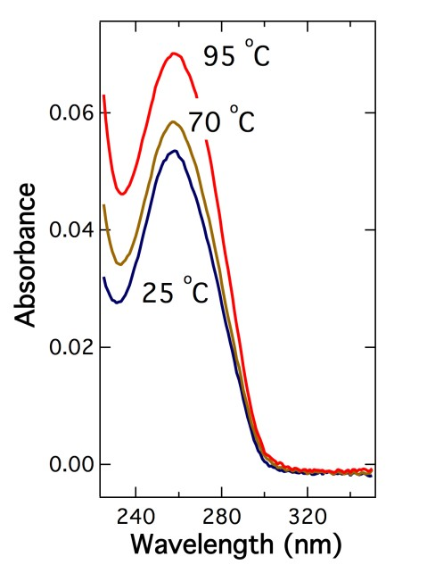
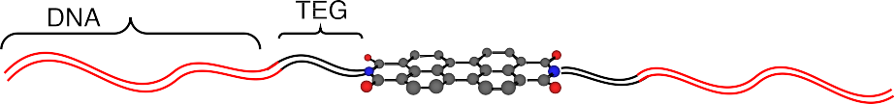





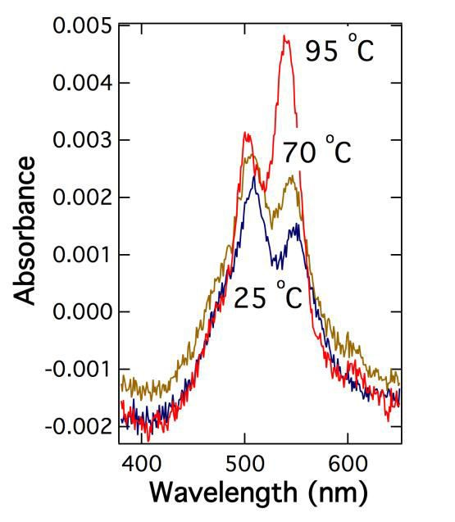
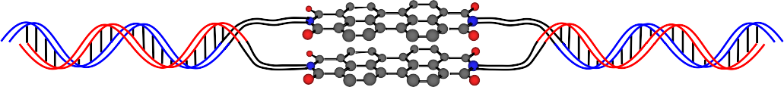
DNA Duplex Organized Stacking
cool
heat
DNA hybridization
Directed Organization
DNA duplex melting or formation (top right) is validated by the π-stacking signature of perylene (bottom right).

Slide 17
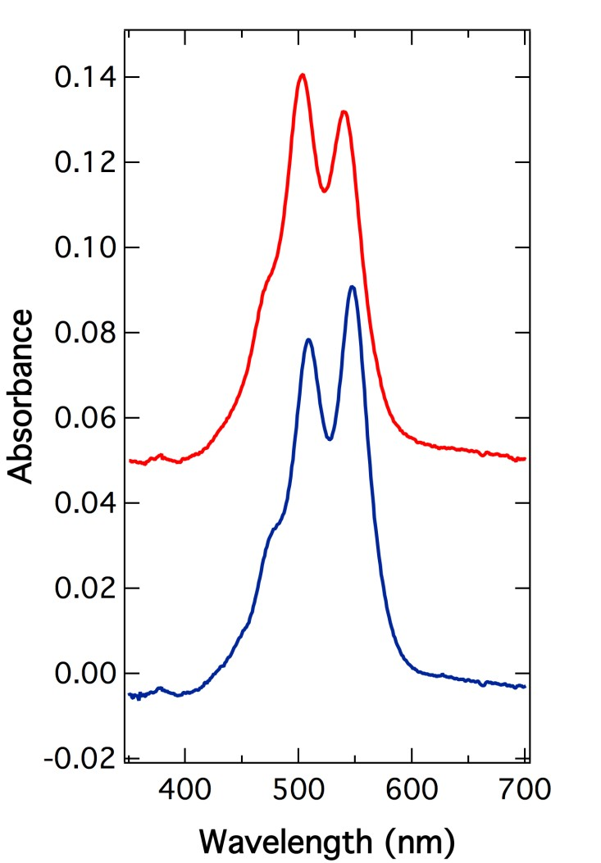
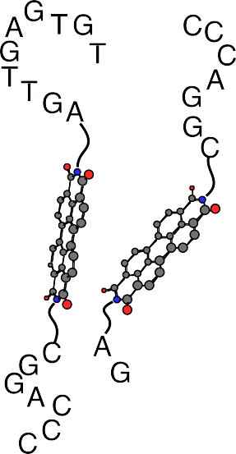
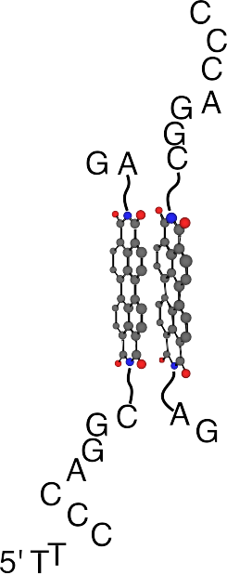
Synthetic and Biological Hybrid: DNA-linked Perylene Dimer
90 ˚C
20 ˚C
20 ˚C
90 ˚C

Slide 18
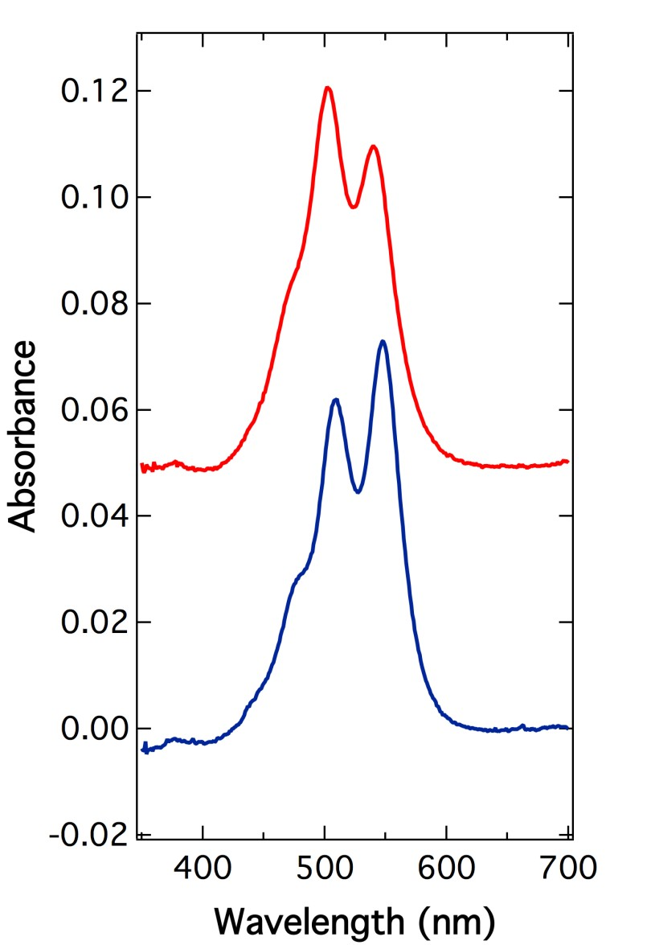
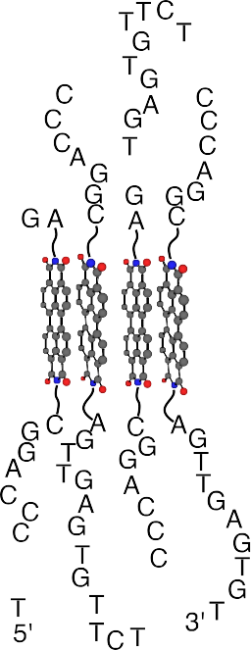
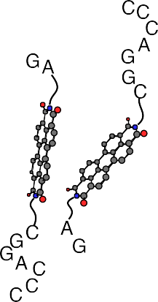
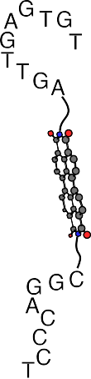

Synthetic and Biological Hybrid: DNA-linked Perylene Tetramer
90 ˚C
20 ˚C
20 ˚C
90 ˚C

Slide 19
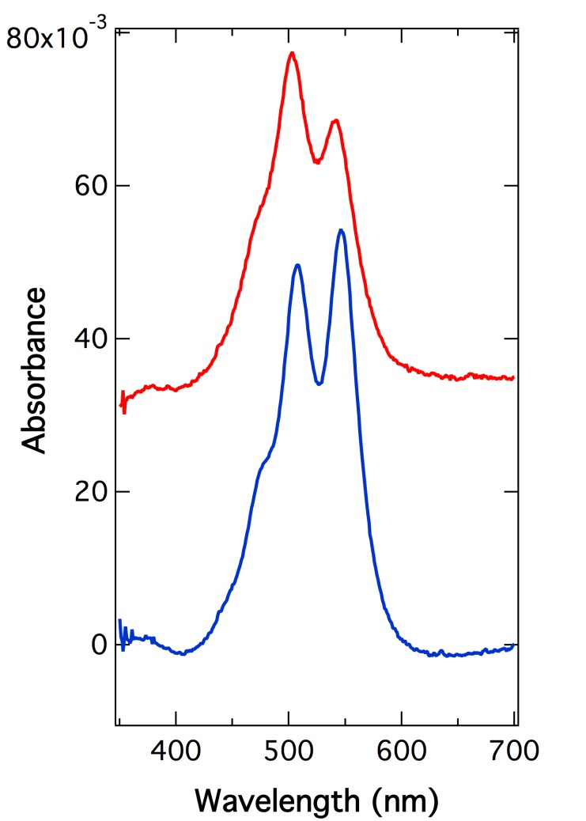
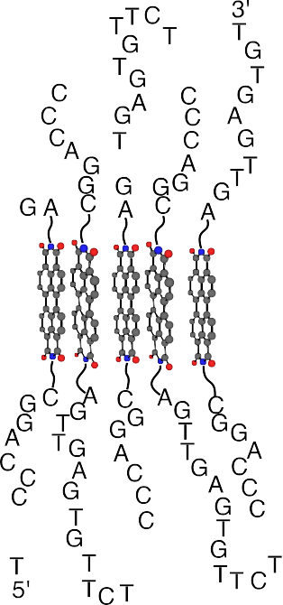
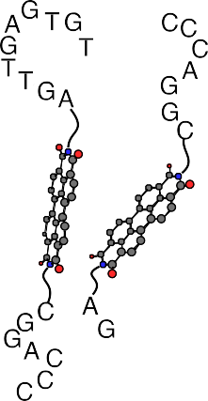



Synthetic and Biological Hybrid: DNA-linked Perylene Pentamer
90 ˚C
20 ˚C
20 ˚C
90 ˚C

Slide 20
The Empirical Rule Observed
Perylene stacking comes from two contributions: intermolecular interactions between π-orbitals and hydrophobic interactions.
Experimental results reveal that hydrophobic effects and π-π stacking do not weaken, perhaps even strengthen, as temperature rises.

Slide 21
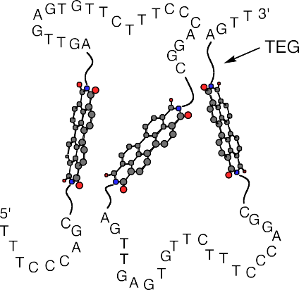
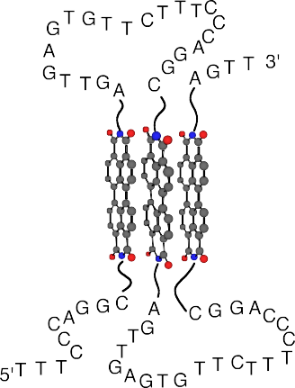
The Origin of Thermophilic Folding Properties
comes from the endothermic interactions
among conjugate sheet-like structures.
Endothermic Folding
Negative slope Positive ΔH
in Water
^{LnK}fold
In Water
ΔSº(cal/mol•K)
ΔHº (kcal/mol)
If a folding process is endothermic, then heat drives the molecule to fold, rather than unfold.
8.64 ~ 15.4
2.72~6.88

Slide 22
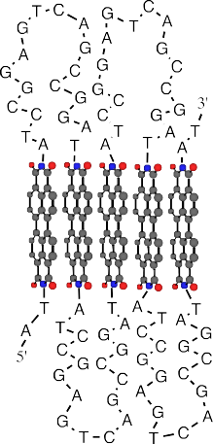
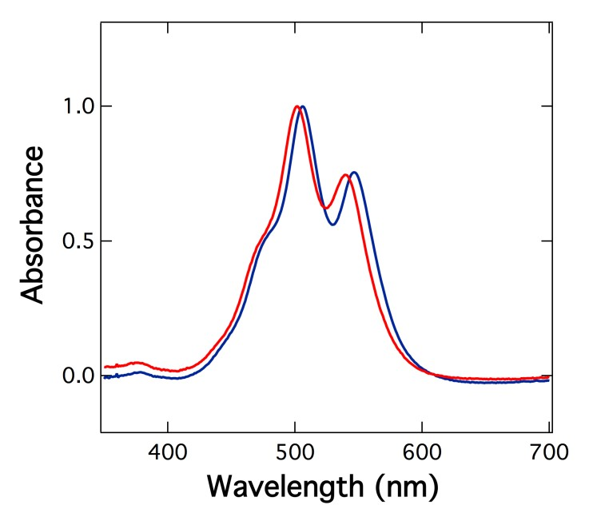
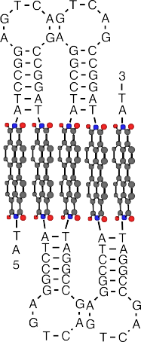


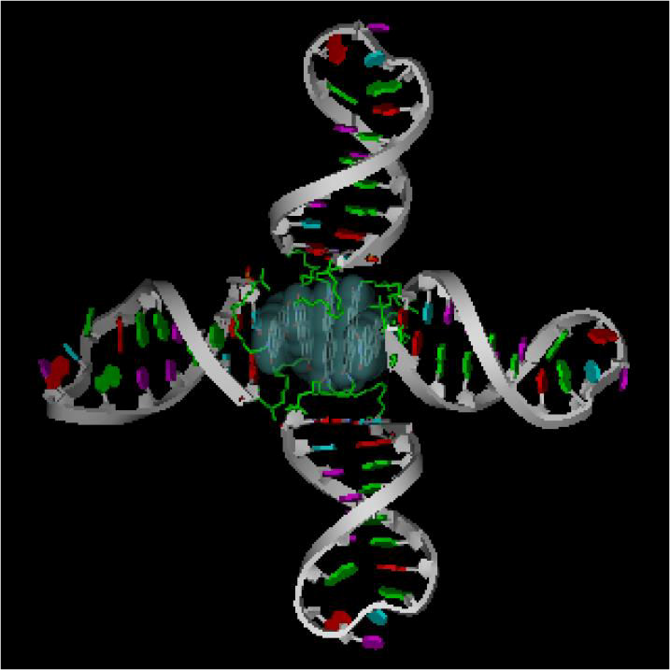
Hyperthermophilic Folded Hybrid
Polymers
heat
cool
90 ˚C
20 ˚C
Introducing DNA stem loops between adjacent perylenes results in hyperthermophilic foldamer because hydrogen bonding stabilizes the
structure at low temperature and π- stacking stabilizes the structure at high temperature.

Slide 23
Conclusions
Optical spectroscopies are powerful tools to reveal molecular interactions, thus enabling deciphering nature laws such the thermophilic folding in biological and synthetic hybrid polymers.
Acknowledgment: The author greatly acknowledges the support of National Science Foundation (CHE-1212429)

Slide 24







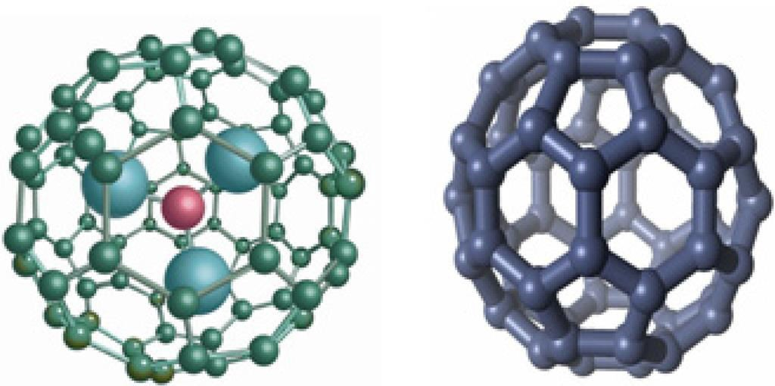
Organic Chemistry: Current Research
Pharmaceutica Analytica Acta
Clinical Pharmacology &
Biopharmaceutics

Slide 25


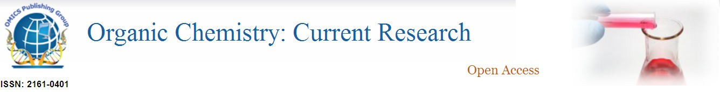


4th International Conference on
Medicinal Chemistry & Computer Aided Drug Designing

Slide 26
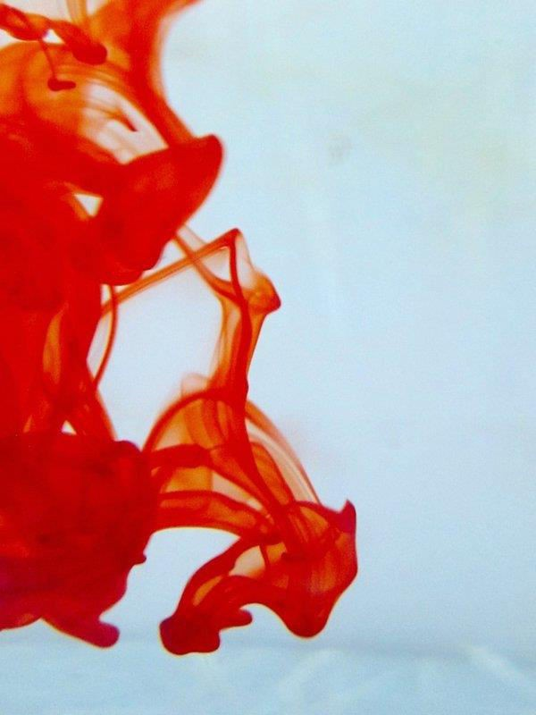
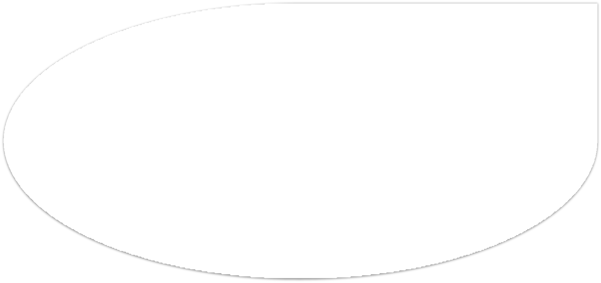



OMICS International Open Access Membership
OMICS International Open Access Membership enables academic and research institutions, funders and corporations to actively encourage open access in scholarly communication and the dissemination of research published by their authors.
For more details and benefits, click on the link
below:
http://omicsonline.org/membership.php

