Slide 1


OMICS Group
OMICS Group International through its Open Access Initiative is committed to make genuine and reliable contributions to the scientific community. OMICS Group hosts over 400 leading-edge peer reviewed Open Access Journals and organizes over 300 International Conferences annually all over the world. OMICS Publishing Group journals have over 3 million readers and the fame and success of the same can be attributed to the strong editorial board which contains over 30000 eminent personalities that ensure a rapid, quality and quick review process. OMICS Group signed an agreement with more than 1000 International Societies to make healthcare information Open Access.
Contact us at: contact.omics@omicsonline.org

Slide 2

OMICS Journals are welcoming Submissions
OMICS Group welcomes submissions that are original and technically so as to serve both the developing world and developed countries in the best possible way.
OMICS Journals are poised in excellence by publishing high quality research. OMICS Group follows an Editorial Manager® System peer review process and boasts of a strong and active editorial board.
Editors and reviewers are experts in their field and provide anonymous, unbiased and detailed reviews of all submissions.
The journal gives the options of multiple language translations for all the articles and all archived articles are available in HTML, XML, PDF and audio formats. Also, all the published articles are archived in repositories and indexing services like DOAJ, CAS, Google Scholar, Scientific Commons, Index Copernicus, EBSCO, HINARI and GALE.
For more details please visit our website: http://omicsonline.org/Submitmanuscript.php

Slide 3

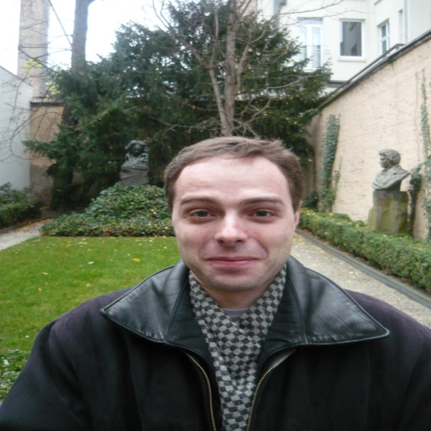

Editor
Alexandr Merkin
Department of Addictions and Psychotherapy
Institute for Advanced Studies of the Federal Medical-Biological Agency of Russia

Slide 4
Biography:
Dr. Alexandr Merkin graduated from the Russian State Medical University (Pirogov Russian National Research Medical University) in 1997. In 1999 he completed his Residency in Functional Diagnostics in Therapy, Neurology and Psychiatry. Then he studied Psychiatry and completed his Residency in Psychiatry, as well as in further advanced trainings in Forensic Psychiatry, Addiction Medicine and Psychotherapy.
Dr. Merkin has been working as a Lecturer at the Institute for Advanced Studies in Moscow since 2005. He completed his PhD dissertation in 2011, and since 2012 he is on Assistant Professor position. He conduct clinical consultations for patients with a variety of mental disorders and psychological problems.
As a researcher he is responsible for research planning, take part in data collection and analysis, write abstracts and articles and present results at scientific conferences. In addition,he give lectures and conduct workshops on different aspects of psychiatry and addiction disorders in Moscow, all around Russia and abroad.

Slide 5
Research Interest:
General psychopathology
Psycholinguistics
Neurosciences and Neuroimaging
Medical Education
Psychotherapy

Slide 6
Recent Publications:
Alexandr Merkin, Ilya Borisov, Alexandr Shushkevitch, Evgeny Dinov, Evgeny Cheremushkin (2014) Difficulties in diagnosing delirium in elderly patients in a general hospital. Asian Journal of Psychiatry, 9, pp. 85-86.
Alexandr Merkin, Alexander Komarov, Evgeny Dinov et al. (2014) Asthenic and depressive disorders in elderly patients in outpatient practice (Differential diagnosis and therapy), 3(10), pp. 36-40.
Alexandr Merkin. Confusional state (delirium) in geriatrics. Clinical signs, comorbidity, care service organization. Saarbrücken: LAP Lambert Academic Publishing, 2013, 181 p.

Slide 7

Psychotherapy

Slide 8

Psychotherapy is often used either alone or in combination with medications to treat mental illnesses. Called "therapy" for short, the word psychotherapy actually involves a variety of treatment techniques.
During psychotherapy, a person with a mental illness talks to a licensed and trained mental health care professional who helps him or her identify and work through the factors that may be triggering the illness.

Slide 9
All psychotherapies provide:
A working alliance between patient and therapist
An emotionally safe setting where the patient can feel accepted, supported, un-criticized
A therapeutic approach that may either be strictly adhered to or modified according to patient needs
Confidentiality as integral to therapeutic relationship except with safety issues

Slide 10

Therapy for….
Children: behavioral, school, family issues
Adolescents: as above and issues of separation and peer relationships
Young adults: all of above plus career issues
Mature adults: all of above plus issues of changing relationships, family alignments, health, work and social status
Older adults: all of above plus end of life issues

Slide 11


Types of Therapy
Therapy can be given in a variety of formats, including:
Individual: This therapy involves only the patient and the therapist.
Group: Two or more patients may participate in therapy at the same time. Patients are able to share experiences and learn that others feel the same way and have had the same experiences.

Slide 12

Marital/couples: This type of therapy helps spouses and partners understand why their loved one has a mental disorder, what changes in communication and behaviors can help, and what they can do to cope.
Family: Because family is a key part of the team that helps people with mental illness get better, it is sometimes helpful for family members to understand what their loved one is going through, how they themselves can cope, and what they can do to help.

Slide 13


Different approaches to therapy include:
Psychodynamic Therapy
Psychodynamic therapy is based on the assumption that a person is having emotional problems because of unresolved, generally unconscious conflicts, often stemming from childhood.
The goal of this type of therapy is for the patient to understand and cope better with these feelings by talking about the experiences. Psychodynamic therapy is administered over a period of at least several months, although it can last longer, even years.

Slide 14

Interpersonal Therapy
Interpersonal therapy focuses on the behaviors and interactions a patient has with family and friends.
The primary goal of this therapy is to improve communication skills and increase self-esteem during a short period of time.
It usually lasts three to four months and works well for depression caused by mourning, relationship conflicts, major life events, and social isolation.

Slide 15


Although many subtypes and variations on therapies exist, some psychotherapy techniques proven to be effective include:
Cognitive behavioral therapy, which helps you identify unhealthy, negative beliefs and behaviors and replace them with healthy, positive ones
Dialectical behavior therapy, a type of cognitive behavioral therapy that teaches behavioral skills to help you handle stress, manage your emotions and improve your relationships with others

Slide 16


Acceptance and commitment therapy, which helps you become aware of and accept your thoughts and feelings and commit to making changes, increasing your ability to cope with and adjust to situations
Supportive psychotherapy, which reinforces your ability to cope with stress and difficult situations

Slide 17

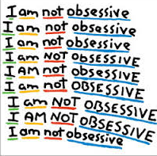
Psychotherapy can be helpful in treating most mental health problems, including:
Anxiety disorders, such as obsessive-compulsive disorder (OCD), phobias, panic disorder or post-traumatic stress disorder (PTSD)
Mood disorders, such as depression or bipolar disorder
Schizophrenia or other disorders that cause detachment from reality (psychotic disorders)

Slide 18
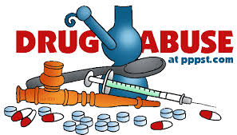

Addictions, such as alcoholism, drug dependence or compulsive gambling
Eating disorders, such as anorexia or bulimia
Personality disorders, such as borderline personality disorder or dependent personality disorder

Slide 19

Not everyone who benefits from psychotherapy is diagnosed with a mental illness. Psychotherapy can help with a number of life's stresses and conflicts that can affect anyone. For example, it may help you:
Resolve conflicts with your partner or someone else in your life
Relieve anxiety or stress due to work or other situations
Cope with major life changes, such as divorce, the death of a loved one or the loss of a job
Learn to manage unhealthy reactions, such as road rage or passive-aggressive behavior

Slide 20

Come to terms with an ongoing or serious physical health problem, such as diabetes, cancer or ongoing (chronic) pain
Recover from physical or sexual abuse or witnessing violence
Cope with sexual problems, whether they're due to a physical or psychological cause
Sleep better, if you have trouble getting to sleep or staying asleep (insomnia)

Slide 21
Psychoanalysis
Focus on unconscious as it emerges in treatment relationship
Insight by interpretation of unconscious conflict
Most rigorous: 3-5 times/week, lasts years, expensive
Patient (analysand) lies on couch, analyst unseen to eliminate visual cues
Must be stable, highly motivated, verbal, psychologically minded and be able to tolerate stress without becoming overly regressed, distraught, impulsive

Slide 22
Analyst neutral
Goal: structural reorganization of personality
Techniques: interpretation, clarification, working through, dream interpretation

Slide 23

Psychiatry
Related Journals
International Journal of Emergency Mental Health and Human Resilience
Journal of Alzheimers Disease & Parkinsonism
Journal of Child and Adolescent Behaviour

Slide 24

Psychiatry
Related Conferences
Neurology & Therapeutics

Slide 25


OMICS Group Open Access Membership
OMICS publishing Group Open Access Membership enables academic and research institutions, funders and corporations to actively encourage open access in scholarly communication and the dissemination of research published by their authors.
For more details and benefits, click on the link below:
http://omicsonline.org/membership.php

