Slide 1
OMICS International
OMICS International through its Open Access Initiative is committed to make genuine and reliable contributions to the scientific community. OMICS International signed an agreement with more than 1000 International Societies to make healthcare information Open Access.
Contact us at: contact.omics@omicsonline.org

Slide 2
OMICS Journals are welcoming Submissions
OMICS International welcomes submissions that are original and technically so as to serve both the developing world and developed countries in the best possible way.
OMICS Journals are poised in excellence by publishing high quality research. OMICS International follows an Editorial Manager® System peer review process and boasts of a strong and active editorial board.
Editors and reviewers are experts in their field and provide anonymous, unbiased and detailed reviews of all submissions.
The journal gives the options of multiple language translations for all the articles and all archived articles are available in HTML, XML, PDF and audio formats. Also, all the published articles are archived in repositories and indexing services like DOAJ, CAS, Google Scholar, Scientific Commons, Index Copernicus, EBSCO, HINARI and GALE.
For more details please visit our website: http://omicsonline.org/Submitmanuscript.php

Slide 3
Introduction
The drug gives pharmacologic response by binding with receptor at the site of action.
There is a factor that limits its optimum entering into this site is considered as barrier.
The barrier can be overcome by chemically linking promoiety to form prodrug which undergoes biotransformation to release the parent drug which gives the pharmacologic response.
The term prodrug was first coined by Albert in1958. Harper (1959) has promoted this concept by defining the term "DRUG LATENIATION" as the chemical modifications of a biologically activity compound to form a new chemical entity, the prodrug.
The drug is only identified as a prodrug after extensive drug metabolism studies ”Serendipity”
Currently, 5–7% of the drugs approved worldwide can be classified as prodrugs, and approximately 15% of all new drugs approved in 2001 and 2002 were prodrugs.by:Dr.Ali Gamal Al-kaf-Editorial board member of American Medicinal Chemistry Journal. Associate prof.of Med.Chem.Sana’a Univesity.Faculty of Pharmacy.Medicinal Chemistry Department.
Prodrug

Slide 4
Terms
Prodrug
prodrug
Non -prodrug
Hard
Soft
antedrug

Slide 5
Initial definitions :
prodrug:
Prodrug
a pharmacological inactive compound that is converted to
.an active drug by a metabolic biotransformation
“Soft Drugs” : These are the opposite of prodrugs. These compounds are designed and synthesized as ACTIVE compounds that readily undergo metabolic inactivation to nontoxic products.
Ex: Insulin.
“Hard Drugs” : compounds having high lipid solubility or high water solubility having long biological half-life and not susceptible to metabolism.
Due to their avoiding to metabolism, they have high efficiency but less readily eliminated due to lack of metabolism.
Ex: . Cocaine and heroin.
“Antedrug”:compounds that are designed and synthesized to exert their pharmacological activity “locally” and when enter the systemic circulation must to be susceptible to metabolic or chemical transformation to inactive compound
(e g steroidal drug that used topically to treat some allergic condition)

Slide 6
Classification of prodrugs
Type | Converting site | Subtype | Tissue location of conversion | Examples
Type I | Intracellular |  | Therapeutic target tissues/cells | Zidovudine, 5-Flurouracil
Type I | Intracellular | Type IB | Metabolic tissues (liver/lung etc) | Captopril, Cyclophosphamide
Type II | Extracellular | Type IIA | GI fluid | Sulfasalazine, Loperamide oxide
Type II | Extracellular | Type IIB | Systemic circulation | Fosphenytoin, Bambuterol
Prodrug

Slide 7
Why use prodrugs?
Prodrugs are used when drugs have unattractive physicochemical properties ((undesirable properties)).
Prodrug
Poor aqueous solubility.
Low lipophilicity.
Chemical instability.
poor patient acceptability.
formulation problems.
Good substrate for first-pass metabolism.
Rapid absorption/excretion.
Not site-specific.
Pain at the site of injection.

Slide 8
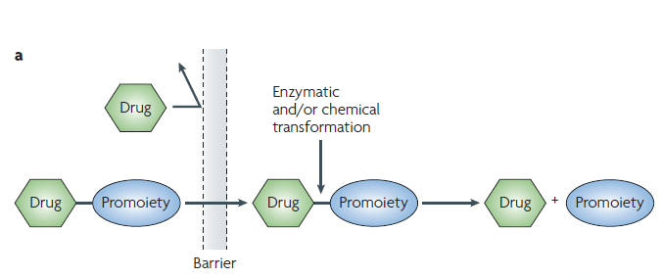
Prodrug Concept
Promoiety
A functional group used
to modify the structure
of pharmacologically
active agents to improve
physicochemical,
biopharmaceutical or
pharmacokinetic properties.
Prodrug
The drug–promoiety is the prodrug that is typically pharmacologically inactive.
limitation of a parent drug that prevents optimal (bio)pharmaceutical or pharmacokinetic performance.
The drug and promoiety are covalently linked via bioreversible groups that are chemically or enzymatically labile,
Notes:
The conversion of prodrug to corresponding drug depend on presence of enzyme capable of metabolizing the promoiety drug linkage. Enzymes may be located in specific region within the body.
Esterase more abundant
Chemically changing of ph & hydrolysisi

Slide 9
Ideal Property Of Prodrug:
The prodrug should be less toxic than the drug.
The pordrug should be inactive or significantly less active than the parant drug.
The rate formation of drug from the prodrug should be rapid enough to maintain the drug’ conc. With its therapeutic window.
The metabolites from the carrier should be non-toxic or have a low degree of toxicity.
The prodrug should be site specific.
Prodrug

Slide 10
Limitation Of Prodrug:
The problem associated with prodrug design is its toxicity which is due to :
·Formation of unexpected metabolite from the total drug conjugates.
·Toxicity may be due to inert carrier generated by cleavage of promoiety and drug conjugate which is converted into toxic metabolite.
·The prodrug might consume a vital cell constituent such as glutathione during its activation stage which causes depletion of prodrug.
Prodrug

Slide 11
Types of prordug
Prodrug
Promeioty
Carrier linked prodrug
Mutual prodrug
Bioprecursors

Slide 12
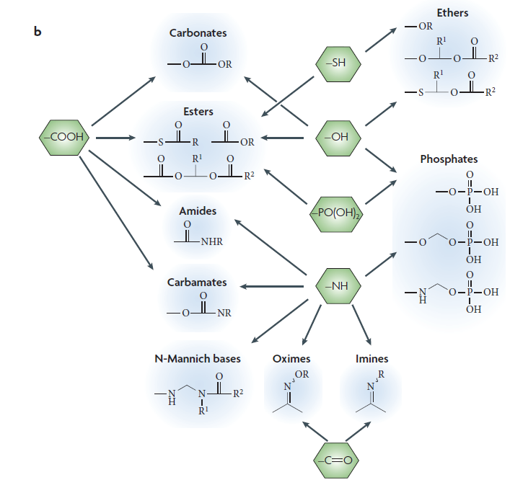
promoiety Prodrugs according to functional groups:
Prodrug
Common functional groups on parent
drugs that are amenable to prodrug design (shown in green).
Notes:
The end part of the drug is one of the function gps and will prepere as prodrug

Slide 13
Related definitions
Double Prodrug or pro-prodrug :
The double prodrug is a biologically inactive molecule which is transformed in vivo in two steps(enzymatically or chemically) to the active species.
Carrier linked prodrug subdivided into:
A. bipartate : in which the parent drug is attached to directly to promoiety.
comprised of one carrier attached to drug.
B. tripartite prodrug : there is a connector group between drug molecule and promoiety .
carrier connected to a linker that is connected to drugs.
Prodrug

Slide 14
Ideal Drug Carriers
Prodrug
Protect the drug until it reaches the site of action.
Localize the drug at the site of action.
Minimize host toxicity.
Are biodegradable, inert, and nonimmunogenic.
Are easily prepared and inexpensive.
Are stable in the dosage form.

Slide 15
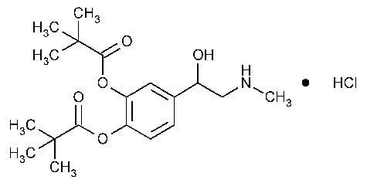
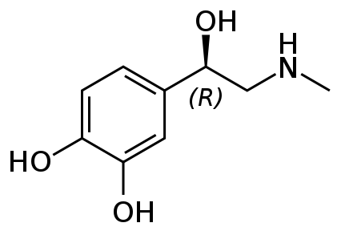
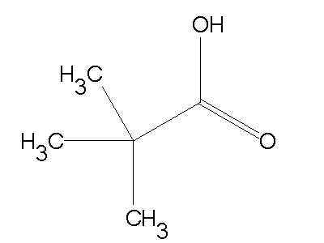
Examples :
Carboxylic acid and alcohols :
: Dipiveferin HCL a)
Dipivefrin HCL is a prodrug of epinephrine formed by the diesterification of epinephrine and pivalic acid.
The agent of use in the treatment of open angle glaucoma . the increased lipophilicity relative to epinephrine allows the agent to move across the membrane of the eye easily when applied .
Prodrug
Esterase
Epinephrine
Dipiveferin HCl
Pivalic acid
Notes:
is a prodrug for the antiglaucoma drug epinephrine. The dipivaloyl esters
allow for greater corneal permeability which are hydrolyzed by corneal and
aqueous humor esterases
Increased absorption by the addition of non-polar carboxylic acid is seen wid dipivefrin HCL , This prodrug from epinephrine in which the caticol hydroxyl groups . Have been utilized in the formation of ester linkage with pivalic acid ,the agent of use in the treatment of open angle glaucoma . the increased lipophilicity relative to epinephrine allows the agent to move across the membrane of the eye easily when applied .

Slide 16
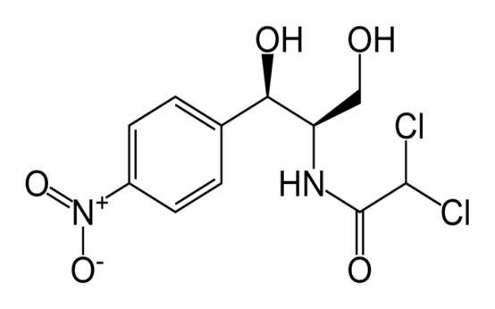
Examples :
Carboxylic acid and alcohols :
b) chloramphenicol palmitate :
A prodrug with reduced water solubility, The hydrophopic palmitate ester dose not dissolve to any appreciable extent in the mouth and therefore dose not interact with taste receptors.
Prodrug
Esterase
₊
chloramphenicol palmitate
chloramphenicol
palmitic Acid
Notes:
A number of agents have unpleasant taste when given orally, this result when the drug begins to dissolve in mouth and then is capable of interacting with taste receptors.
A prodrug with reduced water solubility, The hydrophopic palmitate ester dose not dissolve to any appreciable extent in the mouth and therefore dose not interact with taste receptors.

Slide 17
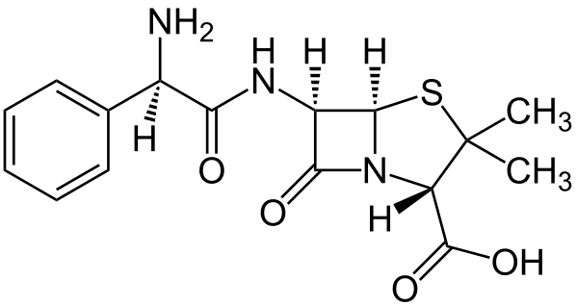
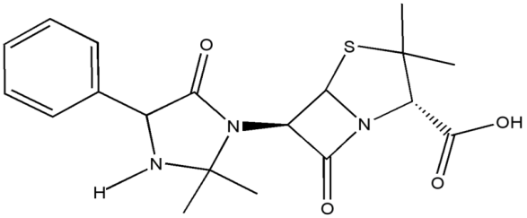
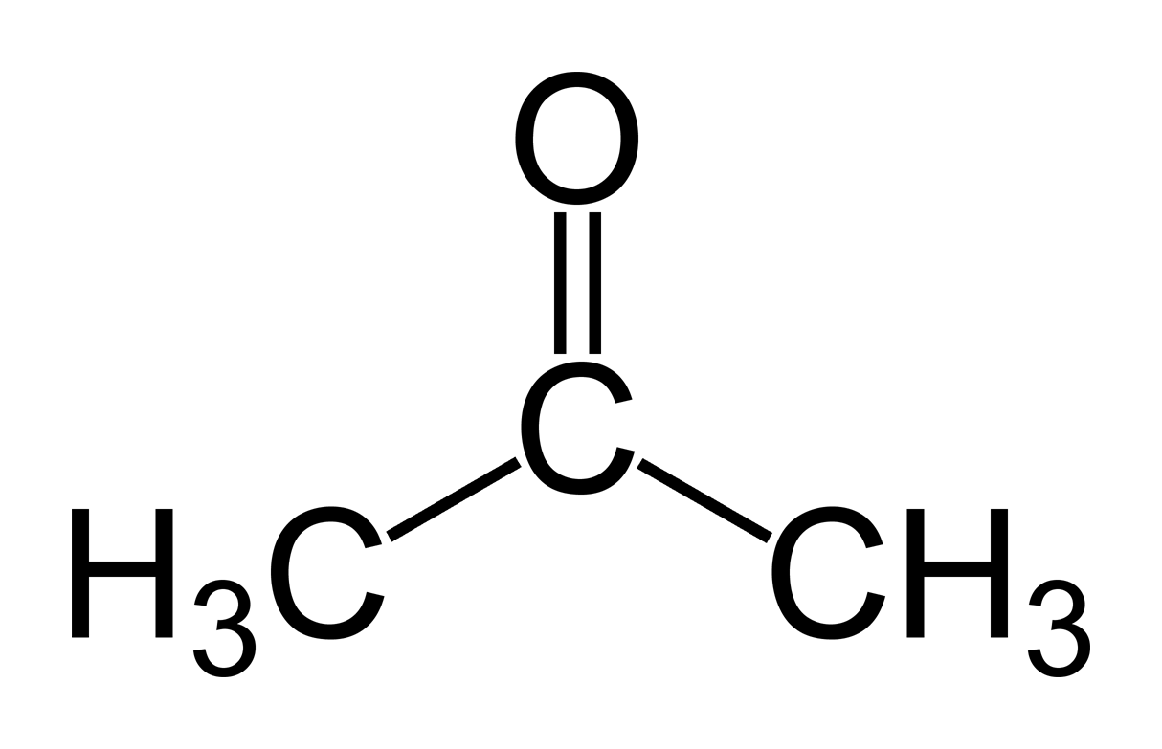
Examples :
Amines
Hetacillin :
Hetacillin is a beta-lactam. Hetacillin is a activity, but is converted by the body to ampicillin, which is active against a variety of organisms.
The effect of forming the Mannich base is to lower the basicity of the amine and there by icrease lipophilicity and absorption .
Prodrug
water
ampicillin
Hetacillin
Acetone

Slide 18
Examples :
Azo linkage
Sulfasalazine :
is used in the treatment of inflammatory bowel disease (ulcerative colitis).
• Anaerobic bacteria in the lower bowel metabolically reduce sulfasalazine to the therapeutic agent 5-aminosalicylic acid.
Prodrug
Azo reductase

Slide 19
Examples :
Carbonyl compounds
Methenamine :
Methanamine is prodrug in acidic pH , methamine is converted to formaldehyde , which act as an antibacterial agent.
Prodrug

Slide 20
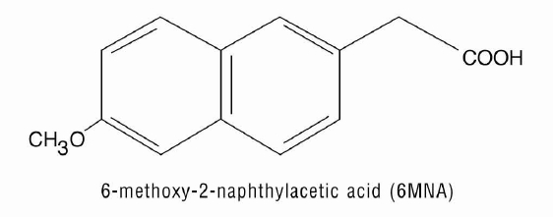
Examples :
Bioprecursor Prodrug
Which result from a molecular modification of the active compound itself. This modification generates a new compound, which acts as a substrates for the metabolizing enzymes, and metabolite being the expected active agent.
Nabumetone : (NSAID) (Relafen) prodrug that requires oxidative activation.
Nabumetone contains no acidic functionality and passes through the stomch without producing the irritation normally associated with this class agent .subsequent absorption occurs in the intestines.
Prodrug
oxidation
Nabumetone
Active Form

Slide 21
Examples :
Bioprecursor Prodrug
Mitomycine C: Mutamycin® (antineoplastic agent) prodrug that requires Reduction of the quinone to hydroquinone.
is a potent DNA crosslinker. This crosslink has shown to be effective in killing bacteria.
Mitomycine C required a reductive activation followed by two N-alkylations specific for a guanine nucleoside. Potential bis-alkylating heterocylic quinones were synthetised in order to explore the antitumoral activities of bacteria.
Prodrug
Notes:
Anti-tumer

Slide 22
Examples :
Bioprecursor Prodrug
Mitomycine C: Mutamycin® (antineoplastic agent) prodrug that requires Reduction of the quinone to hydroquinone.
Prodrug
Notes:
Anti-tumer

Slide 23
Examples :
Bioprecursor Prodrug
Vidarabine : (antiviral agent) prodrug that requires phosphorylation.
works by interfering with the synthesis of viral DNA.
vidarabine is sequentially phosphorylated by kinases to the triphosphate ara-ATP ((active form)). This active form is both an inhibitor and a substrate of viral DNA polymerase.
ara-ATP competitively inhibits dATP leading to the formation of ‘faulty’ viral DNA.
Prodrug
Notes:
Anti-tumer

Slide 24
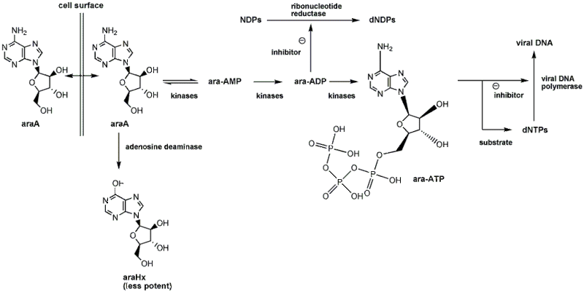
Examples :
Bioprecursor Prodrug
Vidarabine : (antiviral agent) prodrug that requires phosphorylation.
Prodrug
Notes:
Anti-tumer

Slide 25
Examples :
Mutual Prodrug
Prodrug comprises of two pharmacologically active agents coupled together to form a single molecules such that each act as the carrier for the other prodrug of two active compounds are called as mutual prodrug.
Prodrug

Slide 26
Examples :
Mutual Prodrug
Estramustine:
Used for the treatment of progressive carcinoma of the prostate.
Prodrug is selectively taken up into estrogen receptor positive cells then linkage is hydrolyzed.
17-alphaestradiol slow prostate cell growth
Nornitrogen mustard is a weak alkylating agent
Prodrug

Slide 27
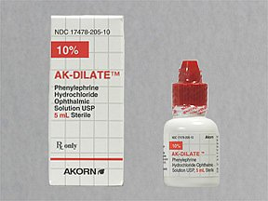
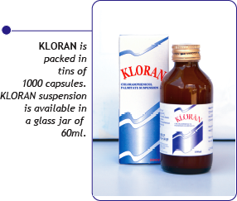
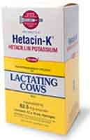
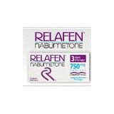
Prodrug
KLORAN SUSPENSION contains 125mg of
Chloramphenicol Palmitate.
DIPIVEFRIN HCl 0.1%, Alcon® ophthalmic solution
Relafen ®
Hetacin-K

Slide 28
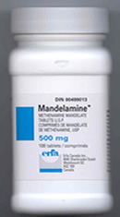
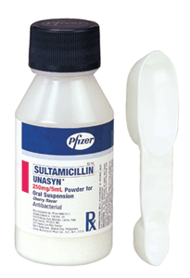
Prodrug
Mandelamine ®
Sultamicillin ®
( methenamine)
(Sultamacillin)

Slide 29
APPLICATIONS
(a) PHARMACEUTICAL APPLICATIONS
Improvement of taste.
Ex: Parent drug prodrug
Chloramphenicol Palmitate ester
Improvement of odor.
e .g; Ethyl mercaptan which is a foul smelling liquid, is converted in to its drug ester ,which has higher b.p. and odorless
Reduction of pain on injection.
E.g. the low aqueous solubility of clindamycin Hcl is responsible for pain on injection. This can be overcome by use of more water soIubIe prodrugs of such agents. E.g. 2-phosphate ester of clindamycin
Enhancement of drug solubility and dissolution rate (hydrophilicity of drug)
Enhancement of chemical stability of drug.
Ex: Formaldehyde is used as prodrug ((methenamine)) in the form of enteric coated to prevent hydrolysis in the stomach. (( urinary tract antiseptic )).
Prodrug

Slide 30
(b) PHARMACOKINETIC APPLICATIONS
Enhancement of bioavailability (lipophilicity).
Prevention of presystemic metabolism.
Prolongation of duration of action.
Reduction of toxicity.
site-specific drug delivery (drug targeting).
Prodrug

Slide 31
Prodrug
Examples of Prodrugs for improved
_{lipophilicity or permeability}

Slide 32
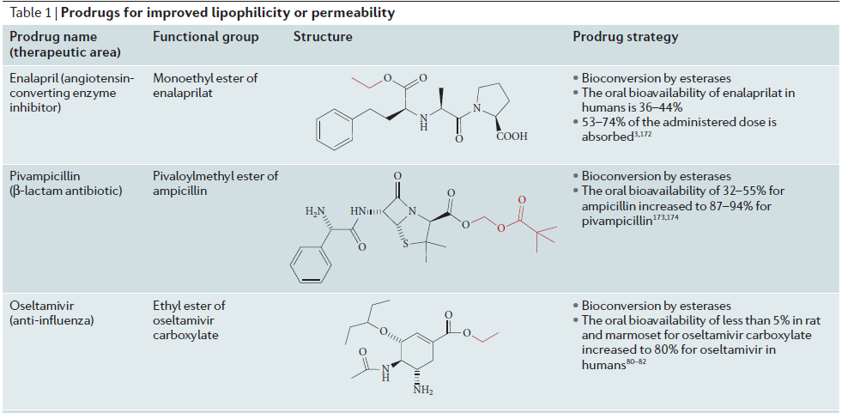
Prodrug

Slide 33
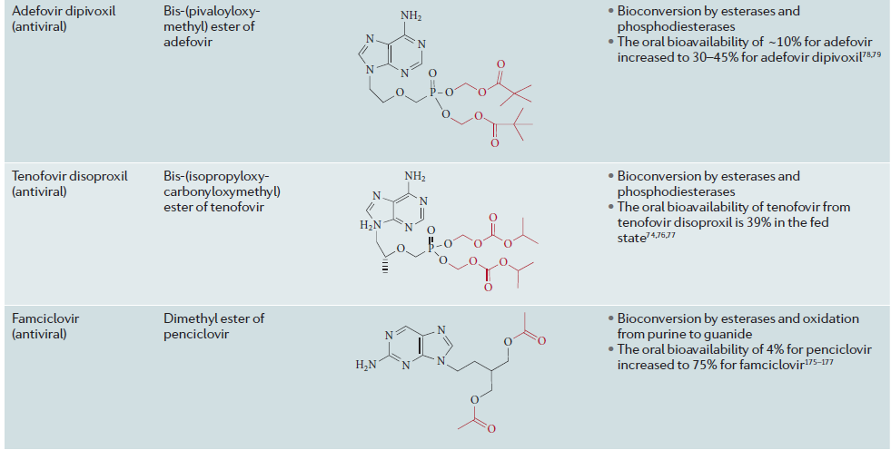
Prodrug

Slide 34
Prodrug

Slide 35
Prodrug
Examples of Prodrugs for improved
_{aqueous solubility}

Slide 36
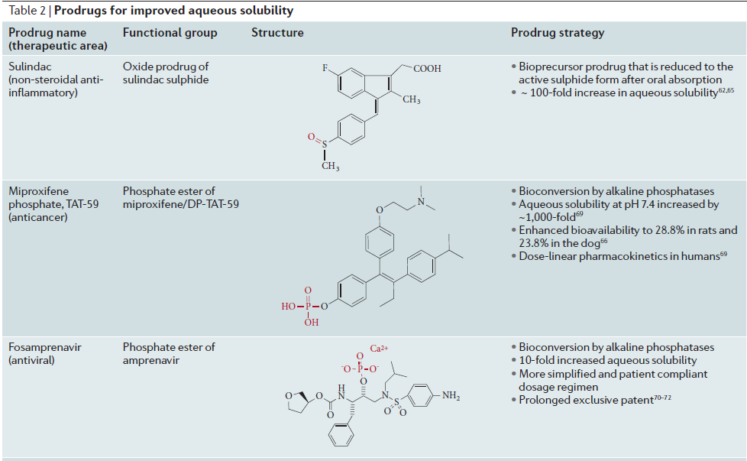
Prodrug

Slide 37
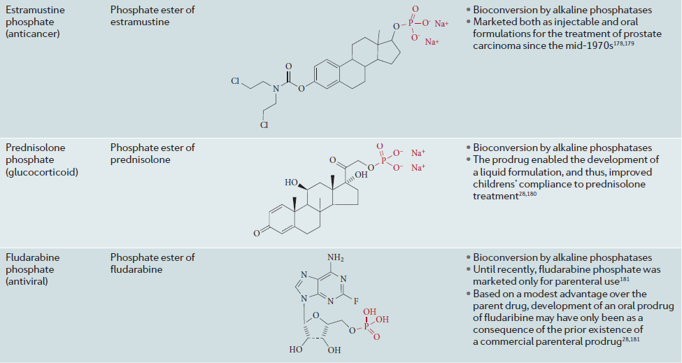
Prodrug

Slide 38
Prodrug
Examples of Prodrugs for improved
_{parenteral administration}

Slide 39
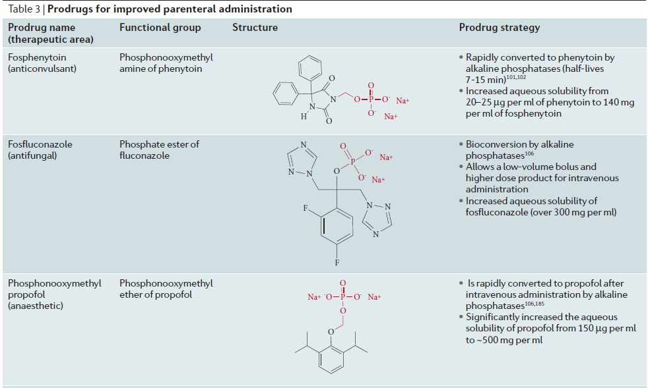
Prodrug

Slide 40
Prodrug

Slide 41
Prodrug
Examples of Prodrugs to exploit carrier-mediated absorption

Slide 42
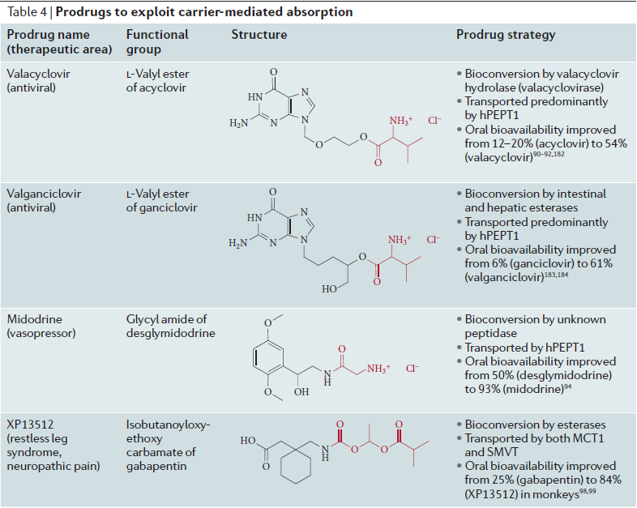
Prodrug

Slide 43
Prodrug
Examples of Prodrugs for improved
_{ophthalmic and dermal delivery}

Slide 44
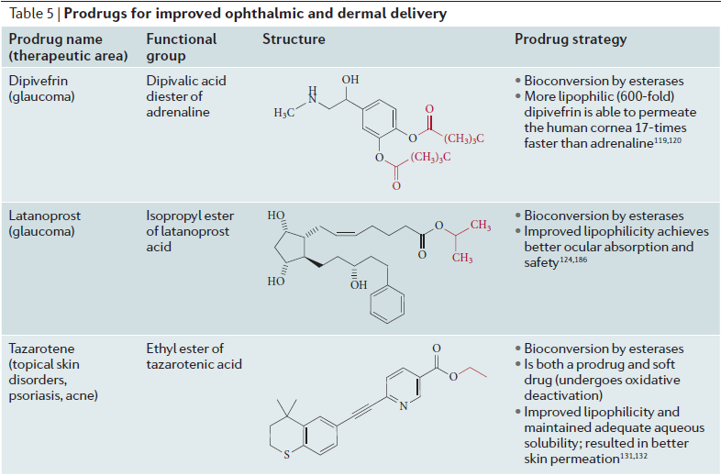
Prodrug

Slide 45
Prodrug
_{Examples of Prodrugs for}
_{other purposes}

Slide 46
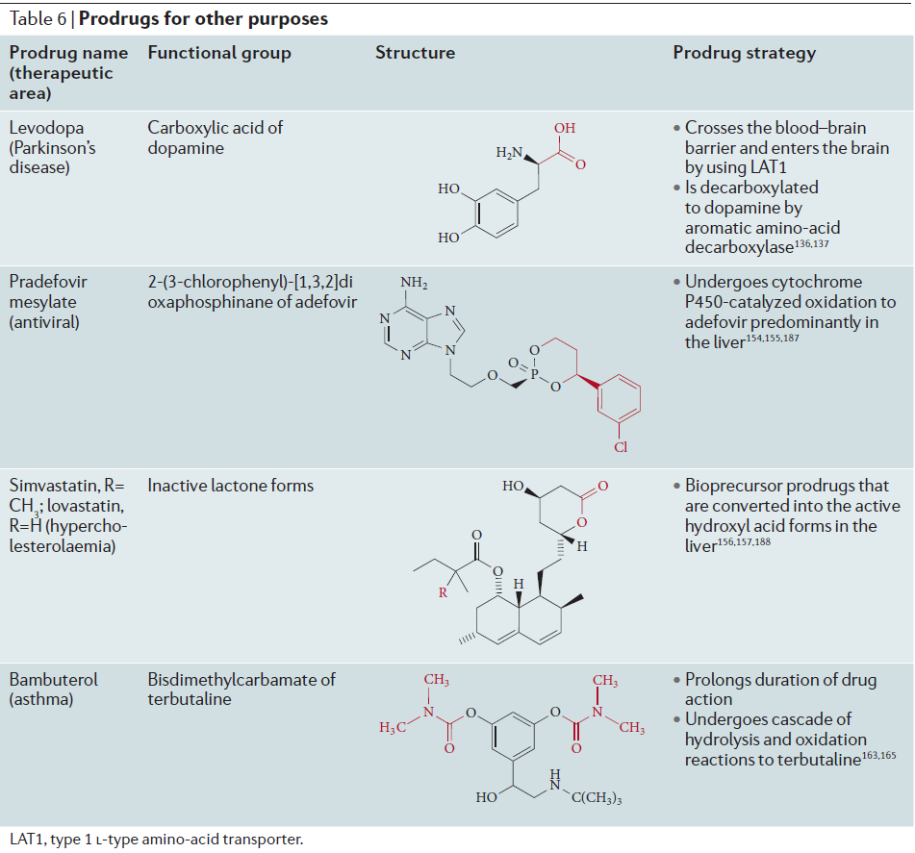
Prodrug

Slide 47
Prodrug Therapies ((cancer therapies))
For selective activation of prodrugs in tumor cells Two steps
I. incorporate a prodrug-activating enzyme into a target tumor cell.
II. administer a nontoxic prodrug which is a substrate for the exogenous enzyme incorporated.
Criteria for Success with Enzyme-Prodrug Therapies
I. The prodrug-activating enzyme is either nonhuman or a human protein expressed poorly
II. The prodrug-activating enzyme must have high catalytic activity
III. The prodrug must be a good substrate for the incorporated enzyme and not for other endogenous enzymes
IV. The prodrug must be able to cross tumor cell membranes
V. The prodrug should have low cytotoxicity and the drug high cytotoxicity
VI. The activated drug should be highly diffusable to kill neighboring nonexpressing cells (bystander killing effect)
VII. The half-life of the active drug is long enough for bystander killing effect but short enough to avoid leaking out of tumor cells
Prodrug

Slide 48
(a) Antibody Directed Enzyme Prodrug Therapy (ADEPT)
An approach for site-specific delivery of cancer drugs.
l. Phase One:
An antibody-enzyme conjugate is administered which binds to the surface of the tumor cells.The antibody used has been targeted for the particular tumor cell.
The enzyme chosen for the conjugate is one that will be used to cleave the carrier group off of the prod rug administered in the next phase.
2 .Phase Two:
After the .antibody-enzyme has accumulated on the tumor cell and the excess conjugate is cleared from the blood and normal tissues, the prodrug is administered.
The enzyme conjugated with the antibody at the tumor cell surface catalyzes the conversion of the prodrug to the drug when it reaches the tumor cell.
Advantages
Increased selectivity for targeted cell.
Each enzyme molecule converts many prodrug Molecules.
The released drug is at the site of action.
Demonstrated to be effective at the clinical level.
Concentrates the drug at the site of action.
Disadvantages
1. Immunogenicity and rejection of antibody-enzyme. conjugate
2. Complexity of the two-phase system and i.v administration
3. Potential for leak back of the active drug
Prodrug

Slide 49
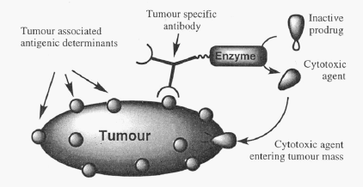
Prodrug

Slide 50
(b) Antibody-Directed Abzyme Prodrug Therapy (ADAPT)
Instead of using a prodrug-activating enzyme, a humanized prodrug¬activating catalytic antibody (abzyme) can be used.
Ideally, the abzyme catalyzes a reaction not known to occur In humans, so the only site where the prodrug could be activated is at the tumor cell where the abzyme is bound.
Antibody 38C2 catalyzes sequential retro-aldol and re tro-Mich ael reactions not catalyzed by any knownsss human enzyme.
Found to be long-lived in vivo, to activate prodrugs selectively, and to kill colon and prostate cancer cells.
(c) Gene-Directed Enzyme Prodrug Therapy (GDEPT)
¬ A gene encoding the prodrug-activating enzyme is expressed in target cancer cells under the control of tumor-selective promoters or by viral transfection.
These cells activate the prodrug as in DEPT.
Prodrug

Slide 51
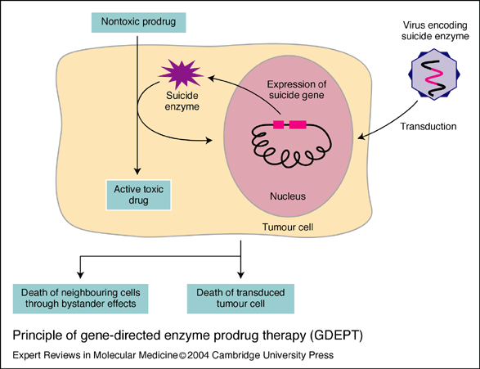
Prodrug

Slide 52
1
References :
1.Gareth Thomas. Medicinal Chemistry. 2nd Edition. Jone Wiley & Sons Ltd, 2007;p464.
2.Wilson and Gisvold’s. Textbook of Organic Medicinal and Pharmaceutical Chemistry. - 11 ed.-New York. 2004; 980.
3. Design of Biopharmaceutical Properties Through Prodrugs and Analogs; Ed. E.B.Roche; Am Pharm. Assoc.; USA; 1977 .
4. Rama Rao Nadendla, Priciples of Organic Medicinal Chemistry. New Age Publishers, New Delhi, 2005; 322.
5. Ashutosh Kar. Medicinal Chemistry.-4ed.-india.2007; 933.
Prodrug

Slide 53
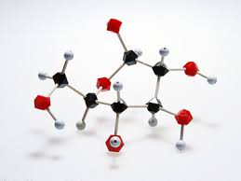
Medicinal chemistry Related Journals
Drug Designing: Open Access
Biochemistry & Pharmacology
Advances in Pharmacoepidemiology & Drug Safety

Slide 54
Medicinal chemistry Related Conferences
3rd International Conference on Medicinal Chemistry &
Computer Aided Drug Designing
3rd International Conference and Exhibition on Pharmacognosy, Phytochemistry & Natural Products

Slide 55
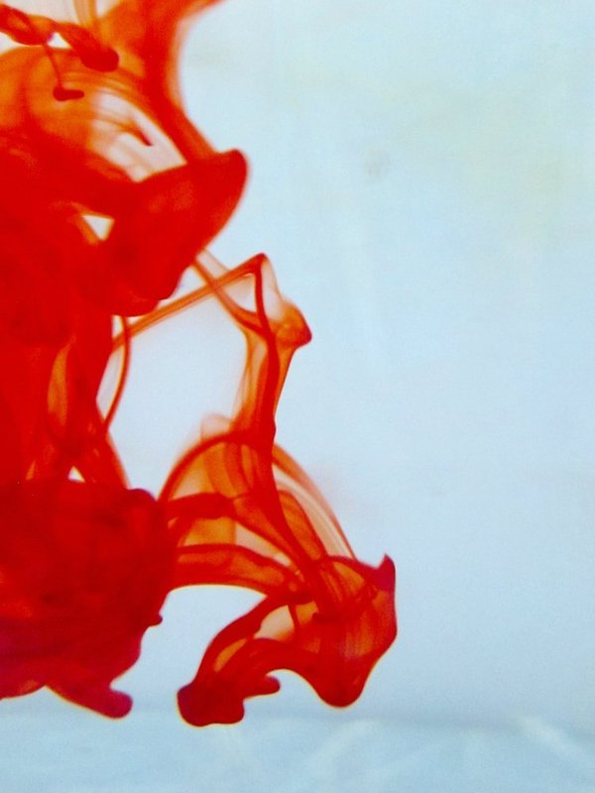
OMICS International Open Access Membership
OMICS International Open Access Membership enables academic and research institutions, funders and corporations to actively encourage open access in scholarly communication and the dissemination of research published by their authors.
For more details and benefits, click on the link below:
http://omicsonline.org/membership.php

