Slide 1
OMICS Group
OMICS Group International through its Open Access Initiative is committed to make genuine and reliable contributions to the scientific community. OMICS Group hosts over 400 leading-edge peer reviewed Open Access Journals and organizes over 300 International Conferences annually all over the world. OMICS Publishing Group journals have over 3 million readers and the fame and success of the same can be attributed to the strong editorial board which contains over 30000 eminent personalities that ensure a rapid, quality and quick review process. OMICS Group signed an agreement with more than 1000 International Societies to make healthcare information Open Access.
Contact us at: contact.omics@omicsonline.org

Slide 2
OMICS Journals are welcoming Submissions
OMICS Group welcomes submissions that are original and technically so as to serve both the developing world and developed countries in the best possible way.
OMICS Journals are poised in excellence by publishing high quality research. OMICS Group follows an Editorial Manager® System peer review process and boasts of a strong and active editorial board.
Editors and reviewers are experts in their field and provide anonymous, unbiased and detailed reviews of all submissions.
The journal gives the options of multiple language translations for all the articles and all archived articles are available in HTML, XML, PDF and audio formats. Also, all the published articles are archived in repositories and indexing services like DOAJ, CAS, Google Scholar, Scientific Commons, Index Copernicus, EBSCO, HINARI and GALE.
For more details please visit our website: http://omicsonline.org/Submitmanuscript.php

Slide 3
Aly Moussa
Editor

Slide 4
Research interest
Virology :
Visualization by electron microscope
Proteins detection using analytical and/or immuno-detection techniques
Nucleic acids detection and identification by hybridization, PCR…etc.

Slide 5
biography
Aly MOUSSA has obtained his BVSc from Cairo University, Egypt; Dr. Vet. Med. From Justus Liebig university, Germany and PhD from Claude Bernard University, France. He worked 4 years at IFFA-Mérieux Laboratory; Lyon- France, for 20 years was the chief of virology service at the French Bovine Pathology laboratory. Then for 8 years he was concerned at the national agency for sanitary security of aliments with research on the pathogenic prion proteins. He has published many papers in the fields of Virology and Transmissible Spongiform Encephalopathies. By the end of 2005 he is retired. During activity he was member of the biotechnology group at the Office International des Epizooties, member of the CEE group on Infectious Bovine Rhinotrachitis and he was a founding member of the European veterinary virology society.

Slide 6
Virology
Introduction to the viruses

Slide 7
Edward Jenner
Vaccinations
Cowpox
cross protection against small pox
Variola virus
Major
Blisters
Blindness
Death
Minor
Poxviridae
dsDNA

Slide 8
Viruses
Define
Classification
Group
NA
Family
-viridae
Genus
-virus
Species
Name

Slide 9
Host Range: Animals

Slide 10
DNA Animal Virus Examples

Slide 11
Viral Culture
Tissue Culture
Chick Embryos
Animal Cells/Tissue
Assays
Hemagglutination
Plaque

Slide 12
Viral Capsid
Function
Protect NA
Aids in transfer to host
Structure
Protein coat
Capsomere arrange
Helical
Polyhedral
Complex

Slide 13
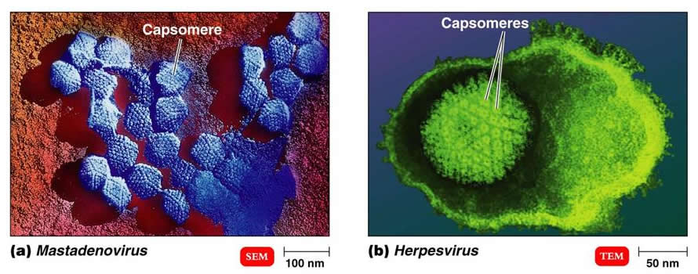
Capsomeres are capsid subunits

Slide 14
Naked vs. Enveloped Viruses

Slide 15
Viral Envelope
Presence
Enveloped
Naked (non-enveloped)
Location
Surrounds capsid
Source
Host plasma membrane
Nuclear membrane
Endoplasmic reticulum
Components
Phospholipid
Proteins
Glycoprotein spikes (+/-)
Examples
Influenza
Rabies
Herpes
HIV

Slide 16
Envelope Glycoprotein Spikes

Slide 17
Viral NA
DNA OR RNA
Shape
Circular
Linear
Number
One
Or more
Strands
ss
ds
+ or - if RNA

Slide 18
Viral Classification
dsDNA
pox
Herpes
Papilloma
ssDNA
Parvo
DsRNA
Reovirus
Rotavirus
ssRNA
Polio
Rhino
Corona
Measles, mumps
Rabies
Influenza
Parainflenza
Retroviruses

Slide 19
Viral Replication Differences

Slide 20
Viral Infections

Slide 21
Replication of Animal Viruses
Attach
Entry
Direct Penetration
Membrane fusion
Endocytosis
Uncoating
Synthesis
Assembly
Release

Slide 22
Viral Attachment

Slide 23
Direct

Slide 24
Endocytosis vs. Membrane Fusion

Slide 25
Release of Genome (uncoating)
Influenza Virus
Endosome formation
pH drop due to H+ pump
Fusion peptide to PM
Conformational change
Release of NA
Adenovirus uncoating

Slide 26
NA synthesis
dsDNA: usual replication (for most)
ssDNA
complementary strand
Normal replication
dsRNA
+ strand = mRNA
Template and copy
+ssRNA
+ strand = mRNA
Complimentary strand for template
-ssRNA
Viral enzymes make + strand
Template for mRNA and -ss
Retroviruses
+ssRNA (mRNA to make DNA)
Reverse transcriptase
DNA is template for new +ssRNA

Slide 28
DNA Virus Biosynthesis

Slide 29
RNA Virus

Slide 30
Retroviruses

Slide 31
Viral Assembly
DNA
Nucleus
Moves to cytoplasm
RNA
cytoplasm

Slide 32
Use of ER and Golgi
Herpes

Slide 33
Viral Release
Types
Budding
Acquire membranes
envelope
Exocytosis
Lysis
Latency

Slide 34
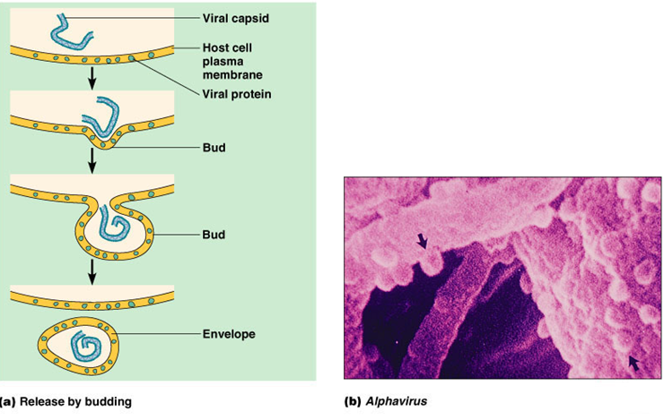
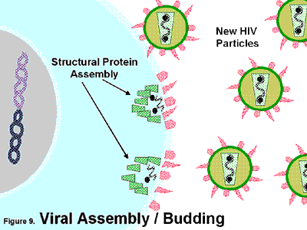
Budding

Slide 35
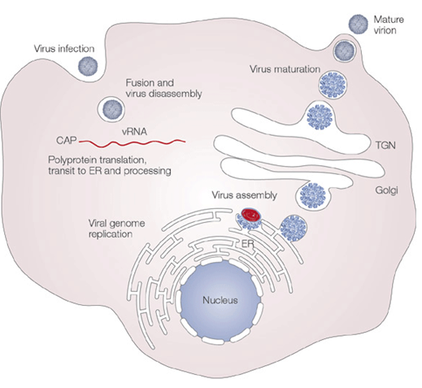
Viral Exocytosis

Slide 36
Viral Lysis

Slide 37
Viral Damage

Slide 38
Viral Transmission

Slide 39
Acute vs. Latent

Slide 40
Viral Infections

Slide 41
Viruses and Cancer
Definitions
Oncogenes
Activation
Mutation
Transduction
Tumor
Types
Benign
Malignant
Characteristics
Examples
DNA
Adenovirus
Herpes
Poxviruses
Papoviruses
Hepadenaviruses
RNA
Retroviruses
HIV
HTLV

Slide 42
Immune Response
Adaptive Immunity

Slide 43
Anti-Viral Drugs
Attachment antagonists
Block attachment molecule
Arildone
Inhibit Uncoating
Neutralize acid environment
Amantadine
Rimantadine
Inhibit DNA/RNA synthesis
Activation by phosphorylation of drug by viral kinases
Acyclovir
Gancyclovir

Slide 44
Prion Proteins

Slide 45
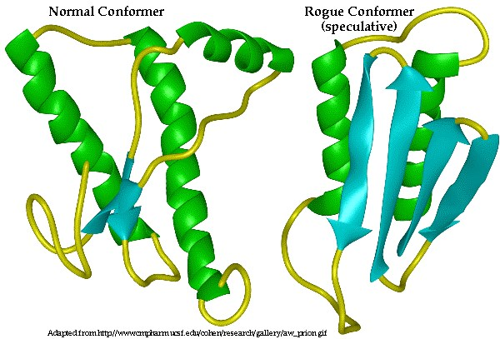
Tridimensional structure of the PRPc rich in alpha- helices (left) and the PrPsc rich in βετα-sheets pR
PrPc PrPsc PrPsc
Sensitive to Proteinase K
p proteinase k resistant detergant Detergant Insoluble

Slide 46
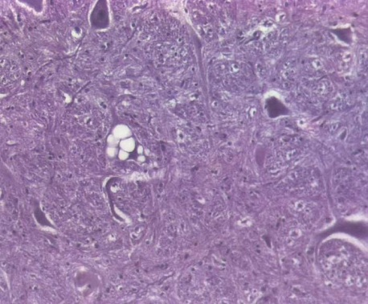
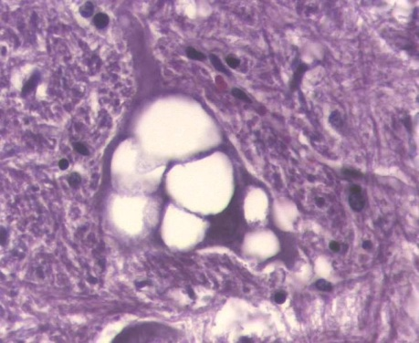
The prion is an amyloid protein which induces alone diseases; The Transmissible Spongiform Encephalitis (TSE) are sub-acute, fatal infections and characterized by the presence of vacuoles in neurons
Exp:
Scrapie in sheep& gaots, BSE in cattle, chronic wasting disease in deer and Creutzfeld-Jakob Disease in humans (CJD).

Slide 47
The Prion Protein (PrP):- PrPc & PrPsc
The cellular Prion protein PrPc is coded by the prnp Gene situated on the chromosome 20 in humans, 13 in bovine and 2 in mice.
This gene was found in all vertebrates and invertebrates and is expressed mainly in the CNS and the reticular-endothelial system.
The gene product (PrPc ) is transported outside the cell and anchored on the cell membrane and is associated with signal transduction.
The pathogenic prion protein PrPsc is produced after conformational transformation of the PrPc induced either by gene mutation or after infection with a PrPsc.

Slide 48
Prion Production

Slide 49
OMICS Group Open Access Membership
OMICS publishing Group Open Access Membership enables academic and research institutions, funders and corporations to actively encourage open access in scholarly communication and the dissemination of research published by their authors.
For more details and benefits, click on the link below:
http://omicsonline.org/membership.php

