Slide 1
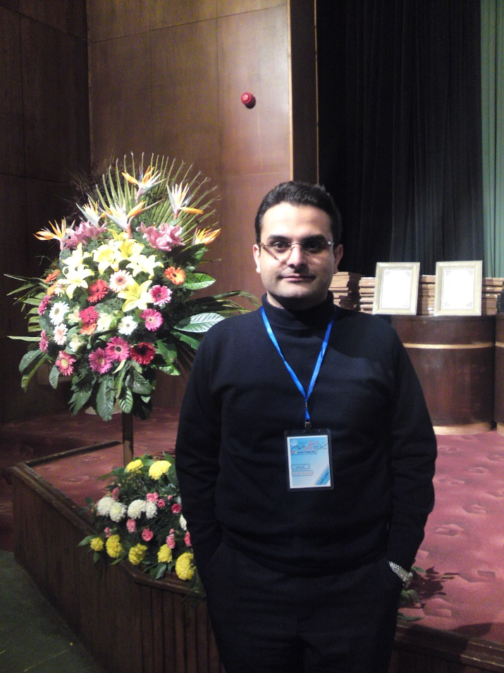
Arash Zibaee
Assistant Professor of Insect Physiology and Toxicology
Department of Plant Protection,
Faculty of Agricultural Sciences
University of Guilan, Iran
arash.zibaee@gmx.com/arash.zibaee@guilan.ac.ir
http://staff.guilan.ac.ir/zibaie/index.php?a=0&lg=1

Slide 2
Areas of expertise
Insect Physiology and Toxicology including, immunology, nutrition, intermediary metabolism and gene expression

Slide 3
Background
I am working in department of plant protection, university of Guilan since September 2010. My research projects have been concentrated on purification and characterization of enzymes involved in nutrition and immunity of insects. Currently, I have initiated working on lectins and ribosome inactivating proteins by purification and feeding assays on digestion and cell apoptosis even in molecular levels.

Slide 4
Education & Positions
Research period: Invertebrate Genetics and Comparative Anatomy, Universita Degli Studi di Modena e Reggio Emilia, Modena, Italy, 2010.
Ph.D. Insect Physiology and Toxicology, University of Tehran, 2010.
M.Sc. Agricultural entomology, Insect Resistance to Pesticides, University of Guilan, Iran, 2007.
B.Sc. Plant protection. University of Guilan, Iran, 2003.

Slide 5
Recent Publications
Zibaee, A., & Malagoli, D. (2014) Immune response of Chilo suppressalis Walker (Lepidoptera: Crambidae) larvae to different entomopathogenic fungi. Bulletin of Entomological Research 104, 155-163.
Sorkhabi-Abdolmaleki, S. & Zibaee, A. (2013) Secretagogue Mechanism of Digestive Enzyme Secretion in the Midgut of Andrallus spinidens Fabricius (Hemiptera: Pentatomidae). Proceedings of National Academy of Science India, Section B: Biological Sciences 82, 373-379.
Ramzi, S. & Zibaee, A. (2014) Biochemical properties of different entomopathogenic fungi and their virulence against Chilo suppressalis (Lepidoptera: Crambidae) larvae. Biocontrol Science and Technology 24, 597–610.
Sorkhabi-Abdolmaleki, S., Zibaee, A., Hoda, H. & Fazeli-Dinan, M. (2014) Purification and characterization of midgut α-amylase in a predatory bug, Andralus spinidens. Journal of Insect Science 14, Article 65, pages 1-13.
Delkash-Roudsari, S., Zibaee, A., Abbci-Mozhdehi, M. R. (2014) Digestive proteolytic activity in larvae and adults of Bactrocera oleae Gmelin (Diptera: Tephritidae). Journal of Asia-Pacific Entomology 17, 483–491.
58, 151-162.
Ramzi, A. & Zibaee, A. (2014) Digestive proteolytic activity in Apodiphus amygdali Germar (Hemiptera: Pentatomidae): effect of endogenous inhibitors. Journal of Entomological and Acarological Research 46, 35-41.
More publications…

Slide 6





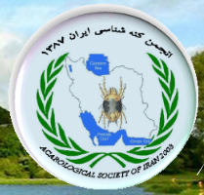
Collaborations

Slide 7
OMICS International
OMICS international Membership enables academic and research institutions, funders and corporations to actively encourage open access in scholarly communication and the dissemination of research published by their authors.
For more details and benefits, click on the link below:
http://omicsonline.org/membership.php

