Slide 1

__________
Ariel Fernández
Collegium Basilea, Institute for Advanced Study, Basel, Switzerland
Instituto Argentino de Matemática, Buenos Aires, Argentina
Ariel Fernandez Consultancy, Houston, TX, USA
Evolutionary insights into the control of drug specificity
Wrapping Designs in Molecular Cancer Therapy:
Dehydrons as Filters for Drug Specificity

Slide 2
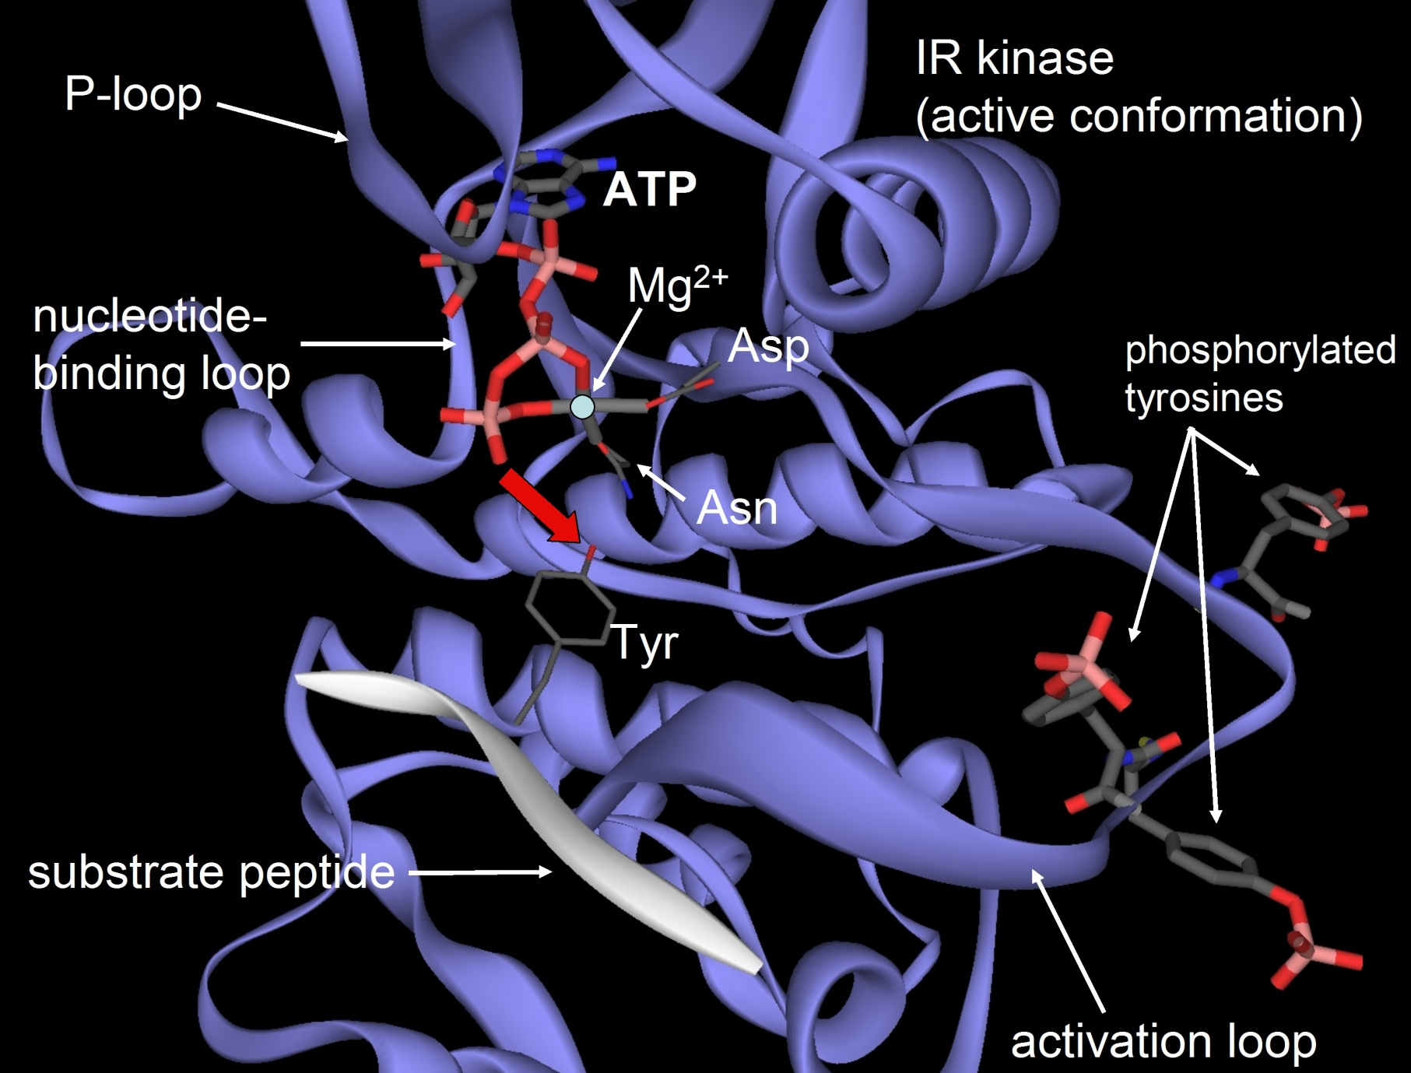

Slide 3
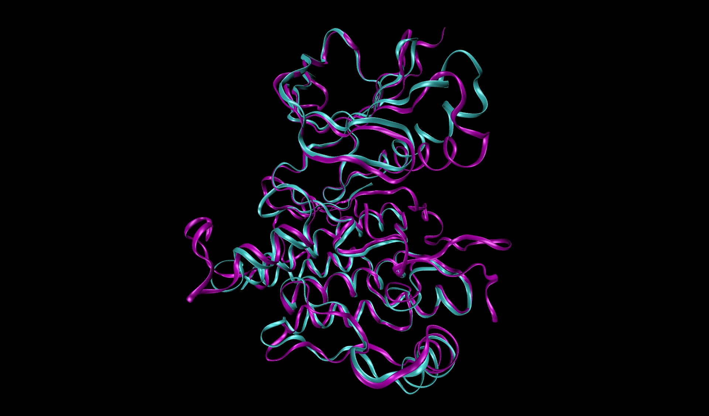
Focal adhesion kinase (FAK, major cancer target)
Insulin receptor kinase (INSR, target to be avoided)
ATP-binding site
Functional innovation
resorts to the
same folds,
especially within
a protein family
or superfamily.
SRC

Slide 4
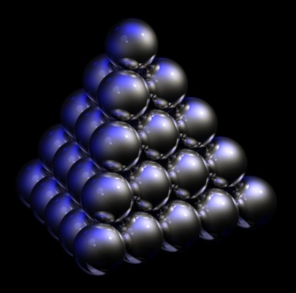
The fold is highly conserved across proteins of common ancestry.
The epistructural features are not conserved.
Evolution tinkers with the epistructure to achieve functional innovation.
Fernandez, A. Phys. Rev. Lett. 108, 188102 (2012)
Fernandez, A. & Lynch, M. Nature 474, 502-505 (2011)
Fernandez, A. Nature Biotechnology 22, 1081-1084 (2004)
Fernandez, A. and Scott, R. Physical Review Letters 91, 018102 (2003)
Fernandez, A., Rogale, K., Scott, R., Scheraga, H. Proc. Natl. Acad. Sci. USA 101, 11640-11645 (2004)

Slide 5
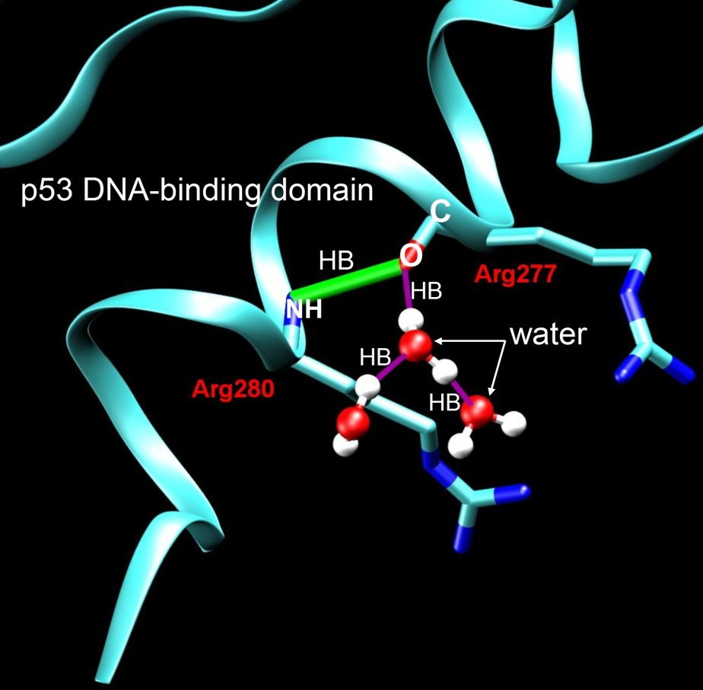
under-wrapped HB (dehydron)

Slide 6
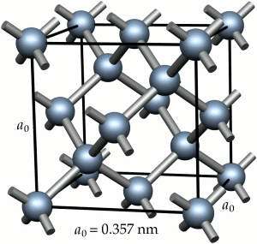
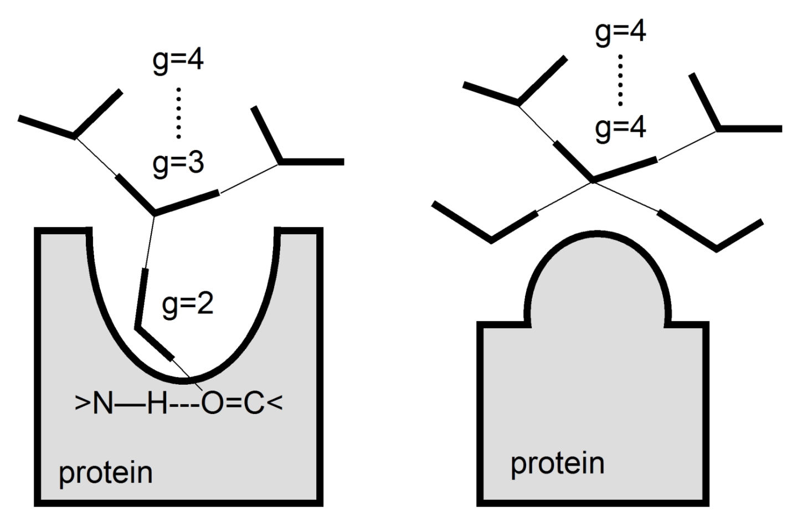
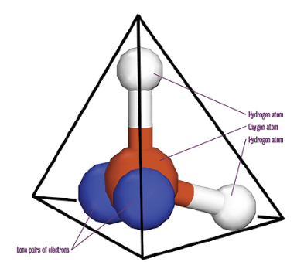
Dehydrons generate interfacial tension
*
tension no tension
*
hot water
A F, Phys. Rev. Lett. 108, 188102 (2012)

Slide 7
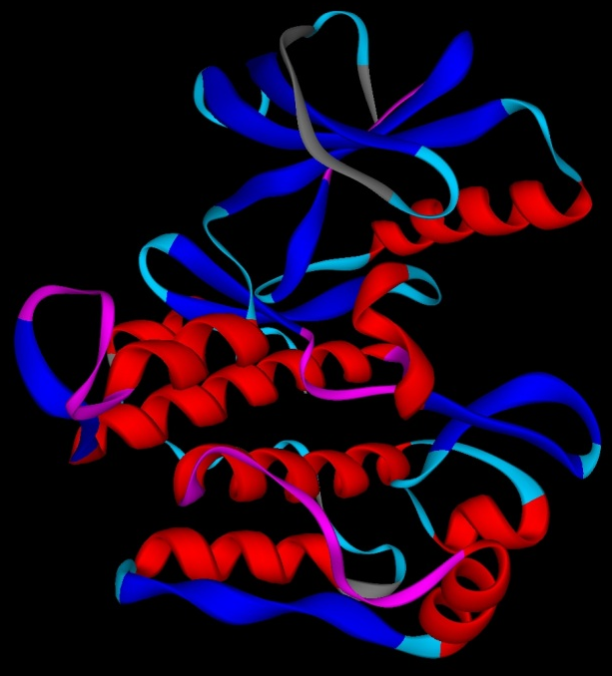
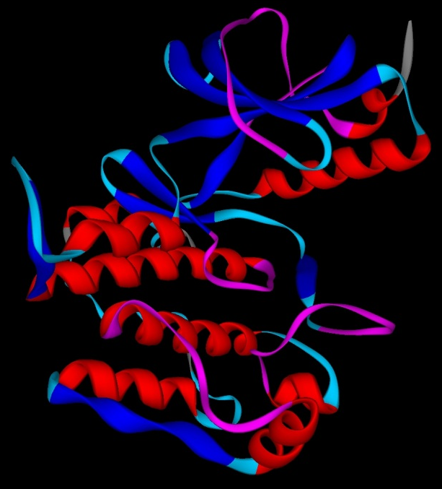
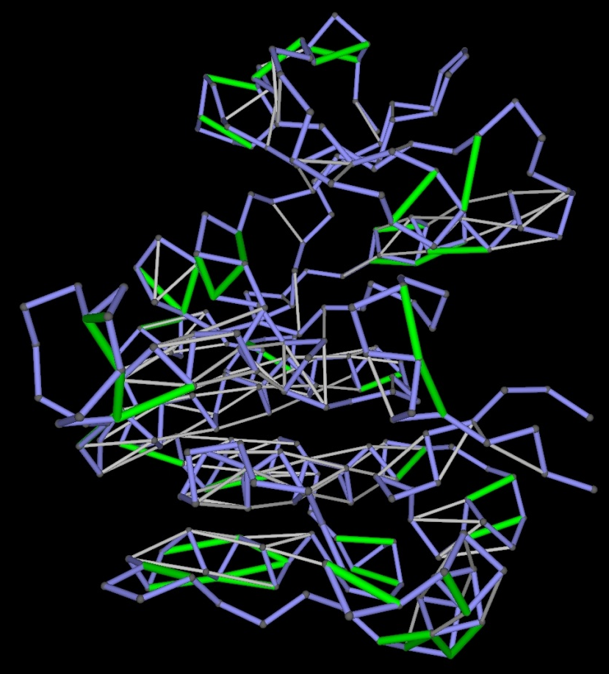
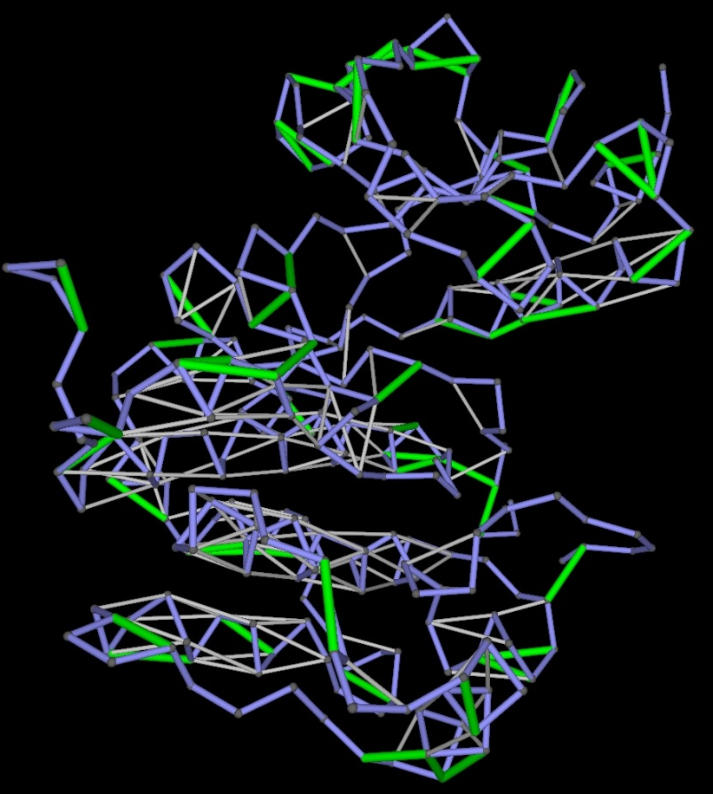
Homo sapiens
“same”
structure
different
epistructure
IR IGF1R

Slide 8
Drug-as-wrapper paradigm
“conventional”
nonbonded
interactions
Typically highly conserved
C
O
protein target
H
drug inhibitor
N
wrapping
interaction
C O H N
Under-wrapped hydrogen bond
(dehydron)
nonpolar group
Nature Reviews Drug Discovery 7, 120-121 (2008)

Slide 9
ARTICLE
Nature Medicine - 12, 908 - 916 (2006) Cardiotoxicity of the cancer therapeutic agent imatinib mesylate Risto Kerkelä^{1, 2}, Luanda Grazette³, Rinat Yacobi⁴, Cezar Iliescu⁵, Richard Patten², Cara Beahm¹, Brian Walters², Sergei Shevtsov^{1, 2}, Stéphanie Pesant¹, Fred J Clubb⁶, Anthony Rosenzweig³, Robert N Salomon⁷, Richard A Van Etten⁴, Joseph Alroy^{7, 8}, Jean-Bernard Durand⁵ & Thomas Force^{1, 2}
“Thus, cardiotoxicity is an unanticipated side effect of inhibition of c-Abl by imatinib”.
Challenge: Can we redesign imatinib to curb the side effect?
A. Fernandez et al. J. Clin. Invest. 117, 4044 (2007)

Slide 10
The role of the target protein is context-dependent
CML:
Bcr-ABL
inhibition
blocks the
anti-apoptotic
pathways
HEART:
ABL kinase inhibition induces ER stress, activates JNK-mediated
pathways, ultimately leading to mitochondrial depolarization, ATP-depletion and cell death.
New target?
ER stress

Slide 11
Wrapping-based molecular engineering
Imatinib Therapeutic impact/
Targets side effects
c-KIT GIST,
KIT-dependent melanomas
Reversal of tumor-induced
immunosuppresssion
Bcr-ABL CML / cardiotoxicity
PDGFR Anti-Angiogenic
LCK Immunosuppression
Wish List
c-KIT
[Drug→ vaccine?]
PDGFR
JNK1/2

Slide 12

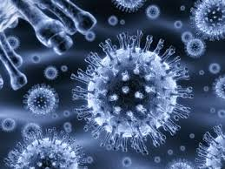
Metabolomics:Open Access
Related Journals
Drug Metabolism & Toxicology
Diabetes & Metabolism
Metabolic Syndrome
Proteomics & Bioinformatics
Metabolomics: Open Access

Slide 13

Metabolomics:Open Access
Related Conferences
For further details regarding the conference please visit:
http://www.metabolomicsconference.com/
http://www.metabolomicsconference.com/america/
http://metabolicsyndromes.conferenceseries.com/

Slide 14


OMICS Group Open Access Membership
Open Access Membership with OMICS international enables academicians
and research institutions, funders and corporations to actively encourage open access in scholarly communication and the dissemination of research published by their authors.
For more details and benefits, click on the link below: http://omicsonline.org/membership.php

