Slide 1


OMICS Group
OMICS Group International through its Open Access Initiative is committed to make genuine and reliable contributions to the scientific community. OMICS Group hosts over 400 leading-edge peer reviewed Open Access Journals and organizes over 300 International Conferences annually all over the world. OMICS Publishing Group journals have over 3 million readers and the fame and success of the same can be attributed to the strong editorial board which contains over 30000 eminent personalities that ensure a rapid, quality and quick review process. OMICS Group signed an agreement with more than 1000 International Societies to make healthcare information Open Access.
Contact us at: contact.omics@omicsonline.org

Slide 2

OMICS Journals are welcoming Submissions
OMICS Group welcomes submissions that are original and technically so as to serve both the developing world and developed countries in the best possible way.
OMICS Journals are poised in excellence by publishing high quality research. OMICS Group follows an Editorial Manager® System peer review process and boasts of a strong and active editorial board.
Editors and reviewers are experts in their field and provide anonymous, unbiased and detailed reviews of all submissions.
The journal gives the options of multiple language translations for all the articles and all archived articles are available in HTML, XML, PDF and audio formats. Also, all the published articles are archived in repositories and indexing services like DOAJ, CAS, Google Scholar, Scientific Commons, Index Copernicus, EBSCO, HINARI and GALE.
For more details please visit our website: http://omicsonline.org/Submitmanuscript.php

Slide 3
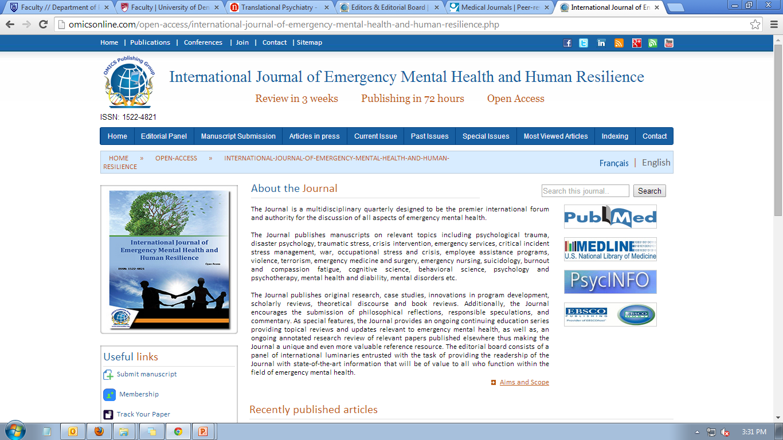
Intimate Partner Homicide and suicide: in general and among Immigrants in particular
Prof. Edelstein
Kaye academic college
Beer-Sheva, Israel

Slide 4
Why do men kill their lovers?
Love and hate are not two poles, but are very closed to each other on a circle.
Love and hate are both full of emotions
There is always “a reason” to murder an intimate partner
Men who murdered their intimate partner turn to re-framing the “whole story” in order to neutralize their shame and responsibility.

Slide 5
Risk factors for intimate partner homicide
The theoretical and empirical literature found more than 20 risk factors for IPH.
In more in-depth, there are 3 main risk factors, or triggers for IPH.
A. prolong conflict together with violence, including formal complaint in a police station against the man.
B. sexual jealousy
C. the woman will to leave the relationships.

Slide 6
IPH among immigrants
The empirical studies all over the world show that immigrant’s women from patriarchal cultures to modern ones, are murdered by their intimate partner, much more than any other women in the population of the absorb country.

Slide 7
It was only natural to put the blame of this phenomenon on culture conflict, reversal of roles and status between men and women.
Social-Cultural Explanations
These explanations were popular for many years, because they seem “so right and logic”.
It is only natural that a man who lost is traditional roles and status, will try to regain them by violence against the “one” who took them from him- his intimate partner.

Slide 8
Psychological Explanations to IPH
One question bothered scholars who search this topic among immigrants: If the social-cultural explanation is so good, why most of the immigrants from Patriarchal cultures does not murder their intimate partner?
Are they not experience the same role reversals, or status reversals?
Are does immigrants who murdered their intimate partner, have some personality problems?

Slide 9
These questions arouse many questions, who left the social-cultural explanations aside.
Many psychological explanations appeared, which tried to understand the motives of each murderer for himself.
These kind of studies suffered two main problems:
A. their ability to incorporation is very poor

Slide 10
B. The murderer tell “his” story after re-framing the reality, in order to look human, suffers and so on.
So again, we found ourselves with out a satisfying explanations to the phenomenon.
Worse than that, every discipline argued that its explanation is the right one.

Slide 11
Inter disciplinary Explanations
Arguments between disciplines tend to break off the reality of a phenomenon.
We can find these tendencies in many areas including medical care, when each of the physicians see the problems by his on expertise glasses or lens.
The conclusion is that we need to look for an inter discipline, more holistic explanation, that will regard the whole reality that wrapping a phenomenon.

Slide 12
Back to IPH in general, and among immigrants, in particular.
We accept the social-cultural explanations
We accept the three main risk factors for IPH
We accept that most men does not murder their intimate partners.

Slide 13
Two kinds of murderers
In order to find special personality traits who are unique to murder of intimate partner, two kinds of personalities emerged:
The Tyrant: A man who’s self identity is identify by his ability to control and rule his intimate partner. Those men murder their intimate partner, when she, the wife, rebels and go against her man or she is unfaithful.

Slide 14
These behaviors are threaten the self esteem, the identity and the self definition of the Tyron as such.
In order to punish the “enemy” who “forgot her place” in the hierarchy, the Tyron will be violence and even murder his wife with rage
(60% of all men who murdered their intimate partners).

Slide 15
The Subject: This kind of man is the opposite of the Tyron. He is depended on his intimate partner, he can not make decisions without her and he suffers from abandonment anxiety.
This man does not violent to his partner because he is afraid that she will abandon him.
In other words, hid self esteem, self definition

Slide 16
Self definition, exist thanks to his intimate partner.
When a wife of this kind of a man, wants to leave the relationships, or when he thinks that she is unfaithful to him, his nightmare become a reality. His all being is under a massive threat.
In order to save his self, he murder his intimate partner, “out of the blue”.

Slide 17
40% of IPH were done without any former violence against the woman.
But, these men can not live without their intimate partners, so the committee suicide in order to “freeze” the relationships as they were before the trigger aroused.
So both personalities, opposite as they are, murder for the same reason: to protect the self.

Slide 18
More than 7000 verdicts in Israeli’s courts were coded in order to understand and to explain the risk factors to IPH among Ethiopian immigrants.
The results show that the combination of personality type together with role and status reversal explain all the cases of IPH among this population.

Slide 19
Conclusions
The conclusion is that the role and status reversal are a common phenomenon among all immigrants men. We can regard them as pre-disposition.
The three triggers we have mentioned: violence and conflict, sexual jealousy and the woman will to leave the intimate relationships
will activate a murderous acts against the
intimate partner, only when these triggers

Slide 20

Emergency Mental Health
Related Journals
International Journal of School and Cognitive Psychology
Psychology & Psychotherapy
Psychiatry: Open Access
Psychological Abnormalities in Children

Slide 21

Emergency Mental Health
Related Conferences
Annual Conference on Fostering Human Resilience
Annual Summit on Sleep Disorders and Medicine
Euro Global Summit and Medicare Expo on Psychiatry

Slide 22


OMICS Group Open Access Membership
OMICS publishing Group Open Access Membership enables academic and research institutions, funders and corporations to actively encourage open access in scholarly communication and the dissemination of research published by their authors.
For more details and benefits, click on the link below:
http://omicsonline.org/membership.php

