Slide 1
OMICS International
OMICS Group International through its Open Access Initiative is committed to make genuine and reliable contributions to the scientific community. OMICS Group signed an agreement with more than 1000 International Societies to make healthcare information Open Access.
Contact us at: contact.omics@omicsonline.org

Slide 2
OMICS Journals are welcoming Submissions
OMICS International welcomes submissions that are original and technically so as to serve both the developing world and developed countries in the best possible way.
OMICS International Journals are poised in excellence by publishing high quality research. OMICS Group follows an Editorial Manager® System peer review process and boasts of a strong and active editorial board.
Editors and reviewers are experts in their field and provide anonymous, unbiased and detailed reviews of all submissions.
The journal gives the options of multiple language translations for all the articles and all archived articles are available in HTML, XML, PDF and audio formats. Also, all the published articles are archived in repositories and indexing services like DOAJ, CAS, Google Scholar, Scientific Commons, Index Copernicus, EBSCO, HINARI and GALE.
For more details please visit our website: http://omicsonline.org/Submitmanuscript.php

Slide 3
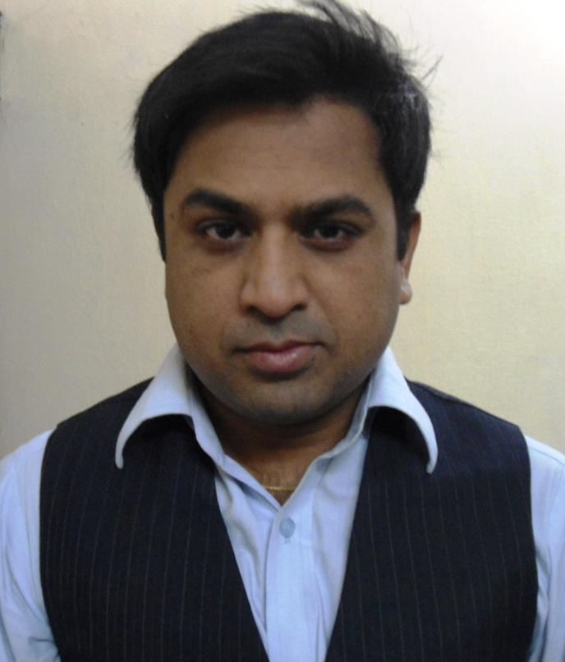
Dr Ashish Chauhan
(Serving under the Ministery of Chemicals and Fertilizers)
Small and Medium Pharmaceutical Industry Centre (SMPIC)
PUNJAB, INDIA
e-mail : aashishchauhan26@gmail.com

Slide 4
Dr Ashish Chauhan and his Scientific Contribution
Dr Ashish Chauhan was born in Himachal Pradesh on 16 October, 1979 in Chamba, India. He did schooling at St. Lukes, Solan and Masters Degree in Organic Chemistry with specialization in Pharmaceutical Chemistry in 2002. He received his PhD Degree in 2011 under the supervision of Dr B. S. Kaith (Professor and Head of Chemistry Department) at Dr B. R. Ambedkar National Institute of Technology, Jalandhar, Punjab. He has distinguished in various subjects and received academic awards.
He has been imparting theoretical and practical training on advanced analytical techniques to Post Graduate and Ph.D Scholars of Science, Applied Science, Pharmacy and Technology at SMPIC Centre under the Ministry of Chemicals and Fertilizers at Punjab, India. He has been working on modern bio-analytical techniques, utillizing the biomass, polymers and composites since last eight years. He has numerous international publications of research and review articles in high impact Journals. He has contributed a number of research articles for International and National Conferences, Editorial Articles for the esteemed Journals. He is associated as an active member in scientific associations. He is member of Advisory Board, Editorial Board and Acknowledged reviewer of many International Scientific Journals.

Slide 5
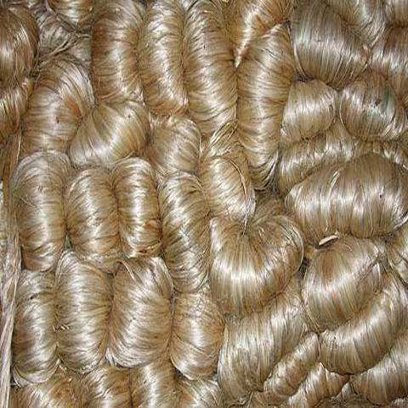
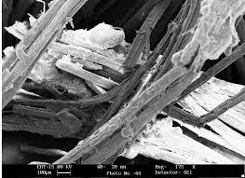
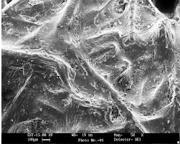
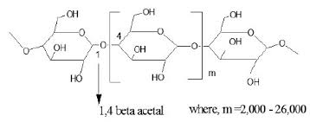
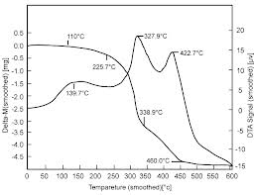
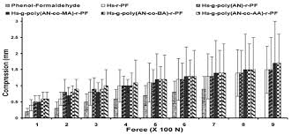
Striving to obtain the Advanced Materials from waste Biomass by using latest Characterization and Evaluation Techniques

Slide 6
Publications in International Journals
Ashish Chauhan and Balbir Kaith, Synthesis, Characterization and Chemical studies of Hibiscus sabdariffa-g-copolymers, Fibers and Polymers , 12(1), 1-7 (2011), Citation:06, IF:0.90.
B. S. Kaith, Ashish Chauhan, A. S. Singha and Deepak Pathania, Induction of the morphological changes in Hibiscus sabdariffa fiber on graft copolymerization with Binary vinyl monomer mixtures, Inter. Jour. Polym. Anal. and Characterization, 14(3), 246-258 (2009), Citation:09, IF:1.2.
Ashish Chauhan and Balbir Kaith, Synthesis, Characterization and Evaluation of novel Hibiscus sabdariffa-g-poly(EA) copolymer from waste biomass, Journal of Applied Polymer Science 123 (1), 448-454 (2011), Citation:08, IF:1.4.
Ashish Chauhan and Balbir Kaith, Thermal and Chemical studies of Hibiscus sabdariffa-graft-(Vinyl monomers), International Journal of Polymeric Materials, 60, 1-15 (2011), Citation:08, IF:1.2

Slide 7
Publications in International Journals
Ashish Chauhan and Balbir Kaith, Development and Assessment of the Advanced Graft obtained from Hibiscus sabdariffa biomass, Journal of Applied Polymer Science, 123 (3) 1650-1657 (2011), Citation: 07, IF:1.4.
Ashish Chauhan and Balbir Singh, X-Ray Powder Diffraction Studies to Accredit the Morphological Transformations in Hibiscus sabdariffa Graft-copolymers, International Journal of Polymer Analysis and Characterization,16 (5), 319-328 (2011), Citation:08, IF:1.2.
Ashish Chauhan and Balbir Kaith, Fabrication and Evaluation of Physico-Chemico-Thermally Resistant Bio-polymers, International Journal of Polymeric Materials, 61(12) 893-905 (2012), Citation:06, IF: 1.2.
Ashish Chauhan and Balbir Kaith, The Potential Use of Roselle as Novel Graft-copolymer, Journal of Natural Fiber, 8(4) 308-321 (2011), Citation:06, IF:0.55.
Ashish Chauhan and Balbir Kaith, XRD Elaborate the Metamorphosis in Graft Copolymers, Journal of Analytical and Bio-Analytical Techniques, 3 (5) 1-6 (2012), Citation: 04, IF: 3.48.

Slide 8
Publications in International Journals
Ashish Chauhan and Balbir Kaith, Using the Advanced Analytical Techniques for Investigating the Versatile Cellulosic Graft copolymers, Journal of Analytical and Bio-Analytical Techniques, 3 (5) 7-14 (2012) Citation: 07, IF: 3.48.
Ashish Chauhan and Balbir Kaith, Exploring the viability of Modified Cellulosic Polymer and its use as reinforcement to obtain Green Composite by Advanced Analytical and Evaluation Techniques, Journal of Analytical and Bio-Analytical Techniques, 3 (7) 156 (2012) Citation 04, IF: 3.48.
Ashish Chauhan and Balbir Kaith, Fabrication and Physico-chemico-thermo-mechanical Accreditation of Green Composite, Journal of Biodegradation and Bioremediation, 4(2) (2013) Citation: 05, IF: 3.5.
Ashish Chauhan and Balbir Kaith, Bioremediation of Natural Fiber by Graft-copolymerization, Journal of Chemical Engineering and Process Technology,(2013). IF: 1.1

Slide 9
Editorial Board Member in Esteemed International Journals
Journal of Chemical Engineering and Process Technology (OMICS Publishers)
Journal of Textile Science and Engineering (OMICS Publishers)
Journal of Chemical Engineering and Material Science (Academic Journals, Victoria Island,Lagos)
International Journal of Plastic and Polymer Technology (Trans Stellar Publishers)
International Jornal of Chemical Technology (Science Alert Publishers, USA)
International Journual of Fundamental and Applied Science (BioMedAsia)
International Journal of Applied, Physical and Bio-Chemistry Research (Trans Stellar Publishers)
American Journal of Food Technology (Science Alert Publishers, USA)
Asian Journal of Material Science (Science Alert Publishers, USA)
Singapore Journal of Scientific Research (Science Alert Publishers, USA)
New York Journal of Science (Marsland Press, USA)
The Journal of American Science (Marsland Press, USA)
Asian Journal of Engineering and Applied Technology (Sriraam Publishers)
Asian Journal of Science and Applied Technology (Sriraam Publishers, India)
International Journal on Chemistry and Chemical Engineering (RI Publishers)
International Journal of Applied Chemistry (Research India Publications, Delhi)
Journal of Material Science Research (Canadian Center of Science and Education Publications, Canada)
International Journal of Chemistry and Applications (Research India Publications)
International Journal of Chemical Engineering Research ( -do-)
International Journal of Material Sciences and Technology (-do-)
International Journal of Advanced Materials Sciences (-do-)
Pakistan Journal of Scientific and Industrial Research (Pakistan Council of Scientific and Industrial Research, Pakistan)-Physical Sciences

Slide 10
Editorial Board Member in Esteemed International Journals
Polymer from Renewable Resources (Smither Rapra Publishers,Akron, North America)
Malaysian Polymer Journal (Plastics Rubber Institute of Malaysia).
International Journal of Chemical & Petrochemical Technology (Transstellar Journal
Publications)
Journal of Chemical Engineering and Technology (Transstellar Journal Publications)
International Journal of Metallurgical & Materials Science and Engineering (-do-)
Journal of Metallurgical & Materials Science and Engineering (-do-)
Journal of Engineering and Physical Science (World Academy of Science, Engineering and Technology) P-38
World Journal of Engineering and Pure & Applied Science (WJEPAS), RRP Journals
Journal of Analytical and Bio-analytical Techniques (OMICS Publishers)
Pharmaceutical Analytica Acta (OMICS Publishers)
Journal of Bioremediation & Biodegradation (OMICS Publishers)

Slide 11
Editorial Advisory Board Member in Distinguished International Journals
Annals of Plant Science [ISSN: 2287-688X]
International Journal of Bioassay (OJS Editorial and Publishing)
International Journal of Chemical and Life Science (OJS Editorial and Publishing)
International Journal of Chemicals and Life Sciences [ISSN NO: 2234-8638 ]
Asian Journal of Science and Applied Technology [ISSN: 2249 - 0698 ]
Asian Journal of Engineering and Applied Technology [ISSN:2249-068X]
International Journal of Chemicals and Life Sciences [ISSN: 2234-8638]
The Journal of Applied Sciences Research [ISSN: 2383-2215]

Slide 12
Acknowledged Reviewer of International Journals
International Journal of Polymer Science
International Journal of Composite Materials,
International Journal of Science and
Advanced Technology
Asiatic Journal of Biotechnology Resources
Journal of Research Update in Polymer
Science

Slide 13
Editorial Articles in International Journals
Ashish Chauhan, The Changing Scenario of SME in India, Journal of Chemical Engineering and Process Technology, 3 (4), 1000e103 (2012).
Ashish Chauhan, Composite, The Wonder Materials, Journal of Analytical and Bio-analytical Techniques, 3 (3) 1000e104 (2012).
Ashish Chauhan, A Debatable Drug Trial System, Pharmaceutica Analytica Acta, 3 (6), e116 (2012).
Ashish Chauhan, Environmental Hazards due to Polychlorinated Biphenyls, Journal of Chemical Engineering and Process Technology, 3 (4), 1000e105 (2012).
Ashish Chauhan, Composite, The Advanced Material, Journal of Chemical Engineering and Process Technology, 3 (4), 1000e106 (2012).
Ashish Chauhan, FTIR: A Novel Bio-analytical Technique, Journal of Analytical and Bio-analytical Techniques, 3 (5) 1000e107 (2012).
Ashish Chauhan, Antioxidants and their Bio-availability, Pharmaceutica Analytica Acta, 3 (6), e119, (2012).
Ashish Chauhan, Pulmonary Drug Delivery System, A Versatile Technology, Pharmaceutica Analytica Acta, 3 (6), e117, (2012).

Slide 14
Editorial Articles in International Journals
Ashish Chauhan, Utilizing the Natural fibers for Textile and Engineering, Journal of Textile Science and Engineering, 2 (5) e 108 (2012).
Ashish Chauhan, Radioisotopes Study and its importance, Pharmaceutica Analytica Acta, 3 (7), e120, (2012).
Ashish Chauhan, God, the Pharmacist!, Open Access Scientific Report , 1 (5), (2012).
Ashish Chauhan, Use of Polymers in Sustained Drug Release System, Open Access Scientific Report, 1 (6), (2012).
Ashish Chauhan, Thermally Resistant Polymers and their use, Pharmaceutica Analytica Acta, 3 (8), e127, (2012).
Ashish Chauhan and Bharti Mittu, Modern Approach to Research by DSC and its Advancements, Pharmaceutica Analytica Acta, 3(8), e129 (2012).
Ashish Chauhan, Polymers and its modifications, Pharmaceutica Analytica Acta, 3(8), e128 (2012).
Ashish Chauhan and Priyanka Chauhan, Advanced Polymer Composites, Journal of Analytical and Bio-analytical Techniques, 3(6) 1000e108 (2012).
Ashish Chauhan and Priyanka Chauhan, Bioremediation of Biopolymers, Journal of Bioremediation and Biodegradation, 3 (12) 100e127 (2012).
Ashish Chauhan, Priyanka Chauhan and Bharti Mittu, Biodegradable Plastic, Journal of Textile Science and Engineering, 3(1) (2013).

Slide 15
Journal of Chemical Engineering & Process Technology Related Journals
Journal of Petroleum & Environmental Biotechnology
Journal of Civil & Environmental Engineering
Journal of Advanced Chemical Engineering

Slide 16
Journal of Chemical Engineering & Process Technology Related Conferences
3rd World Congress on Petrochemistry and Chemical Engineering
International Conference on Significant Advances in Biomedical Engineering

Slide 17
OMICS International Open Access Membership
OMICS International offers Open Access Membership for academic and research institutions, funders and corporations to actively encourage open access in scholarly communication and the dissemination of research published by their authors.
For more details and benefits, click on the link below:
http://omicsonline.org/membership.php

