Slide 1
OMICS Group
OMICS Group International through its Open Access Initiative is committed to make genuine and reliable contributions to the scientific community. OMICS Group hosts over 400 leading-edge peer reviewed Open Access Journals and organizes over 300 International Conferences annually all over the world. OMICS Publishing Group journals have over 3 million readers and the fame and success of the same can be attributed to the strong editorial board which contains over 30000 eminent personalities that ensure a rapid, quality and quick review process. OMICS Group signed an agreement with more than 1000 International Societies to make healthcare information Open Access.
Contact us at: contact.omics@omicsonline.org

Slide 2
OMICS Journals are welcoming Submissions
OMICS Group welcomes submissions that are original and technically so as to serve both the developing world and developed countries in the best possible way.
OMICS Journals are poised in excellence by publishing high quality research. OMICS Group follows an Editorial Manager® System peer review process and boasts of a strong and active editorial board.
Editors and reviewers are experts in their field and provide anonymous, unbiased and detailed reviews of all submissions.
The journal gives the options of multiple language translations for all the articles and all archived articles are available in HTML, XML, PDF and audio formats. Also, all the published articles are archived in repositories and indexing services like DOAJ, CAS, Google Scholar, Scientific Commons, Index Copernicus, EBSCO, HINARI and GALE.
For more details please visit our website:
http://esciencecentral.org/journals/alternative-integrative-medicine.php

Slide 3
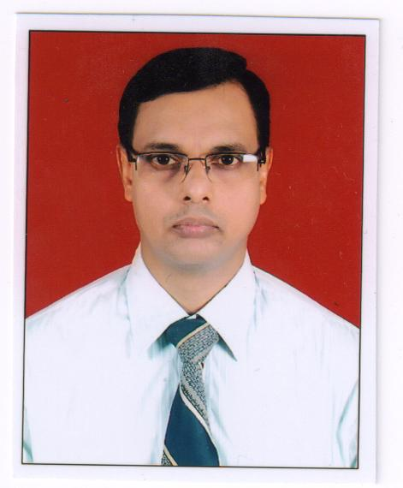
Bio-Sketch of Banamali Das

Slide 4
Biography
Dr. Banamali Das has Completed MD in Ayurvedic Medicine in 1999 and Ph.D (Ayurveda) in 2013. He has 7 years of experience in teaching in the undergraduate and postgraduate colleges of Ayurveda and became the examiner of Rajiv Gandhi University of Health Sciences, Bangalore, Karnataka, India. He has experience as a Research officer in CCRAS, Dept. of AYUSH, GOI from 2006 till date. He has published about nine research papers in National and International Journals, monographs etc.

Slide 5
Research Interest
Research experience as Research Officer(Ay) from August 2006 till date under Central Council for Research in Ayurvedic Sciences (CCRAS), New Delhi.
Working as Investigator of the project “Evaluation of Clinical efficacy and safety of Bramha Rasayana in apparently healthy and elderly volunteers.
Worked as Investigator for Clinical evaluation of Punarnavadi Mandoora and Dadimadi Ghrita in Iron deficiency Anaemia.
Monitored the project “Multicentric Open Clinical Trial on Dhatri lauha and Annabhedi Chenduram in Iron Deficiency Anaemia’, during posting at CCRAS, Head quarter, New Delhi.

Slide 6
Research Interests
Worked as Co-investigator for the clinical trial projects Manodvega allotted by C.C.R.A.S. Head quarter, New Delhi.
Worked as Honorary Clinical Registrar for 2 years at I.P.G.T. & R.A., Jamnagar, from January 1998 to December 1999.
Attended various Medical camps during posting at various institutes of CCRAS.

Slide 7
Training Programmes attended
Participated in the Capacity Building Training Programme on Pharmacovigilance, conducted by Gujarat Ayurveda University, Jamnagar, at JB Roy State Ayurveda College, Kolkata on 4th -5th December 2010.
Participated in the Training Programme on “Ayu Soft” organized by C-DAC, Mumbai on 15th -16th April 2010 at NRIADD, Bhubaneswar.
Participated “Training workshop on Research Methodology” organized by C.C.R.A.S. Headquarters, under W.H.O. Biennium on 8th to 9th December 2006.
Participated Training programme on “Multicentric Open Clinical Trial of selected drugs in Iron deficiency Anaemia” organized by C.C.R.A.S. Headquarters, on 26th-27th April 2007.

Slide 8
Training Programmes attended
Training workshop on Research Methodology for the faculty members of Government Ayurvedic Post Graduate Institutions, under aegis of WHO on 15th-16th December2007.
Training Workshop on Laboratory Techniques for Anticancer Drug Screening sponsored by CCRAS and organized by Anticancer Drug Screening Facility, Tata Memorial Centre, ACTREC, Navi Mumbai-410210.
Participated the Training programme regarding implementation of ISO 9001-2008 based on Quality management system on 20.03.2009 at Committee room, C.C.R.A.S. Headquarters, New Delhi.

Slide 9
Publications
Effect of some Ayurvedic preparations in the management of Urinary tract infection in Journal of Research in Ayurveda & Siddha, CCRAS, New Delhi.
“Parijata’ an Medico-historical review”in Journal of History of Indian Medicine, Indian Institute of History of Medicine.
Concept of Rasayana Therapy with special reference To AIDS in AYU journal.
Effect of Laghumasha Taila Nasya in Apabahuka (Frozen shoulder) in AYU journal.
Role of Rasayana in Geriatric Health Care with special reference to Rajonivritti in Souvenir of National Workshop on Problems of Ageing Women preventive and curative aspects organized by IPGT&RA, Jamnagar during 20-21 July 2008.

Slide 10
Publications cont…
A classical stand point on concept of Puerperium (Sutikavastha) & its management in Souvenir of National scientific seminar on reproductive health of women through Ayurveda organized by Rastriya Ayurveda Vidyapeetha, New Delhi during 24-25 February 2009.
Role of certain herbal Preparations in the management of urinary tract infection in “Ayu” Journal.
Concept of Dietetics and its Importance in Ayurveda-J Homeop Ayurv Med 2014, 3:2
Review on Pharmacological activity of Bhallataka-JDRAS:Vol XXXII, No 3-4, July-December 2011

Slide 11
Journal of Community Medicine & Health Education
Internal Medicine: Open Access
General Medicine: Open Access
Journal of Vascular Medicine & Surgery

Slide 12
Related Conferences
2nd International Conference on
Predictive, Preventive and Personalized Medicine & Molecular Diagnostics

Slide 13
OMICS Group Open Access Membership
OMICS publishing Group Open Access Membership enables academic and research institutions, funders and corporations to actively encourage open access in scholarly communication and the dissemination of research published by their authors.
For more details and benefits, click on the link below:
http://omicsonline.org/membership.php

