Slide 1
OMICS Journals are welcoming Submissions
OMICS International welcomes submissions that are original and technically so as to serve both the developing world and developed countries in the best possible way.
OMICS Journals are poised in excellence by publishing high quality research. OMICS International follows an Editorial Manager® System peer review process and boasts of a strong and active editorial board.
Editors and reviewers are experts in their field and provide anonymous, unbiased and detailed reviews of all submissions.
The journal gives the options of multiple language translations for all the articles and all archived articles are available in HTML, XML, PDF and audio formats. Also, all the published articles are archived in repositories and indexing services like DOAJ, CAS, Google Scholar, Scientific Commons, Index Copernicus, EBSCO, HINARI and GALE.
For more details please visit our website: http://omicsonline.org/Submitmanuscript.php

Slide 4
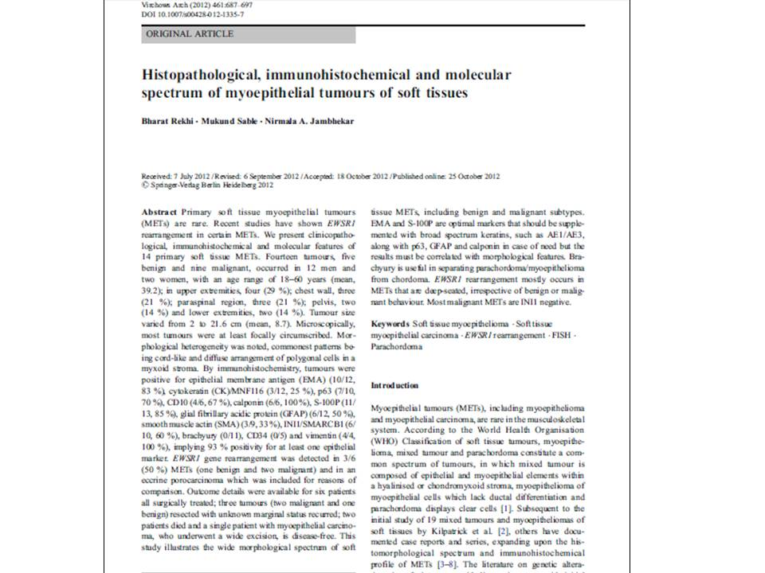

Slide 5
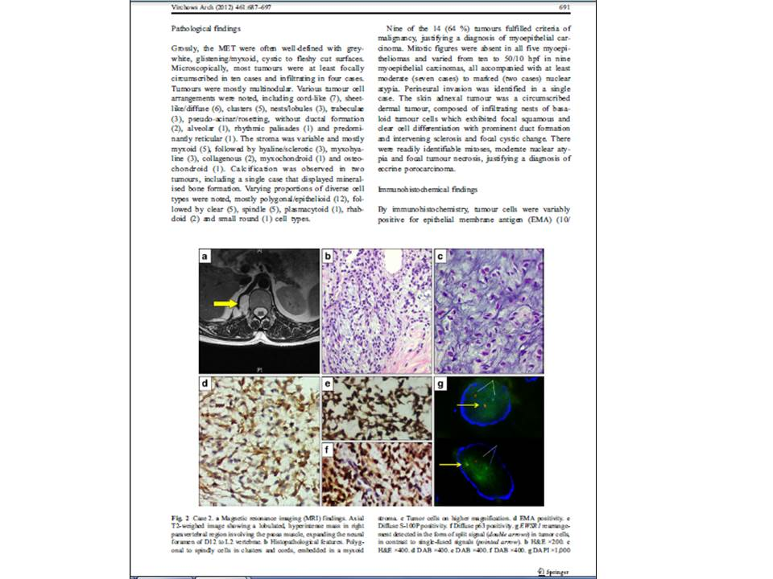

Slide 6
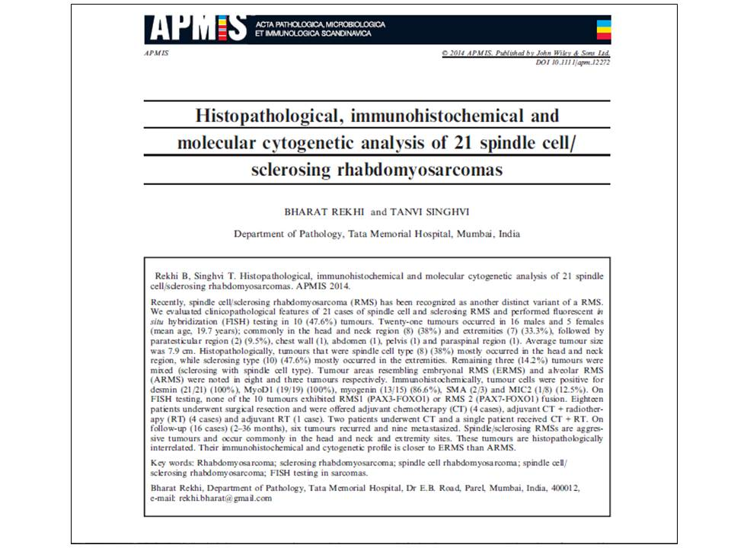

Slide 7
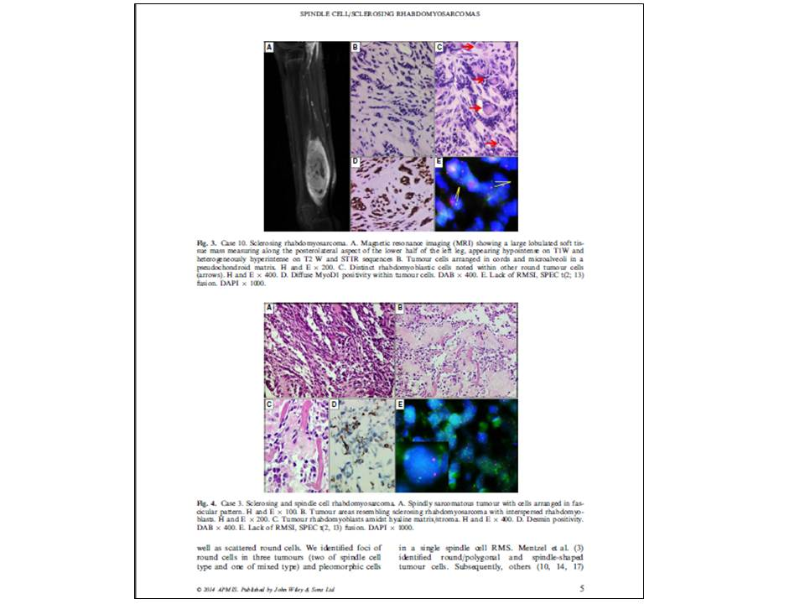

Slide 8
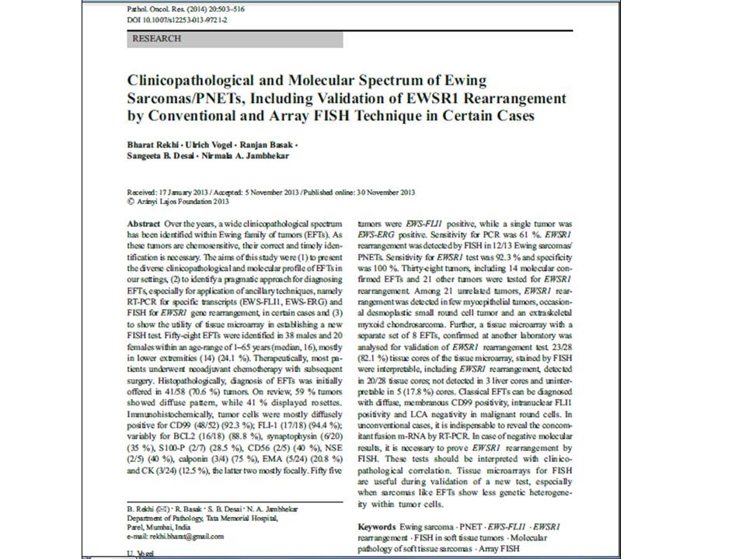

Slide 9
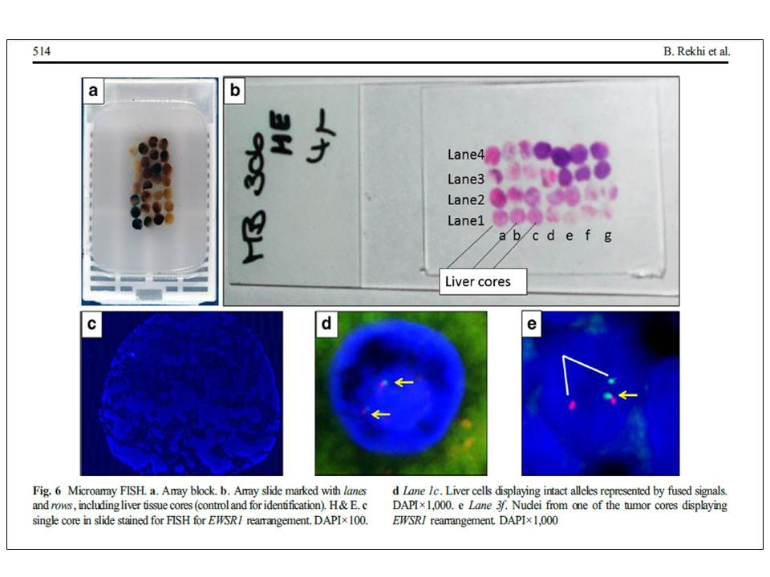

Slide 11
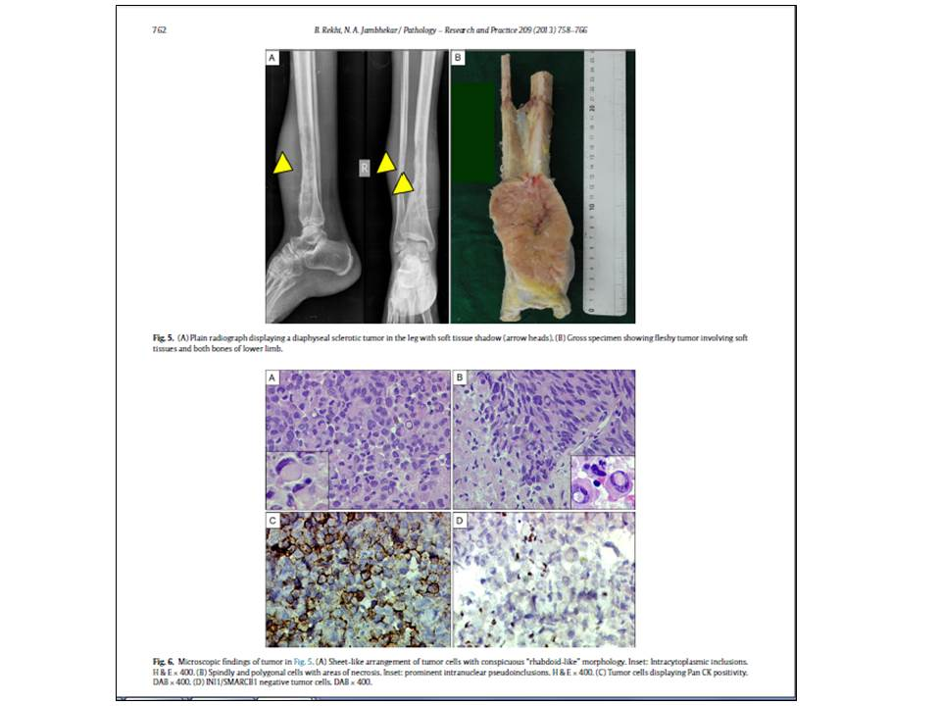

Slide 13
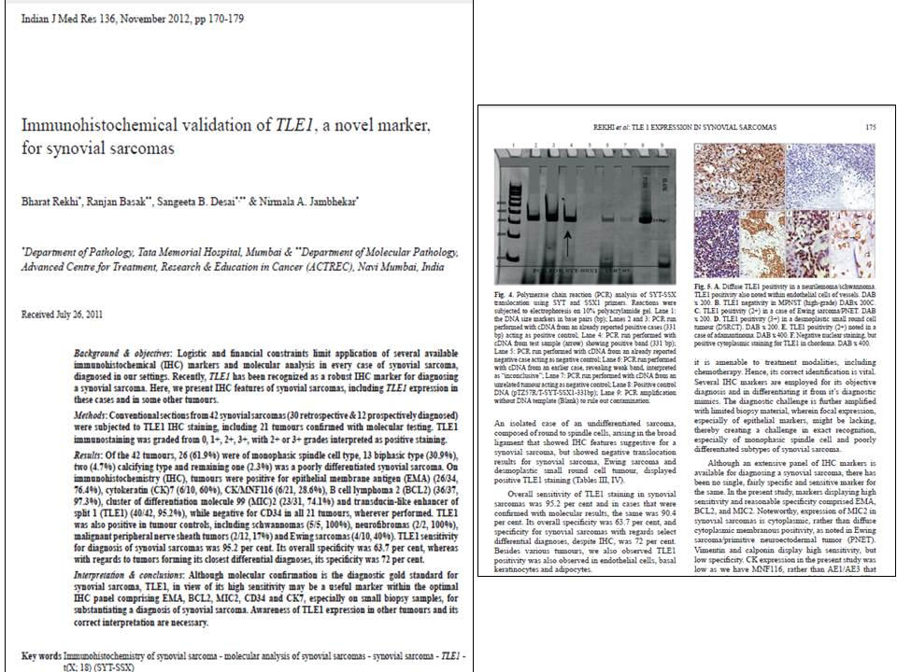

Slide 15
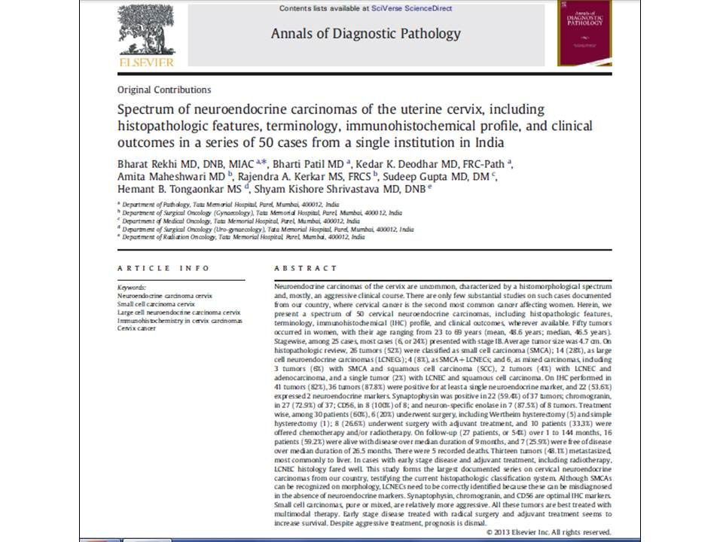

Slide 16
Molecular Biomarkers & Diagnosis Related Journals
Advancements in Genetic Engineering
Journal of Molecular and Genetic Medicine

Slide 17
For Upcoming Conferences
http://www.conferenceseries.com/

Slide 18
OMICS Group Open Access Membership
OMICS publishing Group Open Access Membership enables academic and research institutions, funders and corporations to actively encourage open access in scholarly communication and the dissemination of research published by their authors.
For more details and benefits, click on the link below:
http://omicsonline.org/membership.php

