Slide 1
OMICS Group
OMICS Group International through its Open Access Initiative is committed to make genuine and reliable contributions to the scientific community. OMICS Group hosts over 400 leading-edge peer reviewed Open Access Journals and organizes over 300 International Conferences annually all over the world. OMICS Publishing Group journals have over 3 million readers and the fame and success of the same can be attributed to the strong editorial board which contains over 30000 eminent personalities that ensure a rapid, quality and quick review process. OMICS Group signed an agreement with more than 1000 International Societies to make healthcare information Open Access.
Contact us at: contact.omics@omicsonline.org

Slide 2
OMICS Journals are welcoming Submissions
OMICS Group welcomes submissions that are original and technically so as to serve both the developing world and developed countries in the best possible way.
OMICS Journals are poised in excellence by publishing high quality research. OMICS Group follows an Editorial Manager® System peer review process and boasts of a strong and active editorial board.
Editors and reviewers are experts in their field and provide anonymous, unbiased and detailed reviews of all submissions.
The journal gives the options of multiple language translations for all the articles and all archived articles are available in HTML, XML, PDF and audio formats. Also, all the published articles are archived in repositories and indexing services like DOAJ, CAS, Google Scholar, Scientific Commons, Index Copernicus, EBSCO, HINARI and GALE.
For more details please visit our website: http://omicsonline.org/Submitmanuscript.php

Slide 3
GABA in locus coeruleus in REMS regulation
Presentation for
J. Sleep Dis. Therapy
Birendra N. Mallick
School of Life Sciences, Jawaharlal Nehru University, New Delhi, India
remsbnm@yahoo.com

Slide 4
SLEEP AND WAKING ARE INSTINCT BEHAVIORS AND THEY REPRESENT STATES OF CONSCIOUSNESS
SLEEP IS A REVERSIBLE STATE WHERE CONSCIOUSNESS REMAINS IN A SUBDUED STATE

Slide 5
BASED ON EEG AND EMG
SLEEP-WAKING WAS
OBJECTIVELY CLASSIFIED INTO
AWAKE AND SLEEP
ADDITIONAL PARAMETER,
CLASSICALLY AT LEAST EOG,
HELPED IDENTIFICATION OF
REM SLEEP (REMS)
(PGO AND HIPPOCAMPAL WAVES ALSO HAVE BEEN USED)

Slide 6
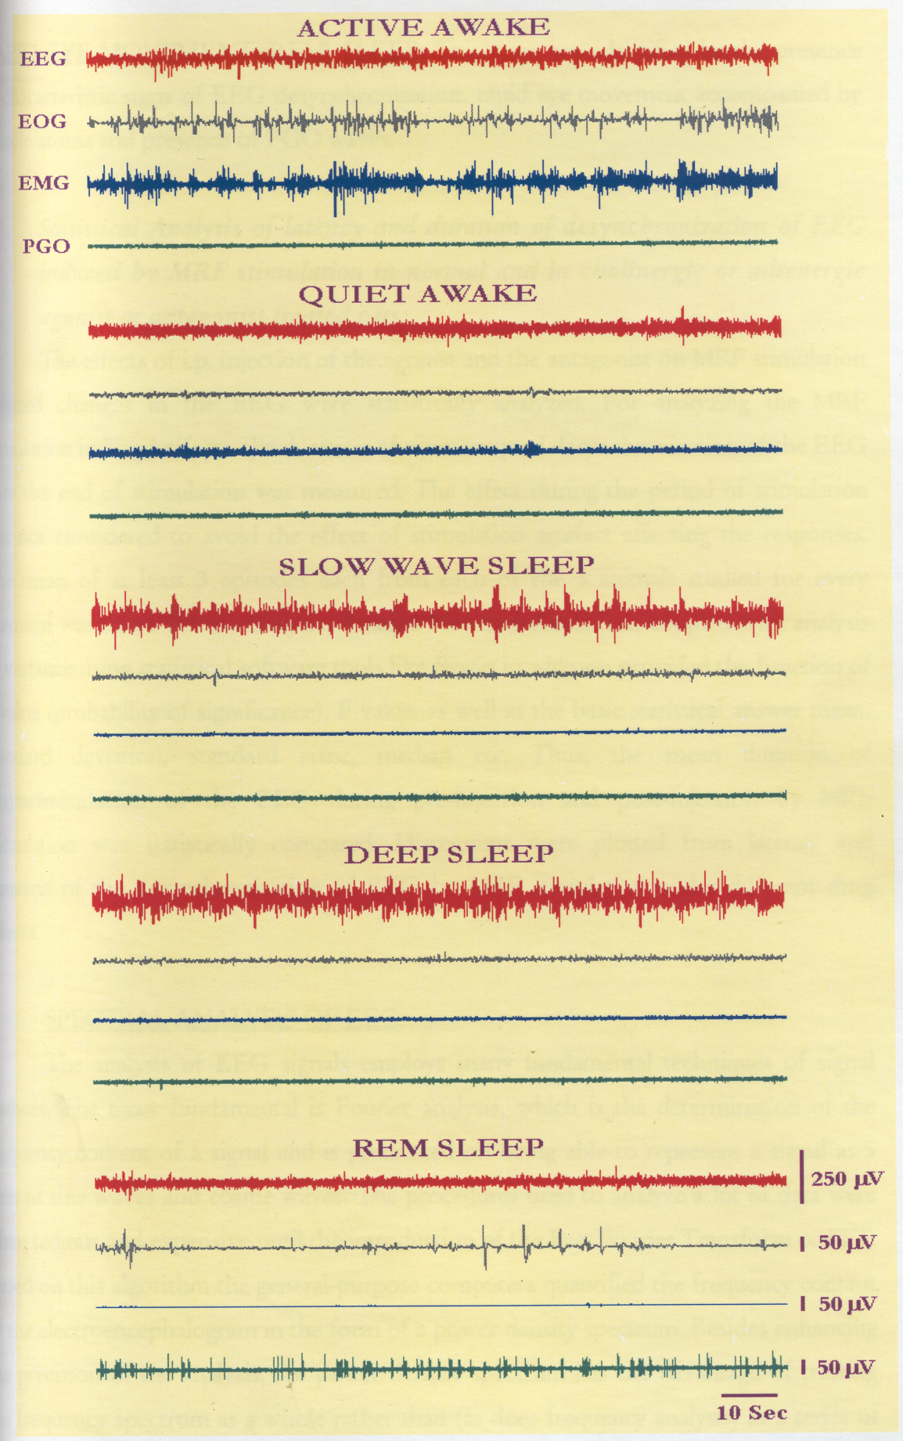
SLEEP-WAKING STAGES IN CAT
Thankachan & Mallick

Slide 7
SLEEP-WAKING STAGES IN RAT
EEG
EOG
Active Wakefulness
EMG
Hipp
Quiet Wakefulness
Slow Wave Sleep 1
Slow Wave Sleep 2
REM Sleep
100µV
25µV
50µV
50µV
Kaur & Mallick
4 Sec

Slide 8
HOW IS REM SLEEP (REMS) REGULATED BY THE BRAIN?
(Neural Regulation of REMS)
Depending on the firing rate of neurons during REMS, in the brain there are
REM-ON neurons (those increasing firing)
and
REM-OFF neurons (those decreasing firing/silent)

Slide 9
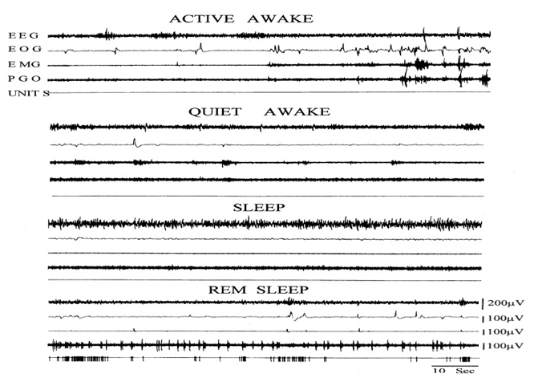
REM-ON NEURON
Mallick et al., Sleep Res. Online, 1998

Slide 10
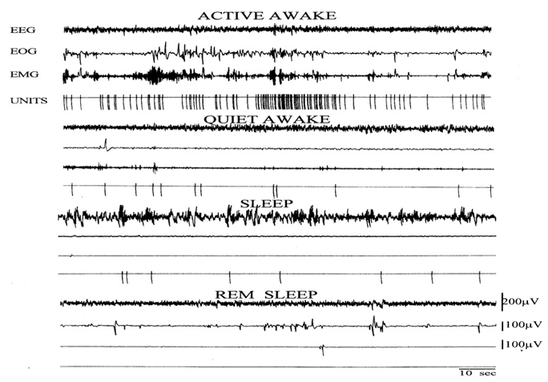
REM-OFF NEURON
Mallick et al., Sleep Res. Online, 1998

Slide 11
Hobson and McCarley, 1974; Sakai, 1980
Based on recording of REM-ON and REM-OFF neuronal activities from isolated, independent studies it was proposed that for REMS
activity of REM-ON neurons inhibit REM-OFF neurons;
acetylcholine from REM-ON neurons inhibit the
Noradrenergic (NA-ergic) REM-OFF neurons

Slide 12
QUESTIONS WE RAISED/ASKED
Is cessation of NA-ergic REM-OFF
neuronal activities in locus coeruleus (LC) a
pre-requisite/pre-condition for REMS generation
or it is an associated phenomenon
Activation of REM-OFF neurons in LC should
not allow REMS to happen
Does acetylcholine inhibit the REM-OFF neurons

Slide 13
REM-OFF NEURON
HYPOTHESIS
Singh & Mallick, Neurosci. Res., 1996
IF LC REM-OFF NEURONS MUST STOP FIRING FOR GENERATION OF REMS
THEIR ACTIVATION IN AN ATTEMPT NOT TO ALLOW THEM TO CEASE FIRING
WOULD CAUSE REMS LOSS OR
AT LEAST WOULD SIGNIFICANTLY
REDUCE REMS

Slide 14
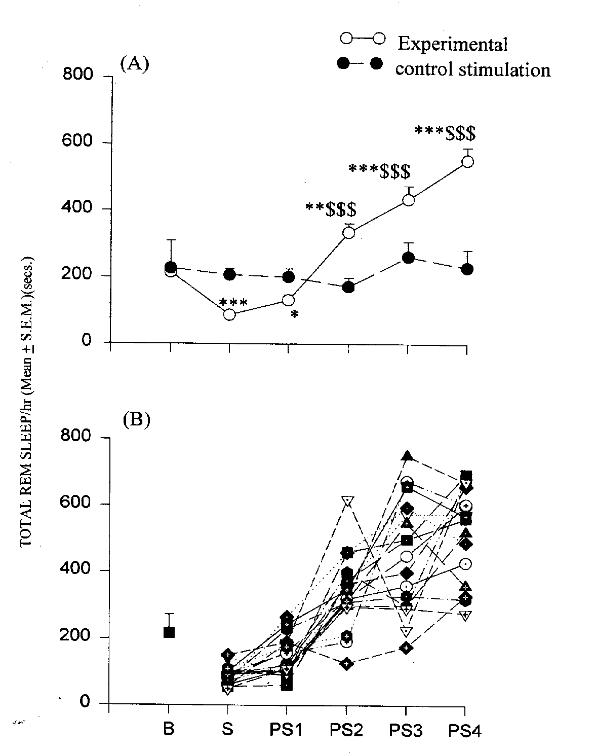
Mild sustained stimulation of LC reduced REMS
Cessation of activities of LC-NA-ergic
REM-OFF neurons is a pre-requisite for the generation of REMS
Singh and Mallick, Neurosci. Res., 1996

Slide 15
Previously, activities of REM-ON and REM-OFF neurons were recorded independently in separate animals,
in isolated experiments on different days.
For confirmation and to understand their temporal correlation, we recorded in freely moving normally behaving, surgically prepared chronic animals,
both REM-OFF and REM-ON neuronal activities simultaneously along with electrophysiological
(EEG, EMG, EOG, PGO) waking-sleep-REMS patterns

Slide 16
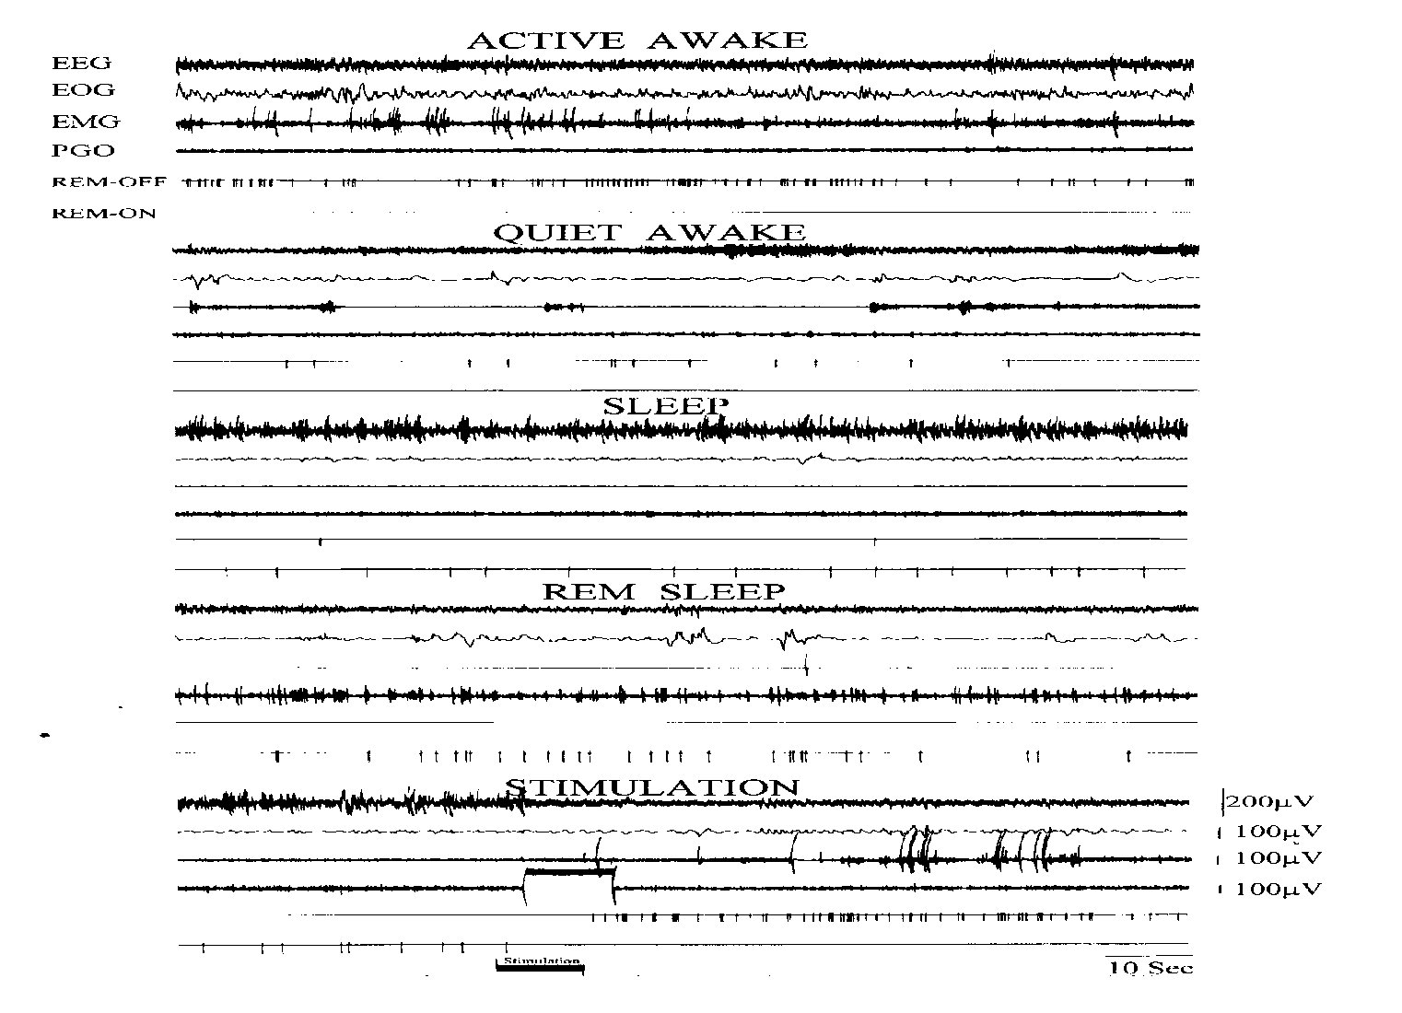
SIMULTANEOUS RECORDING OF REM-OFF AND REM-ON NEURONS
Mallick et al., Sleep Res. Online, 1998
Temporal correlation between REM-ON and REM-OFF neuronal firing

Slide 17
Hobson and McCarley, 1974; Sakai, 1980
REM-OFF NEURONS MUST STOP FIRING FOR REMS GENERATION
BUT HOW ?
in vitro studies showed that
Acetylcholine depolarized LC neurons
i.e. not inhibition (Egan and North, 1985)

Slide 18
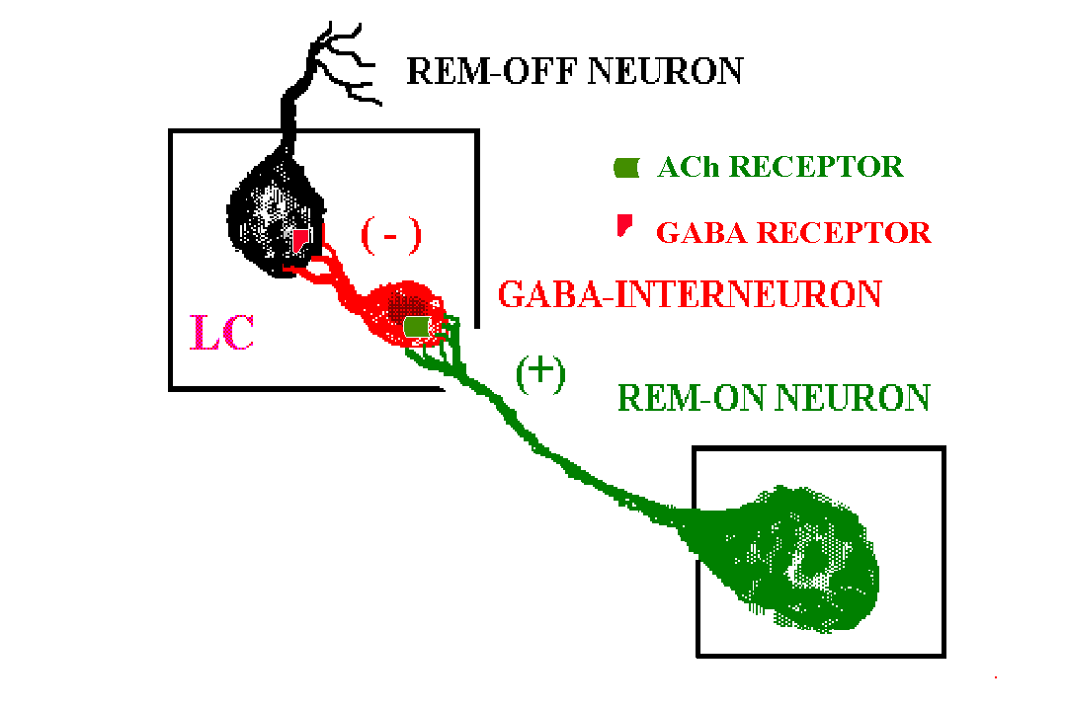
Therefore, it was hypothesized
In LC, excitatory cholinergic input from REM-ON neurons was translated into an inhibition on REM-OFF neurons through GABA interneuron for REMS generation
Mallick et al., Neuroscience, 2001
Challenge was to simultaneously gather information on
Neuro-Micro-Anatomo-Pharmaco-Physiologico-Behavioral aspects
It was overcome by microinjection of agonist/antagonist of one or more types of receptors in LC in various sequence/combination

Slide 20
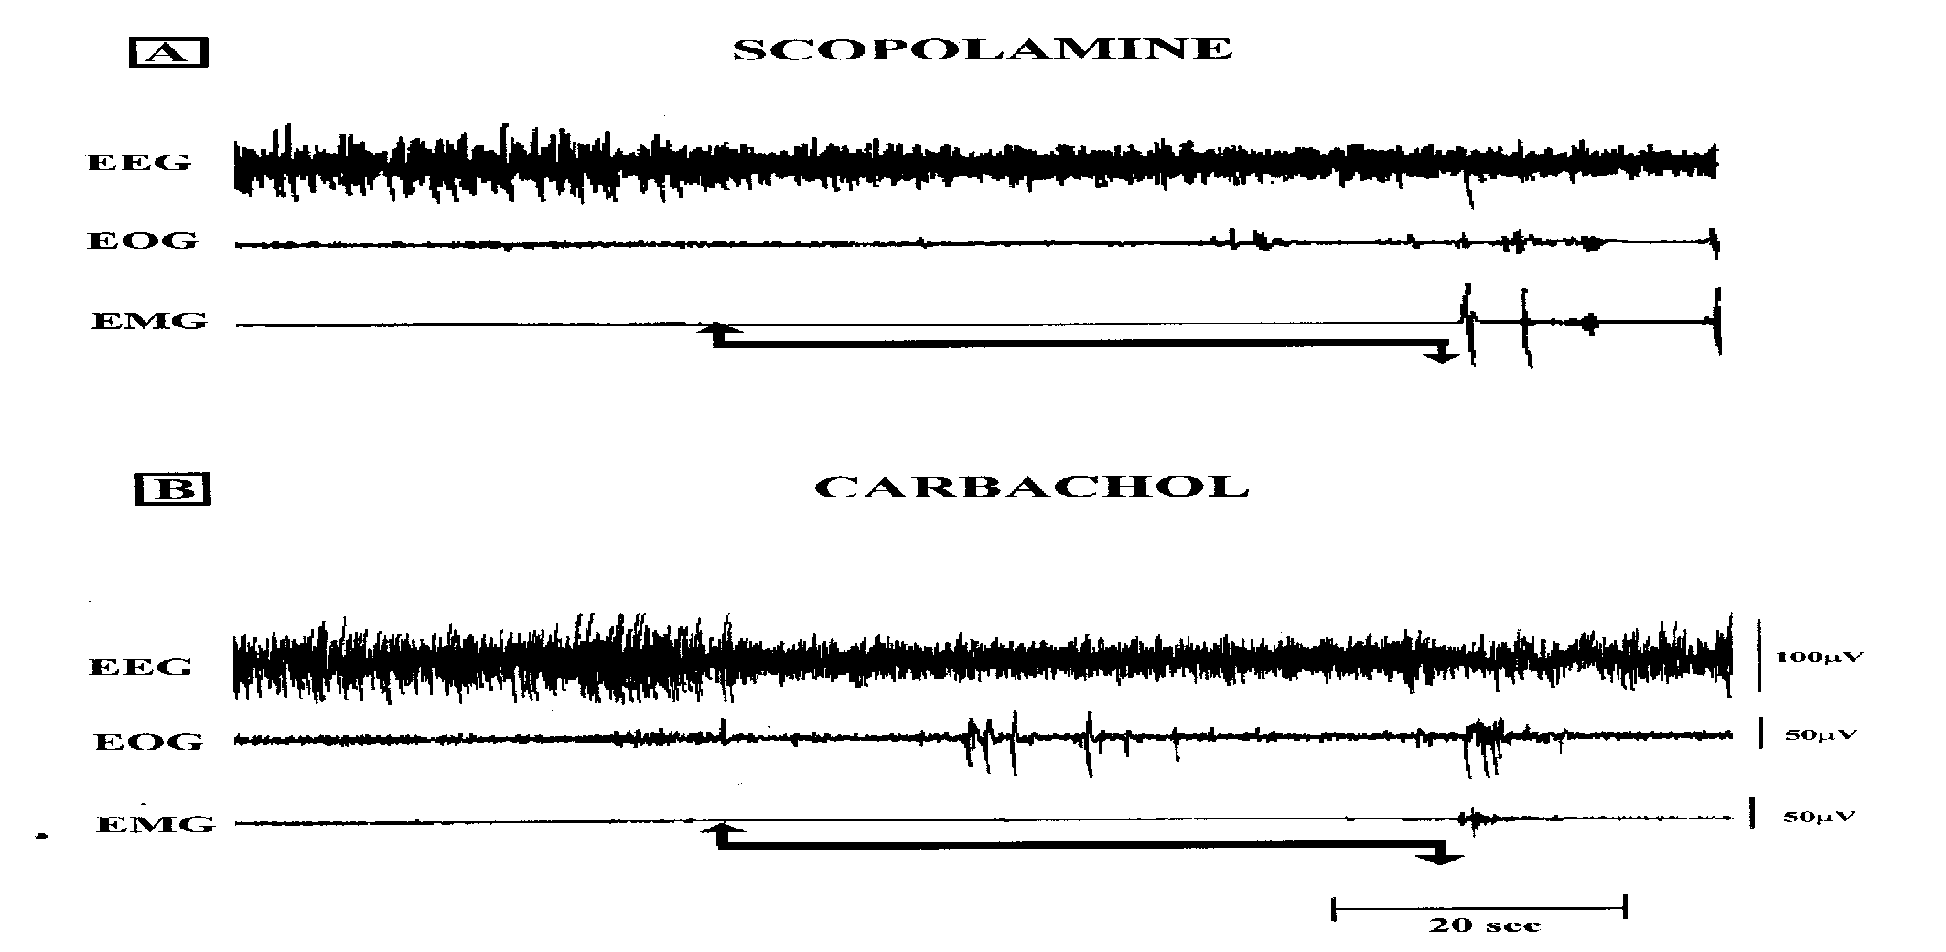
Effect of local microinjection of cholinergic antagonist (scopoloamine)
and agonist (carbachol) bilaterally into the LC on REMS
REMS
Mallick et al., Neuroscience, 2001
REMS
REMS duration per episode was not affected, however,
frequency of REMS generation was increased

Slide 21
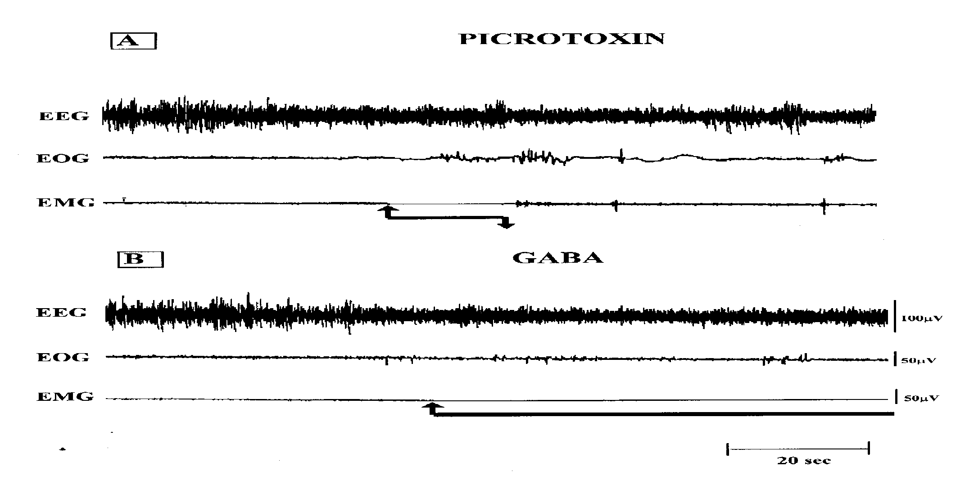
Effect of local microinjection of GABA-ergic antagonist (picrotoxin) and GABA bilaterally into the LC on REMS
REMS
REMS
Mallick et al., Neuroscience, 2001
REMS duration per episode was significantly affected, however, frequency of REMS generation remained unaffected

Slide 22
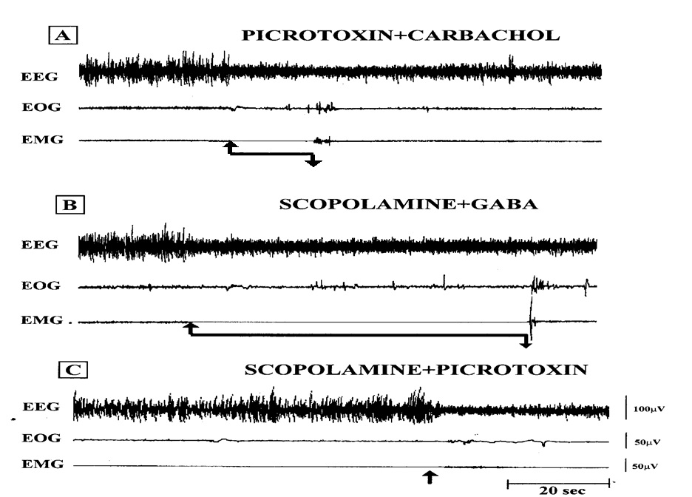
Effect of local microinjection of cholinergic and GABA-ergic antagonist/agonist in various combinations/sequences into the LC on REMS
REMS
REMS
Mallick et al., Neuroscience, 2001
REMS could not be sustained
REMS duration per episode was reduced in (A); it was increased in (B), while in (C) REMS did not continue

Slide 23
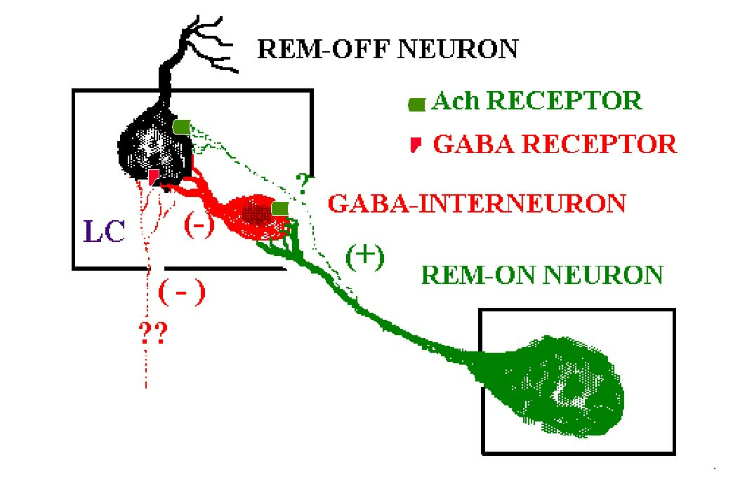
Other inputs
Mallick et al., Neuroscience, 2001

Slide 24
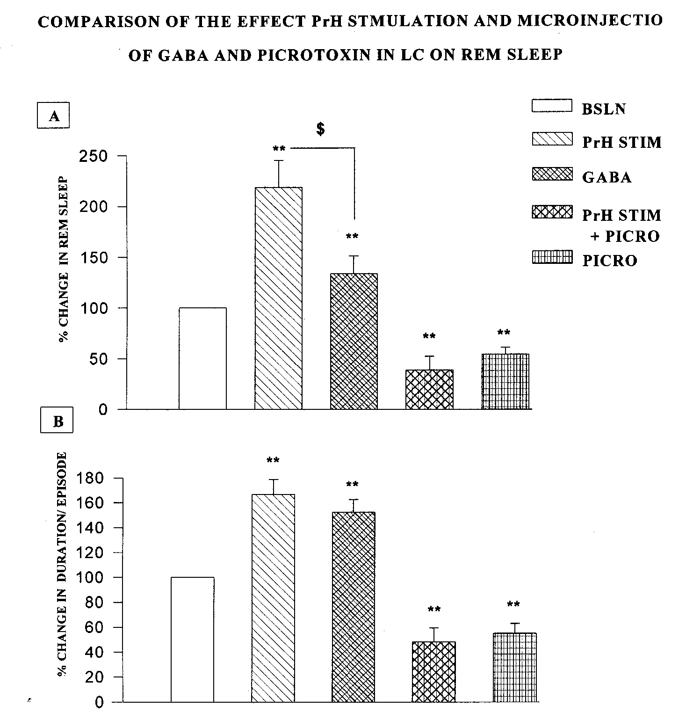
Comparison of the effect PrH Stimulation and microinjection of GABA and Picrotoxin in LC on REM Sleep
Prepositus
hypoglossus
(PrH)
Kaur et al., Synapse, 2001

Slide 25
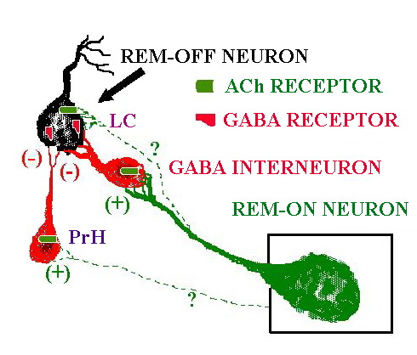
Mallick et al., Neuroscience, 2001 ; and Kaur et al., Synapse, 2001

Slide 26
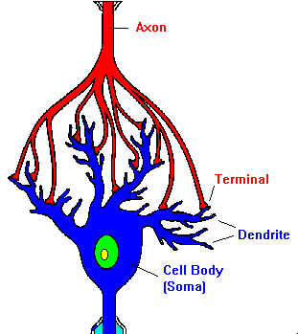
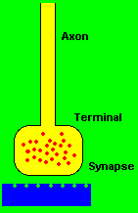
PHYSIOLOGICAL VALIDITY?
HYPOTHESIS
IF THE PROPOSED NEURAL CONNECTIONS ARE EXPERIMENTALLY DISTURBED SO THAT THE NA-ergic LC-REM-OFF NEURONS REMAIN ACTIVE,
REMS SHOULD BE SIGNIFICANTLY REDUCED
AND SIMULTANEOUSLY
REMS LOSS ASSOCIATED SYMPTOMS SHOULD BE EXPRESSED/OBSERVED DUE TO ELEVATED LEVELS OF NA
EVEN IN NORMAL ANIMALS (Contd…)
Mallick et al., Neuroscience, 2001
Neurotransmitter Release

Slide 27
PHYSIOLOGICAL VALIDITY?
HYPOTHESIS
We had already shown that REMSD increased Na-K ATPase activity and it was due to elevated level of noradrenalin (NA) in the brain
(Gulyani & Mallick, Neuroscience, 1995; Mallick et al., J. Neurochem., 2000).
Therefore, we proposed that
GABA-antagonist, picrotoxin, into LC should not allow REM-OFF neurons to cease activity resulting in increased Na-K ATPase activity;
Modulation of Na-K ATPase activity in LC should alter REM-OFF neuronal activity and REMS

Slide 28
Picrotoxin (every 6h) bilaterally into the LC for 48h reduced REMS (A) and increased Na-K ATPase activity (B) significantly
A.
B.
**
20
40
± S.E.M.)
35
15
30
25
μmoles Pi/mg protein/hr + SEM
20
10
Percent time (mean
15
10
5
5
*
0
DS
AW
QA
SWS
REMS
0
Control
Picrotoxin
Baseline
Picrotoxin
Kaur et al., Behav Brain Res. 2003
Kaur et al., Behav Brain Res. 2003

Slide 29
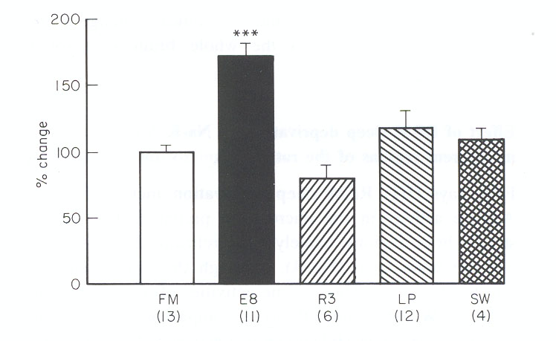
Comparison of Na-K ATPase activity in rat brain
A.
B.
Picrotoxin every 6h into LC
REMSD
20
**
15
10
μmoles Pi/mg protein/hr + SEM
5
0
Control
Picrotoxin
Kaur et al., Behav Brain Res. 2003
Gulyani and Mallick, J. Sleep. Res., 1993
We had confirmed that the REMS loss associated increase in Na-K ATPase activity is actually mediated by elevated level of NA (Gulyani and Mallick, 1995; Mallick et al., J. Neurochem, 2000)

Slide 30
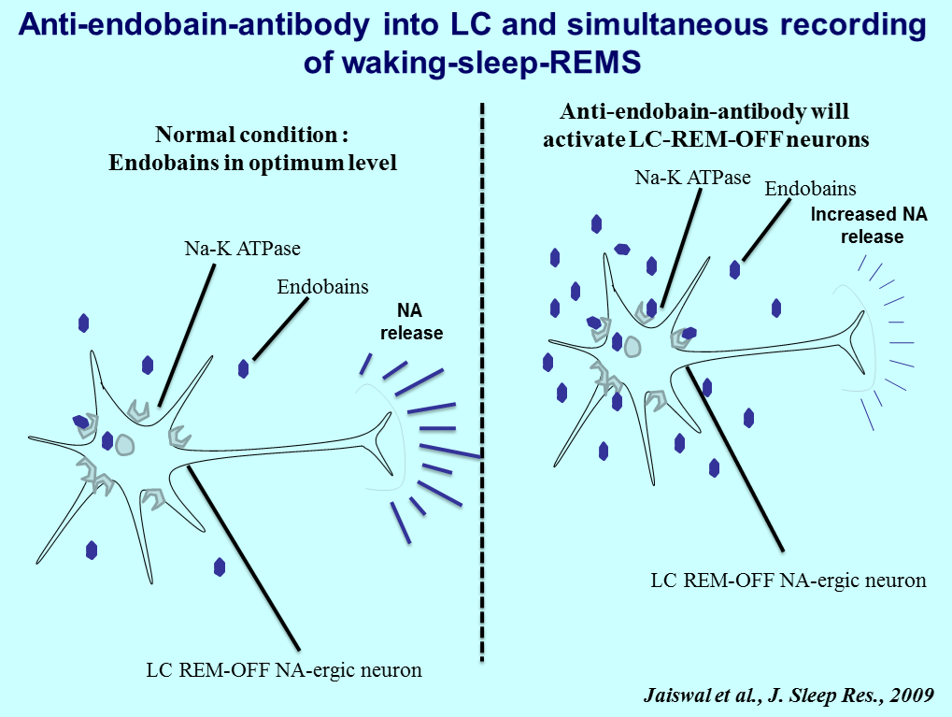

Slide 31
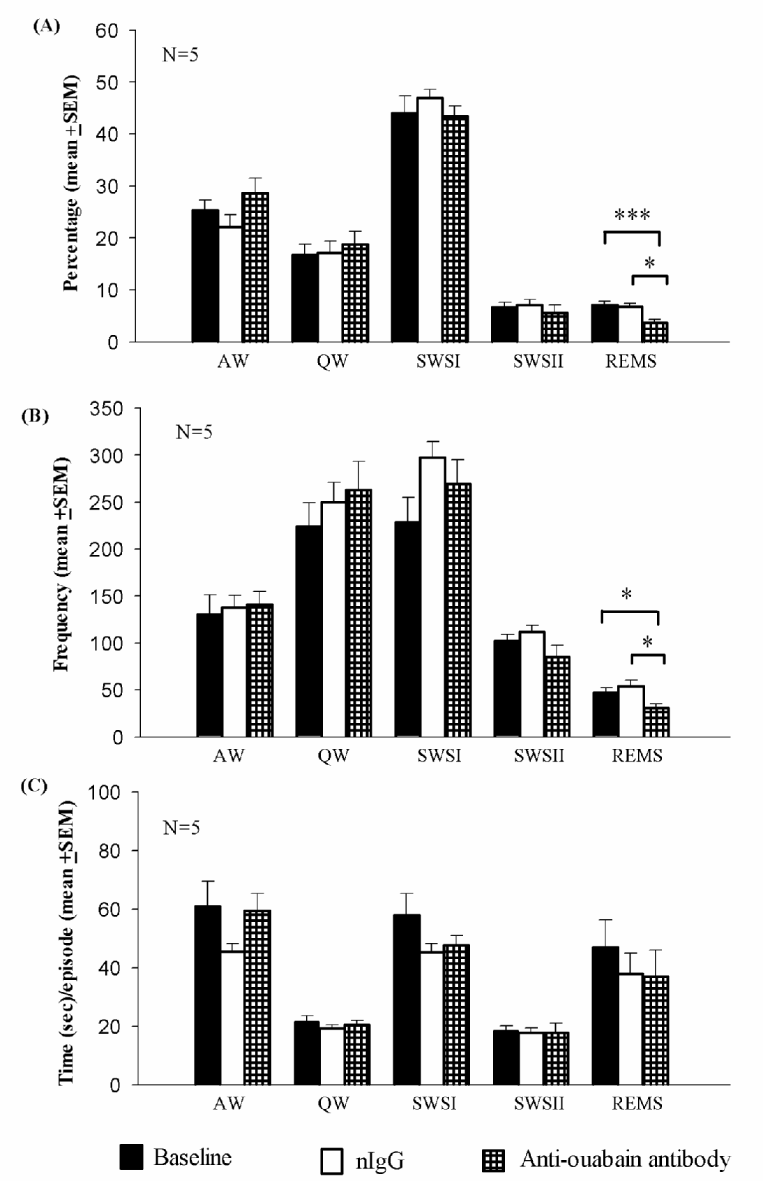
Effect of anti-ouabain antibody into LC on sleep-waking-REMS
Jaiswal et al., J. Sleep Res., 2009

Slide 33
ACKNOWLEDGEMENT
I thank all my co-workers for their contributions in the studies presented here
Funding from the following Indian agencies is acknowledged :
BIOSCIENCE AWARD, CSIR, DBT, DST, ICMR,
J C BOSE FELLOWSHIP, JNU, UGC

Slide 34
Sleep disorders and therapy Related Journals
Alzheimer's Disease & Parkinsonism
Brain Disorders & Therapy

Slide 35
Sleep disorders and therapy Related Conferences
Annual Summit on Sleep Disorders and Medicine August 10-12, 2015 San Francisco, USA
2nd International Conference on Alzheimer's Disease and Dementia September 23-25, 2014 Valencia, Spain

Slide 36
OMICS Group Open Access Membership
OMICS publishing Group Open Access Membership enables academic and research institutions, funders and corporations to actively encourage open access in scholarly communication and the dissemination of research published by their authors.
For more details and benefits, click on the link below:
http://omicsonline.org/membership.php

