Slide 1
OMICS Group
OMICS Group International through its Open Access Initiative is committed to make genuine and reliable contributions to the scientific community. OMICS Group hosts over 400 leading-edge peer reviewed Open Access Journals and organizes over 300 International Conferences annually all over the world. OMICS Publishing Group journals have over 3 million readers and the fame and success of the same can be attributed to the strong editorial board which contains over 30000 eminent personalities that ensure a rapid, quality and quick review process. OMICS Group signed an agreement with more than 1000 International Societies to make healthcare information Open Access.
Contact us at: contact.omics@omicsonline.org

Slide 2
OMICS Journals are welcoming Submissions
OMICS Group welcomes submissions that are original and technically so as to serve both the developing world and developed countries in the best possible way.
OMICS Journals are poised in excellence by publishing high quality research. OMICS Group follows an Editorial Manager® System peer review process and boasts of a strong and active editorial board.
Editors and reviewers are experts in their field and provide anonymous, unbiased and detailed reviews of all submissions.
The journal gives the options of multiple language translations for all the articles and all archived articles are available in HTML, XML, PDF and audio formats. Also, all the published articles are archived in repositories and indexing services like DOAJ, CAS, Google Scholar, Scientific Commons, Index Copernicus, EBSCO, HINARI and GALE.
For more details please visit our website: http://omicsonline.org/Submitmanuscript.php

Slide 3
Dr. Bormin Huang
Space Science Engineering Center
University of Wincosin-Madison
USA

Slide 4
Biography
Dr. Bormin Huang has been serving as a Chair of SPIE Conference on Satellite Data Compression, Communications, and Processing since 2005, and a Chair of SPIE Europe Conference on High-Performance Computing in Remote Sensing since 2011. He is an Associate Editor of the Journal of Applied Remote Sensing (JARS), and serves, or has served, as the Guest Editor of JARS Special Section on "Satellite Data Compression", the Guest Editor of JARS Special Section on "High-Performance Computing in Applied Remote Sensing", and a Guest Editor of Special Issue on "Advances in Compression of Optical Image Data from Space" for the Journal of Electrical and Computer Engineering. He received his MSE in aerospace engineering from the University of Michigan, Ann Arbor, and his PhD in the area of satellite remote sensing from the University of Wisconsin-Madison. He is currently a research scientist and principal investigator at the Space Science and Engineering Center, the University of Wisconsin-Madison, where he advises and supports both national and international MS and PhD students and visiting scientists. He has authored and coauthored over 100 scientific and technical publications, including the Springer book "Satellite Data Compression". He has broad interest and experience in remote sensing science and technology, including satellite data compression, high-performance computing in remote sensing, remote sensing image processing, and remote sensing forward modeling and inverse problems.

Slide 5
Research Interest
Satellite data compression
High-performance computing in remote sensing
Remote sensing image processing
Remote sensing forward modeling
Inverse problems

Slide 6
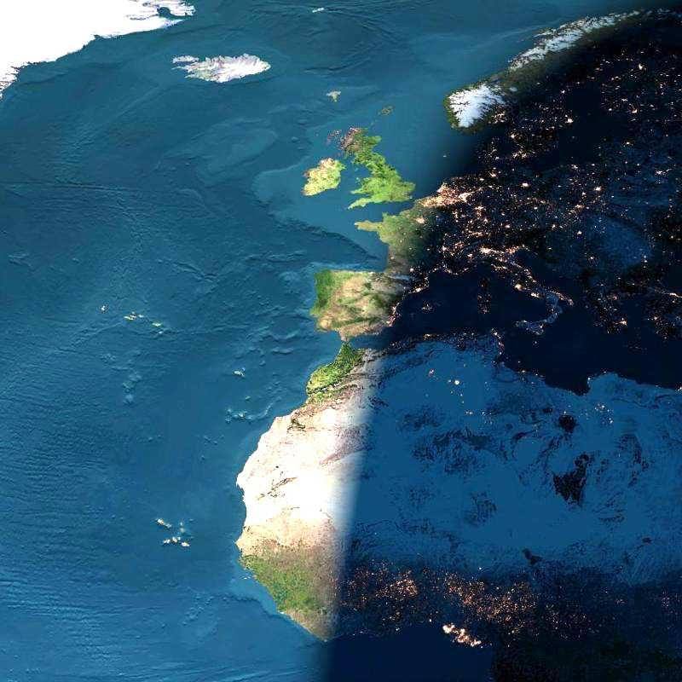
Remote Sensing
REMOTE SENSING is the process of sensing and
measuring objects from
a distance without
physical
contact with them

Slide 7
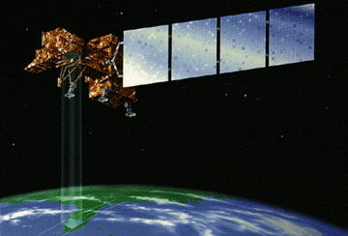
Sensing
Scanning
Characterizing
Classification
Identification/ Quantification
Analysis

Slide 8
REMOTE SENSING
"Remote sensing is the science of acquiring information
about the Earth's surface without actually being in contact
with it. This is done by sensing and recording reflected or
emitted energy and processing, analyzing, and applying
that information."
Three Essential Things for Remote Sensing
Sensor
Object to be sensed
Electro Magnetic Radiation

Slide 9
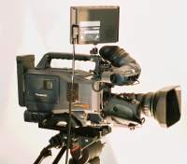
SIX STAGES IN REMOTE SENSING
1
2
4
5 (Film)
4
3
3
6
Stage-1. Source of energy
Stage-2. Transmission of EMR towards the Object
Stage-3. Interaction of EMR with the Object
Stage-4. Transmission of Interacted EMR towards the Sensor
Stage-5. Recording of the Image by the Detector
Stage-6. Analysis of the Imagery
3

Slide 10
Fundamental Principle
Most remote sensing instruments (sensors) are designed to measure photons. The fundamental principle underlying sensor operation centers on what happens in a critical component - the detector. This is the concept of the photoelectric effect This, simply stated, says that there will be an emission of negative particles (electrons) when a negatively charged plate of some appropriate light-sensitive material is subjected to a beam of photons. The electrons can then be made to flow from the plate, collected, and counted as a signal. A key point: The magnitude of the electric current produced (number of photoelectrons per unit time) is directly proportional to the light intensity. Thus, changes in the electric current can be used to measure changes in the photons (numbers; intensity) that strike the plate (detector) during a given time interval.

Slide 11
Types of RS system
Active RS system
Passive RS system
Artificial Energy source
Natural Energy source
e.g.sensors on satellites Landsat,SPOT
e.g. radar systems
SLAR,SAR

Slide 12
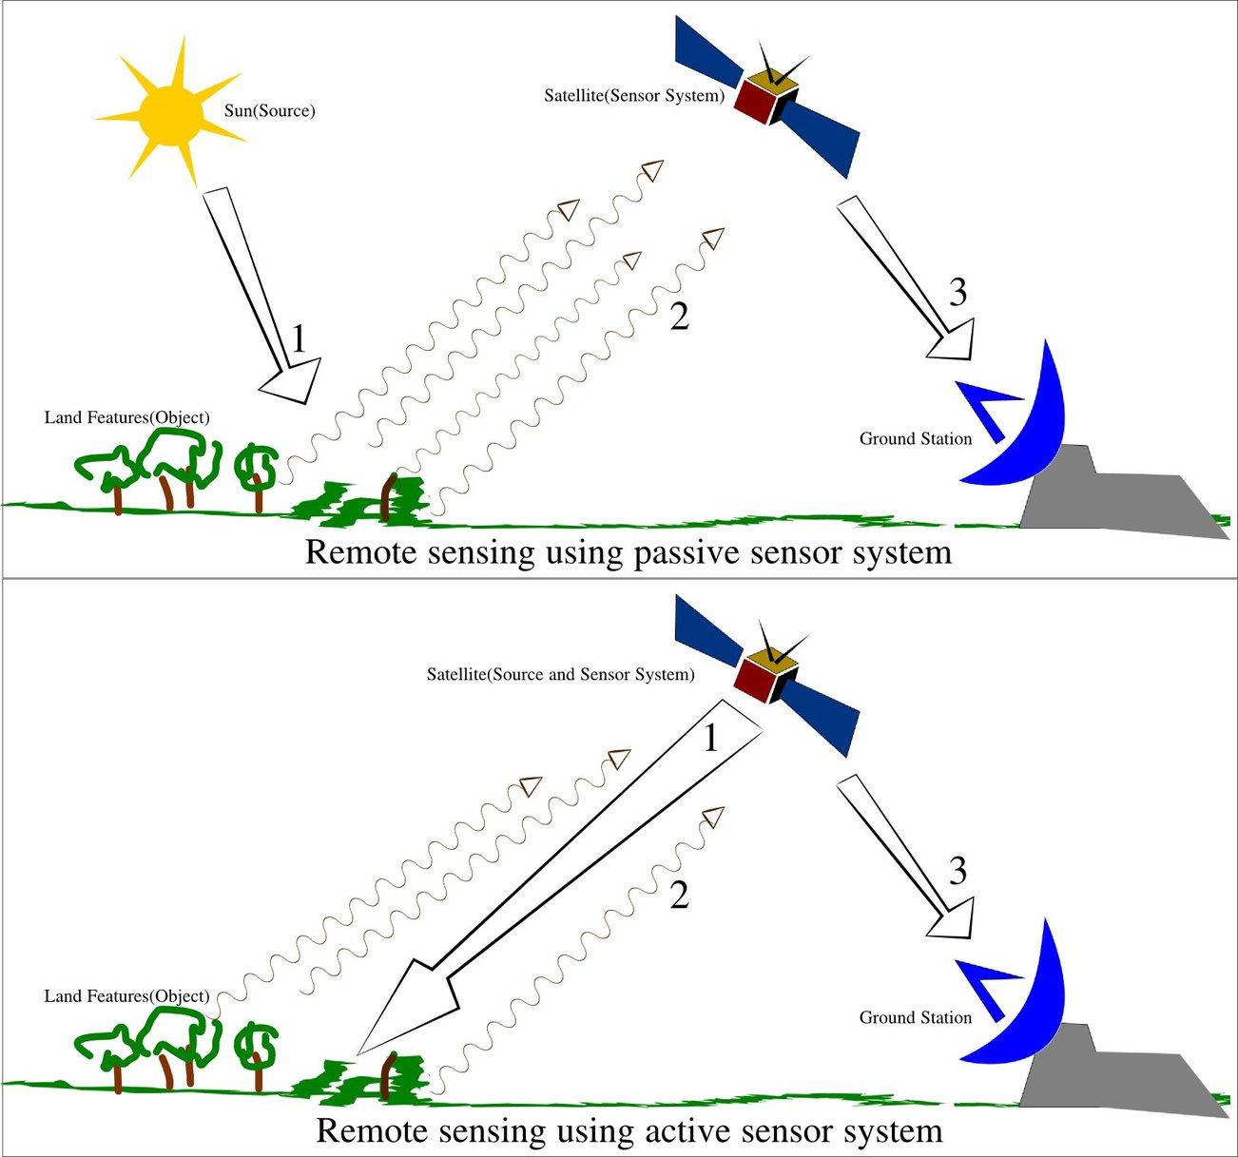

Slide 13
Sensor Detection
Passive Detection
Sensors measure levels of energy that are naturally emitted, reflected, or transmitted by the target object.
Passive sensors are those which detects naturally occurring energy. Most often, the source of radioactive energy is the sun.
Detection of reflected solar energy, for example, can only proceed when the target is illuminated by the sun, thus limiting visible light sensors on satellites from being used during a nighttime pass.
The Thematic Mapper, the primary sensor on the Landsat satellites, is a good example of a passive sensor.

Slide 14
2. Active detection
Active Sensors provide their own energy source for illumination of the target by directing a burst of radiation at the target and use sensors to measure how the target interacts with the energy.
Most often the sensor detects the reflection of the energy, measuring the angle of reflection or the amount of time it took for the energy to return.
Active sensors provide the capability to obtain measurements anytime, regardless of the time of day or season.
They can be used for examining energy types that are not sufficiently provided by the sun, such as microwaves, or to better control the way a target is illuminated. However, active systems require the generation of a fairly large amount of energy to adequately illuminate targets.
Doppler radar is an example of an active remote sensing technology.

Slide 15
IMAGING SENSORS
Sensors which provide output to create an image
Eg : LISS I,LISS II, LISS III etc.
NON IMAGING SENSORS
Sensors which provide numerical output with respect to the quantum of radiation
Eg: Radiometer,Scatterometer etc.

Slide 17
Applications of Remote Sensing
Coastal water mapping, soil/vegetation discrimination, forest classification, man-made feature identification
Vegetation discrimination and health monitoring, man-made feature identification
Plant species identification, man-made feature identification
Soil moisture monitoring, vegetation monitoring, water body discrimination
Vegetation moisture content monitoring
Surface temperature, vegetation stress monitoring, soil moisture monitoring, cloud differentiation, volcanic monitoring
Mineral and rock discrimination, vegetation moisture content

Slide 18
OMICS Group
OMICS Group International through its Open Access Initiative is committed to make genuine and reliable contributions to the scientific community. OMICS Group hosts over 400 leading-edge peer reviewed Open Access Journals and organizes over 300 International Conferences annually all over the world. OMICS Publishing Group journals have over 3 million readers and the fame and success of the same can be attributed to the strong editorial board which contains over 30000 eminent personalities that ensure a rapid, quality and quick review process. OMICS Group signed an agreement with more than 1000 International Societies to make healthcare information Open Access.
Contact us at: contact.omics@omicsonline.org

Slide 19
OMICS Journals are welcoming Submissions
OMICS Group welcomes submissions that are original and technically so as to serve both the developing world and developed countries in the best possible way.
OMICS Journals are poised in excellence by publishing high quality research. OMICS Group follows an Editorial Manager® System peer review process and boasts of a strong and active editorial board.
Editors and reviewers are experts in their field and provide anonymous, unbiased and detailed reviews of all submissions.
The journal gives the options of multiple language translations for all the articles and all archived articles are available in HTML, XML, PDF and audio formats. Also, all the published articles are archived in repositories and indexing services like DOAJ, CAS, Google Scholar, Scientific Commons, Index Copernicus, EBSCO, HINARI and GALE.
For more details please visit our website: http://omicsonline.org/Submitmanuscript.php

Slide 20
Geophysics & Remote Sensing
Related Journals
ISPRS Journal of Photogrammetry and Remote Sensing
IEEE Transactions on Geoscience and Remote Sensing
Applied Earth Observation and Geoinformation
Photogrammetric Engineering and Remote Sensing

Slide 21
Geophysics & Remote Sensing
Related Conferences
International Conference on Earth Science & Climate Change
Asian Conference on Remote Sensing
International Conference on Remote Sensing in Archaeology
International Conference on Remote Sensing
IEEE Conference on Aerospace and Remote Sensing Technology

Slide 22
OMICS Group Open Access Membership
OMICS publishing Group Open Access Membership enables academic and research institutions, funders and corporations to actively encourage open access in scholarly communication and the dissemination of research published by their authors.
For more details and benefits, click on the link below:
http://omicsonline.org/membership.php

