Slide 1
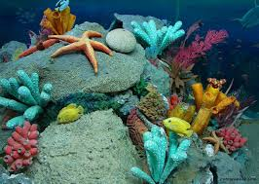
Journal of Oceanography
Dr. Brad de Young
Editorial Board member
Professor Department of Physics and Physical Oceanography Memorial University Canada

Slide 2
Biography
Dr. Brad de Young
Brad deYoung received a BSc in Chemistry and Physics from Memorial University in 1977, an MSc in Physical Oceanography from Memorial in 1983 and a PhD in Physical Oceanography from the University of British Columbia in 1986.
He has worked in environmental consulting and was a postdoctoral fellow at the Bedford Institute of Oceanography.
He has been a faculty member at Memorial University since 19888 where he is a Professor and holds the Captain Robert A. Bartlett Chair in Oceanography.
He is an oceanographer who has worked for more than thirty years on ocean dynamics and coastal ocean ecology.
He has worked on the development of new sampling techniques, such as ocean gliders and cabled observatories, and in the coupling of biological and physical models for improving our understanding of the influence of circulation on marine organisms.
He has worked on the challenges of coupling biological and physical models and in the application of oceanography to improving our ability to ocean management

Slide 3
Research Interests
Physical oceanography
Coastal oceanography
Ocean ecology
Fisheries oceanography
Numerical modeling
Climate change
Northwest Atlantic oceanography
Recent Publications
Bay-scale patterns in the distribution, aggregation and spatial variability of larvae of benthic invertebrates,A Metaxas, B deYoung - MARINE,2014 - INTER-RESEARCH NORDBUNTE

Slide 4
Fisheries
Fishing makes its greatest contribution to the economy when it is harvested as a food source.
This is the commercial fishery
Fisheries is today defined as one of the largest threat to global marine ecosystems
Aquaculture is the worlds fastest growing food sector - and further growth is expected
Important economic sectors in the Nordic countries
Sectors with significant impact on the marine environment

Slide 5
Fishery cont.
It is estimated that over 100 million people in developing countries depend on the fishery for their livelihood
In recognition of the fact that all fish species are a part of the oceans food chains, sustainable use is beginning to be promoted.

Slide 6
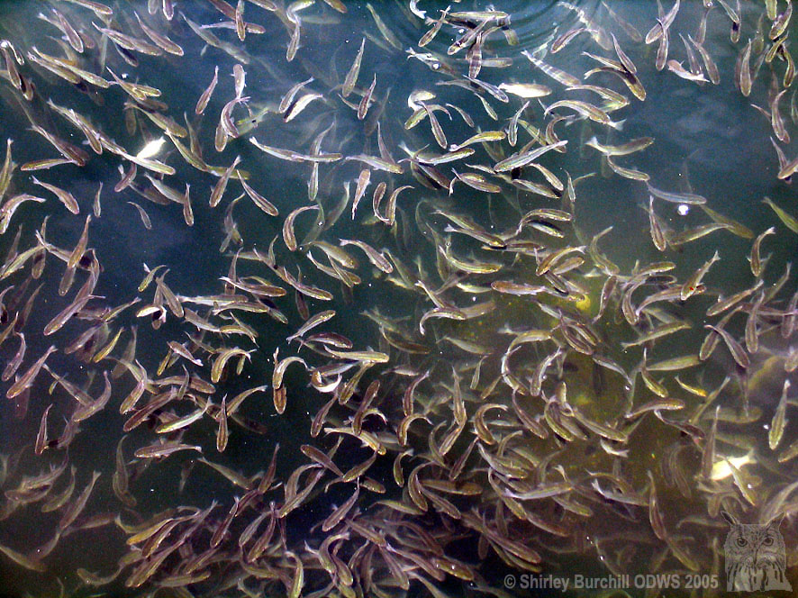
A balance is needed to so that one species does not outstrip the food supply available to the system as a whole.
When humans harvest fish resources, however, there is a risk of overexploitation and a consequent disruption to the balance of nature.

Slide 7
The 4 major fishing regions are:
North east Atlantic (England/Norway);
North west Pacific (Japan);
West central Pacific (China/Indonesia);
South east Pacific (Western South America)

Slide 8
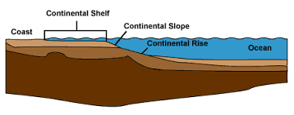
Continental Shelves
Most fishing grounds are found on continental shelves for 2 reasons.
The shallow waters of the self make harvesting more cost effective. The fish have to be landed on shore for human use so the regions closer to shore are fished most profitably.
Most of the fish are on the continental shelves. The shallow waters of the shelf promote plankton production which serve as the base of the marine food web including fish.
Shallow water ensures enough light for phytoplankton and effective circulation of nutrients.

Slide 9
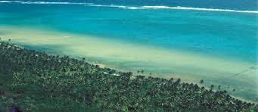
The coastal zone - biodiversity & human activities
Fish, plants, kelp, shell, crusteceans, mammals, sand, minerals, birds etc.
Fishing, fish farming, fish processing, transportation, wood processing, ship building, large industry etc.
Recreation, protection of habitats and species

Slide 10
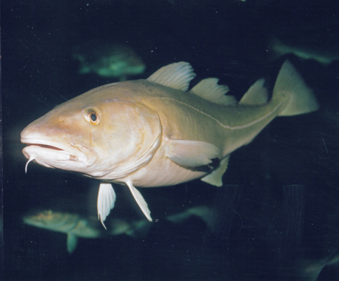
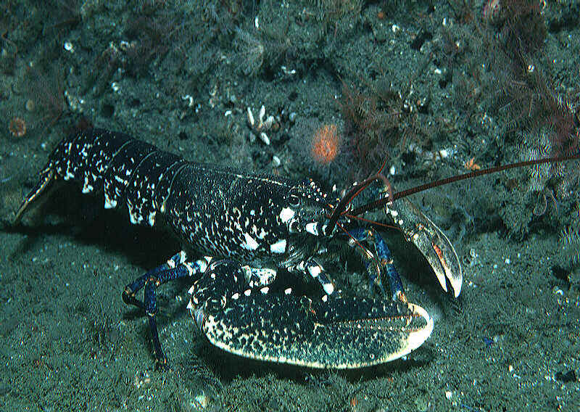
Status of some coastal fish
The sad story of cod..
Globally, catches have gone down by 70% the last 30 years. Today, Norway, Russia and Iceland manage the last, large, remaining stocks..

Slide 11
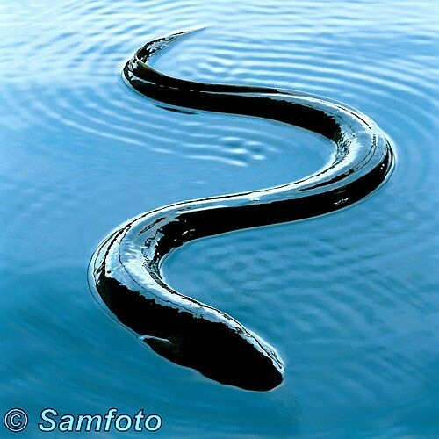
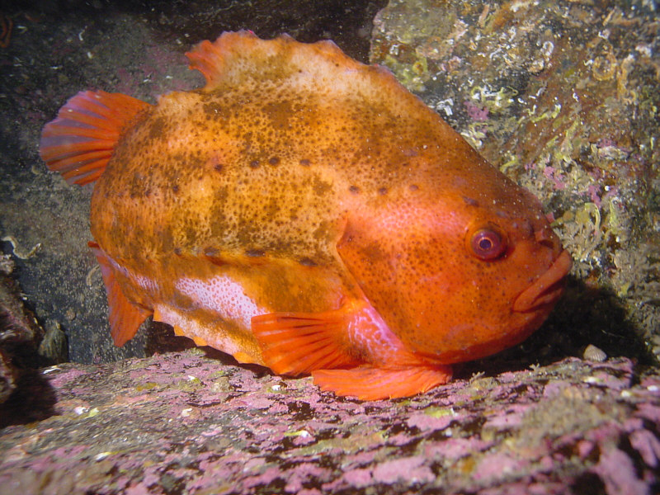
Other fish species that might be relevant?
Lumpfish
Anglerfish
European eel
Golden redfish
Ling, Blue ling, Tusk
- And spawning area for herring and capelin!

Slide 12
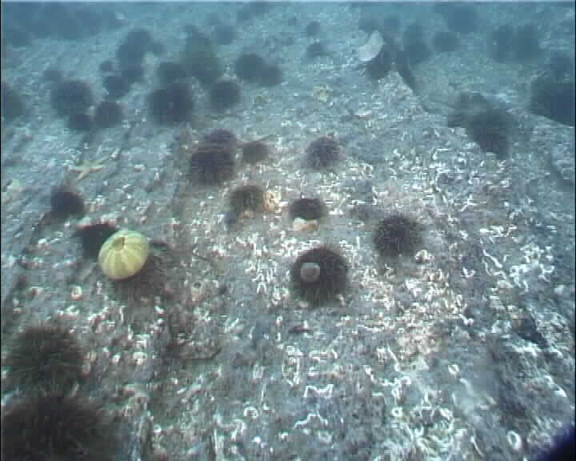
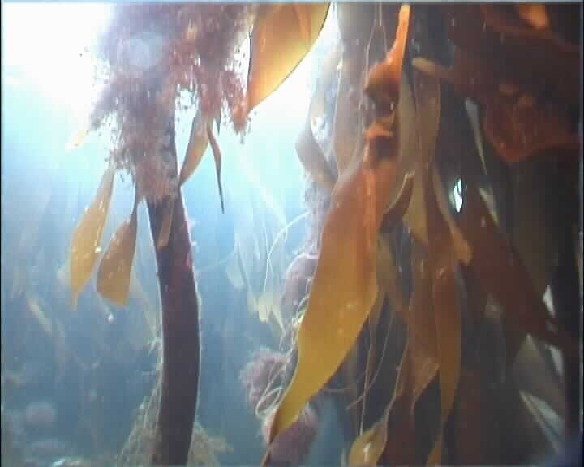
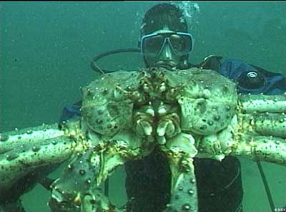
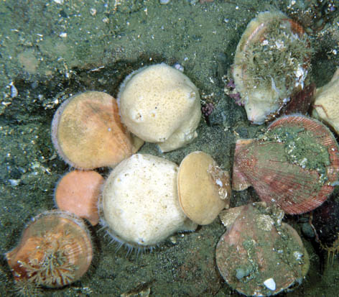
Other species present in coastal areas…
Iceland Scallop
European lobster
Knotted wrack & large kelp
Crab & Norway lobster
Shrimp
Sea urchin
Red king crab
Nordisk idéverksted, Finnøy 24 mai 2004

Slide 13
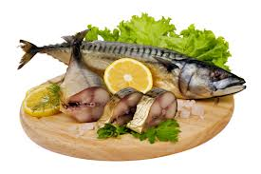
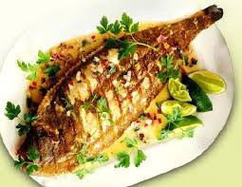
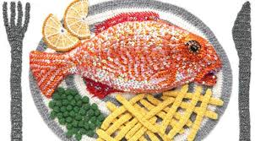
Fish as a source of food
Fish is a highly recommended food item for any balanced diet because it is protein rich.
However, the amount of fish consumed depends on where you are in the world

Slide 14
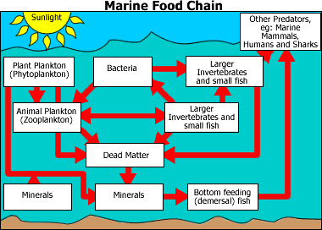

Slide 15
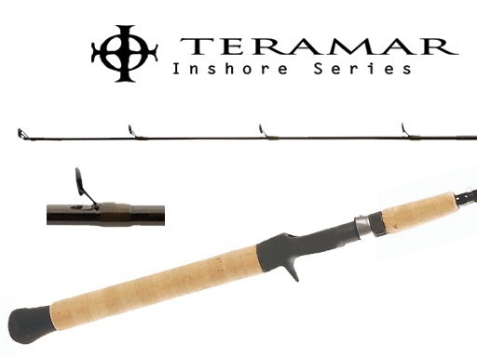
Technology and fishing activity Inshore
In Atlantic Canada most boats are under 25m in length and are owner operated.
They most commonly stay within 20 kms of shore.
Boats have a limited capacity and little refrigeration.
Return to port each day to off load catch.

Slide 16
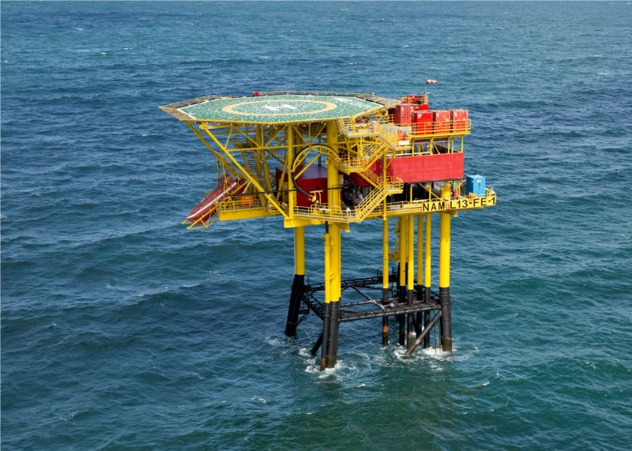
Offshore
More capital intensive and less labour intensive. It accounts for over 40% of the catch but only 20% of the workers.
Vessels are large (35-45m) and are normally owned by large companies.
Vessels have a large refrigeration capacity

Slide 17
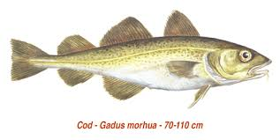
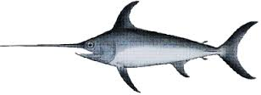
2 categories of fish
Demersal: live on or near the ocean floor (cod, halibut, flounder, hake, shrimp, and shelfish)
Pelagic: tend to congregate in schools near the ocean surface (herring, anchovies, salmon, mackerel, and tuna)

Slide 18
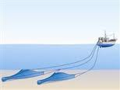
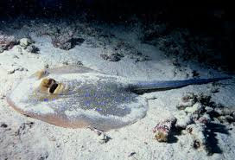
Gear used in Demersal fishery
1. Otter Trawl - also known as dragging.
A large net is dragged along the bottom. Over the past several years there has been a growing concern about the impact that intensive trawling and/or dredging activities have on the habitat on the sea bottom.

Slide 19
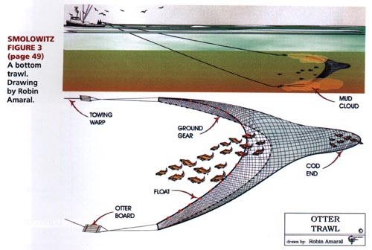
http://www.fishingnj.org/diaotter.htm

Slide 20
2. Long line or baited hook - a commercial fishing technique that uses hundreds or even thousands of baited hooks hanging from a single line.
http://www.birdsaustralia.com.au/albatross/images2/bottom_big.jpg

Slide 21
3. Gill nets – Fish try to swim through deliberately sized mesh openings in a hanging net but are unable to squeeze through. They are prevented from backing out due to the tendency for their gills to become caught. This effectively traps them.

Slide 22
4. Other devices include fish traps for species such a crab and lobster.
http://www.brassbinnacle.com/Merchant2/images-sep2003/102_0211-lg.jpg

Slide 23
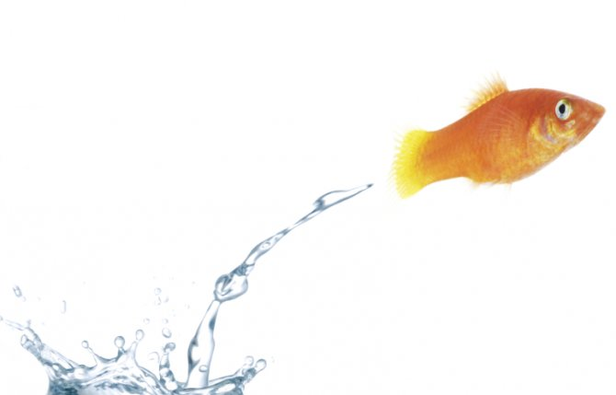
Escaped fish
Escaped farmed fish can give long term negative effects as offspring have shown lower survival rate
Escaped fish can be a carrier of sealice and can spread lice to wild fish and reinfect farms
Escaped fish can compete with wild fish for food and habitat
Escape numbers is NOT a good indicator of environmental impact as it says nothing about survival rate or where the escaped fish go. In addition there are indications of significant underreporting of escapes.
Amounts of escaped fish in fjords, coastal areas and in rivers are better indicators of environmental performance and should be monitored in fjords and rivers with important salmon runs or seatrout stocks.

Slide 24
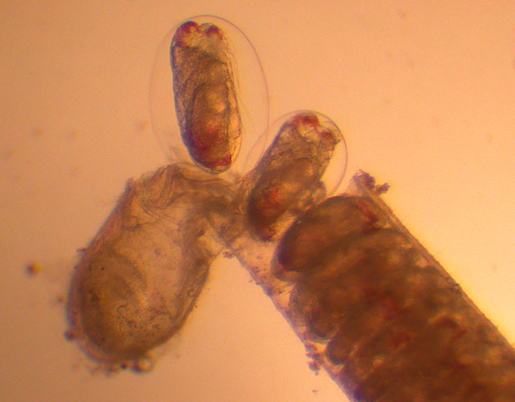
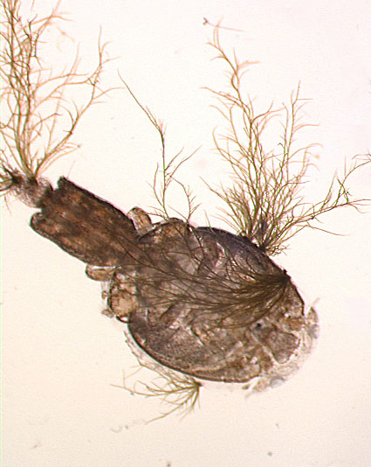
New marine species - New environmental challenges
“To open a cod is like entering a microscopic zoo”
- No generation separation
- Escape attitude
- Local cod stocks are already in strong decline
- No knowledge of possible genetic interactions
- Regulations are not sufficient (fallowing, exclusion zones)

Slide 25
According to Young’s research ,
Improving our ability to sample the ocean is crucial for learning new things about the ocean.
I have been working with coastal observatories for a few years now and am presently working on integrating new sensor systems on gliders so that we can obtain better measurements in coastal waters in general and in ice-covered waters in particular.
The challenge of working under ice is navigation.
How do we know where the sampler is under ice when it cannot get to the surface to get a GPS fix?
We are presently funded to develop acoustic navigation and communication systems that will fundamentally change our ability to work in ice-covered regions.
Our interest in ice-cover began with work in Jakobshavn in Greenland a few years ago but continues given the many applications in the Northwest Atlantic and the Arctic.

Slide 26
Future Research
As always there are various new projects underway or under consideration.
We are presently applying for funding to expand our glider funding.
We will be working on the navigation and sensor integration over the next couple of years with field testing to begin in the next year or so.
We are also working on a vehicle to make ice and iceberg measurements in unattended mode.
There is a recently funded national marine environmental prediction program in which we are interested in developing a smart profiling buoy that will monitor shelf conditions at a fixed location without drifting away.
This project will pose some interesting technical and oceanographic challenges.
We are now developing plans for some new oceanographic sampling in Lake Melville and applying a high-resolution coastal model that includes sea-ice.
I have been working with colleagues in Spain on the carbon sequestration in coastal waters, looking at a particular site on the Spanish coast where we will be collecting regular survey data and interpreting the results of coastal models to determine how circulation moves carbon off the shelf and nutrients up onto the shelf.

Slide 27
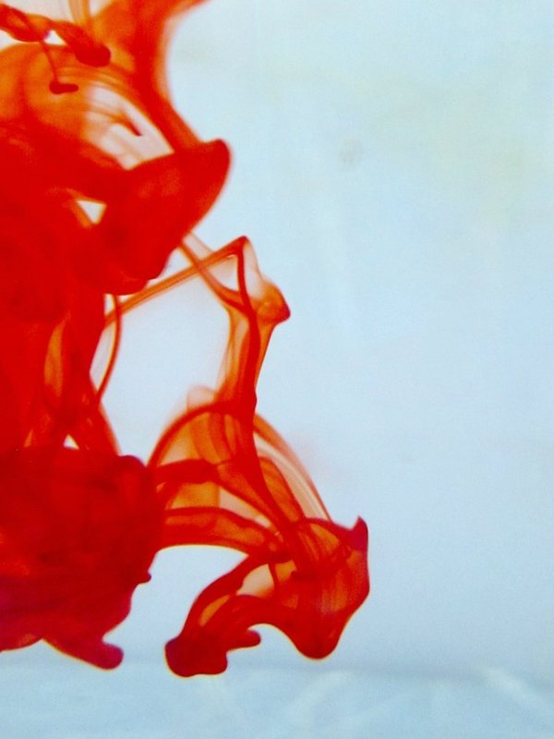
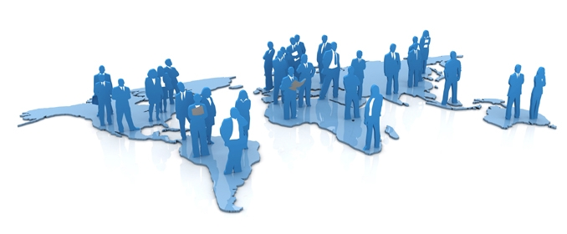
OMICS International Open Access Membership
OMICS International Open Access Membership enables academic and research institutions, funders and corporations to actively encourage open access in scholarly communication and the dissemination of research published by their authors.
For more details and benefits, click on the link below:
http://omicsonline.org/membership.php

