Slide 1
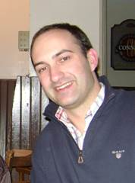
Bruno Sarmento
EB PPT

Slide 2
BIOGRAPHY
PhD in Pharmaceutical Technology and degree in Pharmaceutical Sciences, University of Porto, Portugal; Affiliated Researcher at Institute of Biomedical Engineering (INEB), Porto, Portugal; Assistant Professor of Pharmaceutical and Biopharmaceutical Technology at ISCS-N, Gandra, Portugal. His current research is focused on the study of nanomedicines e.g., polymer-based nanoparticles, solid lipid nanoparticles and polymeric micelles, and their application in the pharmaceutical and biomedical fields, as well as on the use of in vitro cell models as a tool to correlate the transport of biopharmaceuticals and nanoparticles across human intestinal mucosa. He is internationally recognised has an expert on oral delivery of biopharmaceuticals through nanomedicines. In this field he authors several publications, some are key references in the area, being pioneer of polymeric and solid lipid nanoparticles for intestinal delivery of insulin.
His work has been successful, with more than 100 publications in less than 8, 3 edited books in the field of Pharmaceutical Technology and Nanomedicine, 26 book chapters and more than 150 conference proceedings/abstracts and serves as editorial board member of several international journals and evaluator of research projects form international agencies. Further is work as research scientist in various research projects and Professor, he is also supervisor of many PhD (18), postdoctoral (4) and master students (more than 15). He is also an active member of several international associations (AAPS, CRS, EUFEPS, EFSD, FIP, BRG) and collaborates in post-graduate programs at national and international level on the field of biotechnology and health. He has a strong list of national and international collaborations in the areas of controlled drug delivery, nanomedicine and tissue engineering.

Slide 3
RESEARCH INTEREST
Development of new drug delivery systems using colloidal nanoparticles Therapeutic polymers for drug delivery Therapeutic polymers as new targeted cancer systems Methods of micro and nanoencapsulation of biotech drugs Biosimilars Physical and chemical characterization of pharmaceutical dosage forms (DSC, FTIR, CD, PCS, LDA, SEM, TEM, AFM, HPLC, UV) Structural characterization of proteins In vitro and in vivo models of drug bioavailability through gastrointestinal barrier Cell-culture models for drug absorption studies In vitro and in vivo models of drug bioavailability Biomaterials Cell-material interaction Advanced Light Microscopy and Flow Cytometry.

Slide 4
HPLC

Slide 19
Pharmaceutical Regulatory Affairs Journal Related Conferences
For further details regarding the conference please visit
http://www.conferenceseries.com/pharmaceutical-sciences-meetings/

Slide 20
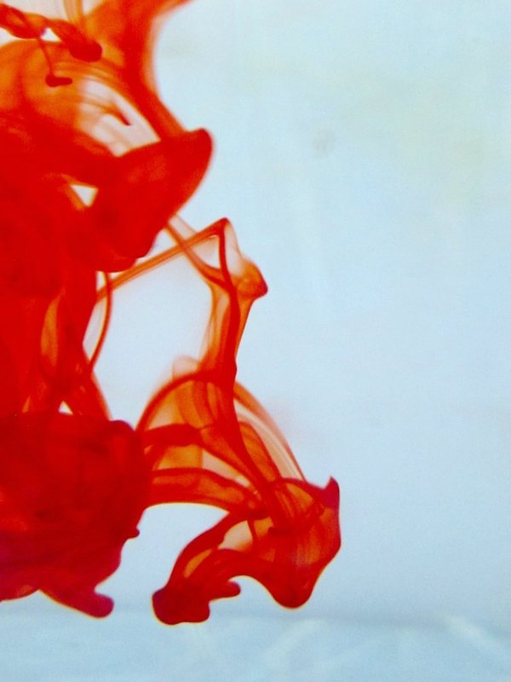
OMICS International Open Access Membership
Open Access Membership with OMICS international enables academicians and research institutions, funders and corporations to actively encourage open access in scholarly communication and the dissemination of research published by their authors.
For more details and benefits, click on the link below:
http://omicsonline.org/membership.php

Slide 21
SIGNATURE
Bruno Sarmento, PhD INEB - Instituto de Engenharia Biomédica (www.ineb.up.pt) Universidade do Porto Rua do Campo Alegre, 823 - 4150-180 Porto, Portugal Phone: +351 226074900/82, Fax: +351 226094567 E-mail: bruno.sarmento@ineb.up.pt

