Slide 1
Calatayud Paul-Andre
Senior Research Scientist Research Institute for Development (IRD) French Institute France.
Editorial Board Member
Entomology, Ornithology & Herpetology: Current Research

Slide 2
Biography
Dr. Calatayud is a Senior Research Scientist of Research Institute for Development (IRD), a French Institute. A native of France, he has experienced field and laboratory studies in South America at CIAT (Colombia) and Africa at ICIPE (Kenya). Dr. Calatayud is an entomologist with experience in insect-plant interactions (including the third trophic level, the parasitoids) ; insect behaviour and insect/plant chemistry (including volatiles). He has published more than 50 papers in refereed journals, written 4 books and 3 book chapters. His professional services include: referee of several international journals (e.g. Bulletin of Entomological Research, Crop Protection, Entomologia Experimentalis et Applicata, European Journal of Entomology, Florida Entomologist, Journal of Agriculture and Food Chemistry, Journal of Applied Entomology, Journal of Insect Behavior, Physiological Entomology); Member, Editorial board of ISRN Entomology and International Journal of Insect Science, Science Advisory Panel, International Fundation for Science (IFS, Sweden).
Dr. Calatayud is a Senior Research Scientist of Research Institute for Development (IRD), a French Institute. A native of France, he has experienced field and laboratory studies in South America at CIAT (Colombia) and Africa at ICIPE (Kenya). Dr. Calatayud is an entomologist with experience in insect-plant interactions (including the third trophic level, the parasitoids) ; insect behaviour and insect/plant chemistry (including volatiles). He has published more than 60 papers in refereed journals, written 4 books and 9 book chapters. His professional services include: referee of several international journals (e.g. Bulletin of Entomological Research, Crop Protection, Entomological Experimentalis et Applicata, European Journal of Entomology, Florida Entomologist, Journal of Agriculture and Food Chemistry, Journal of Applied Entomology, Journal of Insect Behavior, Physiological Entomology); Member, Editorial board of ISRN Entomology and International Journal of Insect Science, Science Advisory Panel, International Foundation for Science (IFS, Sweden).

Slide 3
Research Interest
Plant physiology linked to insect resistance
Insect-plant interactions study
Insect behaviour and insect physiology
Host selection and acceptance by Lepidoptera and parasitoids

Slide 4
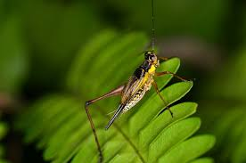
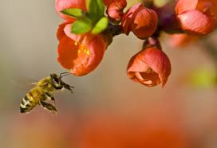
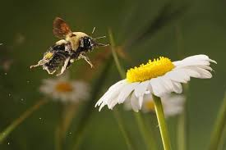
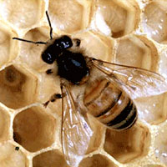
INSECT BEHAVIOR

Slide 5
Communication
Pheromone, light, & sound
Pheromone- chemical released by an animals that affects the behavior or development of other members of the same species through the sense of smell or taste
Example: ant trails- following a pheromone.
Sound- chirping of insects
Attract mates & warn other males away from territories
Example: crickets use sound by rubbing a scraper located on one forewing against a vein on the other forewing
Example: mosquitoes use for mate

Slide 6
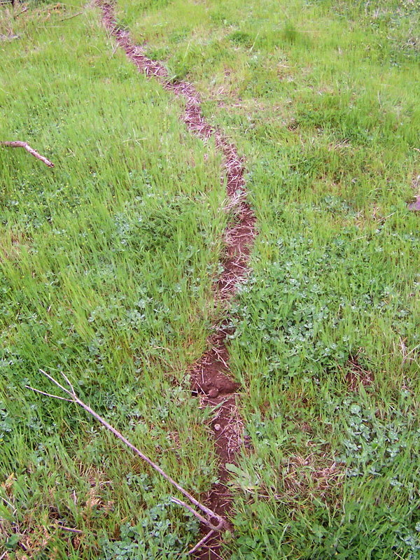
Communication
Pheromones are also used as identification of an animal or home
Pheromones can attract a mate

Slide 7
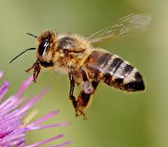
Behavior in Honeybees
Social insects- some individuals gather food, others protect the colony, and other reproduce.
Social insects allow for more independence and dividing work in each colony
Honeybees have innate behavior- genetically determined behavior

Slide 8
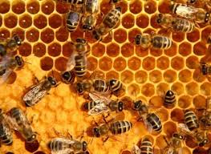
Three types of honeybees: worker bees, queen bee, and drones
Worker bees- non-reproductive females that make up the vast majority of the hive population
Workers perform all duties except reproduction.
Queen bee- only reproductive female in the hive, and her only function is to reproduce
Drones- males that develop from unfertilized eggs, and their only function is to deliver sperm to the queen

Slide 9
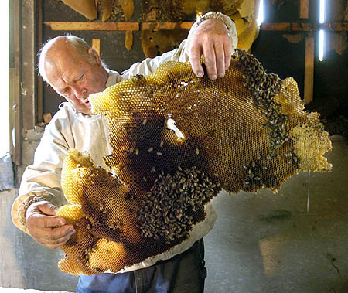
Behavior in Honeybees
Worker bees must feed the drones because their mouth parts are too small to obtain nectar from flowers

Slide 10
Worker Bees
Lifetime = six weeks
Workers feed honey and pollen to queen, drones, and larvae- during this stage, they are called: nurse bees
Royal jelly- high-protein substance worker bees feed to the queen and youngest larvae

Slide 11
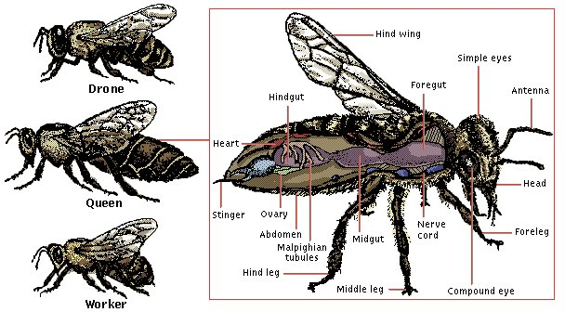
Worker Bees
When a worker bee stings another animal, it dies a day or two later

Slide 12
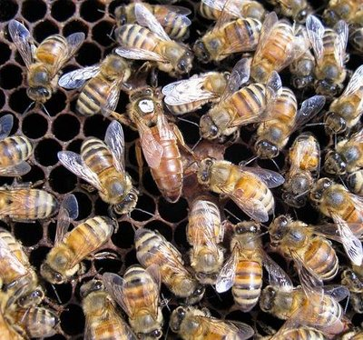
The Queen Bee
Queens develop from larvae that are constantly feed royal jelly
Queens mature and secrete a pheromone called the queen factor- prevents other female larvae from developing into queens.
Queens usually mate once, but lay thousands of eggs
Queens role is to reproduce.
Hive becomes over-crowded, and the queen bee will leave taking worker bees with her causing a swarm.
They search for a new location to build a new hive

Slide 13
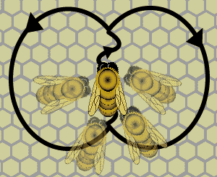
The Dances of the Bees
Round dance- food near hive

Slide 14
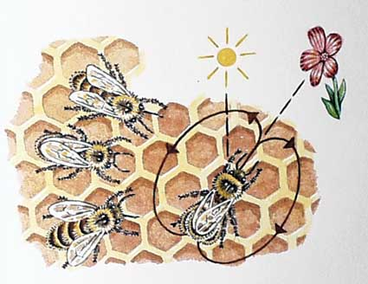
The Dances of the Bees
Waggle dance- food far from hive

Slide 15
Altruistic Behavior
Altruistic behavior- aiding of other individuals at one’s own risk or expense
Example: sting and cause death
Kin selection- mechanism of propagating one’s own genes by helping a related individual reproduce

Slide 16
Approved By
E-signature:

Slide 17
OMICS Group Open Access Membership OMICS INTERNATIONAL Open Access Membership enables academic and research institutions, funders and corporations to actively encourage open access in scholarly communication and the dissemination of research published by their authors. For more details and benefits, click on the link below: http://omicsonline.org/membership.php

