Slide 1
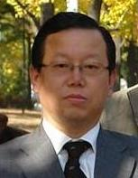
Cheorl-Ho Kim

Slide 2
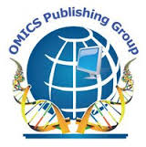
OMICS Group
OMICS Group International through its Open Access Initiative is committed to make genuine and reliable contributions to the scientific community. OMICS Group hosts over 400 leading-edge peer reviewed Open Access Journals and organizes over 300 International Conferences annually all over the world. OMICS Publishing Group journals have over 3 million readers and the fame and success of the same can be attributed to the strong editorial board which contains over 30000 eminent personalities that ensure a rapid, quality and quick review process. OMICS Group signed an agreement with more than 1000 International Societies to make healthcare information Open Access.
Contact us at: contact.omics@omicsonline.org

Slide 3
OMICS Journals are welcoming Submissions
OMICS Group welcomes submissions that are original and technically so as to serve both the developing world and developed countries in the best possible way.
OMICS Journals are poised in excellence by publishing high quality research. OMICS Group follows an Editorial Manager® System peer review process and boasts of a strong and active editorial board.
Editors and reviewers are experts in their field and provide anonymous, unbiased and detailed reviews of all submissions.
The journal gives the options of multiple language translations for all the articles and all archived articles are available in HTML, XML, PDF and audio formats. Also, all the published articles are archived in repositories and indexing services like DOAJ, CAS, Google Scholar, Scientific Commons, Index Copernicus, EBSCO, HINARI and GALE.
For more details please visit our website: http://omicsonline.org/Submitmanuscript.php

Slide 4
Biography
Dr. Cheorl-Ho Kim obtained Bachelor of Science, Biochemistry from Chung-ang University,
Master Degree obtained in Laboratory of Biochemistry, Department of Agricultural Chemistry from The University of Tokyo and
Ph.D. in Laboratory of Biochemistry, Department of Agricultural Chemistry, The University of Tokyo, Japan. Prof. Y.Maruyama (Asssistant: H. Tanigichi)

Slide 5
Reaseach Interest
Sialic acid biosynthesis
Ganglioside-Receptor interaction
Sialyl regulation in human diseases.

Slide 6
Recent Publication
Sialic Acid (N-Acetylneuraminic Acid) as the Functional Molecule for Differentiation between Animal and Plant Kingdom

Slide 7
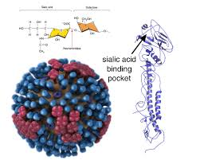
Sialic Acid

Slide 8
INTRODUCTION
Sialic acid is a generic term for the N- or O-substituted derivatives of neuraminic acid, a monosaccharide with a nine-carbon backbone.
Sialic acids are found widely distributed in animal tissues and to a lesser extent in other organisms, ranging from plants and fungi to yeasts and bacteria, mostly in glycoproteins and gangliosides

Slide 9
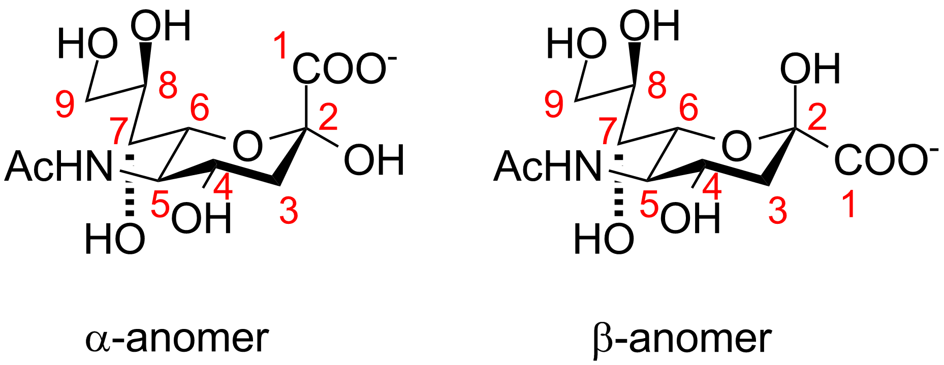
STRUCTURE

Slide 10
SIGNIFICANCE
Fertilization (egg – sperm interaction)
Development
Learning / Cognitive Functions
Immune Regulation
Acquired Disease
Cancer
Infectious Diseases
Viral
Flu
Bacterial
Meningitis

Slide 11
BIOSYNTHESIS

Slide 12
METABOLISM
The synthesis and degradation of sialic acid are distributed in different compartments of the cell. The synthesis starts in the cytosol, where N-acetylmannosamine 6 phosphate and phosphoenolpyruvate give rise to sialic acid. Later on, Neu5Ac 9 phosphate is activated in the nucleus by a cytidine monophosphate (CMP) residue through CMP-Neu5Ac synthase. Although the linkage between sialic acid and other compounds tends to be a α binding, this specific one is the only one that is a β linkage.

Slide 13
CMP-Neu5Ac is then transported to the endoplasmic reticulum or the Golgi apparatus, where it can be transferred to an oligosaccharide chain, becoming a new glycoconjugate. This bond can be modified by O-acetylation or O-methylation. When the glycoconjugate is mature it is transported to the cell surface.
The sialidase is one of the most important enzymes of the sialic acid catabolism. It can cause the removal of sialic acid residues from the cell surface or serum sialoglycoconjugates.

Slide 14
Usually, in higher animals, the glycoconjugates that are prone to be degraded are captured by endocytosis. After the fusion of the late endosome with the lysosome, lysosomal sialidases remove sialic acid residues. The activity of these sialidases is based on the removal of O-acetyl groups.
Free sialic acid molecules are transported to the cytosol through the membrane of the lysosome. There, they can be recycled and activated again to form another nascent glycoconjugate molecule in the Golgi apparatus.

Slide 15
Sialic acids can also be degraded to acylmannosamine and pyruvate with the cytosolic enzyme acylneuraminate lyase.
Some severe diseases can depend on the presence or absence of some enzymes related to the sialic acid metabolism. Sialidosis would be an example of this type of disorder

Slide 16
DISEASES
Sialic acids are related to some diseases observed in humans.
Salla disease:
Salla disease is an extremely rare illness which is considered the mildest form of the free sialic acid accumulation disorders though its childhood form is considered an aggressive variant and people who suffer from it have mental retardation.

Slide 17
Sialic acid and influenza virus:
When a certain influenza A virus is recognized by a sialic acid receptor the cell tends to endocytose the virus so the cell become infected.

Slide 18
SIALIC ACID AND IMMUNITY
Sialic acids are found at all cell surfaces of vertebrates and some invertebrates, and also at certain bacteria that interact with vertebrates.
Many viruses and some bacteria use host-sialylated structures as targets for binding and recognition. Viruses that bind Sia via a hemagglutinin, usually express a sialidase (neuraminidase) that catalyzes the hydrolysis of the terminal sialic acids of host cell receptors and confers virulence for the newly formed virions

Slide 19
Glycobiology Related Journals
Journal of Glycomics and Lipidomics
Pharmacogenomics & Pharmacoproteomics
Fungal Genomics & Biology

Slide 20
Related Conference
3rd International Conference on Functional and Comparative Genomics & Pharmacogenomics

Slide 21
OMICS Group Open Access Membership
OMICS publishing Group Open Access Membership enables academic and research institutions, funders and corporations to actively encourage open access in scholarly communication and the dissemination of research published by their authors.
For more details and benefits, click on the link below:
http://omicsonline.org/membership.php

Slide 22
THANK YOU

