Slide 1
OMICS Group
OMICS Group International through its Open Access Initiative is committed to make genuine and reliable contributions to the scientific community. OMICS Group hosts over 400 leading-edge peer reviewed Open Access Journals and organizes over 300 International Conferences annually all over the world. OMICS Publishing Group journals have over 3 million readers and the fame and success of the same can be attributed to the strong editorial board which contains over 30000 eminent personalities that ensure a rapid, quality and quick review process. OMICS Group signed an agreement with more than 1000 International Societies to make healthcare information Open Access.
Contact us at: contact.omics@omicsonline.org

Slide 2
OMICS Journals are welcoming Submissions
OMICS Group welcomes submissions that are original and technically so as to serve both the developing world and developed countries in the best possible way.
OMICS Journals are poised in excellence by publishing high quality research. OMICS Group follows an Editorial Manager® System peer review process and boasts of a strong and active editorial board.
Editors and reviewers are experts in their field and provide anonymous, unbiased and detailed reviews of all submissions.
The journal gives the options of multiple language translations for all the articles and all archived articles are available in HTML, XML, PDF and audio formats. Also, all the published articles are archived in repositories and indexing services like DOAJ, CAS, Google Scholar, Scientific Commons, Index Copernicus, EBSCO, HINARI and GALE.
For more details please visit our website:
http://esciencecentral.org/journals/alternative-integrative-medicine.php

Slide 3
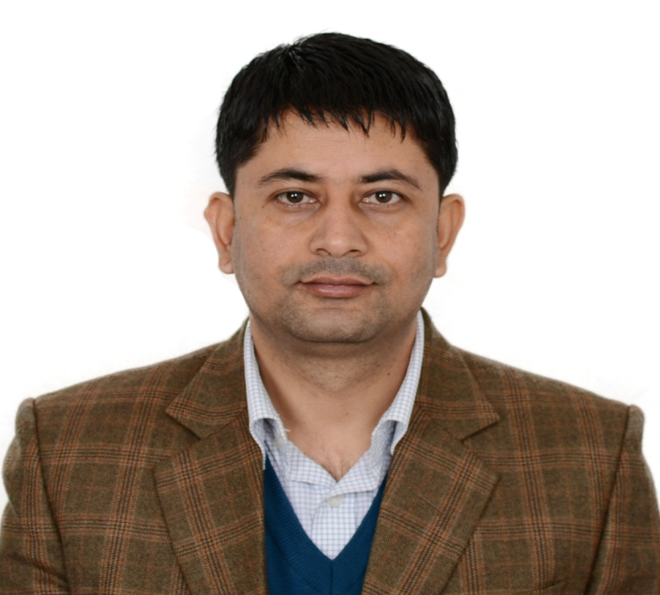
BIO-sketch of Chhabi Ranabhat

Slide 4
Synopsis
My career started as Professional researcher in Institute for Poverty Alleviation and International Development (IPAID) research project under Yonsei University, South Korea. Pursued a PhD fellow and health policy researchers and working for health equity since 10 years. Started my carrier from Ministry of Health and population Nepal, WHO research consultant country office Nepal and community health research expert under Health service Improvement (HIT) project under KOICA Nepal with collaboration of MoHP Nepal and other external development partners. Published many research article and Complementary and Alternative medicine. Aim is to explore the CAM, scientific investigation and application of the herbal product in therapeutic, cosmetic and health promotion area in Himalayan region. Scientific research of CAM, global marketing, and make self-empowerment of the local people for the health equity is his goal.

Slide 5
Major study/Research Projects
A survey for the holistic Development in Ethiopia and Nepal Team Leader Under publication
Health Improvement in Tikaput (HIT) Baseline Health Survey Team Leader Under Good Neighbours International and Yonsei University Korea
A survey in Community Based Health insurance in Mugu Under HIMAL Project KOICA and Good Neighbours International As Team Leader
Effect of Indoor smoke on ARI : A cross sectional study on Rural Sunsari District with WHO and BPKIHS collaboration
Impact of sanitation (Ecosan toilets) in Public health: As Public health expert, Data analyst and report writer: A combine study of WHO and Government of Nepal

Slide 6
Major study/Research Projects
Effect of industrial Air pollution in Lumbini Heritage Place: A combine study of WHO and UNESCO as project director/ Chief Researcher WHO as a Public Health Expert
A qualitative study on Healthy Work place: Case Studies; A project on SERO WHO.
Criteria of choice on household water treatment system in Kathmandu Valley: A project by WHO Geneva.
Case studies in total sanitation in Kaski District: A project of Department Of Water Supply And Sewerage and WHO
Study of Environment of Hospitals in Nepal; 30 Hospitals of Nepal with the initiation of Ministry of health of Nepal and WHO

Slide 7
Research objective
Preparation of the research concept paper in different health issues
Prepare the research proposal and submit for the grant and more focus o NRF (National Research Fund Korea)
Design the research and match with the methodology with objective and the fund
Conduct research and survey, technically, managerial and academic aspects
Prepare the data base, verifying and cleansing of the data
Analyse the data with specific variables and preparation the report
Distribute the report for review and recommendation for publication

Slide 8
Research Interest
Advanced skill on Epidemiology and Biostatistics, and Data analysis on SAS This skill have been
acquired by an online course offered by Harvard University through edx on Health in Numbers:
Quantitative Methods in Clinical Public Health Research

Slide 9
Reviewer for Peer reviewed Journals
Alternative & Integrative Medicine
Regular Reviewer of OMICS life science journal, Complementary and alternative Medicine
Springer Journal Publication on Women’s Health
BMC Public Health
Team member of Curriculum development, Ministry of Education Nepal
Team Member of Exam board Medical Entrance Committee, TU, Nepal

Slide 10
Journal of Community Medicine & Health Education
Internal Medicine: Open Access
General Medicine: Open Access
Journal of Vascular Medicine & Surgery

Slide 11
Related Conferences
2nd International Conference on
Predictive, Preventive and Personalized Medicine & Molecular Diagnostics

Slide 12
OMICS Group Open Access Membership
OMICS publishing Group Open Access Membership enables academic and research institutions, funders and corporations to actively encourage open access in scholarly communication and the dissemination of research published by their authors.
For more details and benefits, click on the link below:
http://omicsonline.org/membership.php

