Slide 1
Journal of Astrobiology and Outreach
Dr. David F Mota
Editorial Board member
Professor Institute of Theoretical Astrophysics University of Oslo Norway

Slide 2
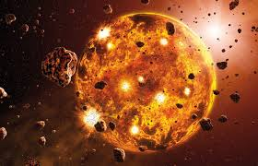
Biography
Dr. David F Mota
DAVID FONSECA MOTA finished his ph.D from University of Cambridge. Currently working as Professor in Institute of Theoretical Astrophysics, University of Oslo. His research produced more than 70 articles published in top-ranked international journals. These articles have more than 3600 citations, and have an h-index of 34.He is a member of PhD Degree committee, Institute of Theoretical Astrophysics,
Research Interests
Cosmology,
Theoretical Astrophysics,
Theoretical Physics,

Slide 3
Recent Publications
Local observables in a landscape of infrared gauge modes, M Thorsrud, DF Mota, FR Urban - Physics Letters B, 2014 - Elsevier
Accelerating cosmologies with an anisotropic equation of state, T Koivisto, DF Mota - The Astrophysical Journal, 2008 - iopscience.iop.org
Constraining dark energy anisotropic stress, DF Mota, JR Kristiansen, T Koivisto, Monthly Notices of, 2007 - mnras.oxfordjournals.org
An Improved Semianalytical Spherical Collapse Model for Nonlinear Density Evolution, DJ Shaw, DF Mota - The Astrophysical Journal Supplement …, 2008 - iopscience.iop.org
Local and global variations of the fine-structure constant, DF Mota, JD Barrow Monthly Notices of the Royal …, 2004 - mnras.oxfordjournals.org
On the magnitude of dark energy voids and overdensities, DF Mota, DJ Shaw, J Silk - The Astrophysical Journal, 2008 - iopscience.iop.org

Slide 4
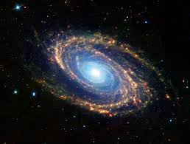
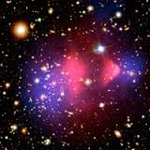
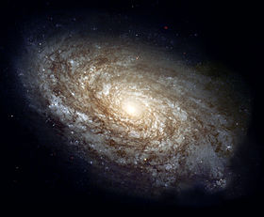
Astrophysics (from Greek astron, ἄστρον "star", and physis, φύσις "nature") is the branch of astronomy that deals with the physics of the universe, especially with "the nature of the heavenly bodies, rather than their positions or motions in space.
Among the objects studied are galaxies, stars, planets, extra solar planets, the interstellar medium and the cosmic microwave background.
Their emissions are examined across all parts of the electromagnetic spectrum, and the properties examined include luminosity, density, temperature, and chemical composition.
Because astrophysics is a very broad subject, astrophysicists typically apply many disciplines of physics, including mechanics, electromagnetism, statistical mechanics,thermodynamics, quantum mechanics, relativity, nuclear and particle physics, and atomic and molecular physics.

Slide 6
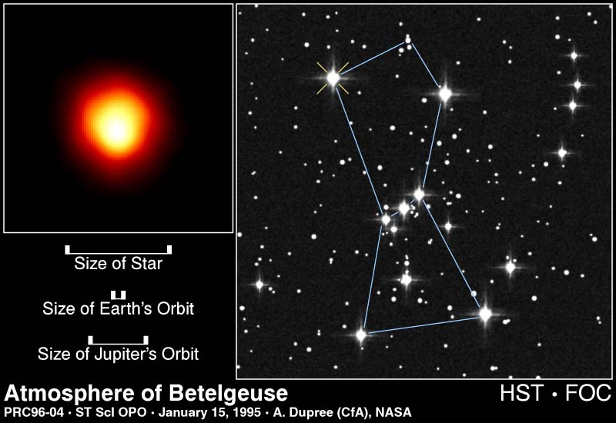
Stellar Sizes

Slide 11
How far is the asteroid belt?
It is 2 – 3.5 AU. An AU is the astronomical unit, the mean distance from the Earth to the Sun Distance = 2 * 1.496 x 108 km = 293200000000 m from the sun.

Slide 12
The most important thing about a star is MASS!
The mass of a normal star almost completely determines its LUMINOSITY & TEMPERATURE!
The LUMINOSITY of a star is the TOTAL ENERGY emitted per time from the surface of the star. This light bulb has a luminosity of 60 Watts The energy the Sun emits is generated by the fusion in its core…

Slide 13
COMETS: are frozen balls of ice and dust that can resemble a “dirty snowball”.They orbit the Sun is highly elliptical orbits. Their orbital periods can range from a few years to several thousand years. Halleys Comet is famous due to the fact that everyone has a chance to see it in their lifetime (Orbital Period of 77 years).
Light Year (ly): is the distance that light travels in one year. One light year equals 9.46 x 1015 metres.
c = distance/time
300000000 = distance/365x24x60x60
Stellar cluster: A number of stars that are held together in a group by a gravitational attraction.They were created at about the same time. There may be many thousands of stars in a group.

Slide 14
Galaxies
A galaxy is a collection of a very large number of starsmutually attracting each other through the gravitational forceand staying together. The number of stars varies between afew million and hundreds of billions. There approximately100 billion galaxies in the observable universe.
There are three types of galaxies: -
Spiral (Milky Way)
Elliptical (M49)
Irregular (Magellanic Clouds)

Slide 18
Locating Information
NASA’s Astrophysics Data System (ADS): http://adswww.harvard.edu/ and particularly http://adsabs.harvard.edu/abstract_service.html
SIMBAD: http://simbad.harvard.edu/simbad/ and http://simbad.u-strasbg.fr/simbad/ (there are 2 sites)
NOTE: VIRTUALLY ALL ELECTRONIC CATALOGS TODAY SEARCH SIMBAD FOR RESOLVING STAR NAMES AND GETTING THEIR COORDINATES. If SIMBAD is down, you may be out of luck!
18

Slide 19
Approved By
E-signature:

Slide 20
OMICS International Open Access Membership
OMICS International Open Access Membership enables academic and research institutions, funders and corporations to actively encourage open access in scholarly communication and the dissemination of research published by their authors.
For more details and benefits, click on the link below:
http://omicsonline.org/membership.php

