Slide 1
OMICS Group
OMICS Group International through its Open Access Initiative is committed to make genuine and reliable contributions to the scientific community. OMICS Group hosts over 400 leading-edge peer reviewed Open Access Journals and organizes over 300 International Conferences annually all over the world. OMICS Publishing Group journals have over 3 million readers and the fame and success of the same can be attributed to the strong editorial board which contains over 30000 eminent personalities that ensure a rapid, quality and quick review process. OMICS Group signed an agreement with more than 1000 International Societies to make healthcare information Open Access.
Contact us at: contact.omics@omicsonline.org

Slide 2
OMICS Journals are welcoming Submissions
OMICS Group welcomes submissions that are original and technically so as to serve both the developing world and developed countries in the best possible way.
OMICS Journals are poised in excellence by publishing high quality research. OMICS Group follows an Editorial Manager® System peer review process and boasts of a strong and active editorial board.
Editors and reviewers are experts in their field and provide anonymous, unbiased and detailed reviews of all submissions.
The journal gives the options of multiple language translations for all the articles and all archived articles are available in HTML, XML, PDF and audio formats. Also, all the published articles are archived in repositories and indexing services like DOAJ, CAS, Google Scholar, Scientific Commons, Index Copernicus, EBSCO, HINARI and GALE.
For more details please visit our website: http://omicsonline.org/Submitmanuscript.php

Slide 3
David Taylor
Editor of Journal of Pharmaceutical Care & Health Systems

Slide 4
Biography
David Taylor is Director of Pharmacy and Pathology at the Maudsley Hospital, Professor of Psychopharmacology at King’s College, London and Honorary Professor at the Institute of Psychiatry.
David is also the Editor-in-Chief of the journal Therapeutic Advances in Psychopharmacology and Head of Pharmaceutical Sciences in King’s Health Partners. He has previously been President of the College of Mental Health Pharmacists and Chairman of the UK Psychiatric Pharmacy Group.
Professor Taylor has been the lead author of the Maudsley Prescribing Guidelines since their inception in 1993. The Maudsley Prescribing Guidelines have sold over 200,000 copies in eleven editions and been translated into nine languages.
David has also authored over 200 clinical papers in journals such as the BMJ, British Journal of Psychiatry and Journal of Clinical Psychiatry. These papers have been cited over 5000 times. Professor Taylor has an H Index of 41.

Slide 5
Research Interests
Studies of drug use in mental health

Slide 6
Recent Publications
Bishara D, Olofinjana O, Sparshatt A, Kapur S, Taylor D, Patel MX. Olanzapine: a systematic review and meta-regression of the relationships between dose, plasma concentration, receptor occupancy, and response. Journal of Clinical Psychopharmacology 2013; 33: 329-335
Taylor D, Lenox-Smith A, Bradley A. A review of the suitability of duloxetine and venlafaxine for use in patients with depression in primary care with a focus on cardiovascular safety, suicide and mortality due to antidepressant overdose. Therapeutic Advances in Psychopharmacology 2013; 3: 151-161
Patel MX, Matonhodze J, Baig MK, Taylor D, Szmukler G, David AS. Natrualistic outcomes of community treatment orders: antipsychotic long-acting injections versus oral medication. Journal of Psychopharmacology 2013; 27: 629-637
Sparshatt A, McAllister Williams RH, Baldwin DS, Haddad PM, Bazire S, Weston E, Taylor P, Taylor D. A naturalistic evaluation and audit database of agomelatine: clinical outcome at 12 weeks. Acta Psychiatrica Scandinavia 2013; 128: 203-211
Whiskey E and Taylor D. A review of the adverse effects and safety of noradrenergic antidepressants. Journal of Psychopharmacology 2013; 27: 732-739
Frogley C, Anagnostakis K, Mitchell S, Mason F, Taylor D, Dickens G, Picchioni MM. A case series of clozapine for borderline personality disorder. Annuals of Clinical Psychiatry 2013; 25: 125-134 [0]
Sylvia M. Dobbs SM, Charlett A, Dobbs RJ, Weller C, Iguodala O, Smee C, Lawson AJ, Taylor D, Bjarnason I. Antimicrobial Surveillance in Idiopathic Parkinsonism: Indication-Specific Improvement in Hypokinesia Following Helicobacter pylori Eradication and Non-Specific Effect of Antimicrobials for Other Indications in Worsening Rigidity. Helicobacter 2013; 18: 187–196
Watras M, Taylor D. A therapeutic interaction between cimetidine and clozapine: case study and review of the literature. Therapeutic advances in Psychopharmacology 2013; 3: 294-297
Blaecher C, Smet A, Flahou B, Pasmans F, Ducatelle R, Taylor D, Weller C, Bjarnason I, Charlett A, Lawson AJ, Dobbs RJ, Dobbs SM, Haesebrouck F. Significantly higher frequency of Helicobacter suis in patients with idiopathic parkinsonism than in control patients. Alimentary Pharmacology and Therapeutics 2013; 38: 1347-1353
Bishara D, Taylor D. Adverse effects of clozapine in older patients: epidemiology, prevention and management. Drugs and Aging 2014; 31: 11-20

Slide 7
Substance Abuse
A maladaptive pattern of use leading to impairment, in at least one of the following, occurring within a 12-month period:
recurrent substance use resulting in a failure to fulfill major role obligations at work, school, or home
recurrent substance use in situations in which it is physically hazardous
recurrent substance-related legal problems
continued substance use despite having persistent or recurrent social or interpersonal problems caused or exacerbated by the effects of the substance

Slide 8
Substance Dependence
A maladaptive pattern of use, leading to impairment as manifested by three (or more) of the following, occurring at any time in the same 12-month period:
tolerance
withdrawal
the substance is often taken in larger amounts or over a longer period than was intended
there is a persistent desire or unsuccessful efforts to cut down or control substance use
a great deal of time is spent in activities necessary to obtain the substance, use the substance, or recover from its effects
important social, occupational, or recreational activities are given up or reduced because of substance use
the substance use is continued despite knowledge of having a persistent or recurrent physical or psychological problem that is likely to have been caused or exacerbated by the substance

Slide 9
Drugs & Effects

Slide 10
Cannabinoids
Hashish, Marijuana
How Consumed: swallowed, smoked
Effects: euphoria, slowed thinking and reaction time, confusion, impaired balance and coordination
Consequences: cough, frequent respiratory infections, impaired memory and learning, increased heart rate, anxiety, panic attacks

Slide 11
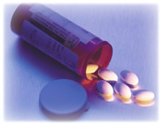
Depressants
Barbiturates, Benzodiazepines, GHB, Rohypnol, Quaalude
How Consumed: swallowed, injected
Effects: reduced anxiety, feeling of well-being, lowered inhibitions, slowed pulse and breathing, lowered blood pressure, poor concentration
Consequences: fatigue, confusion, impaired coordination, memory, judgment, respiratory depression and arrest, death

Slide 12
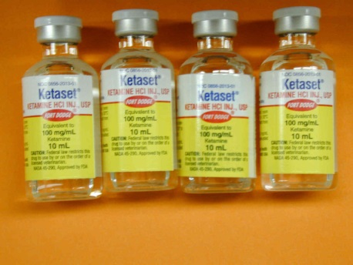
Dissociative Anesthetics
Ketamine, PCP
How Consumed: Injected, swallowed, smoked, snorted
Effects: increased heart rate and blood pressure, impaired motor function, delirium, panic, aggression
Consequences: memory loss, numbness, nausea/vomiting, depression

Slide 13
Hallucinogens
LSD, Mescaline, Mushrooms
How Consumed: swallowed, smoked
Effects: increased body temperature, heart rate, blood pressure, loss of appetite, sleeplessness, numbness, weakness, tremors, altered states of perception and feeling, nausea
Consequences: persisting perception disorder (flashbacks)

Slide 14
Opiods
Codeine, heroin, morphine, opium, Oxycodone, Hydrocodone
How Consumed: injected, swallowed, smoked, snorted
Effects: pain relief, euphoria, drowsiness
Consequences: nausea, constipation, confusion, sedation, respiratory depression and arrest, unconsciousness, coma, death

Slide 15
Stimulants
Amphetamine, cocaine, MDMA, methamphetamine, nicotine, Ritalin
How Consumed: injected, smoked, snorted, swallowed
Effects: increased heart rate, blood pressure, metabolism, feelings of exhilaration, energy, increased mental alertness
Consequences: rapid or irregular heart beat, reduced appetite, weight loss, heart failure, nervousness, insomnia

Slide 16
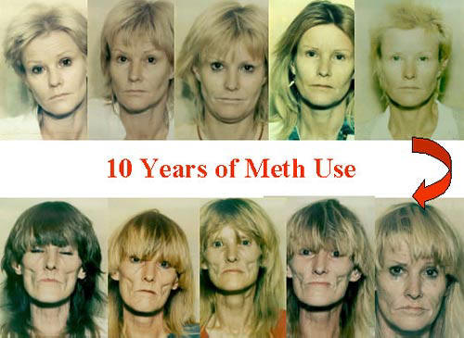
Long Term Methamphetamine Use

Slide 17
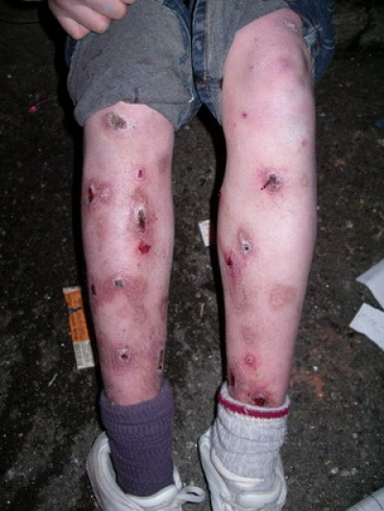
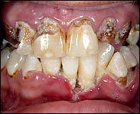
Long term Meth

Slide 18
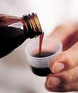
Other
Steroid
Injected, swallowed, applied to skin
no intoxication effect
hypertension, blood clotting and cholesterol changes, liver cysts and cancer, kidney cancer, hostility and aggression, acne
in adolescents - premature stoppage of growth
in males - prostate cancer, reduced sperm production, shrunken testicles, breast enlargement
in females - menstrual irregularities, development of beard and other masculine characteristics
Dextromethorphan
swallowed
Dissociative effects, distorted visual perceptions to complete dissociative effects
memory loss; numbness; nausea/vomiting
Inhalants
Inhaled through nose or mouth
stimulation, loss of inhibition; headache; nausea or vomiting; slurred speech, loss of motor coordination; wheezing
unconsciousness, cramps, weight loss, muscle weakness, depression, memory impairment, damage to cardiovascular and nervous systems, sudden death

Slide 19
Mixing Drugs

Slide 20
Statistics
Substance Abuse and Mental Health Services Administration. (2007). Results from the 2006 National Survey on Drug Use and Health: National Findings (Office of Applied Studies, NSDUH Series H-32, DHHS Publication No. SMA 07-4293). Rockville, MD.

Slide 21
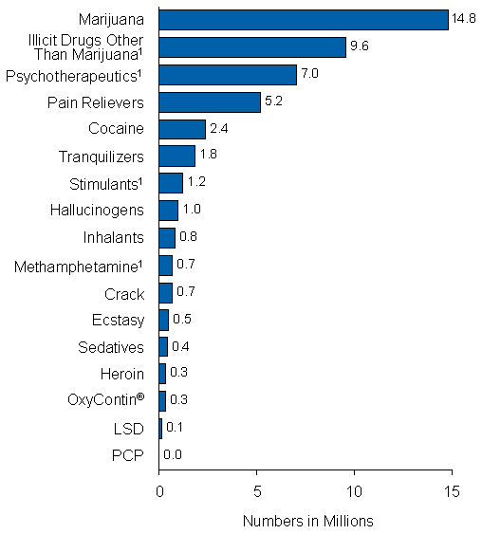
Past Month Use of Specific Illicit Drugs among Persons Aged 12 or Older: 2006
SAMHSA, 2006

Slide 22
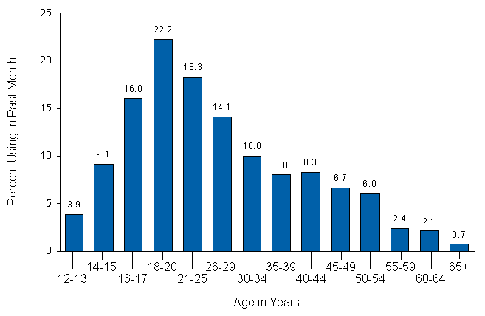
Past Month Illicit Drug Use among Persons Aged 12 or Older, by Age: 2006
SAMHSA, 2006

Slide 23
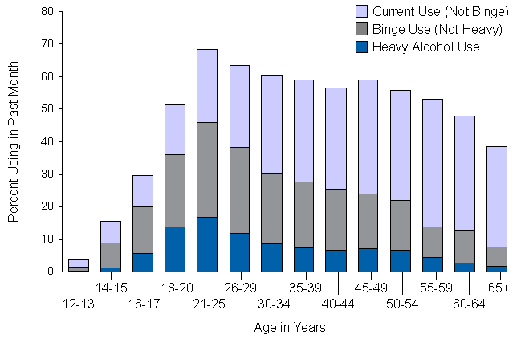
Current, Binge, and Heavy Alcohol Use among Persons Aged 12 or Older, by Age: 2006
SAMHSA, 2006

Slide 24
Assessment
Open-ended questions
Obtain releases for all other providers
Maintain active communication with providers
Observations

Slide 25
How to refer for evaluation
It sounds like you may benefit from talking to someone
Provide 2-3 referrals
Provide the patient with reassurance that you are referring to a resource you trust

Slide 26
Types of treatment available
Abstinence vs. harm reduction
Detoxification
Outpatient
Intensive Outpatient
Inpatient
30-day
Long-term residential
Half-way house
Anonymous meetings

Slide 27
Relapse
IT’S PROBABLY GOING TO HAPPEN!
2/3 relapse rate
Before picking up
Post-Acute Withdrawal Syndrome
Return To Denial – “everything’s alright”
Avoidance And Defensive Behavior
Starting To Crisis Build
Feeling Immobilized (Stuck)
Becoming Depressed
Compulsive And/Or Impulsive Behaviors (Loss Of Control)
Urges And Cravings (Thinking About Drinking/Using)

Slide 28
OMICS Group Open Access Membership
OMICS publishing Group Open Access Membership enables academic and research institutions, funders and corporations to actively encourage open access in scholarly communication and the dissemination of research published by their authors.
For more details and benefits, click on the link below:
http://omicsonline.org/membership.php

Slide 29
Approved By
E-signature: David Taylor

