Slide 1
OMICS Journals are welcoming Submissions
OMICS International welcomes submissions that are original and technically so as to serve both the developing world and developed countries in the best possible way.
OMICS Journals are poised in excellence by publishing high quality research. OMICS International follows an Editorial Manager® System peer review process and boasts of a strong and active editorial board.
Editors and reviewers are experts in their field and provide anonymous, unbiased and detailed reviews of all submissions.
The journal gives the options of multiple language translations for all the articles and all archived articles are available in HTML, XML, PDF and audio formats. Also, all the published articles are archived in repositories and indexing services like DOAJ, CAS, Google Scholar, Scientific Commons, Index Copernicus, EBSCO, HINARI and GALE.
For more details please visit our website: http://omicsonline.org/Submitmanuscript.php

Slide 2
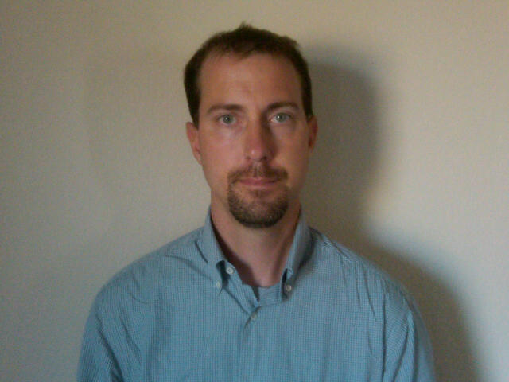
Journal of Sports Medicine and Doping Studies
David W. Keeley Assistant Professor Department of Biomechanics New Mexico State University USA
Editorial Board Member

Slide 3
Biography
David William Keeley is currently an Assistant Professor of biomechanics at New Mexico State University in Las Cruces, NM.
He completed his PhD in the Exercise Science at the University of Arkansas in May, 2011. While at Arkansas, he spent time working with the Human Performance Lab and the Sport Biomechanics Group.
Throughout his academic tenure, he has been invited to give more than 20 national and international presentations and authored/co-authored numerous papers accepted for publication in peer reviewed journals.
He is currently an active member of the American College of Sports Medicine, the American Society of Biomechanics, and the International Society of Biomechanics

Slide 4
Research Interest
Researching injury prevention and rehabilitation in athletic settings. His research focuses primarily on those biomechanical parameters associated with upper extremity injury in throwing athletes.
Currently utilizes a variety of data collection tools including motion capture, electromyography, near-infrared spectroscopy, and ultrasonography in an effort to develop a complete picture of those mechanical characteristics that may lead to upper extremity injury.
Also focuses on the impact that various rehabilitation protocols have on the ability of athletes to return to competition.

Slide 5
Publication Details

Slide 6
For Upcoming Conferences
http://www.conferenceseries.com/

Slide 7
OMICS International Open Access Membership
OMICS International Open Access Membership enables academic and research institutions, funders and corporations to actively encourage open access in scholarly communication and the dissemination of research published by their authors.
For more details and benefits, click on the link below:
http://omicsonline.org/membership.php

