Slide 1

OMICS Journals are welcoming Submissions
OMICS International welcomes submissions that are original and technically so as to serve both the developing world and developed countries in the best possible way.
OMICS Journals are poised in excellence by publishing high quality research. OMICS International follows an Editorial Manager® System peer review process and boasts of a strong and active editorial board.
Editors and reviewers are experts in their field and provide anonymous, unbiased and detailed reviews of all submissions.
The journal gives the options of multiple language translations for all the articles and all archived articles are available in HTML, XML, PDF and audio formats. Also, all the published articles are archived in repositories and indexing services like DOAJ, CAS, Google Scholar, Scientific Commons, Index Copernicus, EBSCO, HINARI and GALE.
For more details please visit our website: http://omicsonline.org/Submitmanuscript.php

Slide 2
Dr. Denong Wang (SRI International Biosciences Division)

Slide 3
Dr. Denong Wang Biography
Denong Wang, Ph.D., is an SRI distinguished scientist and senior program director of the Tumor Glycomics Laboratory in the Center for Cancer and Metabolism in SRI International Biosciences Division.
Wang‘s team has established multiple platforms of carbohydrate microarrays and introduced these glycomics tools to explore the structural and antigenic diversities of the glycome. The main research focus of his lab is in the immunogenic sugar moieties. In the past few years, his group has contributed to the identification of immunologically potent glycan markers of SARS-CoV, Bacillus anthracis exosporium, and a number of human cancers.
Wang received his Ph.D. in immunology and glycobiology with the late Professor Elvin A. Kabat at Columbia University in 1993. After that, he entered the developing field of post-genomics research. Before joining SRI in 2010, he served as head of the Functional Genomics Division at Columbia University's Genome Center from 1998 to 2003 and was director of Stanford University's Tumor Glycome Laboratory from 2007 to 2010.

Slide 4
Dr. Denong Wang Research Interests
Dr. Denong Wang’s research interest is in the immunogenic sugar moieties that play key roles in the host recognition of complex carbohydrates and immune responses to carbohydrate antigens.

Slide 5
A Research Strategy Established in Glycosciences
Integrating structural analysis and immunological characterization to decipher the “glyco code” in living species
Examples of “glyco code”: human blood group substances ABH

Slide 6
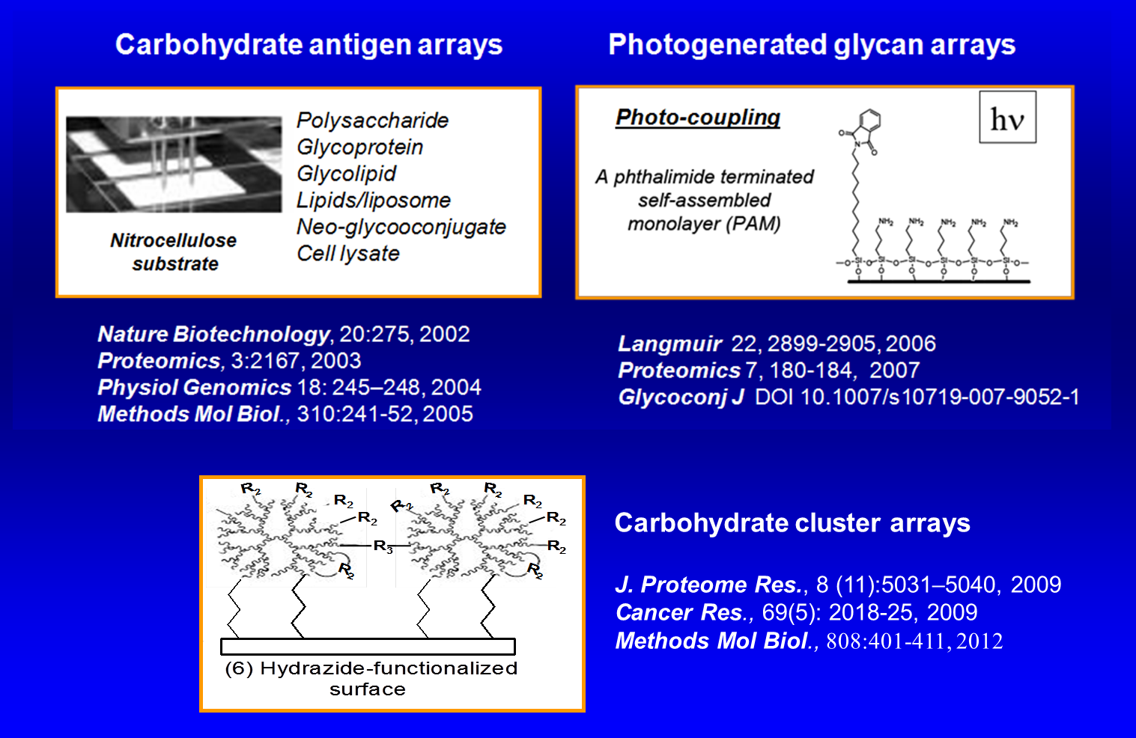
Complementary Platforms of Carbohydrate Microarrays
Developed by Dr. Wang’s Lab and Collaborators

Slide 7
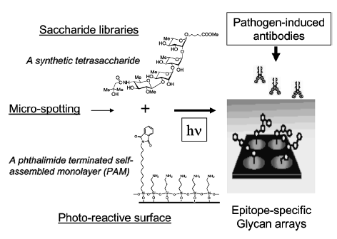
Photo-generated Glycan Arrays Identify Immunogenic Sugar Moieties of B. anthracis Exosporium

Slide 8
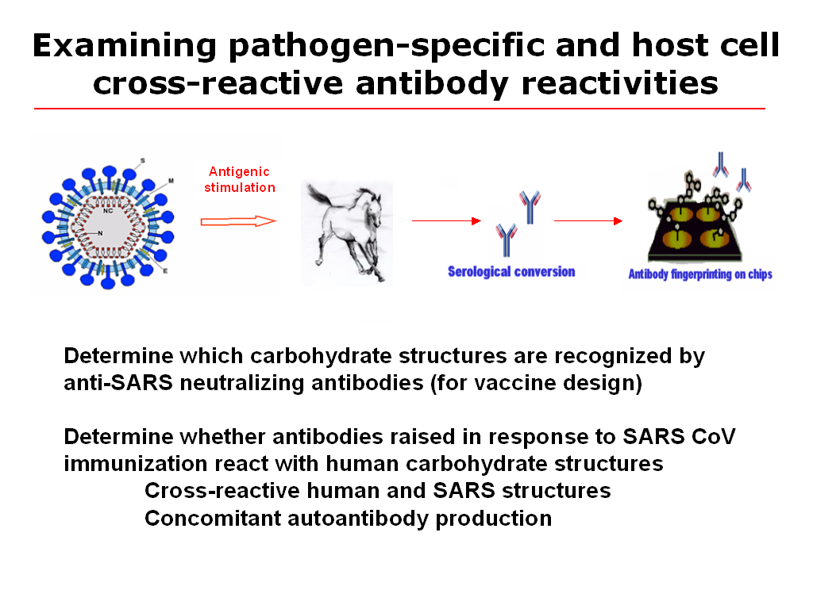
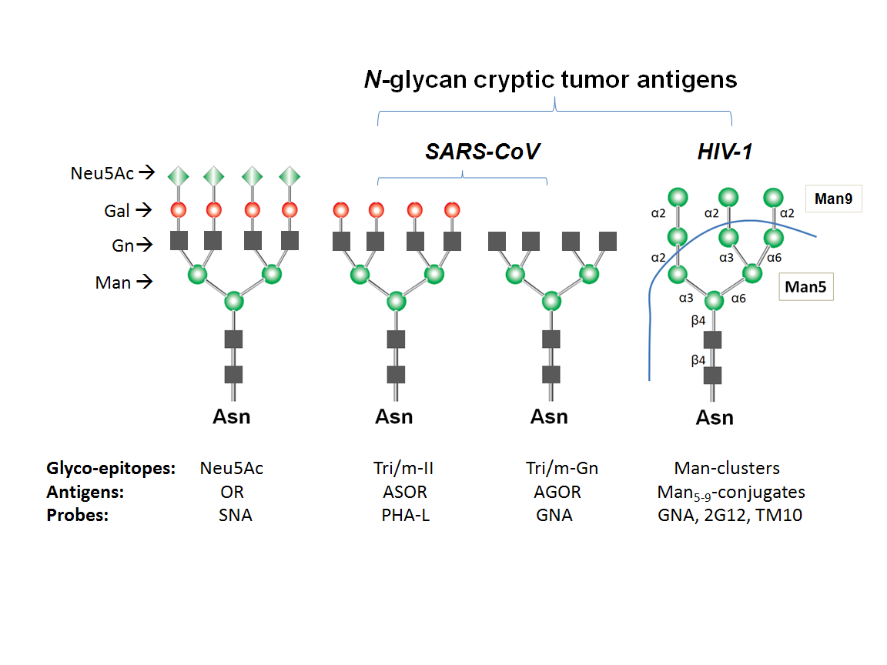
Recognition of Cryptic Glyco-epitopes as Potent Immunological Targets of Viruses and Tumors

Slide 9
Recent Publications Authored By Dr. Denong Wang
Wang D, Shaoyi L, Trummer BJ, Deng C, Wang A. Carbohydrate microarrays for the recognition of cross-reactive molecular markers of microbes and host cells. Nature Biotechnol 2002; 21:275-281. (PMID: 11875429)
Wang D. Carbohydrate microarrays. Proteomics 2003; 3:2167-2175.
Wang D, Lu J. Glycan arrays lead to the discovery of autoimmunogenic activity of SARS-CoV. Physiol Genomics 2004; 18:245-249. (PMID: 15161967)
Carroll GT, Wang D, Turro NJ, Koberstein JT. Photochemical micropatterning of carbohydrates on a surface. Langmuir 2006; 22:2899-2905.
Wang D, Carroll GT, Turro NJ, Koberstein JT, Kováč P, Saksena R, Adamo R, Herzenberg LA, Herzenberg LA, Steinman L. Photo-generated glycan arrays identify immunogenic sugar moieties of Bacillus anthracis exosporium. Proteomics 2007; 7:180-184. (PMID: 17205603)
Zhou X, Turchi C, Wang D. Carbohydrate cluster microarrays fabricated on 3-dimensional dendrimeric platforms for functional glycomics exploration. J Proteome Res 2009; 8(11):5031-5040. (PMID: 19791771)
Thomas E, Newsom-Davis TE, Wang D, Steinman L, Chen PFT, Wang L, Simon AK, Screaton GR. Enhanced immune recognition of cryptic glycan markers in human tumors. Cancer Res 2009; 69(5):2018-2025 (doi:10.1158/0008-5472.CAN-08-3589). (PMID: 19223535)
Palma AS, Liu Y, Childs RA, Herbert C, Wang D, Chai W, Feizi T. The human epithelial carcinoma antigen recognized by monoclonal antibody AE3 is expressed on a sulfoglycolipid in addition to neoplastic mucins. Biochem Biophys Res Commun 2011; 408:548-552 (DOI: S0006-291X(11)00640-1 [pii] 10.1016/j.bbrc.2011.04.055.)
Wang D. N-glycan cryptic antigens as active immunological targets in prostate cancer patients. J Proteomics & Bioinformatics 2012; 5:090-095. (doi:10.4172/jpb.1000218)
Wang, D. and Collins N. (2013). The 10th Anniversary of Carbohydrate Microarrays (2002–2012). J Proteomics Bioinfo. (Editorial) 6: e22 (DOI: 10.4172/jpb.10000e22).
Wang D, Dafik L, Nolley R, Huang W, Wolfinger RD, Wang LX, Peehl DM. (2013) Anti-oligomannose antibodies as potential serum biomarkers of aggressive prostate cancer. Drug Develop Res., 2013, 14(2):65-80 (DOI: 10.1002/ddr.21063).
Wang D. Glyco-epitope diversity: an evolving area of glycomics research and biomarker discovery. J Proteomics & Bioinformatics 2014; 7: e24. (DOI:10.4172/jpb.10000e24).
Wang D, Bhat, R., Sobel, RA., Huang W, Wang LX, Olsson, T., and Steinman, L. Uncovering cryptic glycan markers in multiple sclerosis (MS) and experimental autoimmune encephalomyelitis (EAE). Drug Develop Res., 2014, 75:172–188 (DOI: 10.1002/ddr.21169).

Slide 10

Journal of Proteomics & Bioinformatics
Related Journals
Transcriptomics: Open Access
Journal of Pharmacogenomics & Pharmacoproteomics
Journal of Data Mining in Genomics & Proteomics

Slide 11
For more details on Conferences Related
Journal of Proteomics & Bioinformatics please visit:
http://www.conferenceseries.com/biochemistry-meetings

Slide 12
Open Access Membership with OMICS International enables academicians, research institutions, funders and corporations to actively encourage open access in scholarly communication and the dissemination of research published by their authors.
For more details and benefits, click on the link below:
http://omicsonline.org/membership.php

