Slide 1
OMICS Journals are welcoming Submissions
OMICS International welcomes submissions that are original and technically so as to serve both the developing world and developed countries in the best possible way.
OMICS Journals are poised in excellence by publishing high quality research. OMICS International follows an Editorial Manager® System peer review process and boasts of a strong and active editorial board.
Editors and reviewers are experts in their field and provide anonymous, unbiased and detailed reviews of all submissions.
The journal gives the options of multiple language translations for all the articles and all archived articles are available in HTML, XML, PDF and audio formats. Also, all the published articles are archived in repositories and indexing services like DOAJ, CAS, Google Scholar, Scientific Commons, Index Copernicus, EBSCO, HINARI and GALE.
For more details please visit our website: http://omicsonline.org/Submitmanuscript.php

Slide 2
Major Research Interests
Ding He (PhD)
Department of Chemistry and Biochemistry
Florida International University, USA
University of Georgia, USA (current address)

Slide 3
Major Research Interests
1. Transcriptomics and Bioinfomatics;
2. Using multi-techiniques for noval biomarker development, and the application of traditional biomarker for tracing natural or anthropogenic organic matter source;
3. Using GC-ir-MS analysis to measure specific isotopes (mainly ¹³C/¹²C and ²/¹H) of biomarkers to trace source.

Slide 4
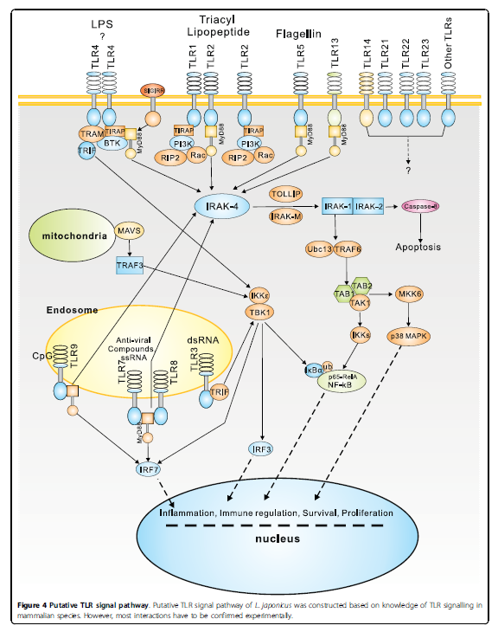
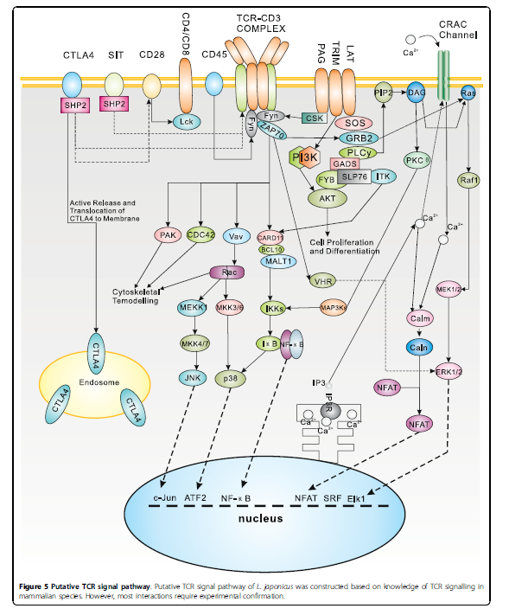
1. Transcriptomics and Bioinfomatics
Putative TLR and TCR pathways of L. japonicus based on new 454 sequencing
Xiang and He et al., 2010

Slide 5
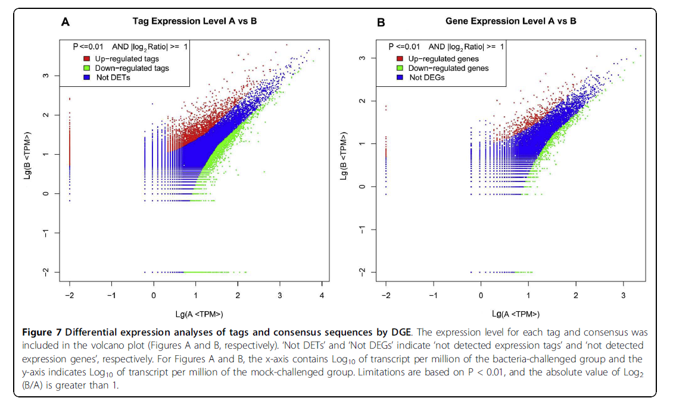
1. Transcriptomics and Bioinfomatics
Different expression analyses of stages and consensus sequences in L. japonicus under bacteria-challenge.
Xiang and He et al., 2010

Slide 6
2. Biomarkers: Analytical Methods
Animals
Floc
Vegetation
Freeze Dry
Bulk measurements
(¹³C and ¹⁵N, etc.)
Solvent Extraction
Saponification
Neutral
Acid
Column clean-up
GC-IRMS
GC-MS
GC×GC-MS
Compound
Specific
Isotope
Biomarkers

Slide 7
2. Common biomarkers to trace source
-n-alkanes
-fatty acid
-Highly brached isoprenoid
-hopanoid
-sterol
-PAHs
-diterpenoid
-triterpenoid
…
He et al., 2014

Slide 8
2. Common biomarkers to trace source (examples)
Raw data measured by GC×GC-TOFMS from a really complex mixture (crude oil for this case)

Slide 9
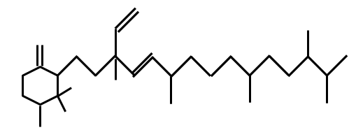
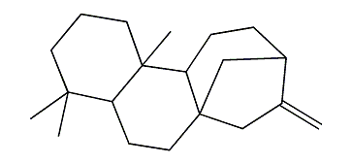
2. Common biomarkers to trace source
Example of an anteiso alkane: 3-methyloctacosane (C₂₉ branched alkane)
Example of a Botryococcene
ent-kaur-16-ene
2,6,11,15-tetramethyl-hexadeca-2,6,8,10,14-pentaene
Example of C₂₀ Highly Branched Isoprenoid (HBI)

Slide 10
2. Common biomarkers to trace source
R
R
R
Olean-18 (germanic-)
R = O : germanicone
R = OH: germanicol
R = C₂H₃O₂: germanicyl acetate
R = C₃H₅O₂: germanicyl propionate
R = C₄H₇O₂: germanicyl butanoate
R = C₅H₉O₂: germanicyl pentanoate
R = C₆H₁₁O₂: germanicyl hexanoate
Olean-12
R = O : β-amyrinone
R = OH: β-amyrinol
R = C₂H₃O₂: β-amyrinyl acetate
R = C₄H₇O₂: β-amyrinyl butanoate
Urs-12
R = O : α-amyrinone
R = OH: α-amyrinol
O
H
O
Friedelan-3-one
Taraxerol

Slide 11
2. Biomarkers in Cattails (examples)
Chemical structures of the ferulic and p-coumaric acids and esters.
He et al., 2014, submitted
Notes:
This figure shows the structure of both E and Z forms of ferulic acid, alkyl ferulates, coumaric acids and alkyl coumarates.

Slide 12
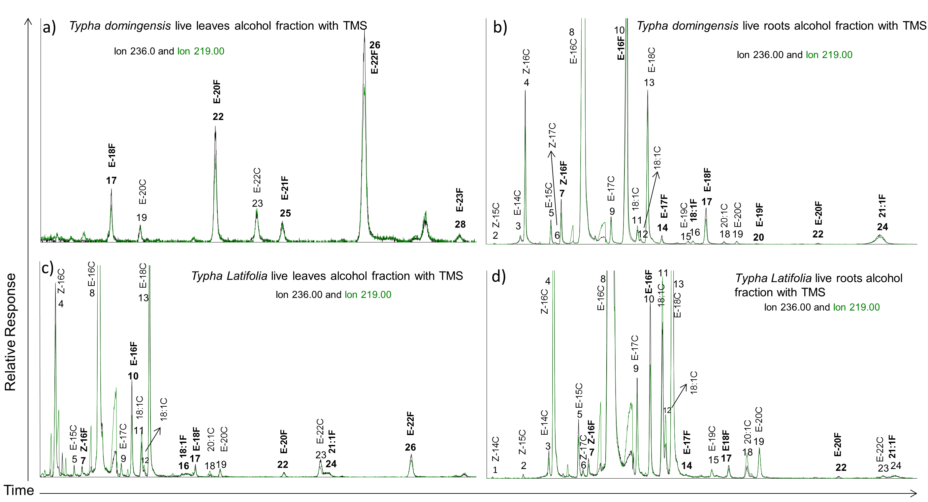
2. Biomarkers in Cattails (examples)
Note: Alkyl-p-coumarates and alkyl-ferulates were listed by elution order from no. 1 to 34. Alkyl-ferulates and alkyl-p-coumarates are marked by numbers, E-nF (n = number of alcohol moieties) means trans-n-alkyl-ferulate, E-nC (n = number of alcohol moieties) means trans-n-alkyl-coumarate.
He et al., 2014, submitted

Slide 13
2. Biomarkers in periphyton and floc (examples)
A total of 46 mono-methylalkanes, including three iso and three anteiso-alkanes, were identified.
He et al., 2015
Notes:
The figure shows the GC of typical periphyton and floc, all annotations in black dots are n-alkanes, and the ones in triangles are MMAs. As you can see the abundance of MMAs are really comparable with that of n-alkanes.

Slide 14
3. Compound specific isotopes for biomarkers
Highly specialized instrumental technique used to ascertain the relative ratio of light stable isotopes of carbon (¹³C/¹²C), hydrogen (²H/¹H), nitrogen (¹⁵N/¹⁴N) or oxygen (¹⁸O/¹⁶0) in individual compounds separated from often complex mixtures of components.
They can provide organic matter source information and direct information such as the primary productivity and hydrology etc.

Slide 15
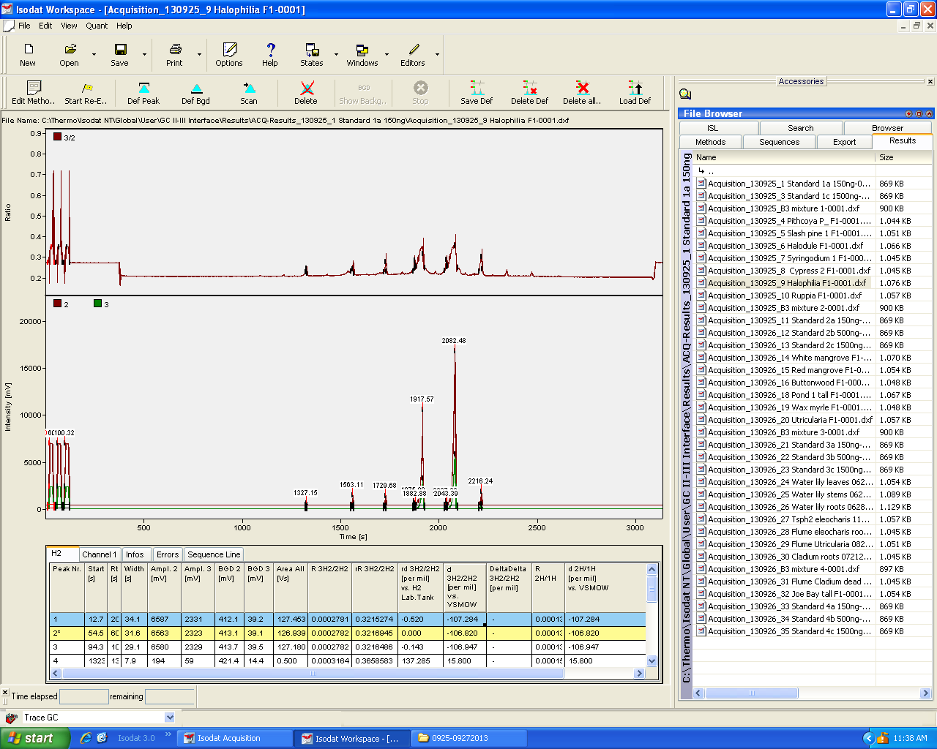
3. Examples of raw data generated from a GC-PirMS

Slide 16
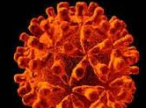
Molecular Biomarkers & Diagnosis Related Journals
Advancements in Genetic Engineering
Journal of Molecular and Genetic Medicine

Slide 17
For Upcoming Conferences
http://www.conferenceseries.com/

