Slide 1
OMICS Group
OMICS Group International through its Open Access Initiative is committed to make genuine and reliable contributions to the scientific community. OMICS Group hosts over 400 leading-edge peer reviewed Open Access Journals and organizes over 300 International Conferences annually all over the world. OMICS Publishing Group journals have over 3 million readers and the fame and success of the same can be attributed to the strong editorial board which contains over 30000 eminent personalities that ensure a rapid, quality and quick review process. OMICS Group signed an agreement with more than 1000 International Societies to make healthcare information Open Access.
Contact us at: contact.omics@omicsonline.org

Slide 2
OMICS Journals are welcoming Submissions
OMICS Group welcomes submissions that are original and technically so as to serve both the developing world and developed countries in the best possible way.
OMICS Journals are poised in excellence by publishing high quality research. OMICS Group follows an Editorial Manager® System peer review process and boasts of a strong and active editorial board.
Editors and reviewers are experts in their field and provide anonymous, unbiased and detailed reviews of all submissions.
The journal gives the options of multiple language translations for all the articles and all archived articles are available in HTML, XML, PDF and audio formats. Also, all the published articles are archived in repositories and indexing services like DOAJ, CAS, Google Scholar, Scientific Commons, Index Copernicus, EBSCO, HINARI and GALE.
For more details please visit our website: http://omicsonline.org/Submitmanuscript.php

Slide 3
Doh-Kwon Lee

Slide 4
Biography
Dr. Doh-Kwon Lee received his Bachelor’s degree in inorganic materials science and engineering from Seoul National University in Seoul in 1997. He continued his studies in materials science and engineering at Seoul National University, where he obtained his Master’s degree and Ph.D. in 1999 and 2005 (Advisor: Prof. Han-Ill Yoo). His Ph.D. thesis was devoted to understanding the interference effect between the ionic and electronic flow, which had long been believed negligible without experimental verification, in the mixed ionic and electronic conductors, and to elucidating the validity of Onsager’s reciprocity theorem in the phenomenon of mixed ionic and electronic conduction. With his Ph.D. completed, he moved onto the Institute of Physical Chemistry, Justus-Liebig-University Giessen in Germany, where he joined Prof. Janek’s research group as a senior scientist. During his period at JLU Giessen (2005-2009), he expanded his interest to the interfacial problems in functional materials, e.g., the enhanced mass and charge transport in nano-sized oxide films and the morphological instability developed at the surfaces of electroceramics, and the photoelectrochemical applications of oxide semiconductors. Since 2009, Dr. Lee has worked as a senior research scientist at Solar Cell Center, Korea Institute of Science and Technology (KIST) in Korea. The current focus of his recent research is to develop dye-sensitized solar cells, CIGS solar cells with high efficiency and photoelectrochemical cells for hydrogen production.

Slide 5
Research Interest
Thin film solar cells (CuIn_{1-x}GaxSe₂ , Cu₂ZnSnS₄, organo-metal halides solar cells, tandem solar cells)
Photoelectrochemical hydrogen production
Solid state electrochemical materials and devices (solid oxide fuel cell, secondary battery, oxygen separation membrane)

Slide 6
Photovoltaics: Multidisciplinary Science
Solid State Ionics (Defect Chemistry)
Semiconductor Physics
Electron concentration
Electron mobility
Nonstoichiometry distribution
Band-gap engineering
Recombination
Electrochemistry
Organic/Polymer Chemistry
- Semiconductor/ electrolyte interface
- Electrode kinetics
Design of dye
Inorganic Chemistry
Optics
- Synthesis of nano- structured electrode
Absorbance of light
Chemical Engineering
Module, System

Slide 7
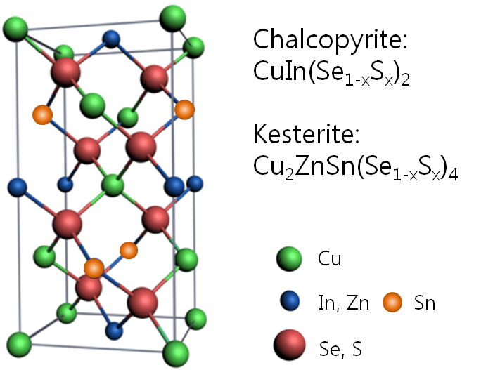
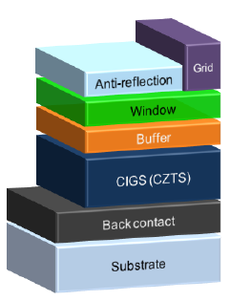
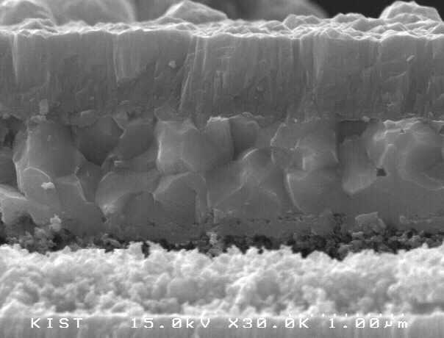
CIGS, CZTS Solar Cells
Low-cost, solution-processed thin-film solar cells

Slide 8
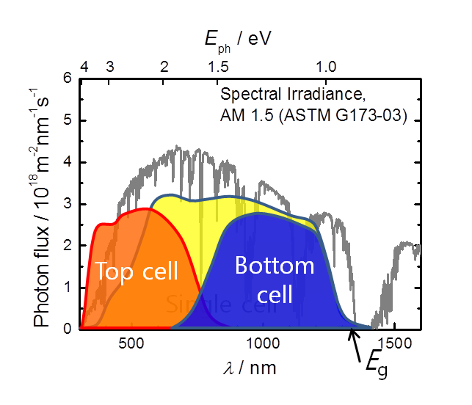
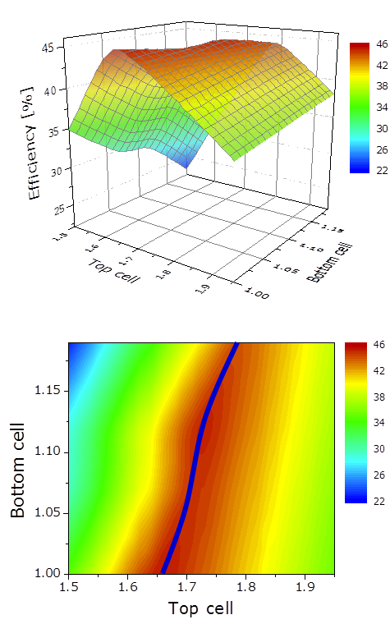
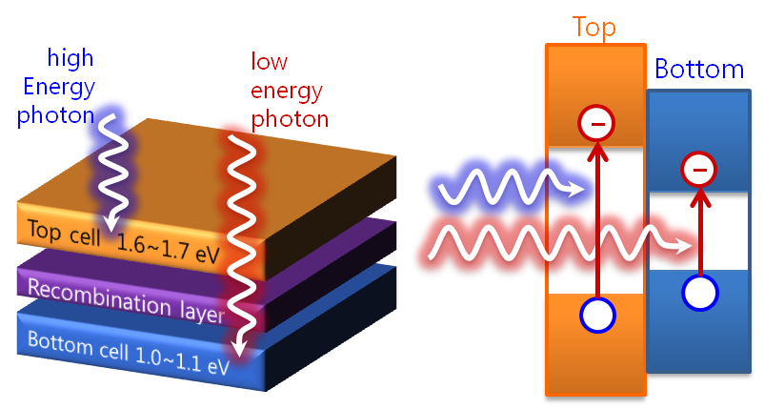
Tandem solar cells
Single junction: severe photon energy loss
by carrier thermalization
→ Multijunction (tandem) approach

Slide 9
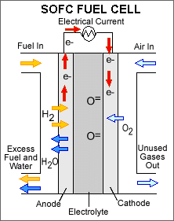
Solid Oxide Fuel Cells
Basic fuel cell operation
Cathode Reaction
Anode Reactions
Taken from fuelcellworks.com

Slide 10
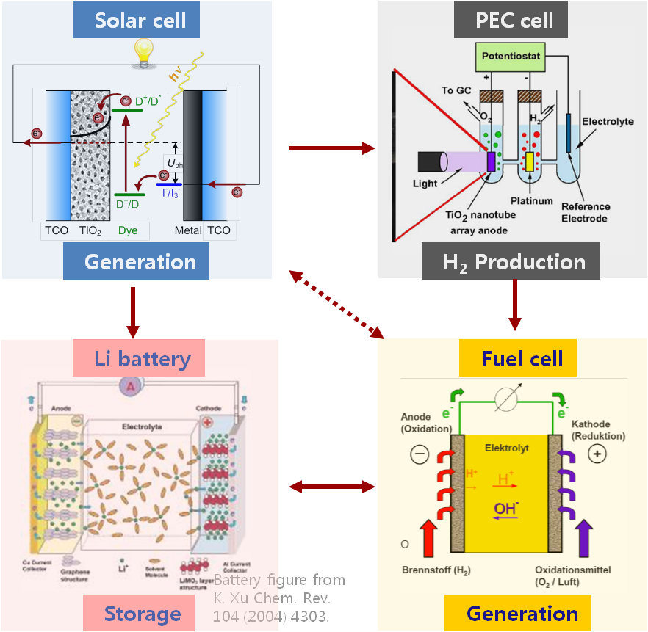
Energy Internet

Slide 11
Signature

Slide 12
Journal of Physical Chemistry & Biophysics Related Journals
Journal of Electrical & Electronic Systems
Journal of Lasers, Optics & Photonics

Slide 13
Gynecology & Obstetrics Related Conferences
3rd International Conference and Exhibition on
Lasers, Optics & Photonics

Slide 14
OMICS Group Open Access Membership
OMICS publishing Group Open Access Membership enables academic and research institutions, funders and corporations to actively encourage open access in scholarly communication and the dissemination of research published by their authors.
For more details and benefits, click on the link below:
http://omicsonline.org/membership.php

