Slide 1
OMICS Journals are welcoming Submissions
OMICS International welcomes submissions that are original and technically so as to serve both the developing world and developed countries in the best possible way.
OMICS International are poised in excellence by publishing high quality research. OMICS International follows an Editorial Manager® System peer review process and boasts of a strong and active editorial board.
Editors and reviewers are experts in their field and provide anonymous, unbiased and detailed reviews of all submissions.
The journal gives the options of multiple language translations for all the articles and all archived articles are available in HTML, XML, PDF and audio formats. Also, all the published articles are archived in repositories and indexing services like DOAJ, CAS, Google Scholar, Scientific Commons, Index Copernicus, EBSCO, HINARI and GALE.
For more details please visit our website: http://omicsonline.org/Submitmanuscript.php

Slide 2
Don Hong
Editor in Chief
Journal of Health & Medical Informatics

Slide 3
Health & Medical Informatics
“... the application of computers, communications, and information technology and systems to all fields of medicine” (Morris Collen)
“...transformation of data to information, information to knowledge”
(M. ‘Scott’ Blois)

Slide 4
Journal of Health and Medical Informatics
The Journal of Health & Medical Informatics (JHMI) is a scholarly journal that integrates the information and communication related to healthcare, medicine and their applications in medical information systems.

Slide 5
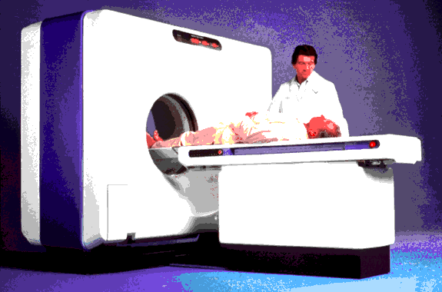
Informatics Applications
Data capture devices
New tools that deliver clinical interventions
Substantive content specific to selected clinical trials
Treat informatics like statistics: expect it in every project!

Slide 7
Editor’s Biography
Don Hong earned his Ph.D. in Mathematics from Texas A&M University
Finished his postdoctoral training in computational mathematics at the University of Texas-Austin.
Currently, he is full professor of the department of mathematical sciences and the Ph.D. program of computational sciences at Middle Tennessee State University.
He has held Visiting Professor positions at several schools including Vanderbilt University, Ningbo University-China, North China University of Technology, and City University of Hong Kong.
.

Slide 8
Awards and other Expertise
He is serving on the editorial boards or as a guest editor for seven journals.
Dr. Hong has received nearly $1M external research grants as the principal investigator.

Slide 9
Research Interests
Approximation Theory and Computational Mathematics including Splines and Wavelets with Applications
Biomedical Data Analysis and Bioinformatics including Proteomic Data Mining and Medical Imaging and Image Processing
Statistical Methods and Actuarial Science

Slide 10
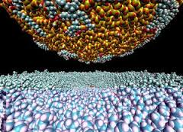
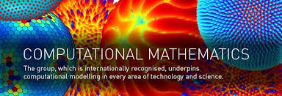
Machine learning
Computational Mathematics

Slide 11
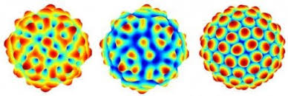
Approximation Theory
Approximation theory a major branch of mathematics which includes function spaces, quantitatively characterization and their approximation schemes and power.
It includes many sub-branches like optimal polynomials, Chebyshev approximation, Splines and Wavelets, Sparse Data Representation, and many more.
Approximation Theory

Slide 12
Recent Publications
Wavelet-based procedures for proteomic mass spectrometry data processing, (with S. Chen and Y. Shyr), Computational Statistics & Data Analysis 52 (2007) 211 – 220.
A novel comprehensive wave-form MS data processing method, (with S. Chen at al), Bioinformatics 6 (2009), 808–814.
Elastic net-based framework for imaging mass spectrometry data biomarker selection and classification, (with F. Zhang), Statistics in Medicine, 30(2011):753-768.
Health Insurance Rate Review Report, the TN Department of Commerce and Insurance, (with Q. Wu, H. Tuthill, and K.Hollman), 2012.
Multi-Resolution Analysis Method for IMS Proteomic Data Biomarker Selection and Classification, (with L. Xiong), British Journal of Mathematics & Computer Science 5(2015): 64-80.

Slide 13
SIGNATURE
Don Hong, Ph.D.
Professor of Mathematical Sciences
Computational Science Ph.D. Program
Middle Tennessee State University
Murfreesboro, Tennessee, USA
http://capone.mtsu.edu/dhong

Slide 14
Journal of Health & Medical Informatics related Journals
http://omicsgroup.org/journals/primary-health-care-open-access.php
http://scitechnol.com/applied-bioinformatics-computational-biology.php

Slide 15
Journal of Health & Medical Informatics related Conferences
For further details regarding the conference please visit: http://healthinformatics.conferenceseries.com/

Slide 16
OMICS Group Open Access Membership
Open Access Membership with OMICS international enables academicians, research institutions, funders and corporations to actively encourage open access in scholarly communication and the dissemination of research published by their authors.
For more details and benefits, click on the link below:
http://omicsonline.org/membership.php

