Slide 1
OMICS Journals are welcoming Submissions
OMICS International welcomes submissions that are original and technically so as to serve both the developing world and developed countries in the best possible way.
OMICS Journals are poised in excellence by publishing high quality research. OMICS International follows an Editorial Manager® System peer review process and boasts of a strong and active editorial board.
Editors and reviewers are experts in their field and provide anonymous, unbiased and detailed reviews of all submissions.
The journal gives the options of multiple language translations for all the articles and all archived articles are available in HTML, XML, PDF and audio formats. Also, all the published articles are archived in repositories and indexing services like DOAJ, CAS, Google Scholar, Scientific Commons, Index Copernicus, EBSCO, HINARI and GALE.
For more details please visit our website: http://omicsonline.org/Submitmanuscript.php

Slide 2
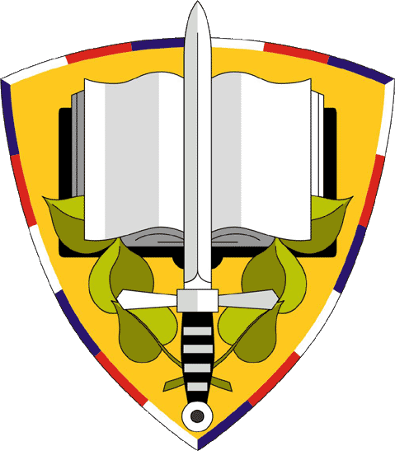
NBC Defence Institute of University of Defence
THE MEMBER OF EDITORIAL BOARD´S RESEARCH INTEREST
Lt-Col. Dipl. Eng. Pavel OTŘÍSAL, Ph.D., MBA

Slide 3
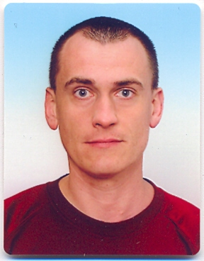
Editorial Board Member
Dr. Pavel Otrisal
Lieutenant Colonel
NBC Defence Institute
University of Defense
Czech Republic

Slide 4
Biography
Dr. Pavel OTŘÍSAL. I was born on the 28th of January 1972 in Ústí nad Orlicí, Czech Republic. I am a soldier. I joined the army in 1986. My current rank is a Lieutenant-Colonel. I had been graduated from the Military College of Ground Forces before I started my military carrier. It was in 1994. Firstly, I had been working as a company commander, then I was a deputy of the chief of staff of the training battalion and then I was promoted to the position of a chief of the training group of the training battalion Secondly, in 1997 I had to move to Vyškov garrison. I had occupied a lot of various positions here before I won a selection procedure in October 2005.
> > >

Slide 5
Thirdly, from that time I have been working as a special assistant at the NBC defence institute of the University of Defence in Brno. As a teacher I am responsible for education of military students in a branch of CBRN defence (CBRN stands for chemical, biological, radiological and nuclear) and chemical support and furthermore in some courses concerning the branch mentioned above. I was interested in a share of chemical units as a part of Integrated Rescue System. In the scientific work I elaborate problems concerning special protective abilities in the area of possible contamination not only with Chemical Warfare Agents but also with Toxic Industrial Materials.

Slide 6
Research Interests
Research activities in a branch of Individual and Collective Protective Equipment – development of new methods for testing of protective characteristics of barrier materials used in protection against CBRN threats especially against Chemical Warfare Agents and Toxic Industrial Chemicals. Research activities in a branch of Combat employment of Chemical Corps.
> > >

Slide 7
Publications
Pavel Otrisal and Zdenek Melicharik (2014) Some Challenges within a Branch of Study of Protective Properties of Barrier Materails in the Czech Armed Forces J Def Manag 4:e123
Pavel Otrisal (2012) Why to Study Chemical Resistance of Selected Ipe against Effects of Decontamination Mixtures? J Def Manag 3:e120
Pavel Otrisal (2012) Selected Software Tools Used for CBRN Situation Assessment within CZECH Armed Forces Chemical Corps J Def Manag 2:e115

Slide 8
Measurement of body surface isolative protection properties
Employment of new methods based on changes of characteristics of special sensor based on QCM;
Development of working procedures related to testing protective materials in accordance to norms;
Contribution to decision making process of commanders in all types of operations

Slide 9
Measurement of body surface isolative protection properties
Using special softeare tools designated only for purposes of this measurements;
Cooperation with other universities and special working places not only in the Czech Republic but also within the NATO framework;
Cooperation with companies which produce material for physical protection.

Slide 10
Tactics and combat employment of chemical corps in operations
Developing of new procedures in new types of military operations in accordance to the NATO standards and doctrines;
Enhancing of capabilities within the framework of CBRN Defence and chemical support;
Contribution to the development of new material for the chemical corps units and formations.

Slide 11
Tactics and combat employment of chemical corps in operations
Enhancing of decision making process with the application of command and control aproaches;
Combining of tasks fulfilled within CBRN Defence and chemical support into one measurement named CBRN Defence in accrodance to NATO standard AJP-3.14.

Slide 12
Joint CBRN Defence Centre of Excellence as a part of NATO
Place, organizational structure, mission and task of Joint CBRN Defence Centre of Excellence in the NATO structure;
Role, responsibility and mission of finncial organs working in favour of this institution;
Development of working procedures and their evaluation within other COEs.

Slide 13
Journal of Defense Management Related Journals
Bioterrorism Journals
Aeronautics Journals
Astophysics Journals
Chemical Engineering Journals
Defense Studies Journals

Slide 14
For Upcoming Conference Visit
http://www.conferenceseries.com

