Slide 1
OMICS International
OMICS Group International through its Open Access Initiative is committed to make genuine and reliable contributions to the scientific community. OMICS Group signed an agreement with more than 1000 International Societies to make healthcare information Open Access.
Contact us at: contact.omics@omicsonline.org

Slide 2
OMICS Journals are welcoming Submissions
OMICS International welcomes submissions that are original and technically so as to serve both the developing world and developed countries in the best possible way.
OMICS International Journals are poised in excellence by publishing high quality research. OMICS Group follows an Editorial Manager® System peer review process and boasts of a strong and active editorial board.
Editors and reviewers are experts in their field and provide anonymous, unbiased and detailed reviews of all submissions.
The journal gives the options of multiple language translations for all the articles and all archived articles are available in HTML, XML, PDF and audio formats. Also, all the published articles are archived in repositories and indexing services like DOAJ, CAS, Google Scholar, Scientific Commons, Index Copernicus, EBSCO, HINARI and GALE.
For more details please visit our website: http://omicsonline.org/Submitmanuscript.php

Slide 3
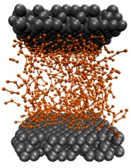
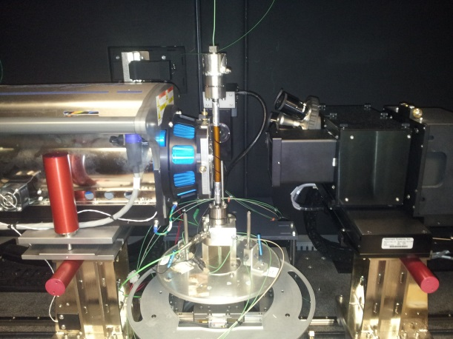
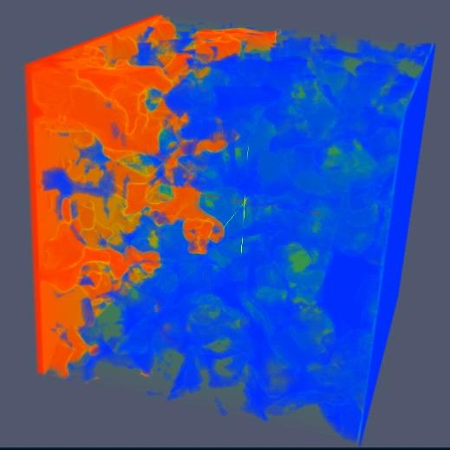
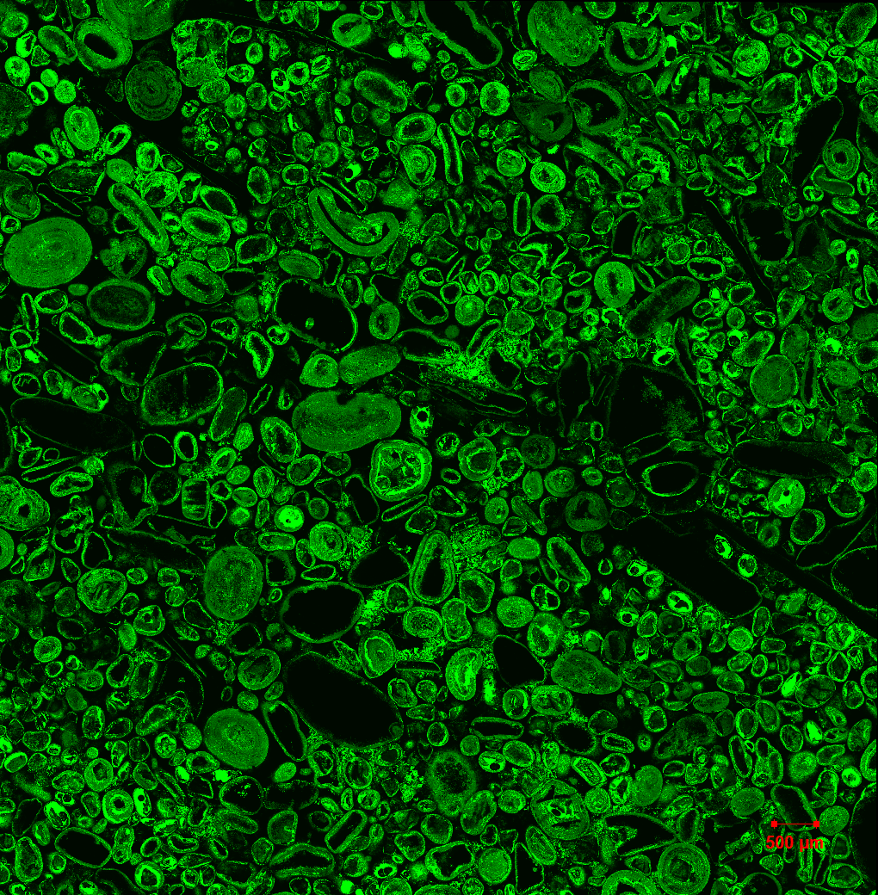
Complex Fluids group – dr Edo Boek
Chemical Engineering Dept, Imperial College London, UK
Research interests
Multi-scale imaging and simulation of flow and structure
Complex fluids: oil / water / CO2 / colloids / polymers / surfactants ..
Flow in porous media – applications in CO2 storage / EOR
Formulation and Non-Newtonian rheology
molecular level explanation of macroscopic behaviour
pore-scale multiphase flow and reactive transport
dynamic properties (e.g. rheology) and microstructure
Experiment & Simulation:
Flow Imaging: micro-CT and medical CT
Microfluidics & etched micro-models
Rheology: ambient & high P (1000 bar)
Microscopy: light & confocal laser scanning
Simulation: Flow (LB, DPD, MPCD) and Structure (MD,MC) – hybrid methods

Slide 4
Journal of Chemical Engineering & Process Technology Related Journals
Journal of Petroleum & Environmental Biotechnology
Journal of Civil & Environmental Engineering
Journal of Advanced Chemical Engineering

Slide 5
Journal of Chemical Engineering & Process Technology Related Conferences
3rd World Congress on Petrochemistry and Chemical Engineering
International Conference on Significant Advances in Biomedical Engineering

Slide 6
OMICS International Open Access Membership
OMICS International offers Open Access Membership for academic and research institutions, funders and corporations to actively encourage open access in scholarly communication and the dissemination of research published by their authors.
For more details and benefits, click on the link below:
http://omicsonline.org/membership.php

