Slide 1


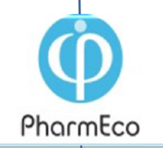
Modular construction
of DNA aptamers
for human thrombin
Zavyalova Elena
Kopylov Alexey
Apto-Pharm Ltd:
Moscow State University
Russian Academy of Sciences
PharmEco Holding
1
1
Notes:
1
1
1
1
1
1

Slide 2
Aptamers –
Molecular Recognition Elements (MoRE)‏
made of Nucleic Acids
Aptamers are oligonucleotides that share some attributes of monoclonal antibodies due to complex 3D structure
“Chemical Antibody” for Theranostics
(Therapy&Diagnostics)
2
2
Notes:
2
2
2
2

Slide 3
030213-141013 PubMed: aptamer + review = 37 refs (370 Total)
Mode of Application:
1: Yadav SK, Chandra P, Goyal RN, Shim YB. A review on determination of steroids in biological samples exploiting nanobio-electroanalytical methods. Anal Chim Acta. 2013 Jan 31;762:14-24.
2: Wang T, Ray J. Aptamer-based molecular imaging. Protein Cell. 2012 Oct;3(10):739-54.
3: Sundaram P, Kurniawan H, Byrne ME, Wower J. Therapeutic RNA aptamers in clinical trials. Eur J Pharm Sci. 2013 Jan 23;48(1-2):259-71.
4: Xing H, Wong NY, Xiang Y, Lu Y. DNA aptamer functionalized nanomaterials for intracellular analysis, cancer cell imaging and drug delivery. Curr Opin Chem Biol. 2012 Aug;16(3-4):429-35.
5: Pednekar PP, Jadhav KR, Kadam VJ. Aptamer-dendrimer bioconjugate: a nanotool for therapeutics, diagnosis, and imaging. Expert Opin Drug Deliv. 2012 Oct;9(10):1273-88
6. Mishra S, Kim S, Lee DK. Recent patents on nucleic acid-based antiviral therapeutics. Recent Pat Antiinfect Drug Discov. 2010 Nov 1; 5(3): 255-71.
Field of Application:
1: Binning JM, Leung DW, Amarasinghe GK. Aptamers in virology: recent advances and challenges. Front Microbiol. 2012;3:29.
2: Hu M, Zhang K. The application of aptamers in cancer research: an up-to-date review. Future Oncol. 2013 Mar;9(3):369-76
3: Yang Y, Ren X, Schluesener HJ, Zhang Z. Aptamers: Selection, Modification and Application to Nervous System Diseases. Curr Med Chem. 2011 18(27):4159-68.
4: Haberland A, Wallukat G, Schimke I. Aptamer binding and neutralization of β1-adrenoceptor autoantibodies: basics and a vision of its future in cardiomyopathy treatment. Trends Cardiovasc Med. 2011 Aug;21(6):177-82.
5: Vavalle JP, Cohen MG. The REG1 anticoagulation system: a novel actively controlled factor IX inhibitor using RNA aptamer technology for treatment of acute coronary syndrome. Future Cardiol. 2012 May;8(3):371-82.
3
Notes:
3
3

Slide 4
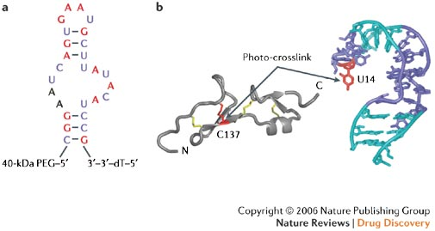

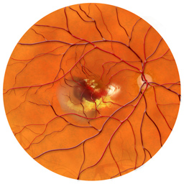
The success story:
ANGIOGENESIS - new vessels are created from pre-existing vasculature. Increased rates of angiogenesis are associated with several disease states:
- cancer
- age-related macular degeneration (AMD)
- psoriasis
- rheumatoid arthritis
- diabetic retinopathy
Treatment options for AMD
have been limited with photodynamic therapy
Commercial VEGF inhibitors/drugs are:
- RNA APTAMER pegaptanib (Macugen, Eyetech Parm/Pfizer)
partial and full length ANTIBODIES ranibizumab
(F_{ab}, Lucentis, $1,600), and bevacizumab (Avastin, $40), Genentech
- VEGF receptor trap - fusion protein aflibercept
- small interfering RNA-based therapies bevasiranib and AGN 211745,
sirolimus
- and tyrosine kinase inhibitors, including vatalanib, pazopanib
TG 100801, TG 101095, AG 013958, and AL 39324
Therapies have met with great success in reducing
the vision loss associated with neovascular AMD
Retina. 2013 Feb;33(2):397-402. Intravitreal pegaptanib sodium (macugen) for treatment of myopic choroidalneovascularization: a morphologic and functional study.
1994 –
(NeXstar
Pharma)
- 2004
(FDA)
4
4
Notes:
4
4
4
4
4
4

Slide 5
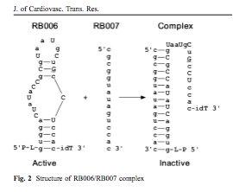
http://www.regadobio.com/
REGADO BIOSCIENCES, INC.
ENROLLS FIRST PATIENT
IN PHASE 3 TRIAL OF REG1"REGULATE-PCI"
TO STUDY REG1 IN PATIENTS UNDERGOING PERCUTANEOUS CORONARY INTERVENTION
BASKING RIDGE, N.J.,
Sept. 17, 2013 /PRNewswire/
TIDES, May 2013, Boston
Regado Biosciences, Inc. (Nasdaq: RGDO) - discovery and development of novel, first-in-class, actively controllable antithrombotic drug systems for acute and sub-acute cardiovascular indications, today announced the enrollment of the first patient in its REGULATE-PCI clinical trial. REGULATE-PCI is Phase 3, PROBE design (Prospective, Randomized, Open-label, Blinded-Endpoint) superiority study comparing the effects of Regado's REG1 to bivalirudin in patients undergoing percutaneous coronary intervention (PCI) electively or for the treatment of unstable angina (UA) or non-ST elevated myocardial infarction (N-STEMI). REGULATE-PCI, if successful, will serve as the basis for product registration applications throughout the world. Led by co-PIs, Drs. J. H. Alexander of Duke University Medical Center, A. M.Lincoff of The Cleveland Clinic and R. Mehran of Mount Sinai School of Medicine, REGULATE-PCI is expected to enroll 13,200 patients at approximately 500 investigational sites worldwide. The primary endpoint of the trial is efficacy compared to bivalrudin based on a composite of death, nonfatal myocardial infarction (MI), nonfatal stroke and urgent target lesion revascularization through day three. The principal secondary endpoint is safety compared to bivalrudin as measured by major bleeding events through day three. The trial is powered to show superiority in efficacy and non-inferiority in safety against bivalirudin. If successful, REGULATE-PCI will become the cornerstone of Regado's international new drug applications, expected to be filed in early 2016. The first of three key interim analyses in the trial will occur after enrollment of the first 1,000 patients and is expected to occur during the second quarter of 2014.
Next – NOXXON?

Slide 6

MAKING APTAMERS
SELEX - Systematic Evolution of
Ligands by EXponential enrichment
SELEX –in vitro selection of RNA/DNA
of single stranded oligo combinatorial libraries
for molecules which bind a target.
Winners, not champs
The molecules are coined APTAMERS [aptus (lat) – to correspond, to fit)
APTAMERS are single-stranded oligos with 3D structure that binds to the target with high affinity and specificity, and possibly modulate target function.
Goal of SELEX – to fish out aptamers, and to make large amount of aptamers by chemical synthesis
L. Gold,1990
6
6
Notes:
6
6
6
6
6
6
6
6
6
6

Slide 7
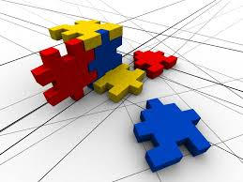
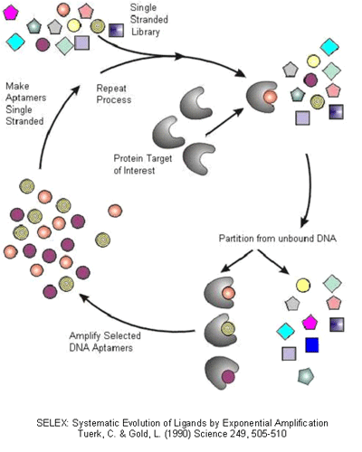
SELEX
Chemical
synthesis
and
selection of aptamers
out of 4^{n}
sequences
(ie 10¹⁴‏ for pegaptanib)
SELEX
Families of aptamers
with repertoire
of affinities
Winners, but not champs
7
7
Notes:
7
7
7
7
7
7
7
7

Slide 8
Aptus: “to fit”
mer : “smallest unit of repeating structure”
Aptamers could be developed for different targets, both LMW and HMW:
Toxins
Proteins
Viruses
Pathogenic microorganisms
Cancer cells
8
8
Notes:
8
8
8
8
8
8
8

Slide 9
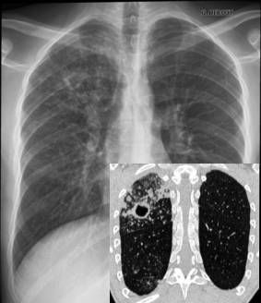
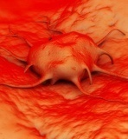
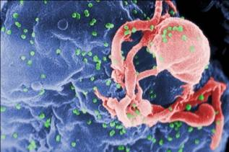
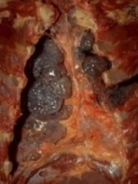
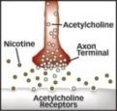
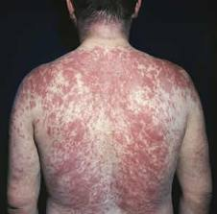
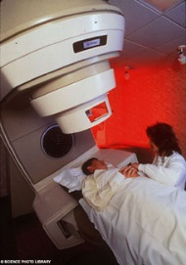
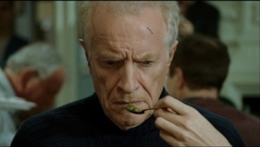

Aptamer targets
Oncology
Mycobacterium tuberculosis‏
Viruses
Acetylcholine
(nicotine)
Aptamers
under
development
Allergy ‏
Photodynamic and Radiotherapy
Prions
Alzheimer's disease
LMW comps & drugs
Thrombin
9
9
Notes:
9
9
9
9
9
9
9
9
9
9

Slide 10
KNOWING APTAMERS
APTAMERS vs/and
ANTIBODIES
High affinity and specificity for the target
High affinity and specificity for the target
In vivo biological protocols
In vitro chemical protocols
Binding parameters could be modified
Possibility for changes of binding parameters
Reversible temperature denaturing
Irreversible temperature denaturing
Extended storage time
Limited storage time
Low immunogenity
High immunogenity
Availability of specific ANTIDOTE
NO rational ANTIDOTE
Aptamers have some potential advantages
Then why the progress slow?
10
10
Notes:
10
10
10
10
10
10
10
10

Slide 11
A key attribute of THERAPEUTIC APTAMERS is the ability to tailor the pharmacokinetic profile by modulating the degree of metabolic stability, renal clearance and rate of distribution
Good safety margins between the pharmacologically effective dose and toxicologically established no-adverse-effect levels
Several Aptamers are on Clinical Trials
Then why the progress slow?
http://clinicaltrials.gov <aptamer>: 27/21 entries (oct, 2013/feb, 2012)
Why the progress is slow?
11
Notes:
11
11
11
11
11
11

Slide 12
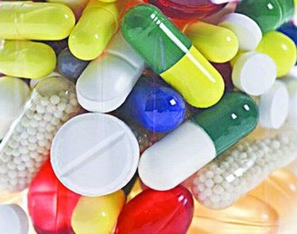
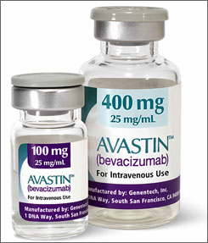
2 Dual Paradigm of Drug Design
I. Small – CHEMICALS, Low molecular weight
Creation of combinatory library of synthetic and natural CHEMICAL COMPOUNDS
Selection by activity
Chemical synthesis
PLUS – Better distribution
MINUS – Less specificity
II. Large – BIOLOGICS, High molecular weight
Identification of proteins with defensive functions (Ig, IFN, GF)
Making genetic engineering constructs Biotechnological synthesis.
MINUS – Slow distribution
PLUS – High specificity
12
12
Notes:
12
12
12
12
12
12
12
12
12

Slide 13
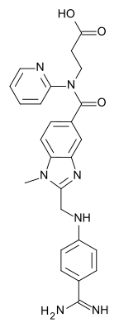
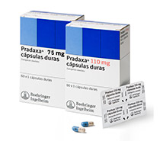
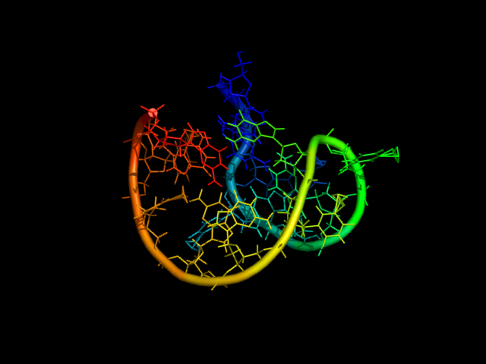
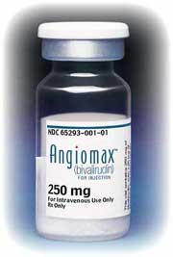
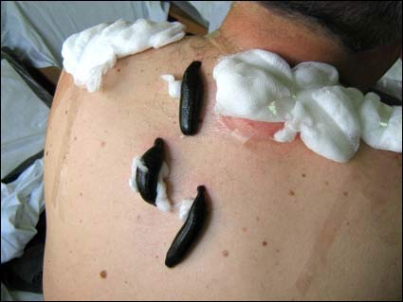
Triple Paradigm of Anti-Thrombin Drug Design
I. CHEMICALS
Dabigatran
(Pradaxa)
APTAMERS as the third paradigm
Intermediate size status in attempt
to combine the best of both groups
Peptamer: Hirulog (20 aa) (Bivalirudin, Angiomax, Angiox)‏
  II. BIOLOGICS
Leeches > hirudin (65 aa)
13
13
Notes:
13
13
13
13
13
13
13
13
13

Slide 14
Prophylactics and Treatments of Thrombosis
1. Thrombolytics – dissolve thrombi
(Streptokinase (SK), Urokinase (UK),
Tissue plasminogen activator (tPA)
2. Anti-aggregants – inhibits platelet aggregation
(aspirin, Thienopyridines – Clopidogrel (Plavix),
IIb-IIIa glycoproteins antagonists
3. ANTI-COAGULANTS – inhibit fibrin formation:
Non-direct anticoagulants (warfarin)
Direct anti-coagulants:
Heparin and derivatives (thrombin, 10a)
Enoxaparin (10a)
Rivaroxaban (10a)
Direct thrombin inhibitors:
monovalent – chemicals (dabigatran)
bivalent - biologics (bivalirudin)
14
14
Notes:
14
14
14
14
14
14

Slide 15
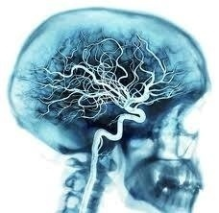
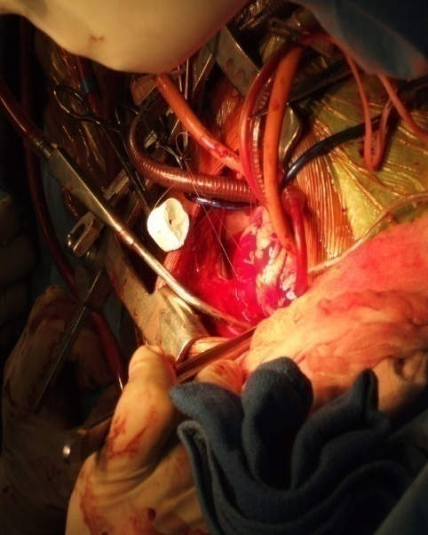
Primary challenges of
anti-thrombin aptamer applications
to reduce
cerebral embolization
after
carotid endarterectomy
to reduce
post-operational bleeding
after
coronary artery bypass surgery
15
15
Notes:
15
15
15
15
15
15
15
15
15

Slide 16
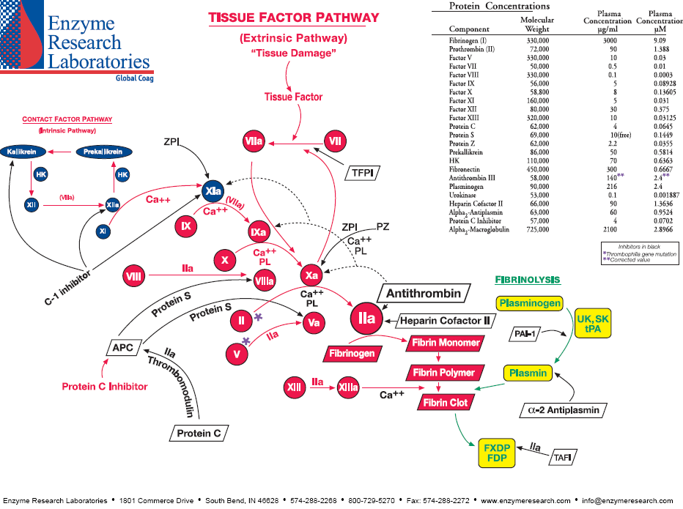


Coagulation Cascade and Aptamers
Willebrand Factor
RA36
REG2
16
16
Notes:
16
16
16
16
16
16

Slide 17
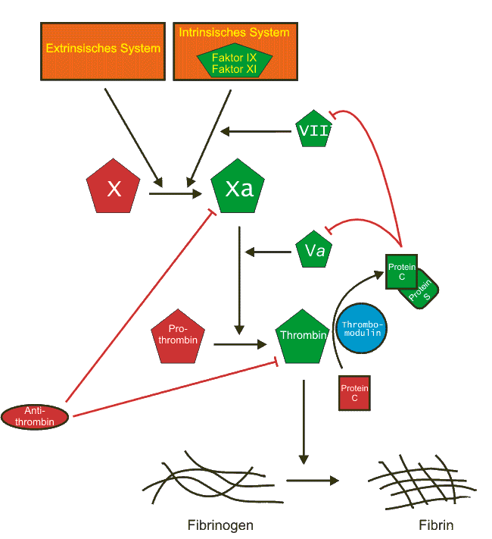
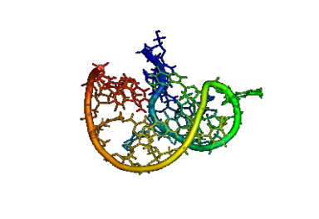
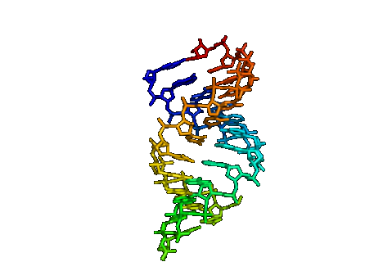
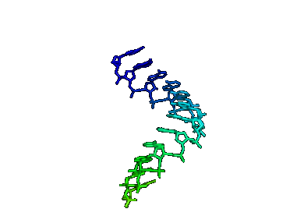
Unique opportunity – fast antidot
Aptamer blocks thrombin, and antidot blocks aptamer, restoring coagulation
Fibrin mesh
for clotting
17
17
Notes:
17
17
17
17

Slide 18
4 steps of making useful aptamer
I. Selecting primary aptamer families
Gold Rush (Missing links):
Understanding aptamers
Designing aptamers
II. Adjusting aptamers to the target
III. Making aptamers stable/durable
IV. Solving specific tasks
V. Making therapeutic aptamer
18
18
Notes:
18
18
18
18
18
18

Slide 19
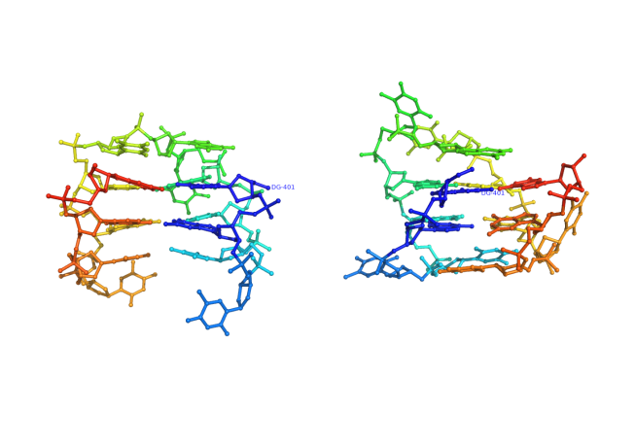
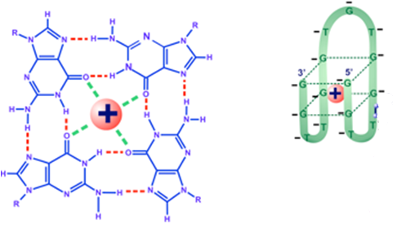
G-quadruplex structure
of 15-mer (15TGT) - chair
minimal DNA aptamer, pharmacophore
Cation (+) in the center
19
19
Notes:
19
19
19
19
19
19

Slide 20
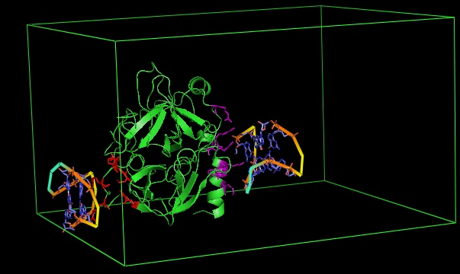
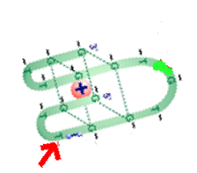
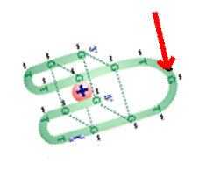
X-Ray of the complex of thrombin with 15TGT
Problem # 2
Which loop (TT or TGT) is a pharmacophore?
20
20
Notes:
20
20
20
20
20
20

Slide 21
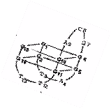
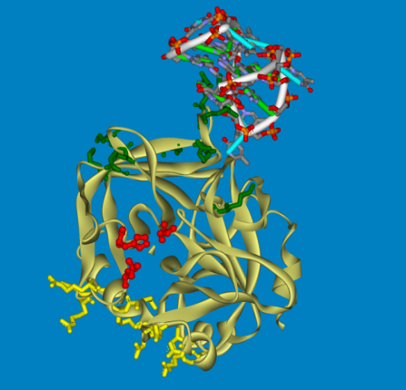
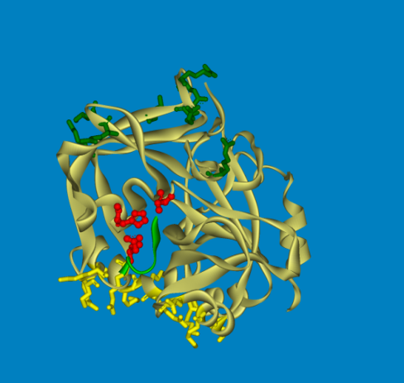

DNA aptamer and Thrombin
1) Thrombin
hydrolyzes
fibrinogen
which yields
clot formation
2) Aptamer inhibits
fibrinogen binding
and clot formation
Question # 3: Is it a competitive binding/inhibiting?
21
21
Notes:
21
21
21
21
21
21

Slide 22
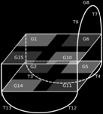
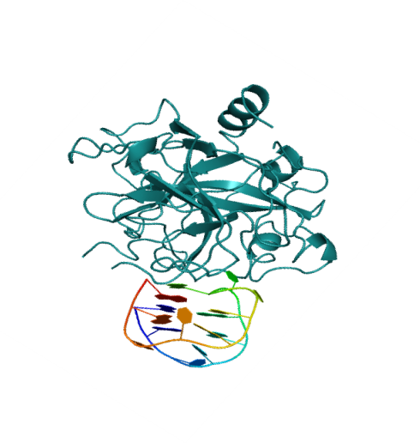
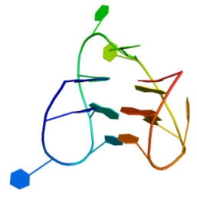
Understanding Aptamers
Lack of Structure -Function Relationship
?
15-mer ТGT‏ (USA)
Ki 14,7 nM (RF)
31-mer TGT‏ (Japan)
Ki 0,3 nM (RF)
26-mer NU 172 (USA)
Ki 0,3 nM (RF)
3D: X-ray, NMR
No 3D: just 1D
complex
?
MD: rational drug design
Apto-Pharm Ltd
RA-36‏ (RF)
Ki 7,5 nM (RF)
22
22
22
Notes:
22
22
22
22
22
22

Slide 23
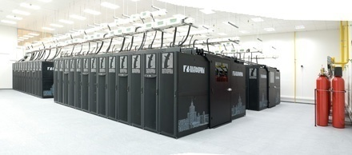
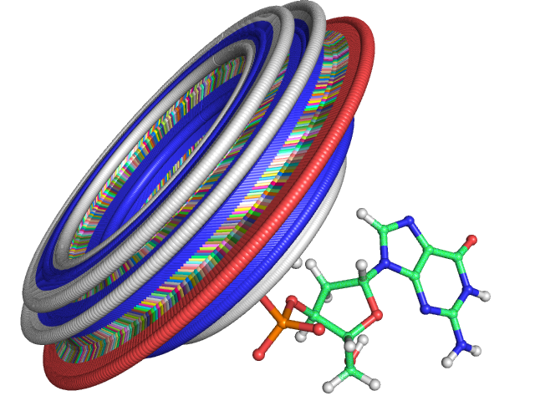
DNA aptamer modelling with molecular dynamics using super-computer
‘Lomonosov’ Top 31 (06/2013)
Cores: 78,660; Rmax (901.9 TFlop/s)
http://www.top500.org/system/177421
NO conventional force field parameters were available till now
Porting of new Force Fields into Gromacs
23
23
Notes:
23
23
23
23
23
23
23

Slide 24
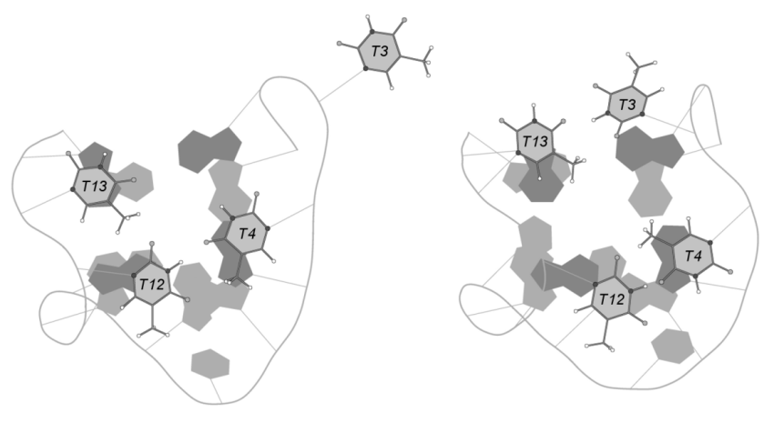
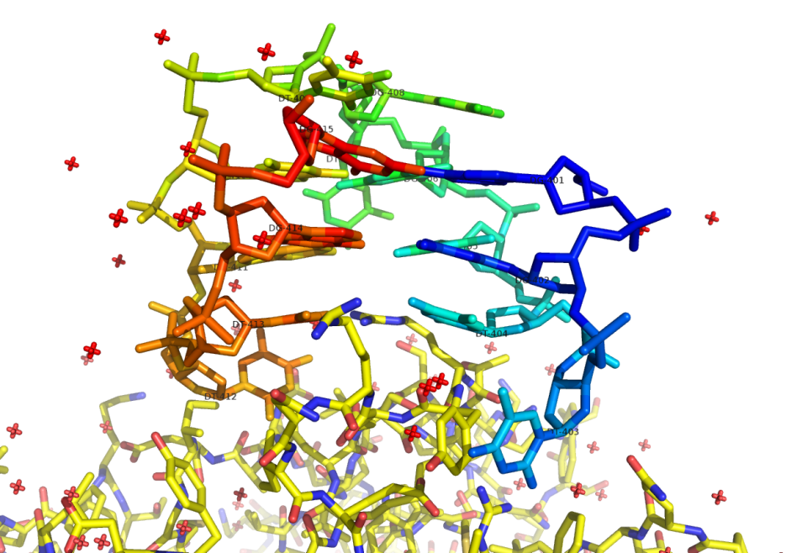
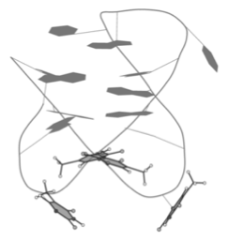
Bottom view of
2 TT base pairs of
2 TT loops
NMR model of 15TGT during MD
in the new force field
T12 and T3 interact with the thrombin
24
24
24
Notes:
24
24
24
24
24
24

Slide 25
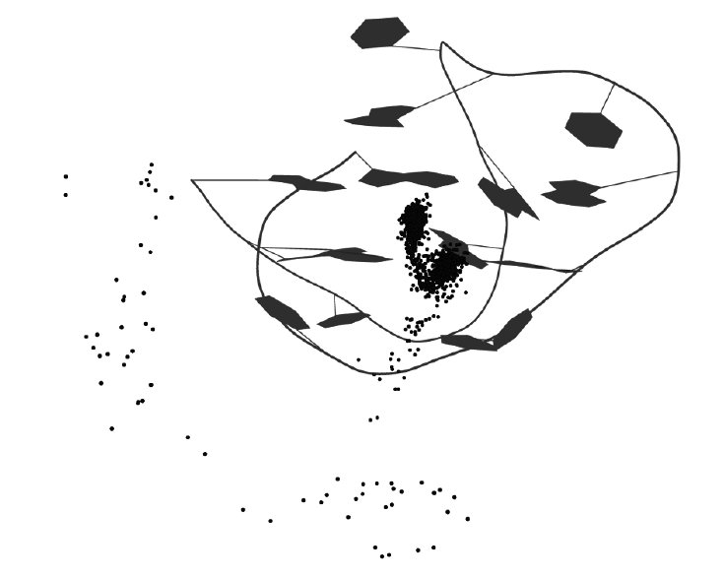
TGT upper loop
vs TT bottom loops
Loops vs cation
MD: 60-80 ns frame
Na⁺ movement into
G-quadrulpex
through TT loops
Most of the time
Na⁺ sits in the center
of G-quadruplex

Slide 26
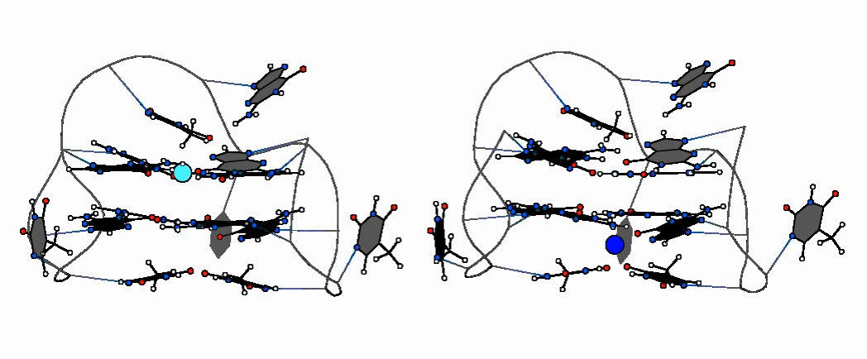
ps scale
Aptamer – cation QM/MM simulation
QM/MM simulation approach for proteins:
Martin Karplus, Michal Levitt, Arieh Warshell,
Nobel Prize in Chemistry 2013, Oct 9

Slide 27
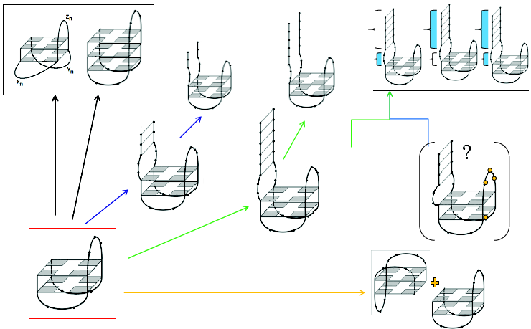
Functional Aptamers: Iº & Coagul Activity
Just putative structures
of 15TGT pharmacophore extentions
31TGT
NU172
no IIIº
single IIIº
RA36
15TGT

Slide 28
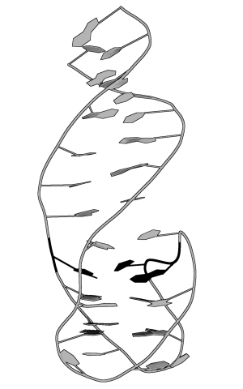
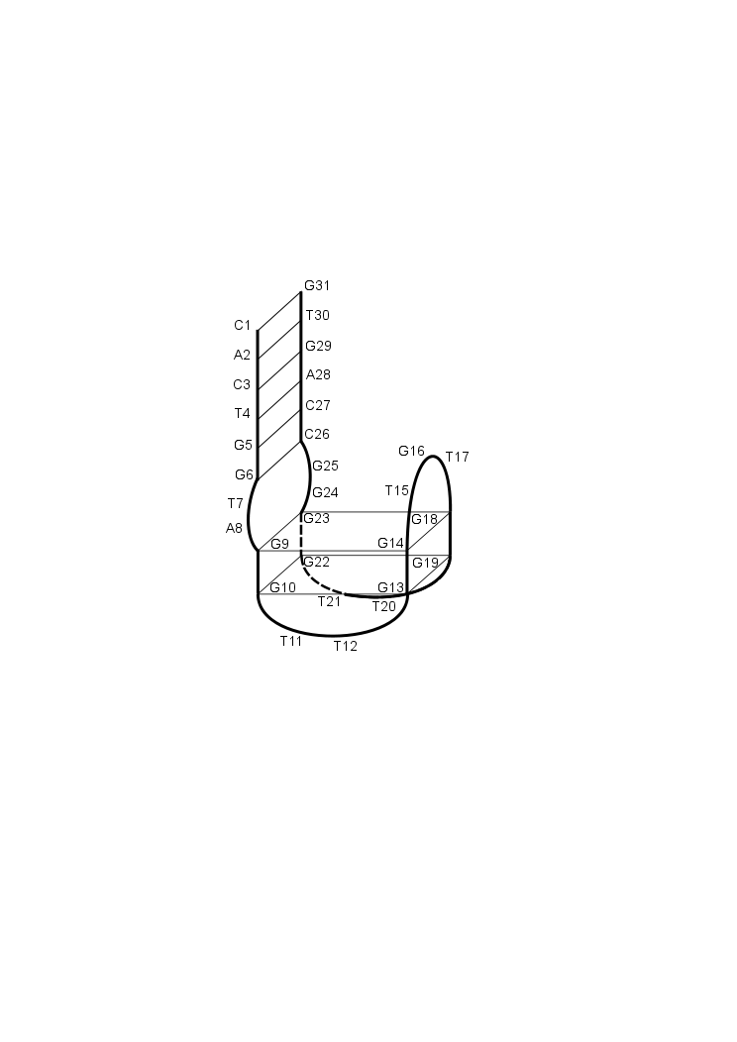
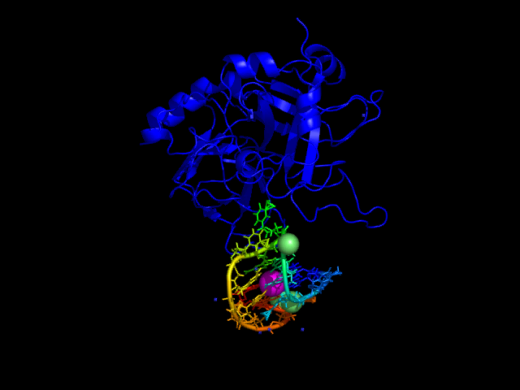
Structure:
MD for exploring and design of
extended pharmacophore structures
[G-quadruplex + Duplex?]
А
B
28
28
Notes:
28
28
28
28
28
28

Slide 29





Structure, 3D Assembly
Duplex is stable enough
UV melting
of 15TGT
and 31TGT
(260 nm)‏
G-quadruplex has
the same
thermal stability
within 15TGT and 31TGT
CD melting of 15TGT and 31TGT (294 nm)‏
29
29
29
Notes:
29
29
29
29
29
29

Slide 30

Affinity. Kinetics of Interactions:
thrombin + 15-mer or 31-mer
Surface Plasmon Resonance
K_{on} different, K_{of} similar

Slide 31
Function:
Kinetics of Fibrinogen Hydrolysis
with Thrombin

Slide 32




Thrombin hydrolyzes fibrinogen, and fibrin aggregates. Models, AFM, optical density measurements
32
Notes:
32
32

Slide 33




Examples:
bivalirudin
hirudin
heparin
aptamer
Possibility of
calculations of both Ki and Inhibition Type
Aptamer | Inhibition type | Inhibition constant, nM
15ТGT | Non-competitive | 14,7±1,0
31ТGT | Competitive | 0,34±0,10
NU172 | Competitive | 0,29±0,06
RA-36 | Non-competitive | 7,5±0,3
33
Notes:
33
33

Slide 34








Apta-nano-Lego
J
J
j
a
a
a
31TGT
15TGT
j
j
a
34
Notes:
34
34

Slide 35
Apta-nano-Lego
15TGT
31TGT
NU172
Ki, nM 14,7 0,3 1,2 1,3 0,3 12

Slide 36



Making multi-nano-tools
Bivalent Aptamer , RA-36
Apto-Pharm
Ki, nM 7,5
The inhibiting type
not like for extended aptamers
36
PCT WO 2011/075004 A1, Dec 13, 2010
Notes:
36
36

Slide 37
Blood plasma tests for RA-36:
species specificity
µM
INR = 3 (like for coumarin)
37
37
Notes:
37
37
37
37
37
37
37

Slide 38
Thrombin Generation Assay
control
[thrombin], nM
Time, s

Slide 39


Mouse model for venous
thrombosis
RA-36 inhibits clot formation: vessel cross-sections
Blood
Clot

Slide 40



Animal tests:
Short duration time – several min
Thrombin time, s
40
40
Notes:
40
40
40
40
40
40
40

Slide 41







CURRENT STATUS: formal pre-clinical trials
1st Moscow State Medical University
1
3
Modelling
Synthesis
Affinity
Animal trials Coagulation Inhibition
PCT WO 2011/075004 A1, Dec 13, 2010
41
41
Notes:
41
41
41
41
41
41
41
41
41
41

Slide 42

Apto-Pharm Ltd: www.apto-parm.com
Kopylov A
(V Dir Sci)‏
Golovin A (Chem Dpt)‏
Reshetnikov R
Savelyeva S
Turashev A
Turchaninov T
Yuminova A
Zavyalova E
Pavlova G (Biol Dpt)‏
Khairulina G
Kust N
Pustogarov N
Revischin A
Suvchenko E
Susova O
Samoylenkova N
Special thanks for Thomas Rupp, Consultant
42
Notes:
42
42

Slide 43


OMICS International
www.omicsonline.org
OMICS International (and its subsidiaries), is an Open Access publisher and international conference Organizer, which owns and operates peer-reviewed Clinical, Medical, Life Sciences, and Engineering & Technology journals and hosts scholarly conferences per year in the fields of clinical, medical, pharmaceutical, life sciences, business, engineering, and technology. Our journals have more than 3 million readers and our conferences bring together internationally renowned speakers and scientists to create exciting and memorable events, filled with lively interactive sessions and world-class exhibitions and poster presentations. Join us!
OMICS International is always open to constructive feedback. We pride ourselves on our commitment to serving the Open Access community and are always hard at work to become better at what we do. We invite your concerns, questions, even complaints. Contact us at contact.omics@omicsonline.org. We will get back to you in 24-48 hours. You may also call 1-800-216-6499 (USA Toll Free) or at +1-650-268-9744 and we will return your call in the same timeframe.
Contact us at: contact.omics@omicsonline.org

Slide 44


Drug Designing Open Access
Related Journals
Journal of Clinical Trials
Journal of Pharmacovigilance
Journal of Developing Drugs

Slide 45
Drug Designing Open Access
Related Conferences
http://www.conferenceseries.com/

Slide 46
OMICS publishing Group Open Access Membership enables academic and research institutions, funders and corporations to actively encourage open access in scholarly communication and the dissemination of research published by their authors.
For more details and benefits, click on the link below:
http://omicsonline.org/membership.php

