Slide 1
OMICS Group
OMICS Group International through its Open Access Initiative is committed to make genuine and reliable contributions to the scientific community. OMICS Group hosts over 400 leading-edge peer reviewed Open Access Journals and organizes over 300 International Conferences annually all over the world. OMICS Publishing Group journals have over 3 million readers and the fame and success of the same can be attributed to the strong editorial board which contains over 30000 eminent personalities that ensure a rapid, quality and quick review process. OMICS Group signed an agreement with more than 1000 International Societies to make healthcare information Open Access.
Contact us at: contact.omics@omicsonline.org

Slide 2
OMICS Journals are welcoming Submissions
OMICS Group welcomes submissions that are original and technically so as to serve both the developing world and developed countries in the best possible way.
OMICS Journals are poised in excellence by publishing high quality research. OMICS Group follows an Editorial Manager® System peer review process and boasts of a strong and active editorial board.
Editors and reviewers are experts in their field and provide anonymous, unbiased and detailed reviews of all submissions.
The journal gives the options of multiple language translations for all the articles and all archived articles are available in HTML, XML, PDF and audio formats. Also, all the published articles are archived in repositories and indexing services like DOAJ, CAS, Google Scholar, Scientific Commons, Index Copernicus, EBSCO, HINARI and GALE.
For more details please visit our website: http://omicsonline.org/Submitmanuscript.php

Slide 3
Emmanuel Andres
EB PPT

Slide 4
BIOGRAPHY
In 1996, Dr Andrès received his MD degree in Internal Medicine, at the University Of Strasbourg, France. He worked as an associated professor in the University Hospital of Strasbourg, France. In 1998 he worked as PhD in Molecular Biology in the Laboratory of Professor Hoffmann (2011, Nobel Prize of Medicine) in the field of cationic antimicrobial peptides and pathogens - host relations. In 2002, he was nominated Professor at the University of Strasbourg, France. He also was in the head of an Internal Medicine Department (of >60 beads) in the University hospital of Strasbourg, France. He was awarded the French Society of Haematology, price for research in the field of anaemia related to cobalamin or folate deficiencies in 2004. Achievements include development of research in: all type of anaemia, neutropenia and thrombocytopenia, particularly drug-induced neutropenia and agranulocytosis or thrombocytopenia; haematopoietic growth factors; and cobalamin deficiencies. His recent works also include research and development on human sounds analysis, electronic stethoscope, e-auscultation, and e-medicine. In that function he was recruited as advisor to several pharmaceutical companies or start-up. In 2007, He was nominated in the French National Commission of Pharmacovigilance

Slide 5
RESEARCH INTEREST
Development of an electronic stethoscope "intelligent" and basic research and clinical auscultation human. Development work and research projects in the field of telemedicine and the contribution of new technologies to support chronic disease and old age (COPD, diabetes, Alzheimer′s...). Clinical research activity in Internal Medicine and Hematology with the following themes: anemia, neutropenia and agranulocytosis drug, idiopathic thrombocytopenic purpura, research activity in the field of Metabolism including deficiencies in vitamin B12. Clinical research activity on Orphan Diseases Developing a biobank of samples from the body of people with common pathologies complex (BIOMAX).

Slide 7
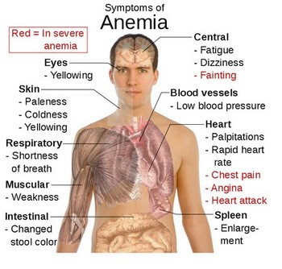

Slide 8
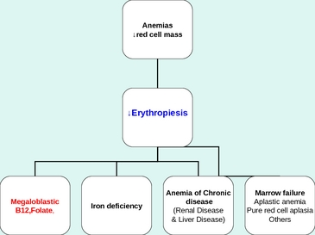

Slide 9
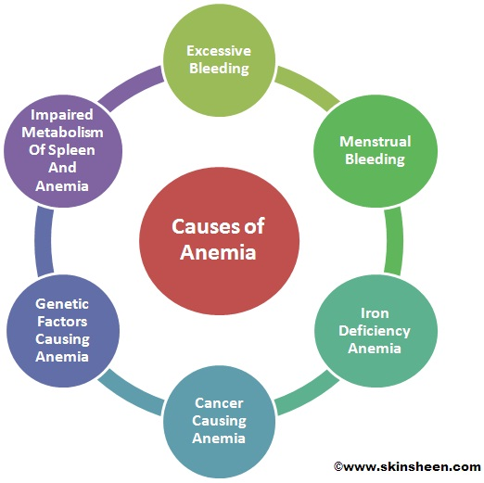

Slide 10
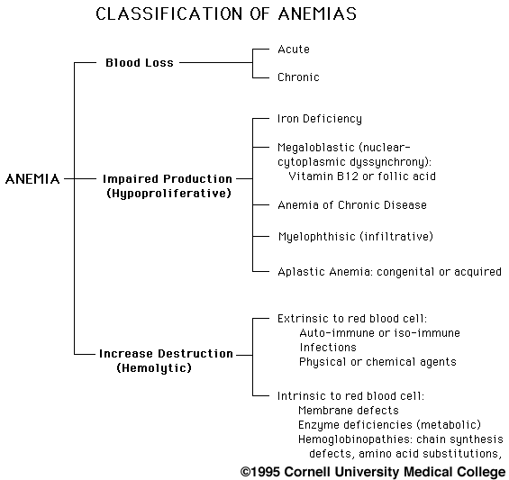

Slide 11
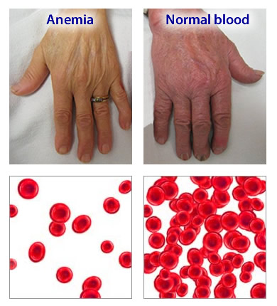

Slide 12
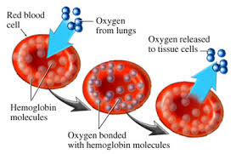

Slide 15
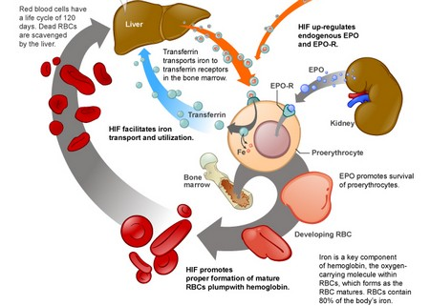

Slide 16
SIGNATURE
Emmanuel Andres

Slide 17
Journals
Drug Designing
Drug Metabolism & Toxicology
Bioequivalence & Bioavailability

Slide 18
conferences
3rd international summit on gmp, gcp and quality control
http://www.pharmaceuticalconferences.com/gmp-gcp-quality-control-2014/
5th international conference and exhibittion on pharmaceuttics & novel drug delivery system
http://novel-drugdelivery-systems.pharmaceuticalconferences.com/
3rd International Conference and Exhibition on Pharmacognosy, Phytochemistry & Natural Products
http://pharmacognosy-phytochemistry-natural products.pharmaceuticalconferences.com/
3rd International Conference and Exhibition on Pharmacovigilance & Clinical Trials
http://www.pharmaceuticalconferences.com/pharmacovigilance-clinical-trials-2014/

Slide 19
OMICS Group Open Access Membership
OMICS publishing Group Open Access Membership enables academic and research institutions, funders and corporations to actively encourage open access in scholarly communication and the dissemination of research published by their authors.
For more details and benefits, click on the link below:
http://omicsonline.org/membership.php

