Slide 1
OMICS International
OMICS International through its Open Access Initiative is committed to make genuine and reliable contributions to the scientific community. OMICS International signed an agreement with more than 1000 International Societies to make healthcare information Open Access.
Contact us at: contact.omics@omicsonline.org

Slide 2
OMICS Journals are welcoming Submissions
OMICS International welcomes submissions that are original and technically so as to serve both the developing world and developed countries in the best possible way.
OMICS Journals are poised in excellence by publishing high quality research. OMICS International follows an Editorial Manager® System peer review process and boasts of a strong and active editorial board.
Editors and reviewers are experts in their field and provide anonymous, unbiased and detailed reviews of all submissions.
The journal gives the options of multiple language translations for all the articles and all archived articles are available in HTML, XML, PDF and audio formats. Also, all the published articles are archived in repositories and indexing services like DOAJ, CAS, Google Scholar, Scientific Commons, Index Copernicus, EBSCO, HINARI and GALE.
For more details please visit our website: http://omicsonline.org/Submitmanuscript.php

Slide 3
Engin Serpersu
EB PPT

Slide 4
BIOGRAPHY
Engin Serpersu is a Professor in the Department of Biochemistry Cellular and Molecular Biology at the University of Tennessee Knoxville. He has received his Ph D in Biochemistry from the Hacettepe University in Ankara Turkey in 1978. He has completed his B Sc Degree in Chemistry at the Middle East Technical University in Ankara Turkey. He received Alexander von Humboldt Fellowship to work as a postdoctoral fellow in the Institute for Biochemistry and Endocrinology at the Veterinary School of Justus Liebig University in Giessen Germany. He is serving as an editorial board member of two journals and reviewer of ~15 journals. He has published more than 80 papers and review articles and reviewed papers for journals including Nature Nature Structural Biology J Med Chem Biochemistry.

Slide 5
RESEARCH INTRESTS
Antibiotic Resistance Thermodynamics of enzyme–lig and complexes. Protein structure, function, and dynamics. Isothermal Titration Calorimetry . Role of solvent in enzyme Catalysis. Spectroscopy

Slide 6
Spectroscopy
Set of methods where interaction of
electromagnetic radiation with
chemical molecules is measured to obtain
characteristics, properties and quantity

Slide 7
Definitions
Spectroscopy- the study of the light from an object.
Spectrometer- an instrument which spreads out light making a spectra.
Spectra- range of electromagnetic energy separated by wavelength.
Notes:
definitions

Slide 8
Spectroscopy – Radiation Terminology
Wavelength (λ) - length between two equivalent
points on successive waves
Wave number – the number of waves in a unit of
length or distance per cycle - reciprocal of the
wavelength
Frequency (ν) – is the number of oscillations of the
field per second (Hz)
Velocity (c) – independent of wavelength – in
vacuum is 3.00 x 1010 cm/s (3.00 x 108 m/s)
Photon (quanta) – quantum mechanics nature of
light to explain photoelectric effect

Slide 9
Spectroscopy
The higher energy ultraviolet and visible wavelengths affect the energy levels of the outer electrons.
Infrared radiation is absorbed by matter resulting in rotation and/or vibration of molecules.
Radio waves are used in nuclear magnetic Resonance and affect the spin of nuclei in a magnetic field.

Slide 10
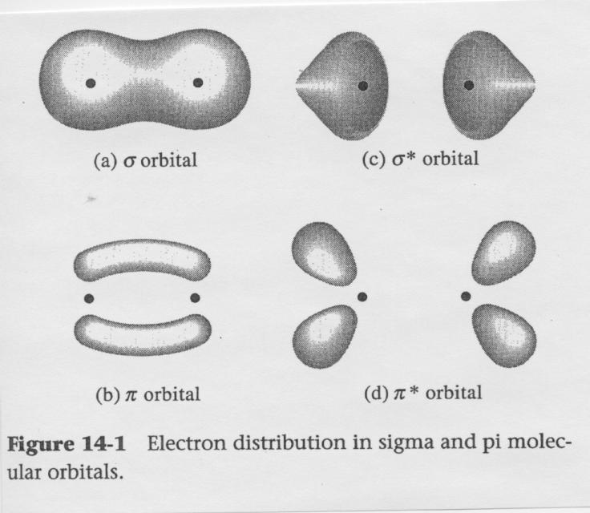
Spectroscopy – Electron Distribution

Slide 11
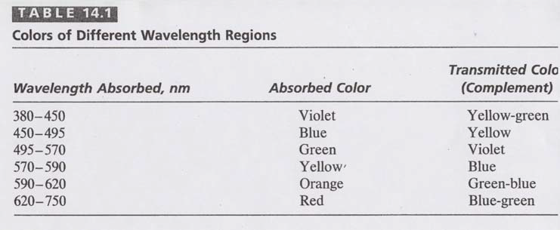
SPECTROSCOPY COLORS

Slide 12
THE ELECTROMAGNETIC SPECTRUM
Important: As the wavelength gets shorter, the energy of the radiation increases.

Slide 13
Types of spectroscopies
ULTRAVIOLET AND VISIBLE
INFRARED SPECTROSCOPY
NMR SPECTROSCOPY

Slide 14
Particle Nature of Radiation
Electromagnetic radiation is also described as having the properties of particles.
Molecules exist in a certain number of possible states corresponding to definite amounts of energy.
Molecules can absorb energy and change to a higher energy level called the excited state.
The amount of energy absorbed in this transition is exactly equal to the energy difference between the states.

Slide 15
Two modern applications of spectroscopy in space…

Slide 16
Mars Exploration Mission
The Mars Exploration Rovers were launched with the goal of searching for and analyzing rock and soils on Mars. They utilized several spectrometers to analyze samples.
Mini-TES: miniature thermal emission spectrometer (examine rock, soil & atmosphere)
MB: Mossbauer Spectrometer (examine mineralogy of rocks & soils)
APXS: Alpha Particle X-ray Spectrometer (analyze elements in rocks & soils)

Slide 17
Cassini-Hyugen’s Mission
Mission: to gather information on Titan (Saturn’s moon).
VIMS: Visual and Infrared Mapping Spectrometer (gather data about surface, rings & atmosphere of Titan and Saturn).
CIRS: Composite Infrared Spectrometer (searches for heat and by that gather information on the object’s composition.

Slide 18
Journals
1.Analytical & Bioanalytical Techniques
http://omicsonline.org/analytical-bioanalytical-techniques.php
2.Chromatography & Separation Techniques
http://omicsonline.org/chromatography-separation-techniques.php

Slide 19
SIGNATURE
Engin Serpersu

Slide 20
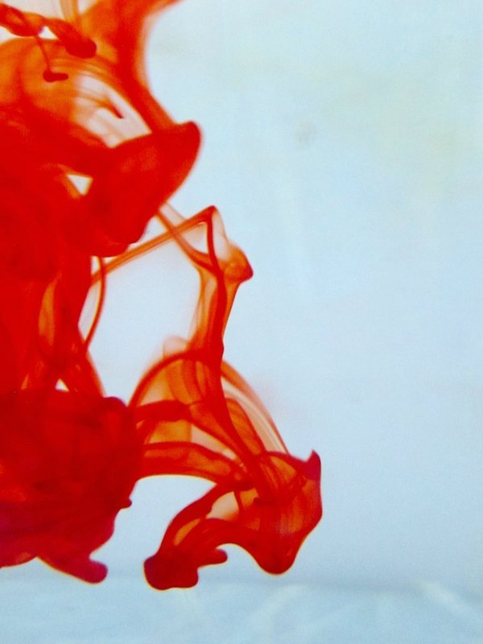
OMICS International Open Access Membership
OMICS International Open Access Membership enables academic and research institutions, funders and corporations to actively encourage open access in scholarly communication and the dissemination of research published by their authors.
For more details and benefits, click on the link below:
http://omicsonline.org/membership.php

