Slide 1
OMICS Group
OMICS Group International through its Open Access Initiative is committed to make genuine and reliable contributions to the scientific community. OMICS Group hosts over 400 leading-edge peer reviewed Open Access Journals and organizes over 300 International Conferences annually all over the world. OMICS Publishing Group journals have over 3 million readers and the fame and success of the same can be attributed to the strong editorial board which contains over 30000 eminent personalities that ensure a rapid, quality and quick review process. OMICS Group signed an agreement with more than 1000 International Societies to make healthcare information Open Access.
Contact us at: contact.omics@omicsonline.org

Slide 2
OMICS Journals are welcoming Submissions
OMICS Group welcomes submissions that are original and technically so as to serve both the developing world and developed countries in the best possible way.
OMICS Journals are poised in excellence by publishing high quality research. OMICS Group follows an Editorial Manager® System peer review process and boasts of a strong and active editorial board.
Editors and reviewers are experts in their field and provide anonymous, unbiased and detailed reviews of all submissions.
The journal gives the options of multiple language translations for all the articles and all archived articles are available in HTML, XML, PDF and audio formats. Also, all the published articles are archived in repositories and indexing services like DOAJ, CAS, Google Scholar, Scientific Commons, Index Copernicus, EBSCO, HINARI and GALE.
For more details please visit our website: http://omicsonline.org/Submitmanuscript.php

Slide 3
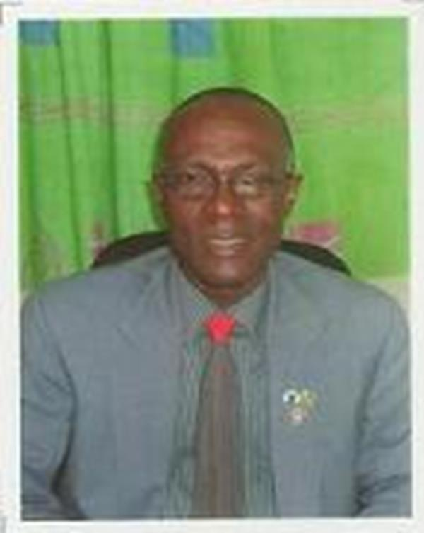
Eric Chikweru Amadi
Management Scienctist Port Harcourt

Slide 4
BRIEF BIOGRAPHY :
Dr. Eric Chikweru Amadi has full-time Post-Master teaching experience in a University as Graduate Assistant in Rivers State College of Education, as a Lecturer In Rivers State College of Education.
He has relevant professional experience in industry or appropriate non-teaching Research institution as a College Orator in Rivers State College of Education and as a examination Officer in General Studies Department at Rivers State College of Education

Slide 5
EDUCATION:
First School Leaving Certificate (FSLC) in St Patrick’s Primary School Rukpokwu in 1972 ,West African Schools Certificate (WASC) in Government Secondary School Abua in 1979, Nigeria Certificate in Education (NCE)in R/S College of Education. Moderated by University of Ibadan in 1984
B.Ed. In Educational Administration & Supervision University of Calabar in 1989, BA. Ed. In Educational Foundations/English 1989, M.Ed. Educational Management & Planning in 1997
Ph.D in Educational Management in 2005

Slide 6
RESEARCH INTERESTS :
Planning, Accountability and Management of education.
It also focuses on inclusive learning outcomes that could bring to end restiveness while emphasizing continuing education in Post – Secondary institutions through tele-centres

Slide 7
ACHIEVEMENTS:
Consultant & Coordinated training workshops for Rivers State Universal Education Board for Teachers in Rivers State
JOURNAL PAPERS PUBLISHED (FOREIGN PAPERS)
Referred Published Conferenced Papers
TEACHING AND PROFESSIONAL EXPERIENCE
CONFERENCES AND LEARNED SOCIETIES ACTIVITIES
Faculty Representative to the Faculty of Law, Rivers State UST, 2008 – Date

Slide 8
Arabian Journal of Business and Management Review Related Journals
Arabian Journal of Business and Management Review
Business and Economics Journal
International Journal of Economics and Management Sciences
Journal of Public Affairs

Slide 9
Arabian Journal of Business and Management Related Conferences
International conference on Business, Economics and Management
International Conference on Advertising and Marketing Expo

Slide 10
OMICS Group Open Access Membership
OMICS publishing Group Open Access Membership enables academic and research institutions, funders and corporations to actively encourage open access in scholarly communication and the dissemination of research published by their authors.
For more details and benefits, click on the link below:
http://omicsonline.org/membership.php

