Slide 1
Ernestina Schipani Associate Professor MGH-Harvard Medical School USA

Slide 2
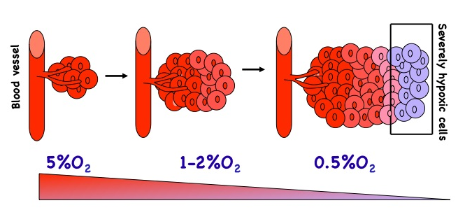
HYPOTHESIS
Gradients of O₂
control
skeletal
development
and homeostasis
by regulating
the HIF pathway

Slide 3
HIF-1α (Hypoxia Inducible Factor)
. PAS (PER-ARNT-SIM) subfamily of bHLH transcription factors
. heterodimer HIF-1α/ARNT; HIF-1α, the hypoxia -responsive
component of the complex
. ubiquitously expressed and highly unstable
. another member in the family, HIF-2α

Slide 4
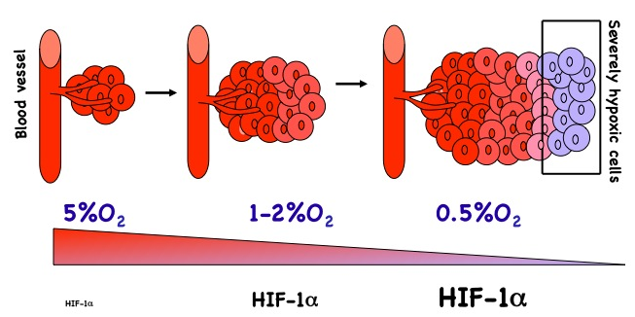
HIF-1α: A KEY FACTOR IN CELLULAR ADAPTATION TO HYPOXIA

Slide 5
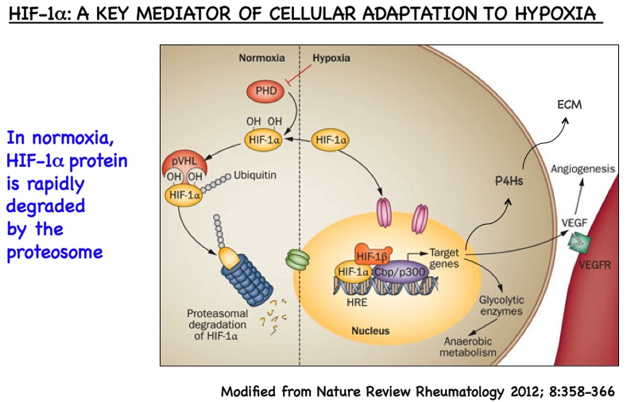
HIF-1α
proliferation

Slide 6
HIFs: A Homeostatic Response
TO KEEP HYPOXIA “in Check”
MITOCHONDRIAL
METABOLISM
O₂ CONSUMPTION CELL NUMBER
/MATRIX RATIO
BLOOD VESSELS
O₂ AVAILABILITY
RED BLOOD CELLS
ROS METABOLISM
REDOX STRESS

Slide 7
HYPOTHESIS
The complex actions of HIFs on O₂ homeostasis are exploited to modulate development and homeostasis of skeletal elements.
HIF-1α
proliferation

Slide 8
OMICS International
www.omicsonline.org
OMICS International (and its subsidiaries), is an Open Access publisher and international conference Organizer, which owns and operates peer-reviewed Clinical, Medical, Life Sciences, and Engineering & Technology journals and hosts scholarly conferences per year in the fields of clinical, medical, pharmaceutical, life sciences, business, engineering, and technology. Our journals have more than 3 million readers and our conferences bring together internationally renowned speakers and scientists to create exciting and memorable events, filled with lively interactive sessions and world-class exhibitions and poster presentations. Join us! OMICS International is always open to constructive feedback. We pride ourselves on our commitment to serving the Open Access community and are always hard at work to become better at what we do. We invite your concerns, questions, even complaints. Contact us at contact.omics@omicsonline.org. We will get back to you in 24-48 hours. You may also call 1-800-216-6499 (USA Toll Free) or at +1-650-268-9744 and we will return your call in the same timeframe.
Contact us at: contact.omics@omicsonline.org

Slide 9
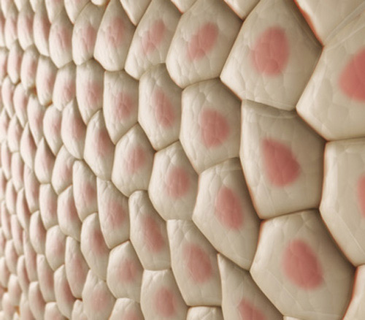
Journal of Tissue Science & Engineering Related Journals
Journal of Biochips & Tissue Chips
Journal of Stem Cell Research & Therapy
Journal of Biomimetics Biomaterials and Tissue Engineering

Slide 10
Journal of Tissue Science & Engineering Related Conferences
http://www.conferenceseries.com/

Slide 11
OMICS Group Open Access Membership
OMICS publishing Group Open Access Membership enables academic and research institutions, funders and corporations to actively encourage open access in scholarly communication and the dissemination of research published by their authors.
For more details and benefits, click on the link below:
http://omicsonline.org/membership.php

