Slide 1
OMICS Journals are welcoming Submissions
OMICS International welcomes submissions that are original and technically so as to serve both the developing world and developed countries in the best possible way.
OMICS Journals are poised in excellence by publishing high quality research. OMICS International follows an Editorial Manager® System peer review process and boasts of a strong and active editorial board.
Editors and reviewers are experts in their field and provide anonymous, unbiased and detailed reviews of all submissions.
The journal gives the options of multiple language translations for all the articles and all archived articles are available in HTML, XML, PDF and audio formats. Also, all the published articles are archived in repositories and indexing services like DOAJ, CAS, Google Scholar, Scientific Commons, Index Copernicus, EBSCO, HINARI and GALE.
For more details please visit our website: http://omicsonline.org/Submitmanuscript.php

Slide 2
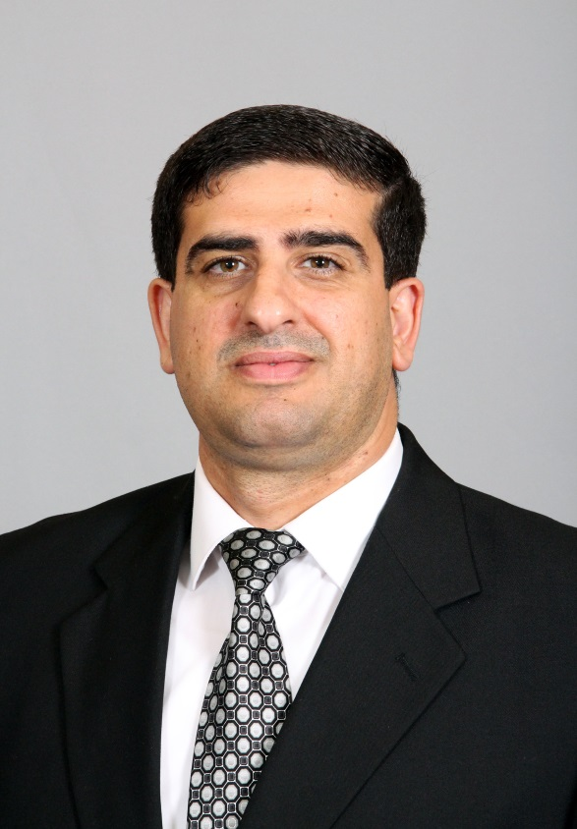
Fadi M. Alkhateeb, BSPharm, MBA, Ph.D.
Editor-in-chief of
Journal of Pharmaceutical Care & Health systems

Slide 3
Biography
Dr. Alkhateeb is the Director of Assessment & Accreditation and Associate Professor of Pharmacy at Texas A&M Health Science Center Irma Lerma Rangel College of Pharmacy. Dr. Alkhateeb has been fortunate to hold a variety of leadership positions throughout his career, including serving as the Founder and Director of the Executive MBA with a concentration in Pharmaceutical & Healthcare Management at University of Charleston, West Virginia. Moreover, he has been selected as a Fellow for the Commission on Accreditation of Health Care Management Education (CAHME). Further, he has published more than 50 peer reviewed articles and over 44 presentations and proceedings related to pharmaceutical care, pharmaceutical marketing, and accreditation and assessment in pharmacy and higher education. Dr. Alkhateeb has served as a field reviewer and evaluator for the following accreditation councils: HLC-NCA, CCAPP, ACPE, ACPE- CPE, and CAHME. Moreover, Dr. Alkhateeb is a member of the 14th Annual Texas A&M Assessment Conference Planning Committee (College Station, TX). Besides being a pharmacist, Dr. Alkhateeb has an MBA degree with concentration in Pharmaceutical Marketing & Management from Aspen University and a PhD in Pharmacy Administration with a concentration in Pharmaceutical Socioeconomics from University of Iowa College of Pharmacy, Iowa.

Slide 4
Research Interests
Pharmaceutical Care; Pharmaceutical Marketing & Policy; Pharmacoeconomics, Pharmacoepidemiology; Education Assessment & Accreditation; Pharmacy Education; Pharmacy Administration; Pharmacy Management; Public Health; Outcome Assessment (Health Care); Outcomes Research

Slide 5
Recent Publications
Attarabeen O, Alkhateeb FM. A Review of Rollins B, Perri M. Pharmaceutical Marketing. AJPE. 2013,77(6): Article 135
Gupta R, Alkhateeb FM, Latif DA, Farley KN. Parental attitudes affecting compliance with the recommendation for 2 doses of 2009 pandemic influenza A (H1N1) vaccine in children less than 10 years of age in Kanawha County, West Virginia. West Virginia Medical Journal. 2013; 109(3):10-14.
Khanfar NM, Harrington C, Anderson H, Alkhateeb FM. Cultural Differences in Leadership Styles of Pharmacist Preceptors. Business and Management Research. 2013; 2(1):1-14.
Latif DA, Alkhateeb FM, Easton M, Bowyer D. The Changing Landscape of Pharmacy Manpower in the United States: One State’s Experience between 2005 and 2011. International Journal of Pharmacy and Integrated Life Sciences (IJOPILS). 2013; 1(3): 59-68
Alkhateeb FM, Latif DA, Adkins R. Economic, Social and Administrative Pharmacy (ESAP) Content Taught at United States Schools and Colleges of Pharmacy. International Journal of Management, Economics & Social Sciences (IJMESS). 2013; 2(3):187-204.
Al-Rousan RM, Alkhateeb FM, Veronin M, Latif DA, Dodd M. Availability, Uniqueness and Perceived Value of Bachelor of Science in Pharmaceutical Sciences (BSPS) Programs in the United States. Pharmacy. 2014; 2(1):1-16.
Veronin M, Alkhateeb FM, Everett-Houser J. Patient-centered Health Care Delivery Uniting MTM, EHRs and Patients: Opportunities for Pharmacists. J Pharma Care Health Sys (JPCHS). 2014; 1(3) (In press)
Alkhateeb FM, Attarabeen OF, Latif DA, Deliere R. Workload Perceptions of West Virginia Pharmacists: Part of Changing a National Trend. Social Pharmacy Journal (SPJ). 2015; 1(1): (In press)

Slide 6
Introduction
Pharmacy Practice
The traditional role of pharmacists is to manufacture and supply medicines.
More recently, pharmacists have been faced with increasing health demands which change their direction and focus to PATIENTS instead of the Product.

Slide 7
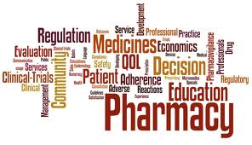

Slide 8
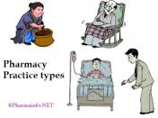

Slide 10
Professional Prospects
The practice of pharmacy is a vital part of a complete health care system.
The number of people requiring health care services has steadily increased, and this trend will likely continue.
pharmacy will face new challenges, expanded responsibilities, and an ever-increasing growth in opportunities.

Slide 11
Issues that our Profession will face
increases in average life span
the increased incidence of chronic diseases;
the increased complexity, number, and sophistication of medications and related products and devices;
increased emphasis on primary and preventive health services,

Slide 12
Issues that our Profession will face
home health care, and long term care;
concerns about improving patients' access to health care, controlling its cost, and assuring its quality.
Because of the large role that medications and their proper use play throughout these issues, pharmacists will play an important part in the future of health care.

Slide 13
Definition
Pharmacy Practice is the discipline within Pharmacy that involves developing the professional roles of the pharmacist.

Slide 14
Pharmacy Practice is vital, since it facilitates and enables pharmacists to fully exploit their substantial knowledge and expertise in areas such as pharmacology, pharmaceutics, chemistry and therapeutics within a clinical context.

Slide 15
Pharmacy Practice Aim
The practice of pharmacy aimed at providing and promoting the best use of drugs and other health care services and products, by patients and members of the public.
It requires that the welfare of the patient is the pharmacist's prime concern at all times.

Slide 16
Why become a Pharmacist?

Slide 17
Approved By
E-signature:

Slide 18
OMICS International Open Access Membership
Open Access Membership with OMICS international enables academicians and research institutions, funders and corporations to actively encourage open access in scholarly communication and the dissemination of research published by their authors.
For more details and benefits, click on the link below:
http://omicsonline.org/membership.php

