Slide 1
OMICS Journals are welcoming Submissions
OMICS International welcomes submissions that are original and technically so as to serve both the developing world and developed countries in the best possible way.
OMICS Journals are poised in excellence by publishing high quality research. OMICS International follows an Editorial Manager® System peer review process and boasts of a strong and active editorial board.
Editors and reviewers are experts in their field and provide anonymous, unbiased and detailed reviews of all submissions.
The journal gives the options of multiple language translations for all the articles and all archived articles are available in HTML, XML, PDF and audio formats. Also, all the published articles are archived in repositories and indexing services like DOAJ, CAS, Google Scholar, Scientific Commons, Index Copernicus, EBSCO, HINARI and GALE. For more details please visit our website: http://omicsonline.org/Submitmanuscript.php

Slide 2
Fabrizio De Ponti, MD, PhD
Professor of Pharmacology
Department of Medical and Surgical Sciences University of Bologna
Italy

Slide 3
Biography
Present Position. Fabrizio De Ponti is working as a Professor of Pharmacology in the Department of Medical and Surgical Sciences, School of Medicine at the University of Bologna, Bologna, Italy.
Education. He received his degree of Medical Doctor at the University of Pavia in1983. After that, in 1990, he earned his Ph.D. degree in Pharmacology and Toxicology at the University of Turin. He also received the Pharm. D. degree at the University of Pavia in 2002.
Publications and Scientific Activity. He has authored more than 150 publications in many international journals. He is an active member of the Italian Pharmacological Society; British Pharmacological Society; American Gastroenterological Association; American Neurogastroenterology and Motility Society; Italian Group for the Study of Digestive Tract Motility; Italian Society of Gastroenterology; and Italian Association for Laboratory Animal Sciences. He has also served as an Expert at the Commissione Unica del Farmaco, Italian Ministry of Health (2001-2004), at the Italian Medicines Agency (2004-2012) and at the European Medicines Agency for ad hoc expert groups on QT prolongation (2000-2001).

Slide 4
Research Interests
Research interests includes:
Clinical Pharmacology: Pharmacovigilance; drug utilization studies, pharmacoepidemiology, innovative drugs; drugs prolonging the QT interval of the electrocardiogram (European FP7 Project: ARITMO: www.aritmo-project.org).
Translational Pharmacology: Pharmacology of gastrointestinal motility; evaluation of new drugs for the treatment of functional gastrointestinal disorders; neuronal plasticity in the enteric nervous system.

Slide 5
Pharmacovigilance
Pharmacovigilance (PV) is the pharmacological science related to the detection, assessment, understanding and prevention of adverse effects, particularly long term and short term side effects of medicines.
All medicines (pharmaceutical and vaccines) have side effects. Some are known, many are still unknown. It is important to monitor both known and unknown side effects of medicines in order to determine any new information in relation to their safety profile.

Slide 6
How Pharmacovigilance Works
1
2
3
4
ADR
Suspicion
ADR
Reporting
ADR
Analysis
Sharing
of Findings

Slide 7
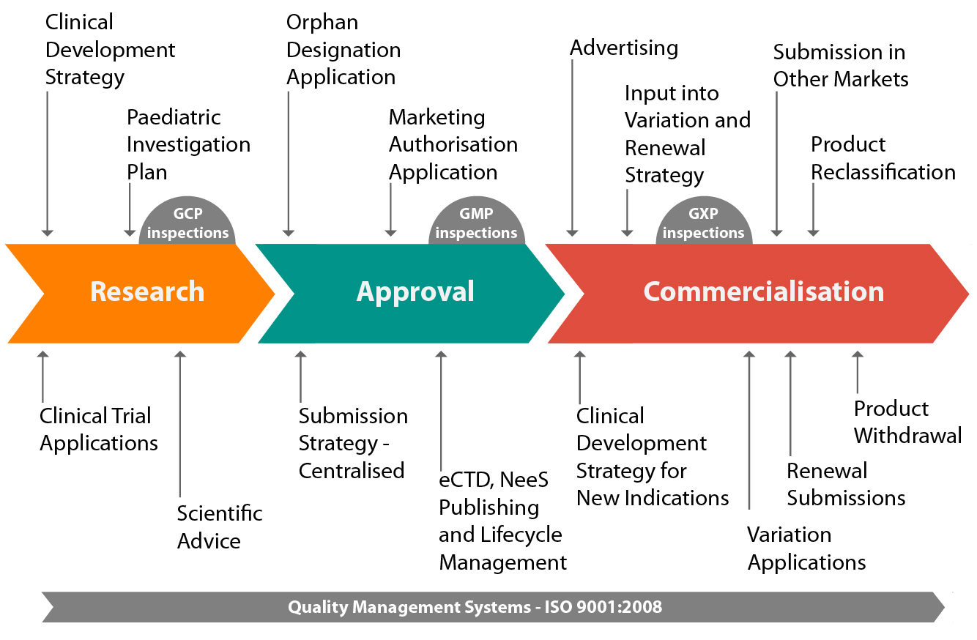
Phases of Pharmacovigilance

Slide 8
Adverse Drug Reaction
Adverse drug reactions (ADRs) are the undesirable effects of the drug /medicinal product beyond its intended therapeutic effect when used for clinical purpose.
During the last decades, it has been demonstrated by a number of studies that medicine morbidity and mortality is one of the major health problems which is beginning to be recognized by health professionals and the public. It has been estimated that such adverse drug reactions (ADRs) are the 4th to 6th largest cause for mortality in the USA.
Both in USA and Europe, ADRs are one of the leading cause of hospital admission, especially in children and elderly patients; antiplatelets, warfarin, diuretics, insulin and non-steroidal anti-inflammatory drugs are reported among the most frequently implicated agents.
Budnitz et al. Emergency hospitalizations for adverse drug events in older Americans. N Engl J Med 2011;365:2002-12
Pirmohamed et al. Adverse drug reactions as cause of admission to hospital: prospective analysis of 18 820 patients. BMJ 2004;329:15-9.
Lazarou J. et al. Incidence of ADR in hospitalized patients: a meta-analysis of prospective studies. JAMA 1998;279:1000-5.

Slide 9
Spontaneous Reporting
Healthcare professionals
Physicians
Pharmacists
Other healthcare professionals
Pharmacovigilance/Regulatory Officers
Investigational products (clinical trials)‏
Post-approval reporting – Individual Case Safety Report (ICSR), Periodic Safety Update Report (PSUR)‏
Citizens/Patients

Slide 10
Pharmacovigilance Team at the Company
Each R&D international company has a dedicated Clinical Safety team for:
Overseeing the above plans
Signal detection from ADR reporting
Perform trend analysis
Local Office of R&D company has dedicated regulatory/medical affairs expert for looking after the local pharmacovigilance plans and coordinating with the global team

Slide 11
Improving Pharmacovigilance
Increase the awareness of healthcare professionals and the public on its importance
Promote effective use of existing systems for ADR reporting
Improve communication among stakeholders in the reporting of adverse events such as, the regulator, the health care providers, and manufacturer for pharmacovigilance

Slide 12
Main pillars of the new European pharmacovigilance legislation
Proactive and proportionate risk management
Higher quality of safety data
Stronger link between safety assessments and regulatory action
Strengthened transparency, communication and patient involvement
Clear tasks and responsibilities for all parties (marketing authorisation holders, competent authorities, EMA)
Improved EU decision-making procedures (harmonised decisions and efficient use of resources)
Establishment of a new scientific committee at the European Medicines Agency (Pharmacovigilance Risk Assessment Committee, PRAC)

Slide 13
Good Pharmacovigilance Practice (GVP): final modules
Pharmacovigilance system and its quality system
Pharmacovigilance master file
Pharmacovigilance inspection
Pharmacovigilance audit
Risk management system
Management and reporting of ADR medicinal product
Periodic safety update report (PSUR)
Post-authorisation safety studies
Signal management
Additional monitoring
Safety communication
Risk minimization measures

Slide 14
Key Recent Publications
Raschi E., Poluzzi E., Koci A., Caraceni P., De Ponti F. Assessing liver injury associated with antimycotics: Concise literature review and clues from data mining of the FAERS database. World J Hepatol 2014; 6(8): 601-612.
Raschi E, Poluzzi E, Godman B, Koci A, Moretti U, Kalaba M, Bennie M, Barbui C, Wettermark B, Sturkenboom M, De Ponti F. Torsadogenic risk of antipsychotics: combining adverse event reports with drug utilization data across Europe. PLoS One 2013 Nov 20;8(11):e81208.
Poluzzi E, Raschi E, Koci A, Moretti U, Spina E, Behr ER, Sturkenboom M, De Ponti F. Antipsychotics and torsadogenic risk: signals emerging from the US FDA Adverse Event Reporting System database. Drug Saf 2013 Jun;36(6):467-79.
Raschi E., Poluzzi E., Koci A., Moretti U., Sturkenboom M., De Ponti F. Macrolides and Torsadogenic Risk: Emerging Issues from the FDA Pharmacovigilance Database. J Pharmacovigilance 2013, 1(2): 104.
Raschi E, Piccinni C, Poluzzi E, Marchesini G, De Ponti F. The association of pancreatitis with antidiabetic drug use: gaining insight through the FDA pharmacovigilance database. Acta Diabetol 2013 Aug;50(4):569-77.
Poluzzi E., Raschi E., Piccinni., De Ponti F. Data Mining Techinques in pharmacovigilance: analysis of the publicly accessibile FDA Adverse Event Reporting System (AERS). In: Data Mining Applications in Engineering and Medicine. InTech, 2012. Available at: http://www.intechopen.com/books/howtoreference/data-mining-applications-in-engineering-and-medicine/data-mining-techniques-in-pharmacovigilance-analysis-of-the-publicly-accessible-fda-adverse-event-re

Slide 15
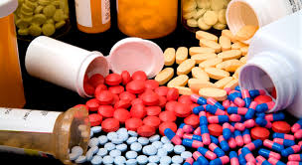
Pharmacovigilance Related Journals
Journal of Clinical Trials
Advances in Pharmacoepidemiology & Drug Safety
Journal of Drug Metabolism & Toxicology

Slide 16
Pharmacovigilance Related Conferences
For further details regarding the conference please visit
http://www.conferenceseries.com/pharmaceutical-sciences-meetings/

Slide 17
OMICS Group Open Access Membership
Open Access Membership with OMICS international enables academicians and research institutions, funders and corporations to actively encourage open access in scholarly communication and the dissemination of research published by their authors.
For more details and benefits, click on the link below:
http://omicsonline.org/membership.php

