Slide 1
OMICS Journals are welcoming Submissions
OMICS International welcomes submissions that are original and technically so as to serve both the developing world and developed countries in the best possible way.
OMICS Journals are poised in excellence by publishing high quality research. OMICS International follows an Editorial Manager® System peer review process and boasts of a strong and active editorial board.
Editors and reviewers are experts in their field and provide anonymous, unbiased and detailed reviews of all submissions.
The journal gives the options of multiple language translations for all the articles and all archived articles are available in HTML, XML, PDF and audio formats. Also, all the published articles are archived in repositories and indexing services like DOAJ, CAS, Google Scholar, Scientific Commons, Index Copernicus, EBSCO, HINARI and GALE.
For more details please visit our website: http://omicsonline.org/Submitmanuscript.php

Slide 2
Additional therapeutic options in Parkinson’s disease according to a neuronal network
Werner, F.-M.^{1, 2}; Coveñas, R.²
1 Euro-Schulen Pößneck, Pößneck
2 Institute of Neuroscience of Castilla and León, Laboratory 14, University of Salamanca, Spain

Slide 3
Werner, F.M.; Coveñas, R.
Introduction: In Parkinson’s disease exists
a dopaminergic cholinergic and GABAergic
glutaminergic neurotransmitter imbalance in
the extrapyramidal system. The development of
neuronal networks in the basal ganglia, the
thalamus and the cortex could contribute to
derive additional pharmacological options.

Slide 4
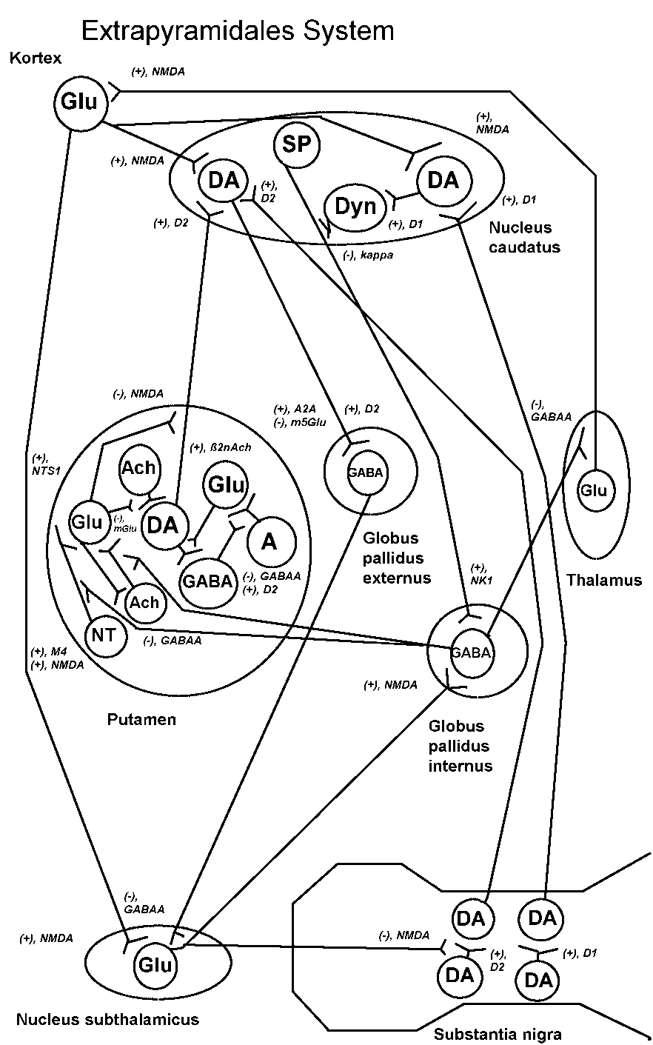
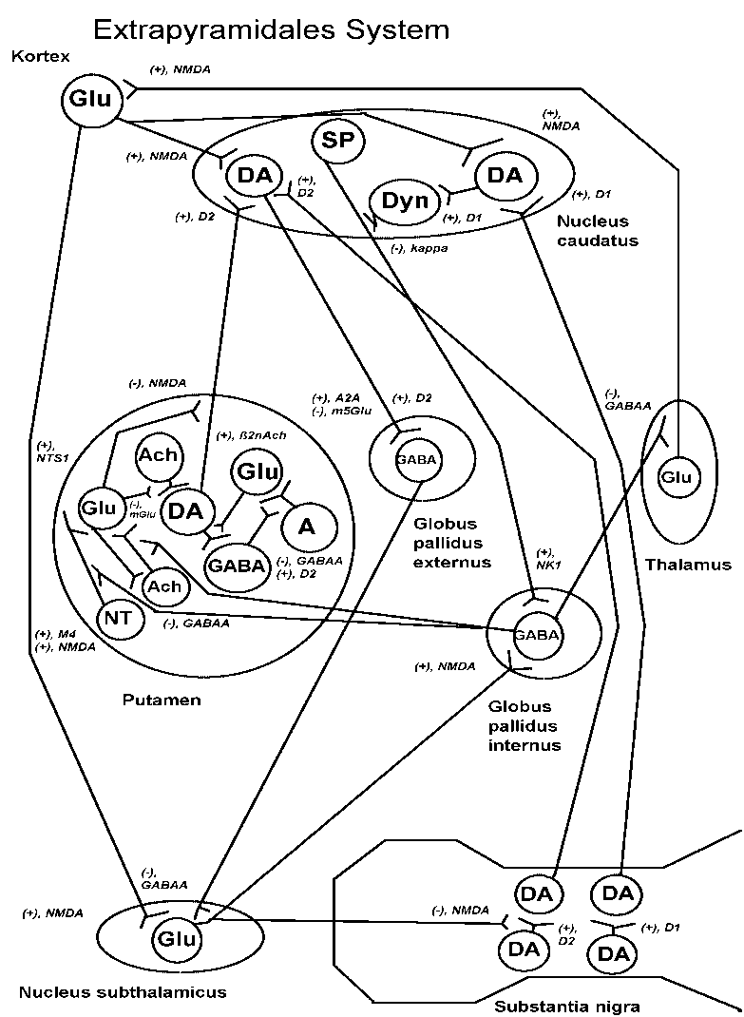
Werner, F.M.; Coveñas, R.
Material/methods: The neuronal network can
be described as follows: Dopaminergic
neurons from the substantia nigra weakly
activate other dopaminergic neurons in
the caudate nucleus via D₁ and D₂ receptors.
The D₁ dopaminergic neurons transmit a
weak activating impuls to dynorphin neurons
which inhibit substance P neurons via kappa
receptors. The latter neurons transmit a weak
postsynaptic excitatory impulse via NK₁
receptor to GABAergic neurons in the globus
pallidus internus. D₂ dopaminergic neurons
weakly activiate GABAergic neurons in the
globus pallidus externus, which inhibit
glutaminergic neurons in the nucleus
subthalamicus via GABA_{A} receptors.

Slide 5
Werner, F.M.; Coveñas, R.
The latter neurons strongly inhibit via
NMDA receptors dopaminergic neurons
in the substantia nigra and transmit an
activating impulse via NMDA receptors
to GABAergic neurons in the globus
pallidus internus. The GABAergic
neurons in this nucleus inhibit glutaminergic
neurons in the thalamus which transmit an
activating impulse to glutaminergic neurons in
the cortex. The cortical glutaminergic
neurons can activiate D₁ and D₂
dopaminergic neurons in the caudate nucleus
via NMDA receptors and activate other
glutaminergic neurons in the nucleus
subthalamicus.

Slide 6
Werner, F.M.; Coveñas, R.
The GABAergic neurons in the globus pallidus
internus weakly inhibit via GABA_{A} receptors
muscarinic cholinergic and neurotensin neurons in
the putamen. The muscarinic cholinergic and
neurotensin neurons with a high activity transmit a
strong activating impulse respectively via M₄ and
NTS₁ receptors to glutaminergic neurons. The latter
neurons strongly presynaptically inhibit dopaminergic
neurons via NMDA receptors. Nicotinic cholinergic
neurons activate dopaminergic neurons via ß2 nAch
receptors, and adenosine neurons activate via A_{2A}
receptors glutaminergic neurons which strongly inhibit
dopaminergic neurons via the subtype 5 of the
metabotropic glutamate receptors. The D₂
dopaminergic neurons in the putamen are connected
to other dopaminergic neurons in the caudate
nucleus.

Slide 7
Werner, F.M.; Coveñas, R.
Results: In addition to l-dopa combined with a decarboxylase inhibitor, dopamine
agonists, M₄ antagonists, NMDA antagonists and inhibitors of enzymes degrading
dopamine, the following drugs can be administered according to the neuronal network:
- Antagonists of the subtype 5 of the metabotropic glutamate receptors, e.g. m5Glu receptor antagonists, which increase dopamine levels through a reduced presynaptic inhibition,
- A_{2A} adenosine antagonists, which reduce the presynaptic glutaminergic inhibition of dopaminergic neurons,
- ß2 nAch agonists, which stimulate the ß2 subreceptor of the nicotinic cholinergic receptors and activate dopaminergic neurons,
- NTS₁ antagonists, which reduce the presynaptic glutaminergic inhibition of dopaminergic neurons.
Discussion: It can be concluded that it is important to examine such neuronal
networks in order to coordinate a multimodal pharmacotherapy in Parkinson’s
disease.

Slide 8
Cytology & Histology Related Journals
Journal of Cell Science & Therapy
Journal of Stem Cell Research & Therapy
Cellular & Molecular Biology

Slide 9
Cytology & Histology Related Conferences
For upcoming Conference visit
http://www.conferenceseries.com/

