Slide 1
OMICS Group
OMICS Group International through its Open Access Initiative is committed to make genuine and reliable contributions to the scientific community. OMICS Group hosts over 400 leading-edge peer reviewed Open Access Journals and organizes over 300 International Conferences annually all over the world. OMICS Publishing Group journals have over 3 million readers and the fame and success of the same can be attributed to the strong editorial board which contains over 30000 eminent personalities that ensure a rapid, quality and quick review process. OMICS Group signed an agreement with more than 1000 International Societies to make healthcare information Open Access.
Contact us at: contact.omics@omicsonline.org

Slide 2
OMICS Journals are welcoming Submissions
OMICS Group welcomes submissions that are original and technically so as to serve both the developing world and developed countries in the best possible way.
OMICS Journals are poised in excellence by publishing high quality research. OMICS Group follows an Editorial Manager® System peer review process and boasts of a strong and active editorial board.
Editors and reviewers are experts in their field and provide anonymous, unbiased and detailed reviews of all submissions.
The journal gives the options of multiple language translations for all the articles and all archived articles are available in HTML, XML, PDF and audio formats. Also, all the published articles are archived in repositories and indexing services like DOAJ, CAS, Google Scholar, Scientific Commons, Index Copernicus, EBSCO, HINARI and GALE.
For more details please visit our website: http://omicsonline.org/Submitmanuscript.php

Slide 3
EDITOR journal of Chemotherapy
Gary L. Johanning
PhD Associate Professor University of Texas USA

Slide 4
BIOGRAPHY
Gary L. Johanning, MS, PhD, is an Associate Professor of Comparative Medicine at the Michale E. Keeling Center for Comparative Medicine and Research with the University of Texas MD Anderson Cancer Center at Bastrop TX. He received his B.S., M.S. and PhD in Biochemistry from the University of Missouri at Columbia and completed a postdoctoral fellowship in the Biochemistry Department at Case Western Reserve University. He is an Editorial Board Member of Cancer Management and Research and The Open Lung Cancer Journal, and is Associate Editor of Nutrition and Dietary Supplements. He has been awarded grants from the National Institutes of Health, the Department of Defense and several foundations. He is a member of the Executive Committee of The Nutritional Sciences Council. His primary research interests include micronutrients and their effect on chemotherapy efficacy, nutrition and cancer, endogenous retroviruses, and cancer prevention and immunotherapy.

Slide 5
RESEARCH INTREST
A major goal of the research in Dr. Johanning’s laboratory is to determine the role of the vitamin folic acid (foliate) in carcinogenesis, cancer prevention, and immune response. An important aspect of this research is evaluating the influence of folic acid on the development of resistance to cisplatin and other chemotherapeutic agents. Cancer cells can become resistant to the cytotoxic action of chemotherapeutic agents either at the outset (intrinsic resistance) or after the agents are administered for a period of time (acquired resistance). Resistance to cisplatin and other agents is an important problem in cancer therapy, and the mechanism by which resistance develops is not clear. Dr. Johanning has obtained data indicating that folic acid can prevent the development of both intrinsic and acquired resistance to cisplatin in lung and ovarian cancer cell lines.

Slide 6
PUBLICATIONS
Human endogenous retrovirus type K antibodies and mRNA as serum biomarkers of early-stage breast cancer.
Feng Wang-Johanning, Ming Li, Francisco J Esteva, Kenneth R Hess, Bingnan Yin, Kiera Rycaj, Joshua B Plummer, Jeremy G Garza, Stefan Ambs, Gary L Johanning Int. J. Cancer
Int J Cancer 2014 Feb 13;134(3):587-95. Epub 2013 Sep 13.
A lower degree of PBMC L1 methylation is associated with excess body weight and higher HOMA-IR in the presence of lower concentrations of plasma folate.
Chandrika J Piyathilake, Suguna Badiga, Ronald D Alvarez, Edward E Partridge, Gary L Johanning PLoS ONE
PLoS One 2013 24;8(1):e54544. Epub 2013 Jan 24.
A dietary pattern associated with LINE-1 methylation alters the risk of developing cervical intraepithelial neoplasia.
Chandrika J Piyathilake, Suguna Badiga, Edmond K Kabagambe, Andres Azuero, Ronald D Alvarez, Gary L Johanning,Edward E Partridge Cancer Prev Res (Phila)Cancer Prev Res (Phila) 2012 Mar 18;5(3):385-92. Epub 2012 Jan 18.
Sheep stromal-epithelial cell interactions and ovarian tumor progression.
Feng Wang-Johanning, Miao Huang, Jinsong Liu, Kiera Rycaj, Joshua B Plummer, Kirstin F Barnhart, William C Satterfield,Gary L Johanning Int. J. CancerInt J Cancer 2007 Nov;121(10):2346-54

Slide 7
FOLIC ACID
What is folic acid?
B vitamin essential for healthy development of unborn baby’s spine, brain and skull
can help reduce risk of birth defects such as spina bifida by as much as 70% B vitamin plays a role in:
Building proteins in the body
Producing DNA
Helping to form red blood cells

Slide 8
What is folic acid defieciency
Folic acid deficiency means that there is a lower than normal amount of folic acid in your blood. Folic acid is a water-soluble B vitamin, which means it cannot be stored in the body.

Slide 9
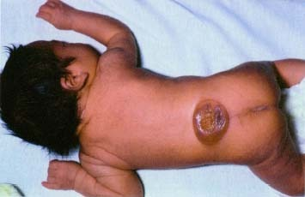
neural tube defects (NTDs) are birth defects that occur early in pregnancy
often before a woman knows she is pregnant
neural tube grows to become baby’s spinal cord, spine, brain and skull

Slide 10
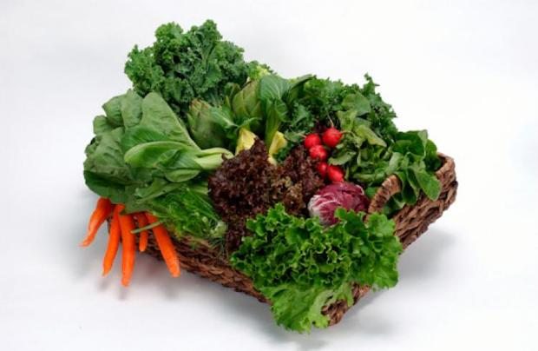
SOURCES OF FOLIC ACID

Slide 11
foods high in folic acid
asparagus, broccoli, corn, spinach, orange juice, sunflower seeds, peanut butter, beans
foods fortified with folic acid
white flour, enriched pasta, enriched cornmeal

Slide 12
symptoms
Fatigue
Poor appetite
Headache
Pallor (pale skin)
Grey hair
Red, irritated, swollen, and sometimes shiny tongue
Mouth ulcers
Shortness of breath and lightheadedness
Change in bowel patterns, usually diarrhea

Slide 13
WHO IS AT HIGHER RISK
women who...
have a previous pregnancy affected by an NTD
have a family history of NTDs
use certain anti-seizure medication
have insulin-dependent diabetes
been diagnosed as clinically obese
abuse alcohol
are of Celtic, Northern Chinese, Cree and Sikh heritage

Slide 14
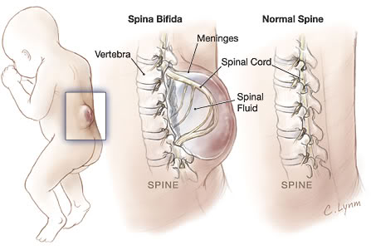
Spina Bifida a condition that results when the lower part of the neural tube fails to develop properly

Slide 15
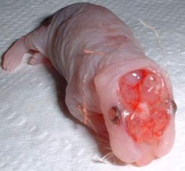
Anencephaly
a fatal condition in which the upper end of the neural tube fails to close

Slide 16
What if I’m in high risk
consult a health professional
to determine correct dosage of folic acid
to determine best multivitamin
may require up to 5 mg of folic acid daily

Slide 17
PREVENTION
It is possible to consume enough folic acid by eating a balanced, varied diet including rich sources of folate, the food form of folic acid. The recommended dietary allowance (RDA) for folic acid is 400 micrograms per day for most adults.
To get enough folate, consume plenty of the following foods:
Fortified grains, cereals, and bread products
Dried beans and legumes
Poultry, pork, liver, and shellfish
A variety of fresh fruits and vegetables, especially dark, leafy green vegetables, and citrus fruits and juices

Slide 18
TREATMENT
Folic acid deficiency is usually treated with 1,000 micrograms of supplemental folic acid, given once a day until folic acid levels are replenished. The anemia usually is corrected within two months. Few drugs are used to treat the folic acid defiecency are Deplin,Duleek, Zervalx, FA-8, Folacin-800

Slide 19
DIAGNOSIS
A physical exam will be done. A blood test can help confirm a diagnosis of low folate levels and megaloblastic anemia.
It is difficult to distinguish between folic acid deficiency and vitamin B12 deficiency . However, folic acid deficiency is confirmed only by measuring red blood cell (RBC) folate levels in the blood.
It is especially important to confirm a diagnosis of folic acid deficiency before treatment with supplemental folic acid begins. Mistreating an actual vitamin B12 deficiency with supplemental folic acid will mask the vitamin B12 deficiency, meaning the anemia will be corrected, but the neurological damage associated with vitamin B12 deficiency will progress.

Slide 20
Approved By
E-signature:

Slide 21
THANK YOU

Slide 22
OMICS Group Open Access Membership
OMICS publishing Group Open Access Membership enables academic and research institutions, funders and corporations to actively encourage open access in scholarly communication and the dissemination of research published by their authors.
For more details and benefits, click on the link below:
http://omicsonline.org/membership.php

