Slide 1
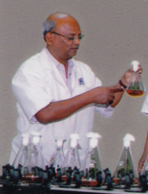
Dr. Girish M. Bhopale
Dr. D. Y. Patil Biotechnology & Bioinformatics Institute,
Dr. D.Y. Patil Vidyapeeth
Tathawade, Pune, 411033, Maharashtra, India

Slide 2
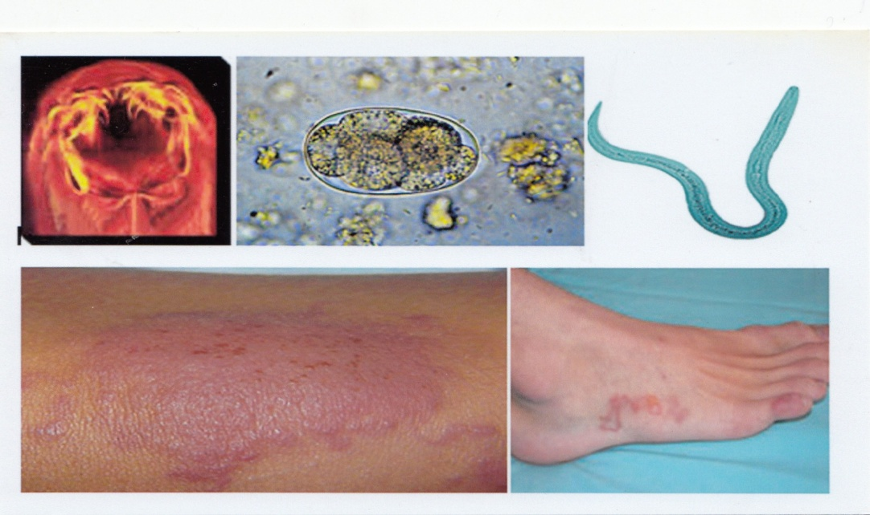
Experimental Ancylostomiasis – Chemotherapy – Immunology
Dr. Bhopale was recipient of junior research fellowship from Indian council of Medical Research , New Delhi, India and obtained his Ph. D degree from Vikram University, Ujjain. MP, India [ year 1882]
* Ancylostomiasis is a disease of world-wide distribution affecting both animals and man.
Cutaneous and visceral larva migrans caused by Ancylostoma caninum are zoonotically
important .
Several broad spectrum anthelmintics are available for the treatment of adult intestinal
nematodes but very few are effective against migrating larvae.
We evaluated various anthelmintics against the experimental larval infection of
Ancylostoma caninum in mice. In addition, we also studied the serum protein changes
after administration of effective anthelmintics and host immune response against
homologous challenge infection after application of effective anthelmintics.

Slide 3
The research result outcomes has published
Selected research publications: [Google Scholar]
Bhopale G.M. and Bhatnager B.S. Evaluation of the efficacy of anthelmintics against Ancylostoma caninum in vitro. Indian Veterinary Journal, (1984), 61,103-106. [IF 0.05] [Number of Citations 1 ].
* Bhopale G. M. and Bhatnagar B.S. The efficacv of some newer broad spectrum anthelmintics against third stage larvae of Ancylostoma caninum in the mice. Journal of Helminthology (1985), 59, 307-311. [ IF 1.38 ] [ Number of Citations 5 ].
* Bhopale G.M. and Bhatnagar B.S. Serum protein profile of mice during infection with larvae of Ancylostoma caninum and after the administration of tetramisole and levamisole. Journal of Hygiene Epidemiology Microbiology and Immunology ( 1984), 4, 455-459. [Number of Citations 4].
>>>>>>>>>>>

Slide 4
>>>>> [ Google Scholar]
* Bhopale G. M. and Bhatnagar B.S. Host immune response against homologous challenge infection of Ancylostoma caninum after application of effective anthelmintics. Journal of Hygiene, Epidemiology, Microbiology and Immunology (1984), 28, 399-343.
* Bhopale G.M. and Bhatnagar B.S. Efficacy of benzimidazoles against larval Ancylostoma caninum infection in mice. Folia Parasitologica (1986), 33, 148-150. [ IF 1.812 ].
* Bhopale G. M. and Bhatnagar B. S. Efficacy of various anthelmintics against third stage larvae of Ancylostoma caninum in the brain of mice. Journal of Helminthology (1988), 62, 42-44. [ IF 1.38 ] [Number of Citations 3].
* Bhopale G. M. , Arun Kumar and Nayar P. R. G. Development of host resistance to Ancylostoma ceylanicum after the elimination of primary infection with oxfendezole. Hindustan Antibiotics Bulletin (1984), 26,140-141. [ Number of Citations 1 ].

Slide 5
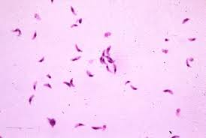
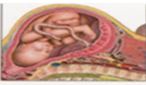
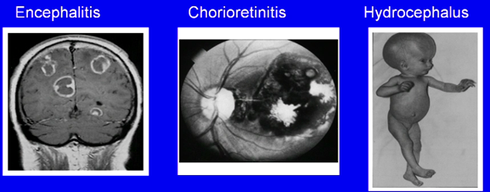
Toxoplasmosis- Immunodiagnosis- Chemotherapy
Toxoplasmosis, caused by intracellular protozoan parasite, Toxoplasma gondii , is
widely distributed throughout the world. The disease exhibited various clinical
manifestation and therefore pose difficulty in diagnosis.
We have developed ELISA based diagnostic kits Toxokit-G and Toxokit-M using
penicillilase as an enzyme marker for the diagnosis of toxoplasmosis.

Slide 6
The research result outcomes has published
Selected research publications: [ Google Scholar]
* Bhopale G. M. and Naik S. R. Toxoplasmosis in India. Indian Practitioner (1992), 45,237-245. [Number of Citations 3].
Bhopale G.M. and Naik S.R. Penicillinase as a potent enzyme marker for Enzyme link Immunosorbent Assay and its application in immunodiagnostic. Hindustan Antibiotics Bulletin (1993), 35, 257-17 [Number of Citations 2].
* Bhopale G. M. and Naik S. R. Strip ELISA for the detection of IgG antibodies to Toxoplasma gondii. Indian Journal of Medical Research (1994), 99, 68-70. [IF 1.83 ] [Number of Citations 1 ].
Bhopale G. M. Naik S. R. Bhave G. G. Naik S. S. and Gogate A. Assessment of Enzyme Linked Immunosorbent Assay based diagnostic kits (Toxokit-G and ToxoKit-M) for the detection of IgG and IgM antibodies to Toxoplasma gondii in human serum. Comparative Immunology Microbiology and Infectious Diseases (1997), 20, 309-314. [IF 2.337] [Number of Citations 5].
* Bhopale G. M. and Naik S. R. Detection of circulating antigens by ELISA using penicillinase in mice infected with Toxoplasma gondii. Rocz Akad Med Bialymst (2000), 45, 14-18. [Number of Citations 4].

Slide 8
The most cited articles: [Google Scholar] * Bhopale G.M. Pathogenesis of toxoplasmosis. Comparative Immunology Microbiology and Infectious Diseases. (2003), 26, 213-222 [IF 2.337] [Number of Citations 63]. [Rated in Top 25 articles by Scopus] * Bhopale G.M. Development of vaccine for toxoplasmosis: Current status. Microbes and Infection (2003), 5,457-462. [IF 3.101] [Number of Citations 118].

Slide 9
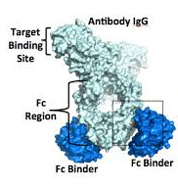
Protein A production
*Protein A has potential applications in immunodiagnosis, affinity purification of monoclonal antibodies and in the extracorporeal removal of IgG from plasma.
Protein A is quantitified according to its ability to interact
with the FC protein of IgG employing different immunological
method.
* We developed ELISA method for estimating the protein A concentration in fermented and
extracted samples.
Selected research publications:
Muniaswamy N, Bhopale G.M. Ambedkar S.S. and Naik. S.R. Protein A quantitation by competitive ELISA using peniciollinase. Biotechnology Techniques (1996), 10, 779-782. [Number of Citations 2 ].

Slide 10
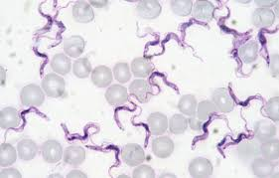
Immunodiagnosis of Trypanosoma evansi
Trypanosomiasis commonly known as surra caused
by Trypanosoma evansi is most widely distributed in
Asia, Africa and Central & South America affecting
domesticated livestock.
An ELISA based test was developed for the detection of IgG antibodies in sera of
Trypanosoma evansi infected rabbits.
The developed assay was reproducible and simple as end results assessed visually.
The research result outcomes has published
Bhopale G.M. and Naik S.R. ELISA using enzyme penicillinase for the detection of IgG antibodies to
Trypanosoma evansii in sera of experimentally infected rabbits. Hindustan Antibiotics Bulletin (1998), 40, 47-50

Slide 11
Antidiabetic drugs screening
* Diabetes is one of the most common metabolic disorder in the world and mainly
characterized by hyperglycemia. In recent years many medicinally important plants
have been reported for their antidiabetic effects.
The antihyperglycemic activity of Phyllanthus reticulatus leaves extract was investigated in
normal and alloxan induced diabetic mice.
The results of the present experiments revealed that leaf extract of P. reticulatus has a
significant antihyperglycemic activity in normal as well as in alloxan induced diabetic
mice.
The research result outcomes has published
Bhopale G. M., Damame M, More S.M. and Nanda R.K. Antihyperglycemic activity of Phyllanthus reticulates leaves extract in normal and alloxan induced diabetic mice. Indian Drugs. (2007), 44, 615-617. [Number of Citations 7].

Slide 12
Analysis of recombinant DNA products
Analyzed bulk and formulated recombinant Erythropoietin using electrophoresis techniques for identification and stability studies. Human sera samples were also analyzed by electrophoresis techniques and carryout toxicity studies in laboratory animals.
The research result outcomes has published
Bhopale GM. and Nanda R.K. Recombinant DNA expression products for human therapeutic use. Current Science (2005), 89, 614-622. [ IF - 0.897 ] [Number of Citations 16 ]
Bhopale G.M. and Nanda R.K. Recombinant human erythropoietin: An overview. Indian Drugs (2004), 707- 713, [Number of Citations 2 ].
Bhopale G.M. and Nanda R.K. Analysis of recombinant DNA expression products. Pharma Bioword
(2003),104-110.

Slide 13
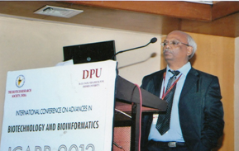
Invited speaker:
Delivered lecture on “Recombinant human therapeutic products - Current status “
during International Conference “ Advances in Biotechnology and Bioinformatics “ ICABB 2013 held at Pune, Nov 25-27,2013.
Delivered lecture on “Recent advances in the development of HIV drugs” during UGC sponsored one day National seminar “ Advances in Microbiology and their impact on public health” organized by the Dept. of Microbiology , J.M. Patel College, Bhandara, Oct 26,2013.
Delivered guest Lecture on “Prospects for Hepatitis C Vaccine” during the International symposium on Management of Vector born viruses and Annual conventional of Indian Virological Society held at International Crop Research Institute for Semi-Arid Tropics, Hyderabad, Feb.7, 2006.
Delivered guest lecture on “Recombinant DNA expression products for human therapeutic use” during seminar “Present Advances in Industrial Pharmaceutical Biotechnology” at Alard College of Pharmacy, Hinjewadi, Pune, Feb.16, 2008.

Slide 14
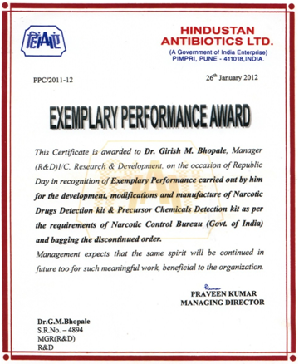
Development of Narcotic drugs detection and Precursor chemical detection kits
“ Exemplary Performance Award”–
Hindustan Antibiotics Limited, Pimpri,
Pune, (Jan. 2012), for the Development
& commercially manufactured of
Narcotic Drugs Detection Kits
and Precursor Chemical Detection Kits
as per the requirement of Narcotic Control
Bureau, New Delhi.

Slide 15
Other important research publications
Bhopale G.M. and Nanda R.K. Blood coagulation factor VIII: An overview. J.
Bioscience, (2003), 28,783- 789. [IF 1.648 ] [Number of Citations 27].
Bhopale G.M. and Nanda R.K. Prospects for hepatitis C vaccine. Acta
Virologica (2004), 48, 215-221.[IF 0.644 ], [ Number of Citation 15 ].
Bhopale G.M. and Nanda R.K. Emerging drugs for hepatitis C. Hepatology
Research (2005), 32, 146-153. [ IF 2.199] [Number of Citations 25 ].
[Rated in Top 25 articles by Scopus ].

Slide 16
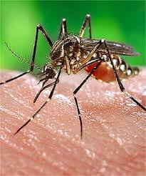
Journal of Infectious Diseases and Therapy
Bacteriology & Parasitology
Clinical Microbiology: Open Access
Virology & Antiviral Research
Virology & Mycology

Slide 17
Journal of Infectious Diseases and Therapy
2nd International Congress on Bacteriology and Infectious Diseases
3rd International Conference on Clinical Microbiology & Microbial Genomics

Slide 18
OMICS Group Open Access Membership
OMICS publishing Group Open Access Membership enables academic and research institutions, funders and corporations to actively encourage open access in scholarly communication and the dissemination of research published by their authors.
For more details and benefits, click on the link below:
http://omicsonline.org/membership.php

Slide 19
OMICS Journals are welcoming Submissions
OMICS Group welcomes submissions that are original and technically so as to serve both the developing world and developed countries in the best possible way.
OMICS Journals are poised in excellence by publishing high quality research. OMICS Group follows an Editorial Manager® System peer review process and boasts of a strong and active editorial board.
Editors and reviewers are experts in their field and provide anonymous, unbiased and detailed reviews of all submissions.
The journal gives the options of multiple language translations for all the articles and all archived articles are available in HTML, XML, PDF and audio formats. Also, all the published articles are archived in repositories and indexing services like DOAJ, CAS, Google Scholar, Scientific Commons, Index Copernicus, EBSCO, HINARI and GALE.
For more details please visit our website: http://omicsonline.org/Submitmanuscript.php

