Slide 1


Link Between Cancer and Alzheimer Disease via Oxidative Stress Induced by Nitric Oxide-Dependent Mitochondrial DNA Overproliferation and Deletion in the Context of the Drug Development for Neurodegeneration and Cancer
Prepared for:
Targeting Mitochondrial Dysfunction & Toxicity:
March 19-20, 2014 in Boston, MA USA
Gjumrakch Aliev, M.D., Ph.D.
E-Mail: aliev03@gmail.com, cobalt55@gallyinternational.com, GAliev@uofa.edu
March 19-20, 2014
Not allowed to print or share without obtaining permission form GALLY International
Notes:
1. Oxidative Stress Induced Cellular Hypoperfusion and Mitochondrial DNA deletion in the Context of Neurodegeneration: Past, Present and Future. Institute of the Theoretical and Experimental Biophysics of Russian Academy of Sciences (RAS), Pushino, Moscow District , Russia. November 15, 2011.

Slide 2
Collaborators:
Institute of Physiologically Active Compounds, Russian Academy of Sciences, Chernogolovka, Russia
Case Western Reserve
The University of Texas at
San Antonio
Donald Anthony
Sergey O. Bachurin
Kathryn Fischbach
Mark E. Obrenovich
Medical Center of the Administration of the President of the Republic of Kazakhstan, Astana, Kazakhstan
Hector H. Palacios
EuroEspes Biomedical Research Center Spain
Dmitry Gokman
Valery V. Benberin
Stress Relief and Memory Training Center,
Brooklyn, New York
Ramón Cacabelos
University College London and Royal Free Hospital, London
Kansas University, Medical Center
Valentin Bragin
Geoffrey Burnstock
Russell H. Swerdlow
University of California Los Angeles
University of California Berkeley and Children’s Hospital Oakland Research Institute, Oakland
Slovak Medical University
Harry V. Vinters
Jaromír Horecký and Olga Vancová
Missouri University of Science and Technology, MO, USA
Bruce N. Ames
Wroclaw Medical University Poland
V. Prakash Reddy
I.M. Sechenov Moscow State Medical University, Russian Federation
Jerzy Leszek
Institute of Theoretical and Experimental Biophysics, Russian Academy of Sciences, Pushchino, Russian Federation
King Fahd Medical Research Center Saudi Arabia
Nikolenko VN, Zamyatnin AA and Yakhno NN
M.A. Kamal & G.Md. Ashraf
Yury G. Kaminsky

Slide 3
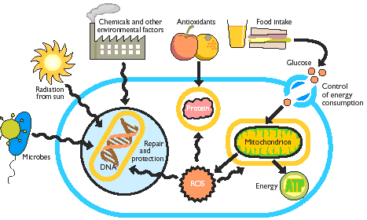
The Aging Process
Disease = accelerated aging
Aging = Time manner metabolic and structural change
Highly metabolic, specific cells are affected first (neuron)

Slide 4
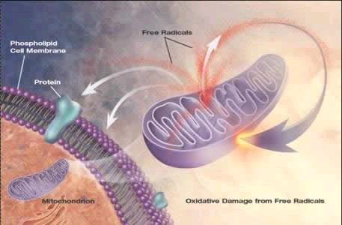
The Aging Process
Usually oxidative stress and accumulation of unnecessary materials within cell trigger a cascade of events that contribute to mitochondria decay, loss of cell function, and eventually systemic failure.
Compensatory regulation ceases to balance the effects of the lifelong stimulus.
Manifestation usually later in adulthood as culmination of several factors
  Exposure (environment)
  Life style
  Genetics

Slide 5
Q &A for mitochondrial tuning-up
Q: What should we do when mitochondria decay with age?
A Tune up.
Q: How?
A: With mitochondrial antioxidants and metabolites.
Q: Why?
A: Because mitochondrial antioxidants and metabolites:
1) Decrease with age
2) Are enzyme cofactors or precursors of cofactors
3) Prevent and repair oxidative damage

Slide 6
Riboflavin
H⁺
H⁺
H⁺
Cellular Cytoplasm
H⁺
Fatty acids
H⁺
CoQ
H⁺
Creatine
Mitochondrial Outer Membrane
Carnitine
H⁺
Intermembrane
Space
H⁺
H⁺
H⁺
H⁺
Creatine kinase
H⁺
H⁺
H⁺
H⁺
H⁺
H⁺
FMN
FeS
H⁺
I
CoQ
Inner Membrane
III
CytC
II
IV
V
NADH
H⁺
H⁺
H⁺
Niacin
NAD⁺
FAD
H⁺
FADH₂
ADP
H⁺
Succinate
H⁺
H⁺
H⁺
H⁺
ATP
Mitochondrial
Matrix
Fumarate
ATP
Succinyl-Co-A
H⁺
CITRIC
ACID
CYCLE
H⁺
NADH
α-KetoGDH
L-Malate
Lipoic
acid
NADH
Pyruvate
Dehydrogenase
complex
NADH
α-Ketoglutarate
Oxaloacetate
Isocitrate
NADH
Acetyl-Co-A
Citrate
O₂ O₂^{-.} H₂O₂ .OH H₂O
Citrate Synthase
Lipoic acid
Lipoic acid

Slide 7
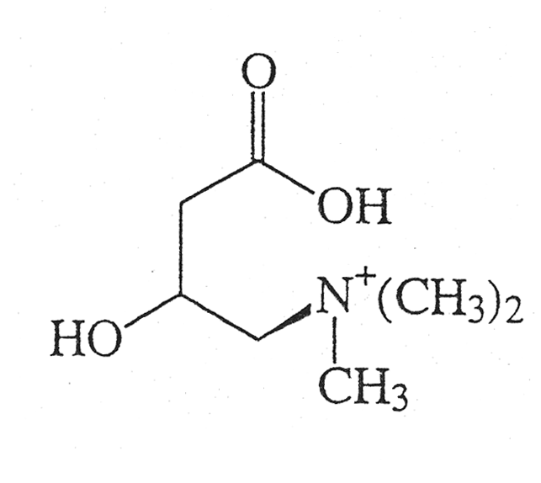
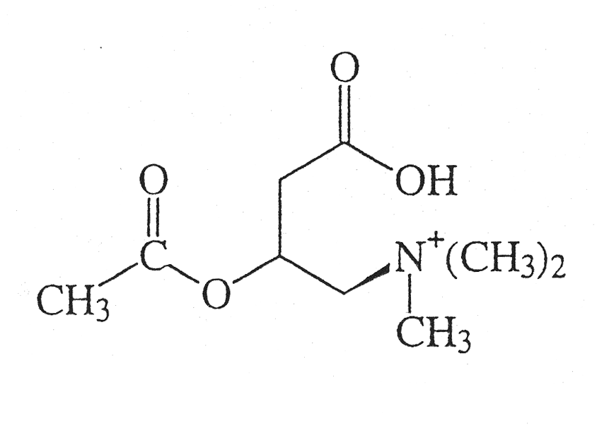
L-Carnitine/Acetyl-L-Carnitine (ALCAR)
Transports long-chain fatty acids into mitochondria
Removes short- and medium-chain fatty acids that accumulate
Mediates the ratio of acetyl-CoA/CoA
Decreases with age in plasma and in brain
Improves cognitive function in rats
12

Slide 8
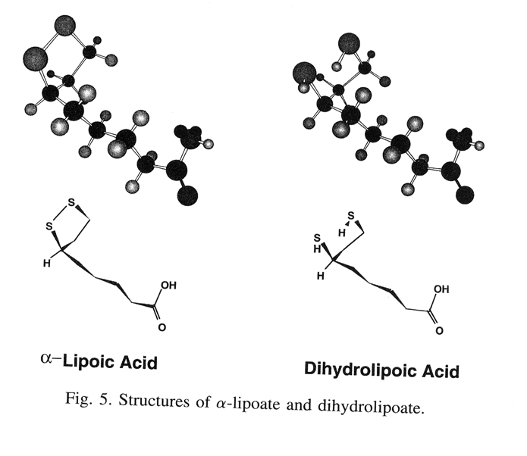
Structures of alpha-lipoic acid and dihydrolipoic acid (Packer et al., FRBM 22:359, 1997)

Slide 9
R-α-Lipoic Acid (LA)
A coenzyme of pyruvate dehydrogenase
Involved with carbohydrate utilization for the production of ATP in mitochondria
Reduced in mitochondria, where oxidants are generated, to dihydrolipoic acid, which is a potent antioxidant scavenging free radicals and chelating iron and copper
Improves cognitive function in aged mice

Slide 10
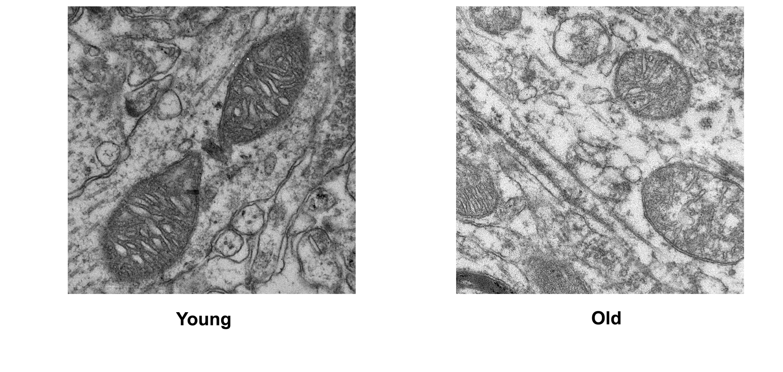
Mitochondria decay with age
1. Decreased cardiolipin levels and structural deficit;
2. Decreased membrane potential (the driving force for
ATP synthesis) and cellular oxygen consumption;
3. Increased oxidation and heterogeneity;
4. Prone to oxidative damage, leading to a vicious cycle.

Slide 11
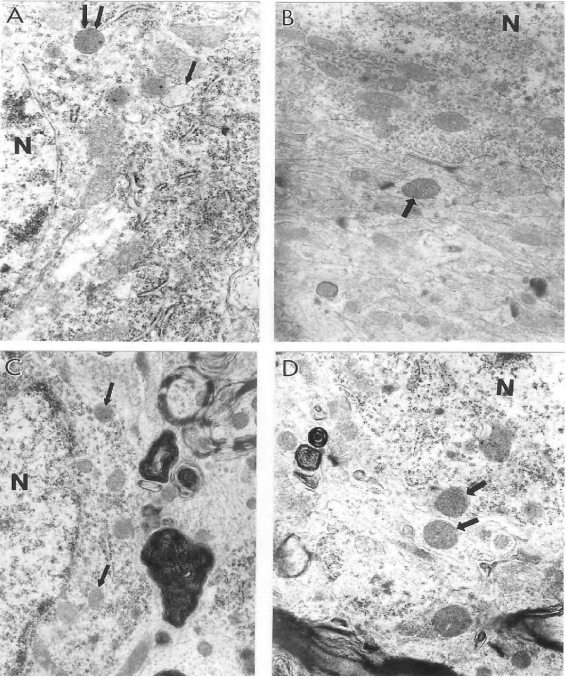
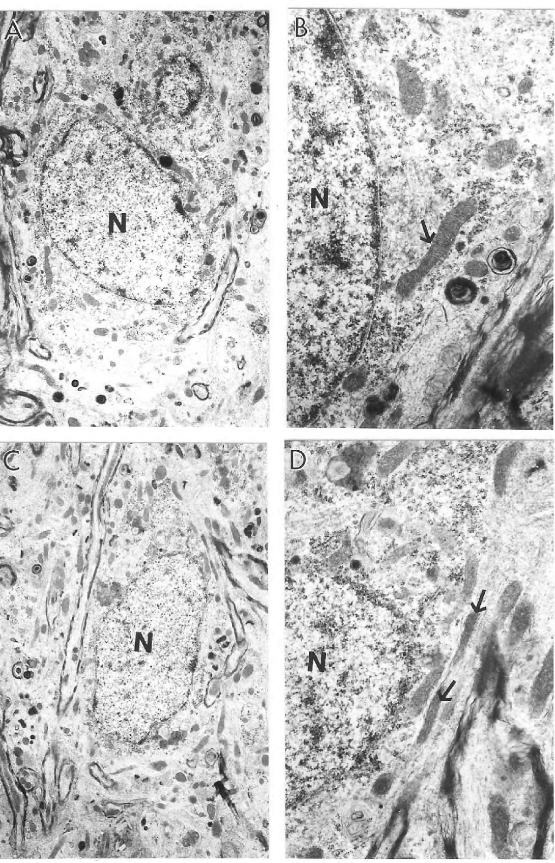
Ultrastructural characteristics of hippocampal neurons in young and old rats without (A and C) and with (B and D) 0.2% ALCAR and 0.1% LA diet.
Features of hippocampal neurons from old control rats.

Slide 12
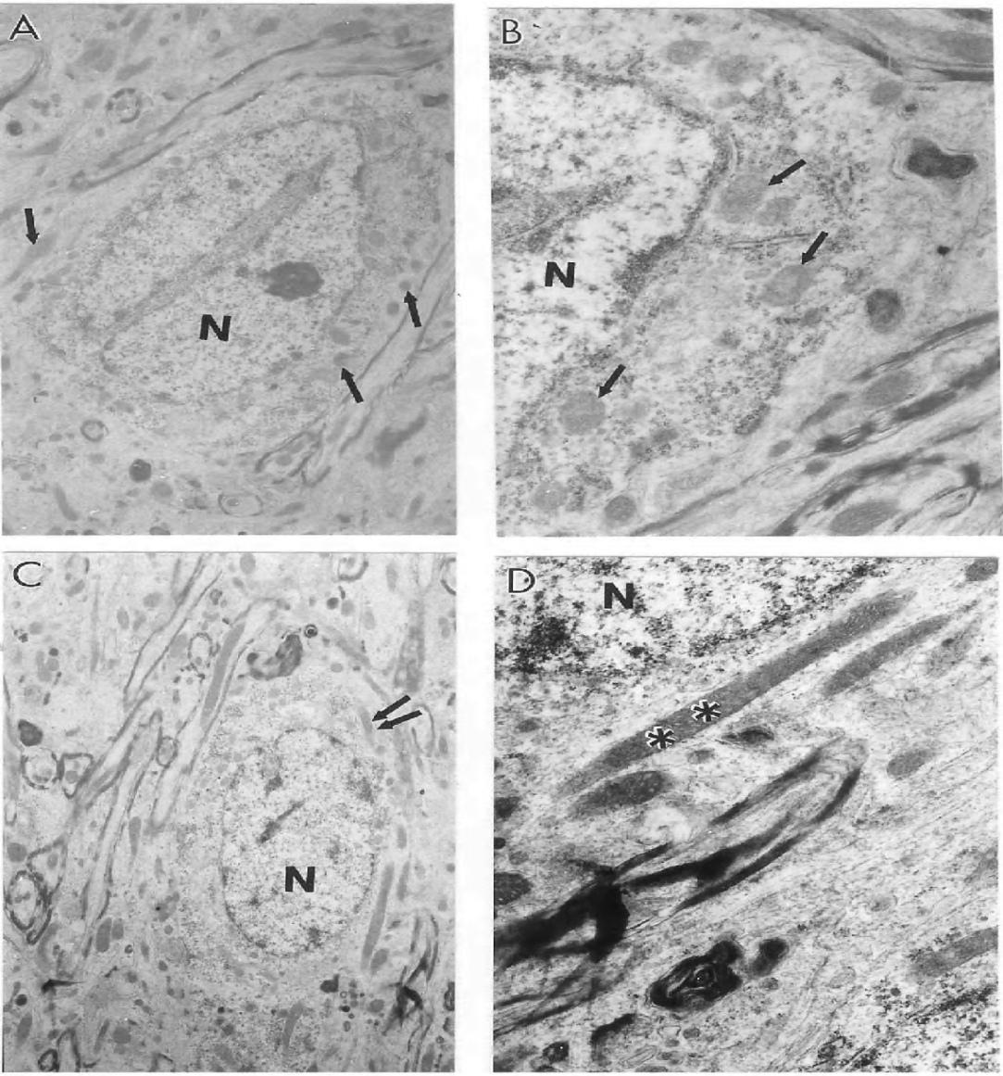
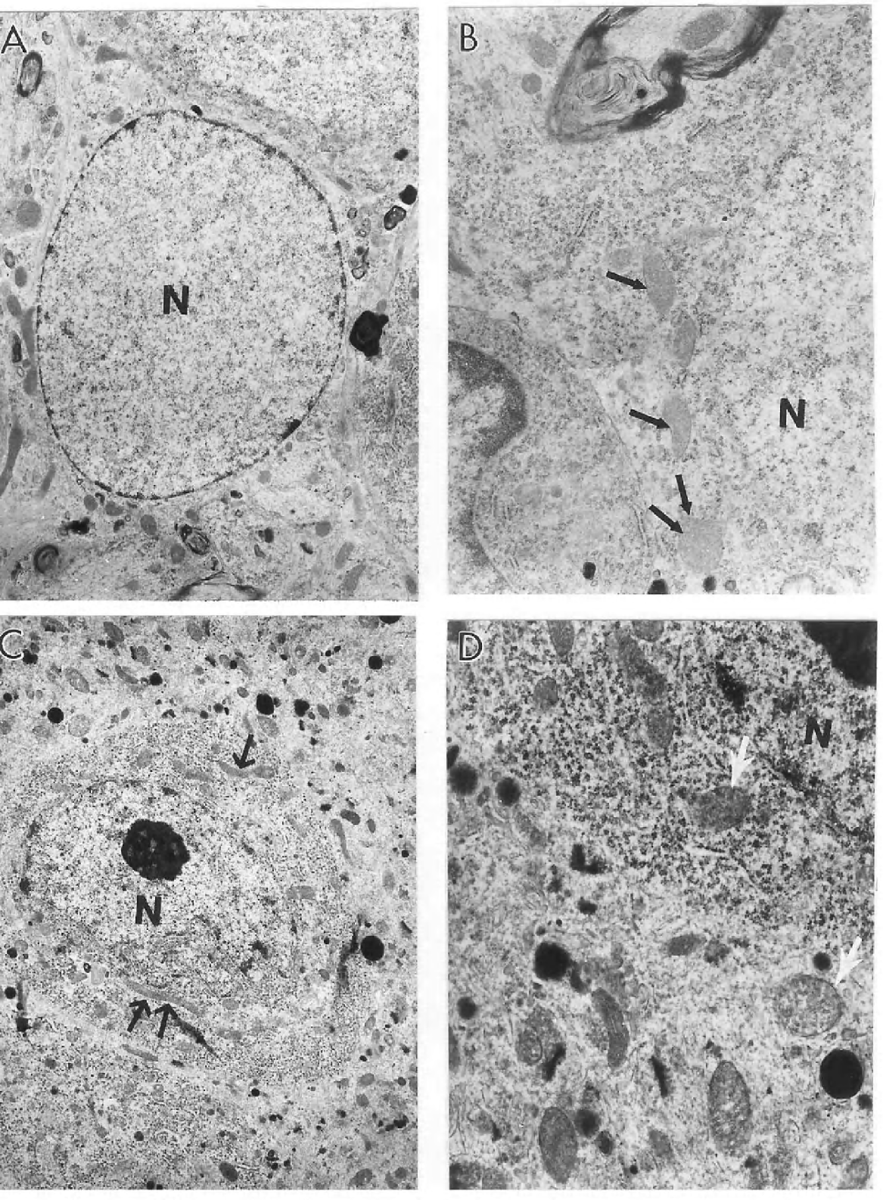
Ultrastructural characteristics of mitochondrial abnormalities in aged old control rat hippocampi.
The electron microscopic features of aged rat hippocampal astrocytes (A and B) and neurons (C and D).

Slide 13
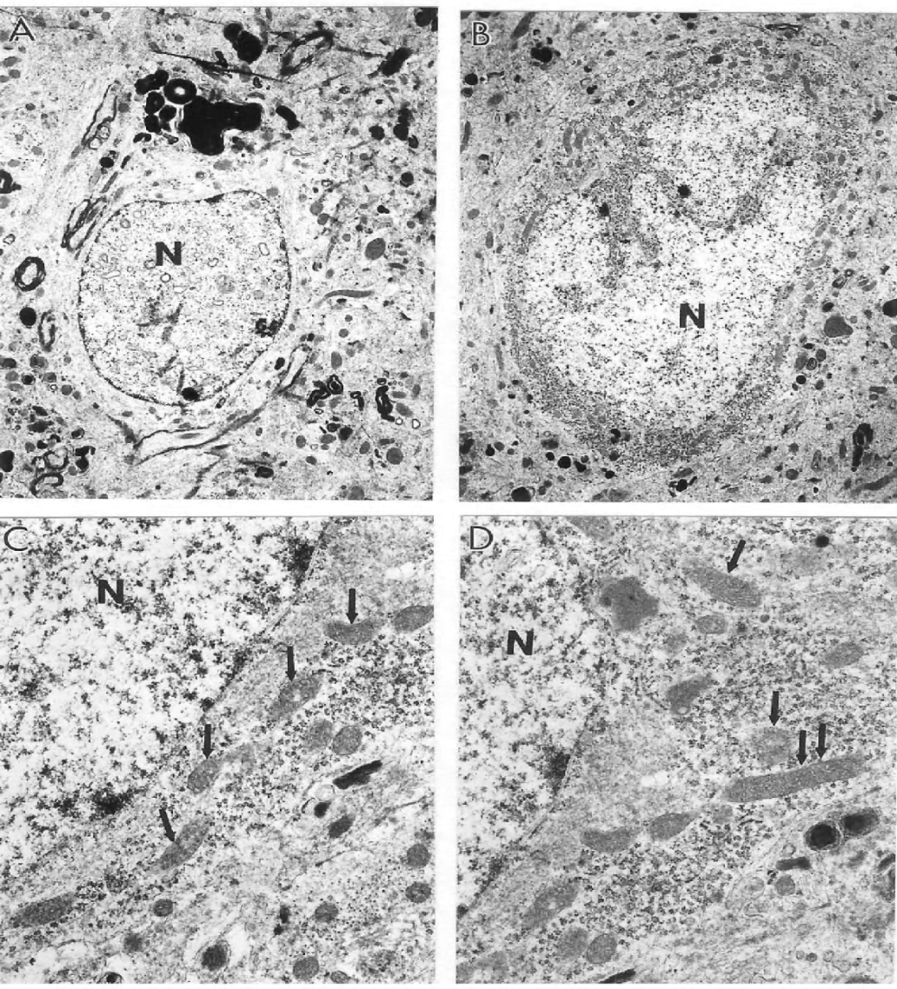
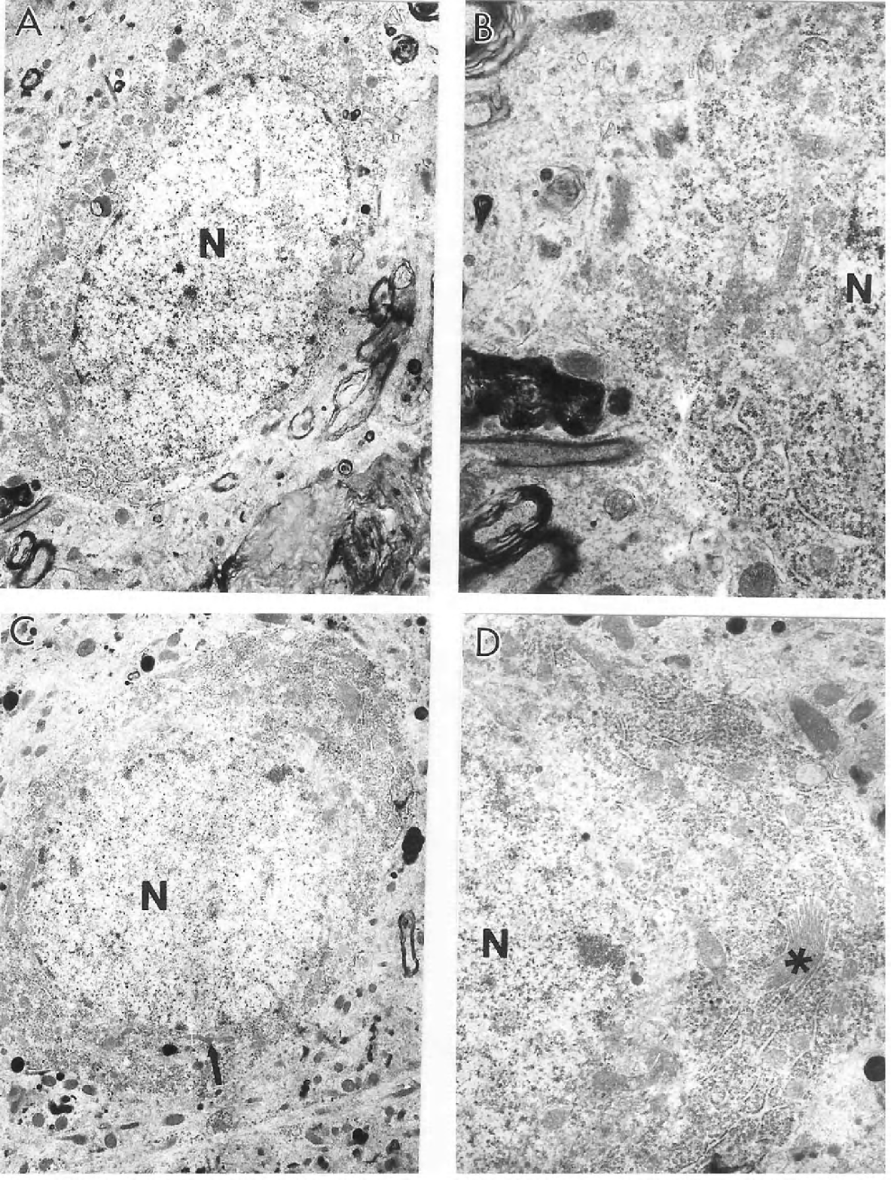
The heterogeneous morphology of mitochondria in aged old control rat hippocampal neurons.
The characteristics of hippocampal neurons from aged rats treated with 0.2% ALCAR and 0.1% LA for 3 months.

Slide 14
Intact mitochondria in hippocampal neurons under electron microscopy

Slide 15
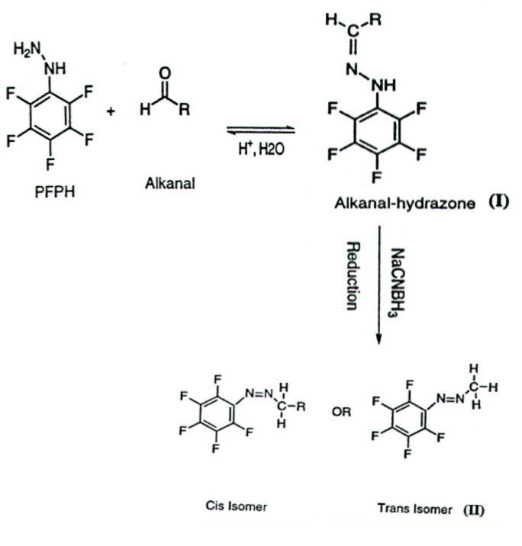
Development of GC-MS assay for lipid peroxidation

Slide 16
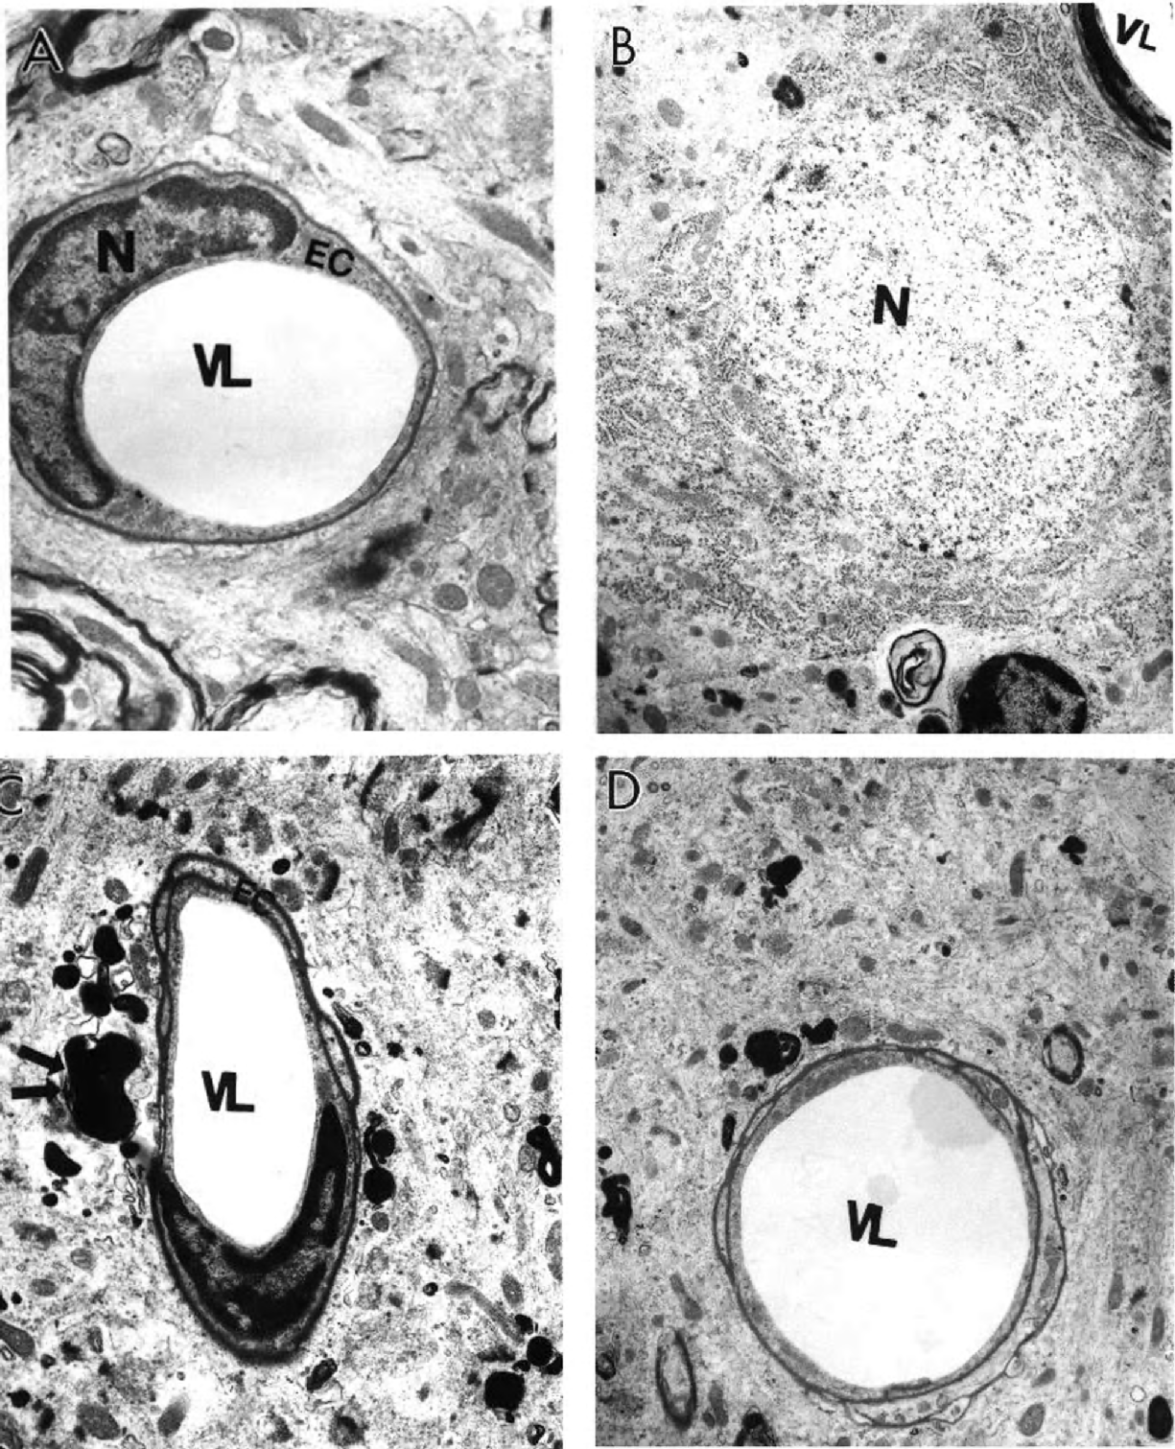
Ultrastructural characteristics of microvessels in young (A and B ) and old rat hippocampus with and without ALCAR + LA dietary supplementation.

Slide 17
Mitochondrial damage types: EDM, Mitochondria with electron dense matrix;
Giant,Giant mitochondria; PD, Mitochondria with partially damaged cristae
and presence of edema; CD, Severely damaged mitochondria.

Slide 18
20
Oxidants in Hepatocytes
Fl. Units/O2 Consumed per min.
10
0
Young
Old
Hamilton, M et al. PNAS 98:10469, 2001

Slide 19
Mitochondrial membrane potential and cardiolipin
in old and young rat hepatocytes
0.03
Old
0.02
Young
Normal cell number
Cardiolipin (µg per 10⁶ Cells)
0.01
0.00
10
100
1000
Young
Old
Fluorescence/cell
11
Notes:
R123 Fluorescence in old and young rat hepatocytes

Slide 20
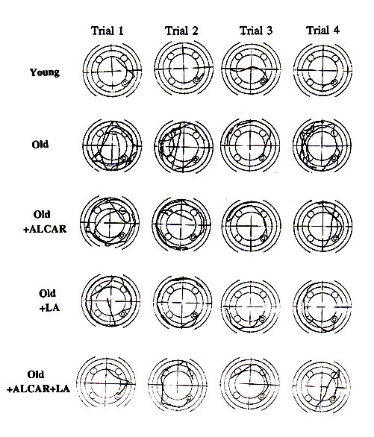
Morris Water Maze for
Testing Spatial Memory
Spatial memory relies on intact hippocampal function.
Old Rats showed poorer performance and the treatments showed improving effects.

Slide 21
Improvements in Spatial Learning by Old Rats
Given a Combination of ALCAR and LA

Slide 22
2. Peak procedure (Skinner box) for measuring temporal memory
14
Peak rate measures learning and motivation.
Young
12
Old
Old+ALCAR
Old+LA
Old+ALCAR+LA
10
Peak time measures internal clock, because the food is rewarded only when the animals push the lever at 40 sec after they hear or see a signal.
8
Response rate (responses/min)
6
4
2
0
0
50
100
150
200
Time

Slide 23
16
14.00
Young
Old
14
Old+ALCAR
12.00
Old+LA
Old+ALCAR+LA
12
10.00
10
SOUND
8.00
LIGHT
8
6.00
6
4.00
4.00
2.00
2.00
0.00
0.00
0
50
100
150
200
0
50
100
150
200
Time to Signal
Time to Signal

Slide 25
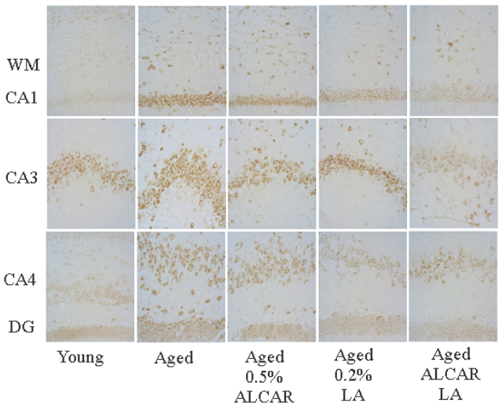
Oxidative Damage to Nucleic Acid in Old Rats by mAb to oxo8G/oxo8dG: Immunohistochemical stain of neurons

Slide 26
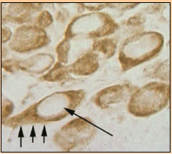
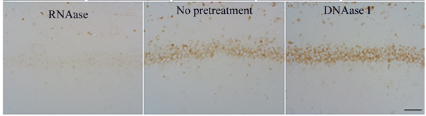
mAb to oxo8dG in DNA/oxo8G in RNA:
Oxidized RNA is predominant
in neuronal cytoplasm
*oxo8G: 8-hydroxyguanosine; oxo8dG: 8-hydroxy-2’-deoxyguanosine

Slide 27
MultiBrain technique for
immunohistochemical study of mitochondria
Nissl staining

Slide 28
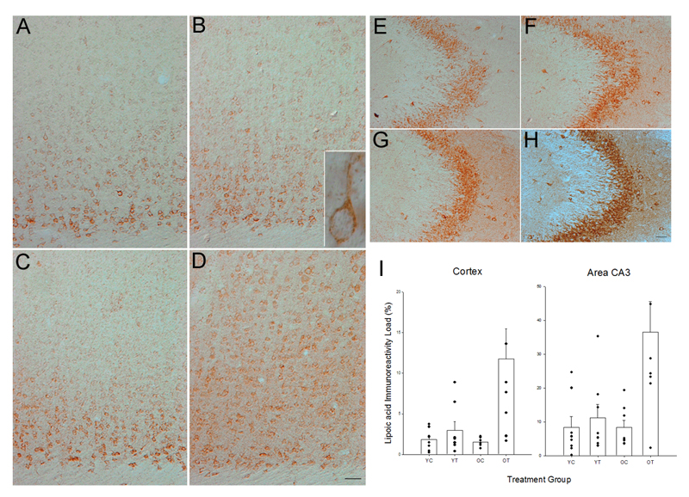
Anti-lipoic acid immunoreactivity in the frontoparietal cortex and hippocampal CA3

Slide 29
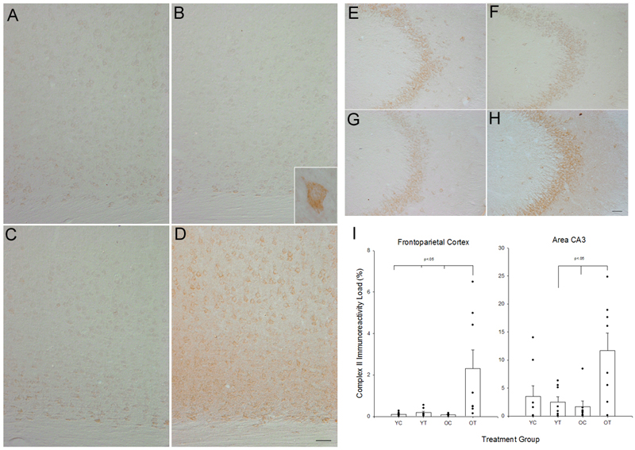
Mitochondrial complex II immunoreactivity
in the frontoparietal cortex and hippocampal CA3

Slide 30
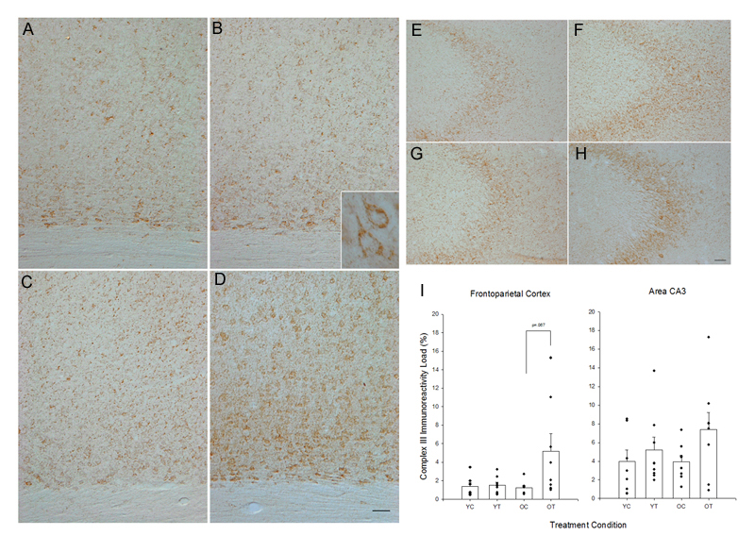
Mitochondrial complex III immunoreactivity
in the frontoparietal cortex and hippocampal CA3

Slide 31
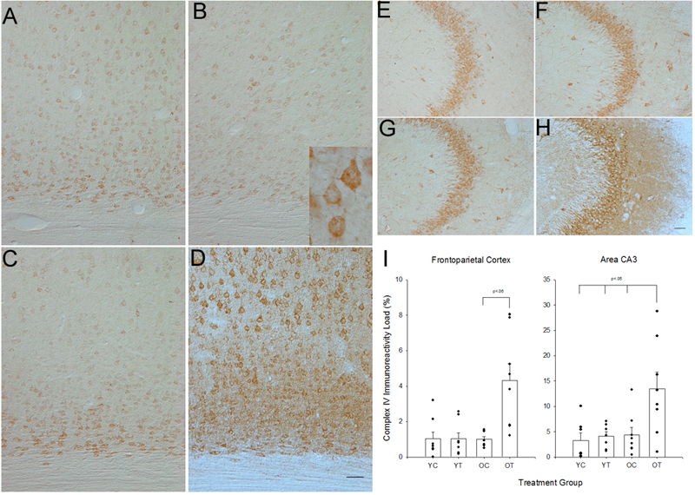
Mitochondrial complex IV immunoreactivity
in the frontoparietal cortex and hippocampal CA3

Slide 32
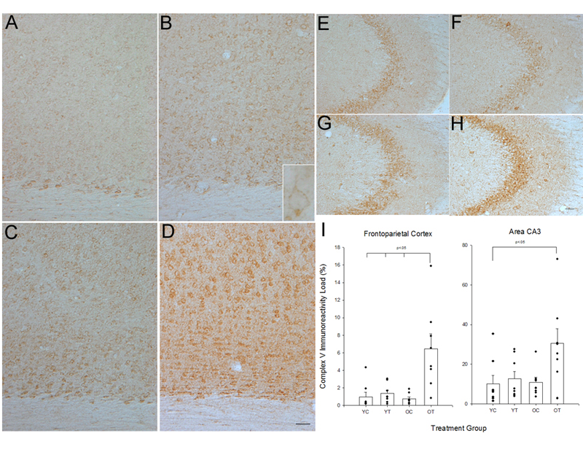
Mitochondrial complex V immunoreactivity
in the frontoparietal cortex and hippocampal CA3

Slide 33
SUMMARY:
The mitochondrial and free radical theory of aging postulates that age-associated cellular energy misbalance and therefore brain and most likely other human disorders are caused by an imbalance between pro-oxidants and anti-oxidants that can result in oxidative stress.

Slide 34
CONCLUSION:
We have concluded that age-associated neuronal and vascular degeneration which accompanied with mitochondrial decay tunes up with the mitochondrial antioxidants and metabolites [Aliev et al., 2009, 2010-a-b, and 2011-c; 2012-a-b; 2013-a-f].

Slide 35
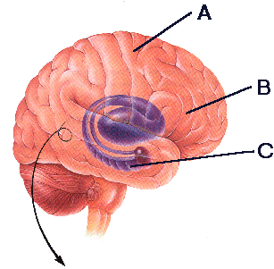
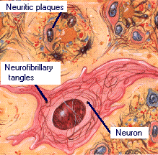
Alzheimer disease attacks nerve cells in several regions of the brain.
A. Cerebral Cortex: Involved in conscious
thought and language.
B. Basal forebrain: Has large numbers of neurons containing acetylcholine, a chemical important in memory and learning.
C. Hippocampus: Essential to memory storage. The earliest signs of Alzheimer are found in the nearby entorhinal cortex.

Slide 36
Proposed Etiologies of
Alzheimer Disease
•
Aluminum or other toxin
•
Infectious agent
•
Synaptic abnormalities
•
Vascular/immune abnormalities
•
Lack of growth factor
•
Lipoproteins
•
Protein abnormalities
•
Oxidative stress

Slide 37
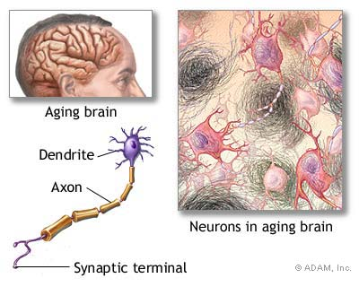
The finding of amyloid-beta (Aβ) deposition in AD brains after death led to the so-called “amyloid hypothesis”

Slide 38
Definition of oxidative stress
Oxidative damage increases in Alzheimer disease
Sources of reactive oxygen
Responses to oxidative stress
Involvement of pathological lesions
Phosphorylation control of oxidative damage

Slide 39
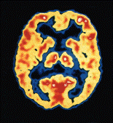
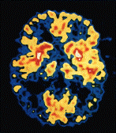
A leading hypothesis of the biological basis of aging is oxidative stress. Metabolism is the primary source of oxidants.
AD is strictly age dependent
Normal Alzheimer
Diet
Lipoic Acid
Estrogen
Antioxidants are Protective
Acetylsalicylic
acid (Aspirin)
(-) Deprenyl
(selegiline)
Ibuprofen
Progression/Incidence
Tenilsetam
Dapsone
Vitamin E
Fruits and vegetables
Acetyl-L-Carnitine
(ALCAR)

Slide 40
Uric Acid Accumulation (Gout) is Protective
Alzheimer Parkinson
Osteoarthritis Prostate
cancer
Medicare In-Patient Database
Total 7,500,000
Alzheimer Disease 128,120
Gout 77,136
Parkinson Disease 130,611

Slide 41
Current Most Accepted Theory of Alzheimer Disease (Amyloid Theory)
The finding of amyloid-beta (Aβ) deposition in AD brains after death led to the so-called “amyloid hypothesis”.
For over a decade, the amyloid hypothesis has so influenced and guided research in the field of Alzheimer dementia that many workers regard it as the gold standard of scientific investigation.
We have extensively reviewed the literature which claims that AD is caused by the deposition of Aβ within structures called senile plaques that invade AD brains and that such plaque formation then leads to further abnormalities within the nerve cells, eventually killing them.
We have found little evidence to support this claim and ample evidence to question it. For example, the amyloid hypothesis has been criticized because its research findings up to now have not generated any benefits in the clinical management and treatment of AD patients nor to an understanding of how the elderly are preferentially affected.

Slide 42
The mitochondrial and free radical theory of aging postulates that age-associated brain energy disorders are caused by an imbalance between pro-oxidants and anti-oxidants that can result in oxidative stress.
1. Aliev G, Palacios HH, Walrafen B, Lipsitt AE, Obrenovich ME, Morales L. Brain mitochondria as a primary target in the development of treatment strategies for Alzheimer disease. Int J Biochem Cell Biol. 2009 Oct;41(10):1989-2004.
2. Vančová O, Bačiak L, Kašparová S, Kucharská J, Palacios HH, Horecký J, Aliev G. In vivo and in vitro assessment of brain bioenergetics in aging rats. J Cell Mol Med. 2010 Nov;14(11):2667-74. doi: 10.1111/j.1582-4934.2009.00879.x.
3. Aliev G, Li Y, Palacios HH, Obrenovich M.E. Oxidative Stress induced mitochondrial DNA deletions as a halmark for the drug development in the context of the cerebrovascular diseases. Recent Pat Cardiovasc Drug Discov. 2011 Sep;6(3):222-41.
4. Aliev G, Obrenovich ME, Tabrez S, Jabir NR, Reddy VP, Li Y, Burnstock G, Cacabelos R, Kamal MA. Link between cancer and Alzheimer disease via oxidative stress induced by nitric oxide-dependent mitochondrial DNA overproliferation and deletion.Oxid Med Cell Longev. 2013;2013:962984. doi: 10.1155/2013/962984. Epub 2013 Apr 3.
5. Aliev G, Priyadarshini M, Reddy VP, Grieg NH, Kaminsky Y, Cacabelos R, Ashraf GM, Jabir NR, Kamal MA, Nikolenko VN, Zamyatnin AA, Benberin VV, Bachurin SO. Oxidative Stress Mediated Mitochondrial and Vascular Lesions as Markers in the Pathogenesis of Alzheimer Disease. Curr Med Chem. 2013 Dec 27. [Epub ahead of print]

Slide 43
Possible Pathogenetic Mechanisms of the Effect of Vascular Hypoperfusion During Aging and During the Development of Stroke and AD.
arterial
occlusion
compression
brain microvessel
hypoperfusion
cholesterol
lipid
metabolism
imbalance
hypoxia
energy failure &
metabolite
accumulation
↑iNOS
protein
modification
DNA RNA
oxidation
↑ROS
↑ET-1
NO
↓metabolic
activity
neutralize
ROS
↓neuronal
activity
permanent
vessel collapse
peroxinitrite
and peroxinitrate
permanent
neuronal
damage

Slide 44
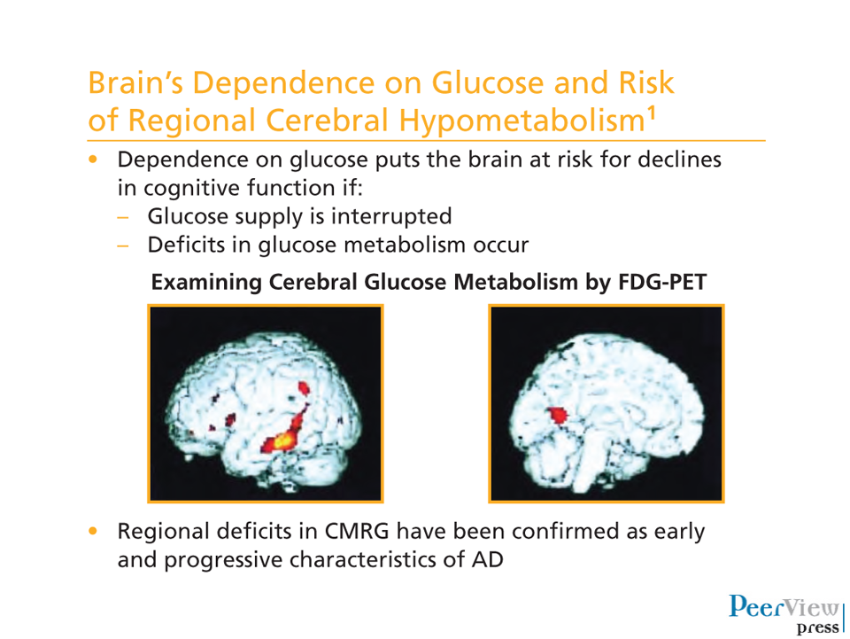

Slide 45
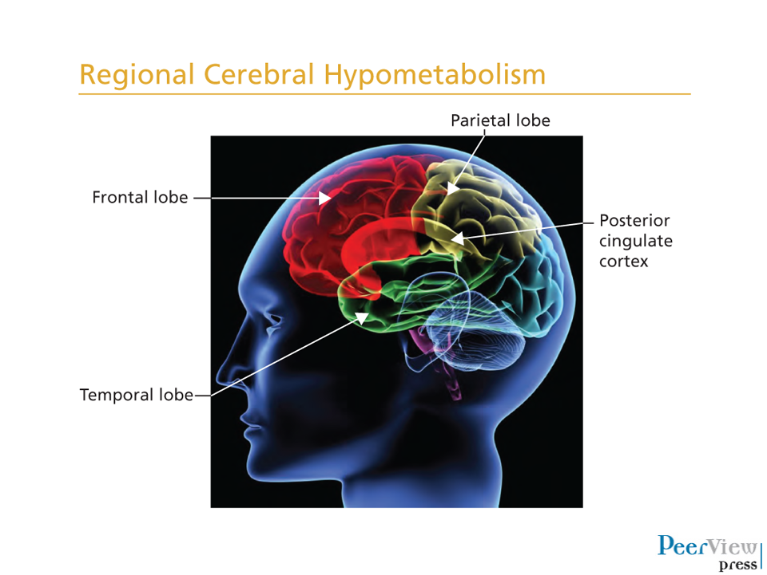

Slide 46
GOAL:
To examine this issue directly, we undertook a morphometric study of brain biopsy specimens from AD and control cases.

Slide 47
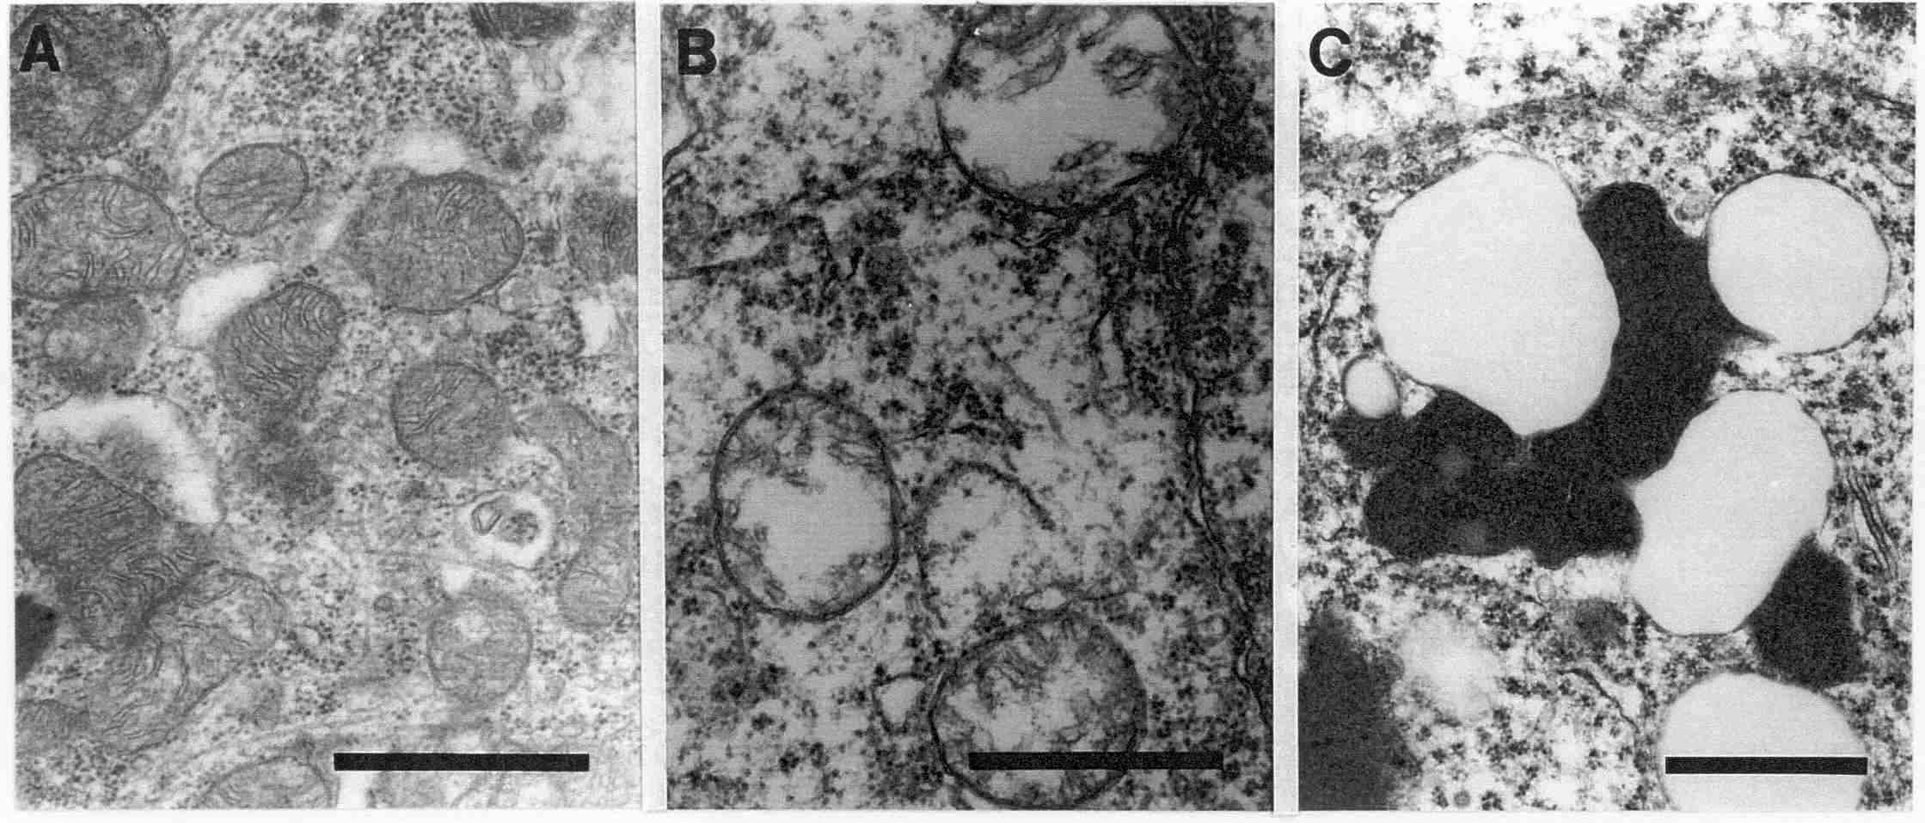
While mtDNA is increased, mitochondria are not.
Examination of neurons in biopsy specimens shows normal mitochondria (A), mitochondria with broken cristae (B), and lipofuchsin with vacuoles (C).
Mitochondria
Percentage area of intact mitochondria is significantly decreased in cases of AD (n=8) as compared to age-matched controls (n=5). p=0.012
*

Slide 48
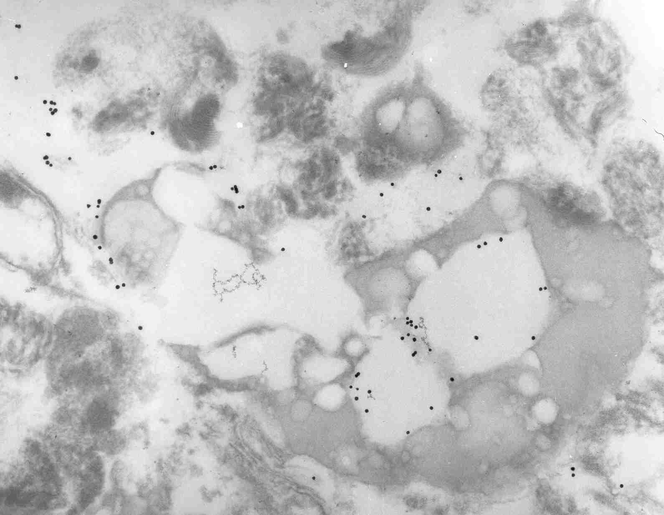
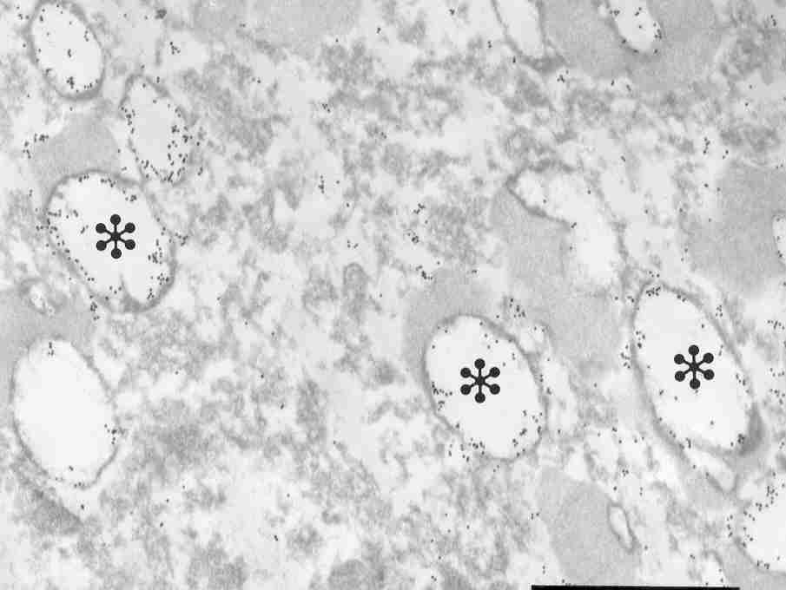
Mitochondria components are in autophagosomes
mtDNA
mt-Enzymes

Slide 49

Could oxidative damage be related to the autophagosomal pathway?
lysosome
mitochondria
Fe
Fe
H
O
O
-
2
2
2
·OH

Slide 50
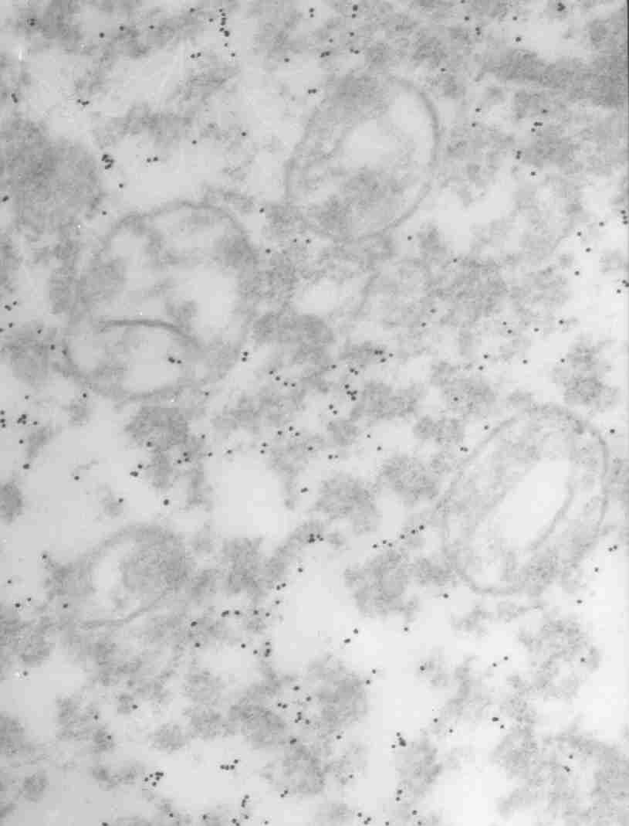
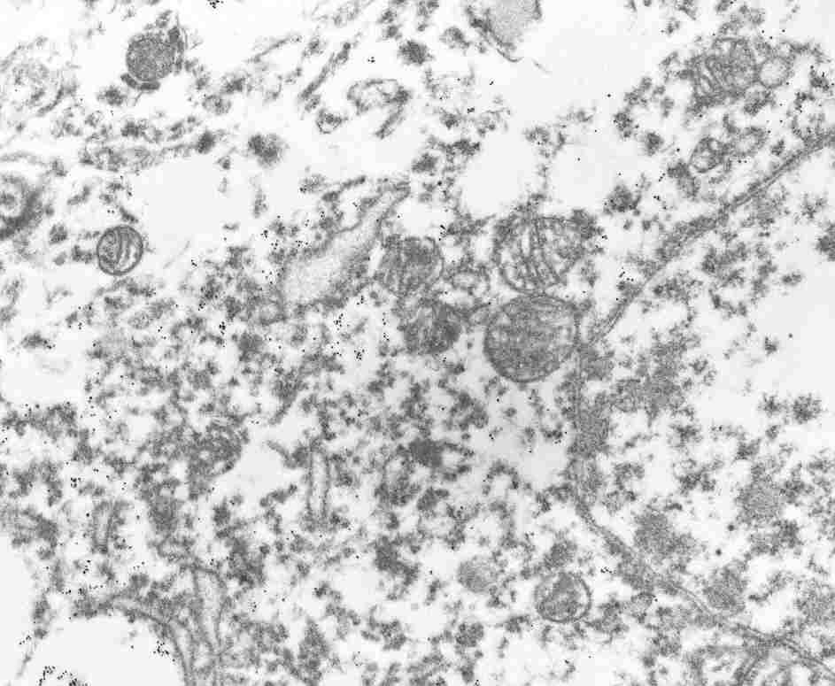
Nucleic acid damage, as well as redox active metals are cytosolic
8-hydroxyguanosine Redox active metals

Slide 51
Could there be a more complex cytoplasmic interplay leading to oxidative damage?
lysosome
mitochondria
Fe
H
2
O
2
H
2
O
2
Fe(II)
-
O
2
-
Fe(III)
-
H
2
O

Slide 52
Aliev G, et al., Brain Mitochondria as a Primary Target in the Development of treatment Strategies for Alzheimer Disease.
Int J Biochem Cell Biol. 2009 Oct;41(10):1989-2004. Epub 2009 Apr 5.
H.H. Palacios, B.B. Yendluri, K. Parvathaneni, V. B. Shadlinski, M. E. Obrenovich, J. Leszek, D. Gokhman, K. Gasiorowski, V. Bragin and G. AlievMitochondrion-Specific Antioxidants as Drug Treatments for Alzheimer Disease. CNS Neurol Disord Drug Targets. 2011 Mar;10(2):149-62 .
Horecký J, Gvozdjakova A, Kucharska J, Obrenovich ME, Palacios HH, Li Y, Vancova O, Aliev G. Effects of coenzyme Q and creatine supplementation on brain energy metabolism in rats exposed to chronic cerebral hypoperfusion. Curr Alzheimer Res. 2011 Dec;8(8):868-75.
Aliev G, Priyadarshini M, Reddy VP, Grieg NH, Kaminsky Y, Cacabelos R, Ashraf GM, Jabir NR, Kamal MA, Nikolenko VN, Zamyatnin AA, Benberin VV, Bachurin SO. Oxidative Stress Mediated Mitochondrial and Vascular Lesions as Markers in the Pathogenesis of Alzheimer Disease. Curr Med Chem. 2013 Dec 27. [Epub ahead of print].
4. Kosenko E.A., Solomadin I.N., P. Reddy, Aliev G. and Kaminsky Y.G. Pathogenesis of Alzheimer Disease: Role of Oxidative Stress, Amyloid Beta Peptides, Systemic Ammonia and Erythrocyte Energy Metabolism. CNS Neurol Disord Drug Targets. 2013 Sep 16. [Epub ahead of print].
5. V.P. Reddy, J. Mehta and Aliev G. Role of α-Lipoic Acid and Acetyl-L-Carnitine in Dementia. In: Diet and Nutrition in Dementia and Cognitive Decline, Kings College, UK, 2014 (in press).

Slide 53

THE ROLE OF HYPOPERFUSION, MITOCHONDRIA FAILURE,
AND OXIDATIVE STRESS
IN TRANSGENIC MOUSE MODEL OF ALZHEIMER DISEASE

Slide 54
METHODS:
Transmission electron microscopy (TEM) Qualitative Analysis.
In Situ Hybridization; Light and EM in situ hybridization was performed using mitochondria DNA probes for human wild type, 5kb deleted and mouse mtDNA.
EM pre-embedding immunogold cytochemistry was performed using antibodies against cytochrome C-oxidase (subunit 1), APP (C-terminal), and Aβ.
Quantitative Morphometric Analysis of the Degree of Mitochondria Lesions.

Slide 55
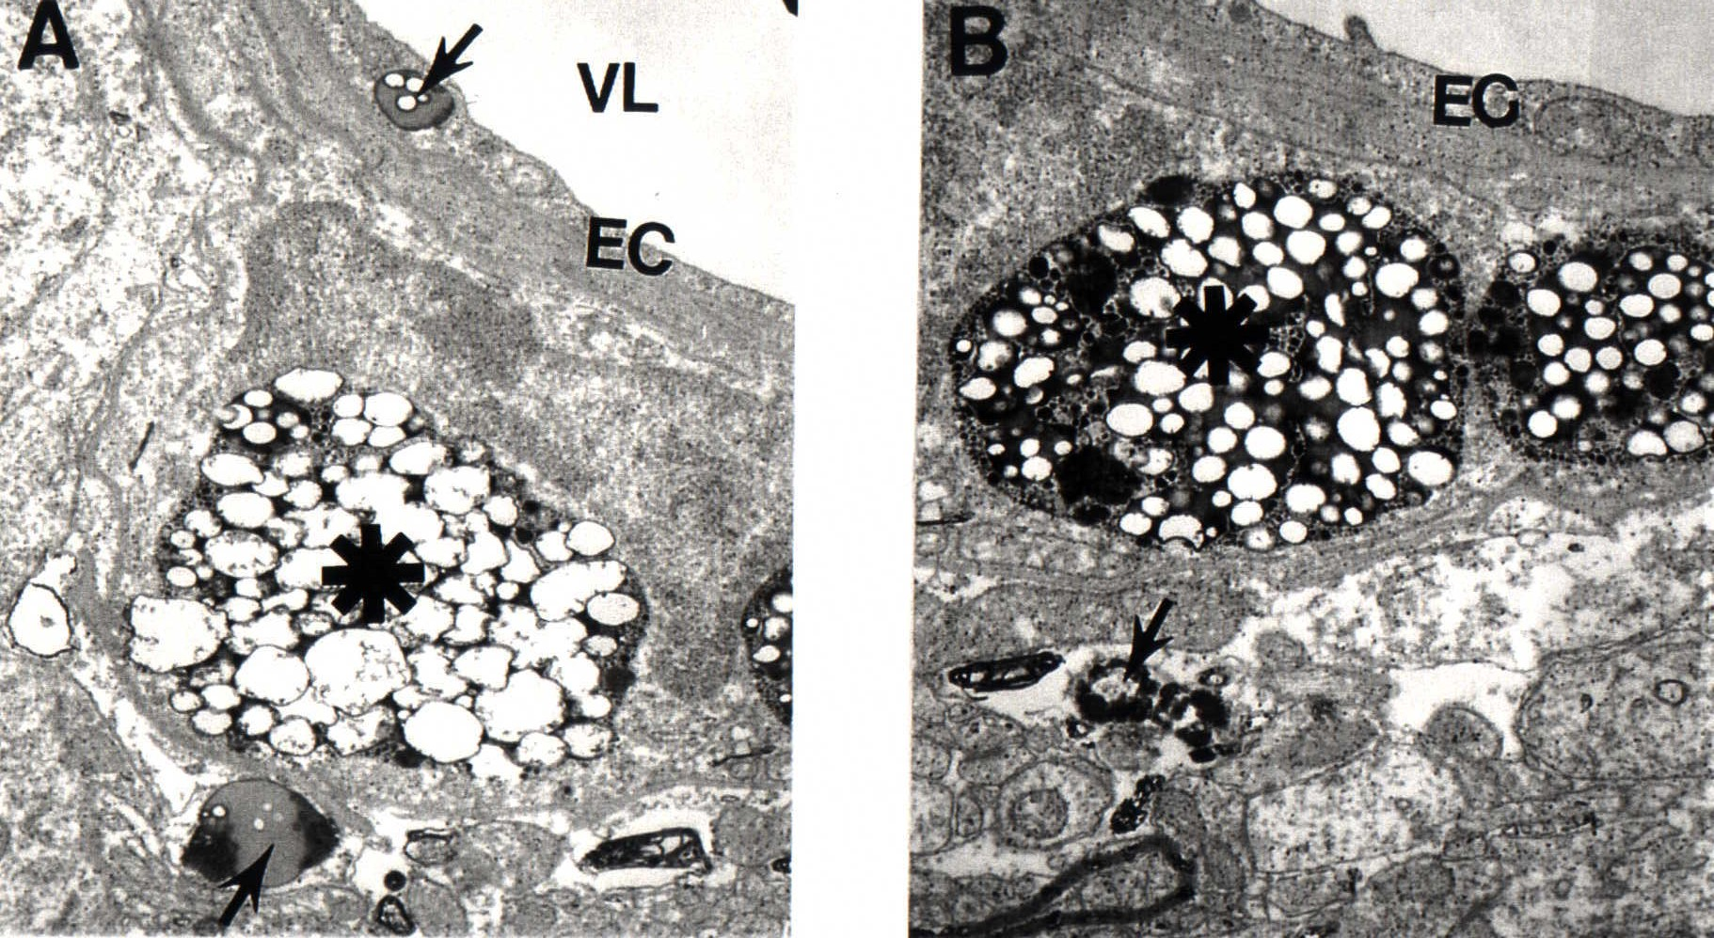
The ultrastructural features of cortical microvessels from aged YAC AbPP Tg (+) mice.

Slide 56

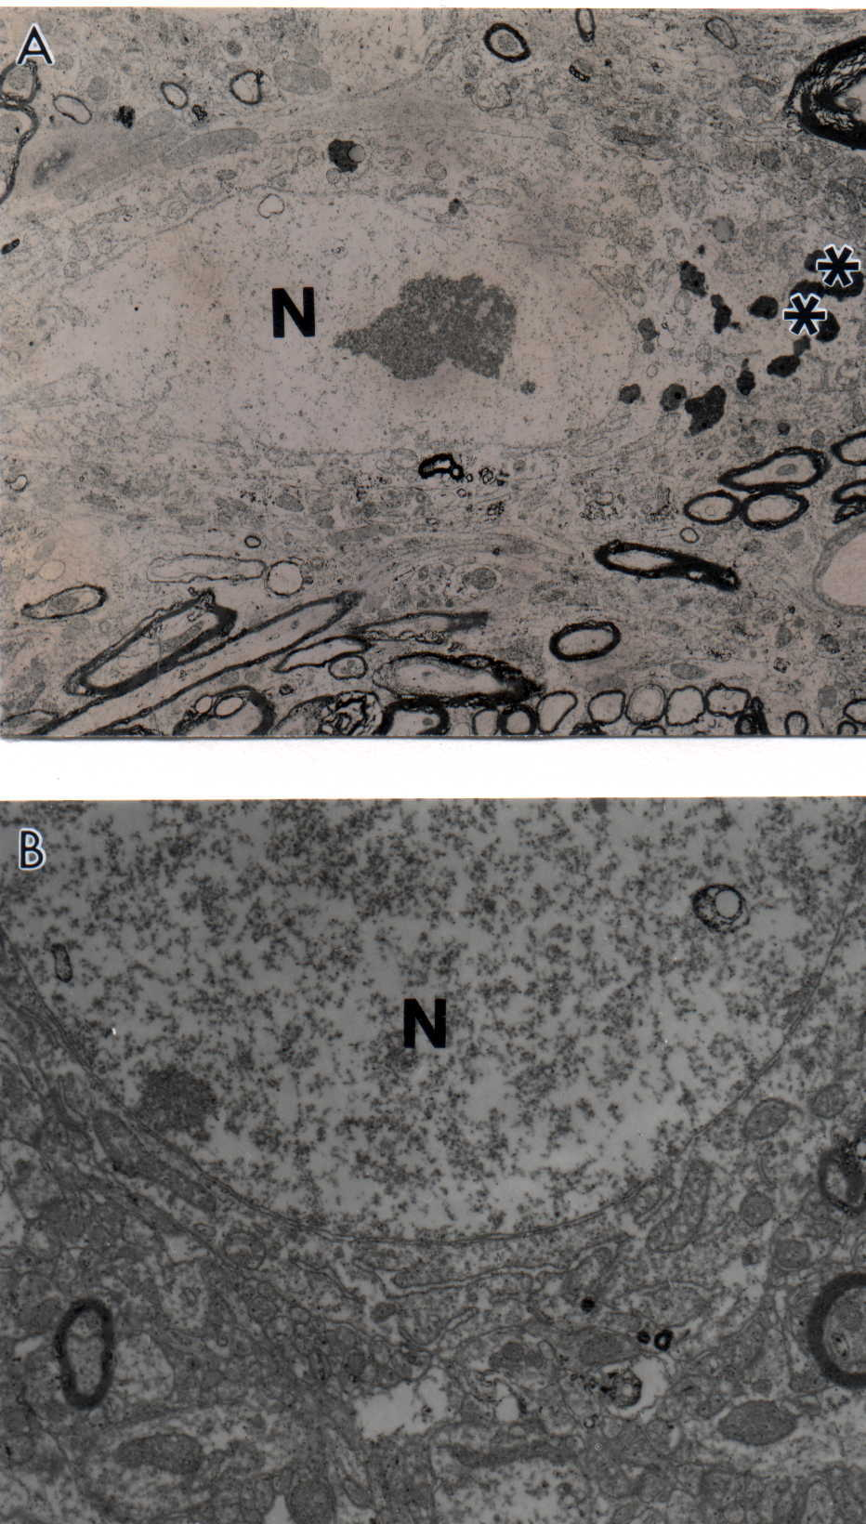
Age-matched control, non-transgenic mice did not show any particular changes in their neuronal ultrastructure.
In some neurons lipofuscin was sometimes seen.

Slide 57

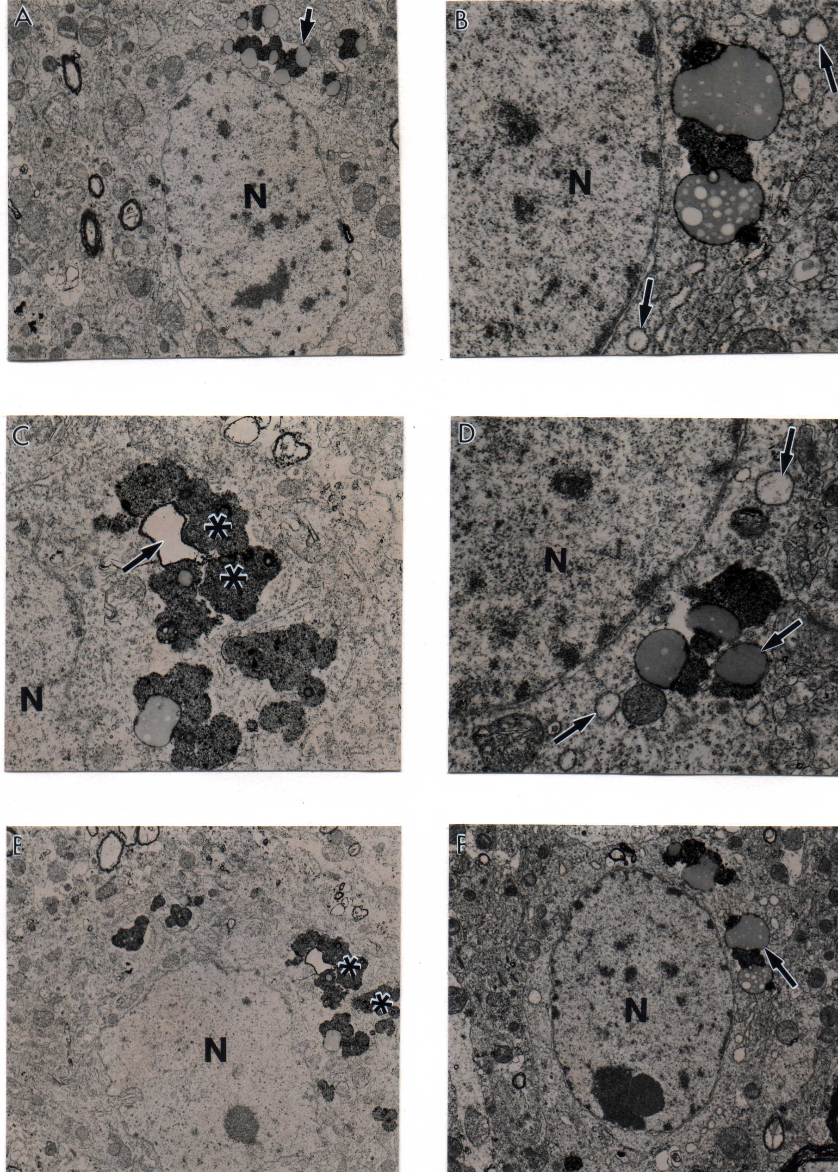
YAC AβPP transgenic mice. In the neuronal cell body mitochondria lesions were associated with lipofuscin formation and mitochondria appeared to be a major substrate for their formation.

Slide 60

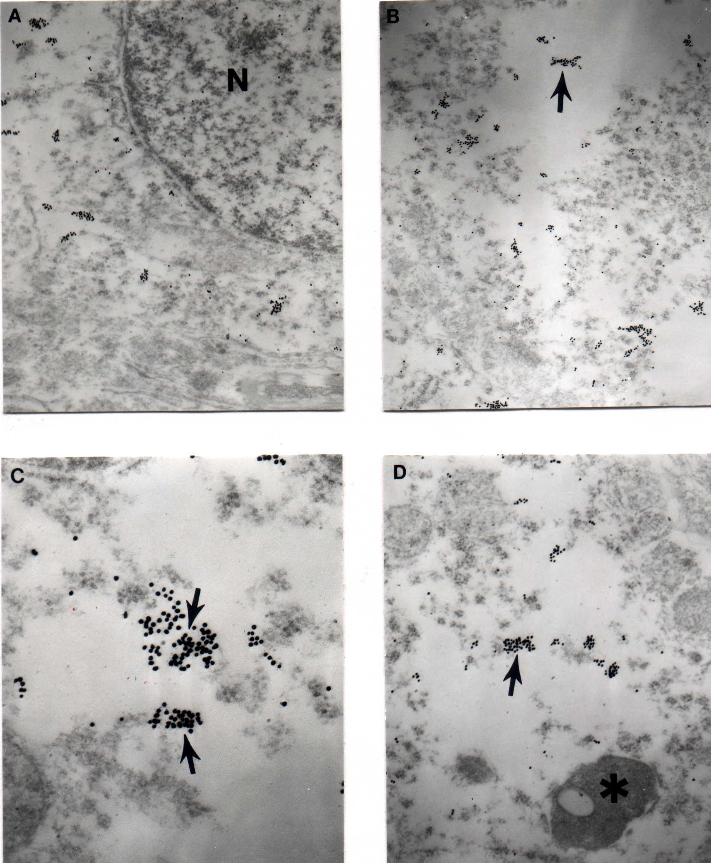
The clusters of APP immunopositive gold particles (17 nm) in the neuronal cell body from the parietal cortical neurons of aged YAC AbPP transgenic mice.

Slide 61
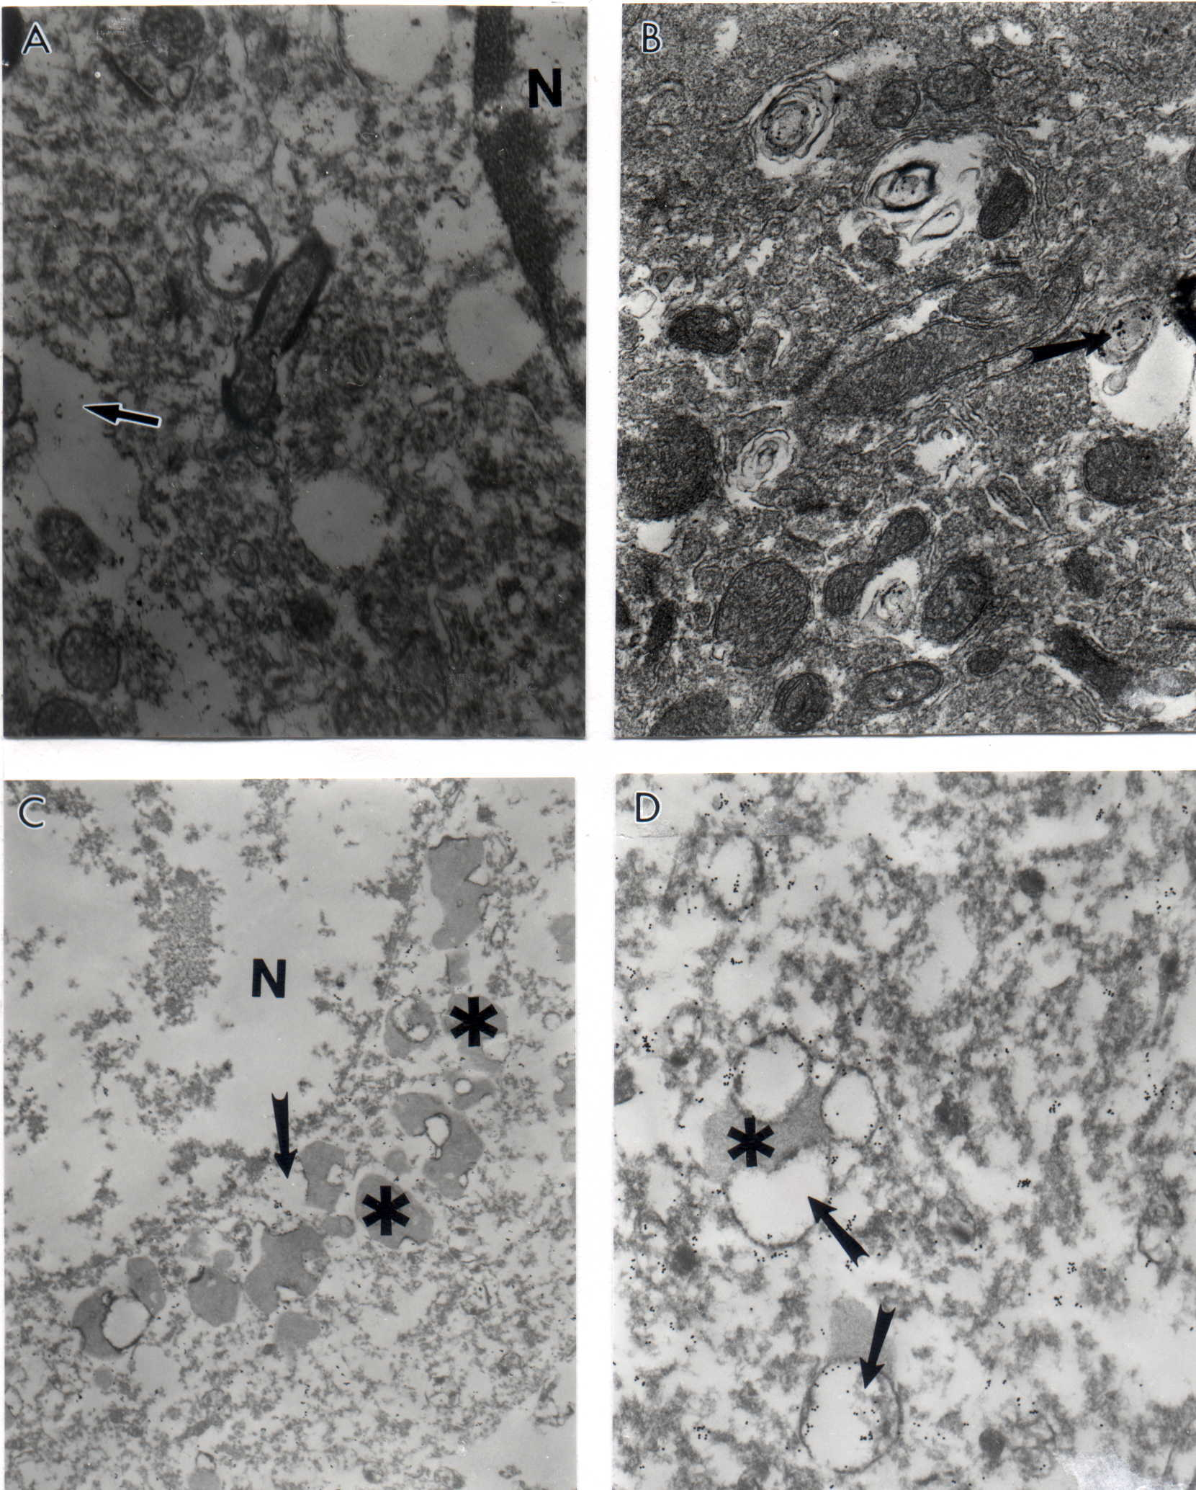
In situ hybridization using the wild type human mtDNA probe was detected using colloidal gold probe. Hybridization was detected in YAC AbPP (C and D), but not control (A and B) mouse hippocampus (CA1 regions). The main source of mtDNA probe is in damaged mitochondria, and mitochondria derived lysosomes, but not in lipofuscin.

Slide 62
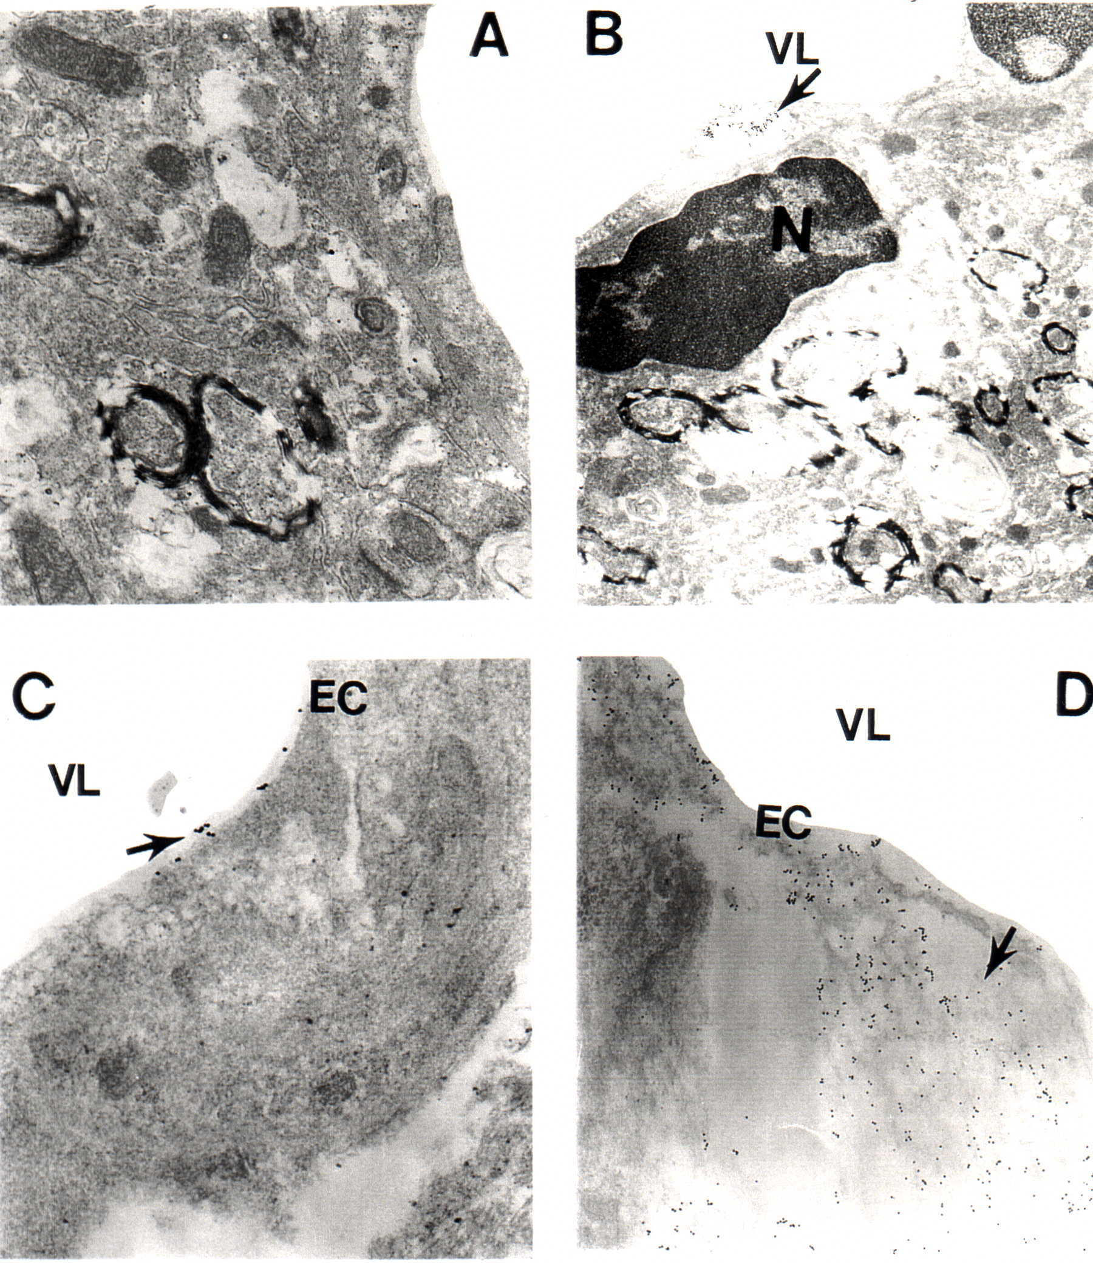
The ultrastructural localization of wild mtDNA probes in the cortical vessels of control mice (A-B) and YAC AbPP Tg (+) mice (C-D).

Slide 63
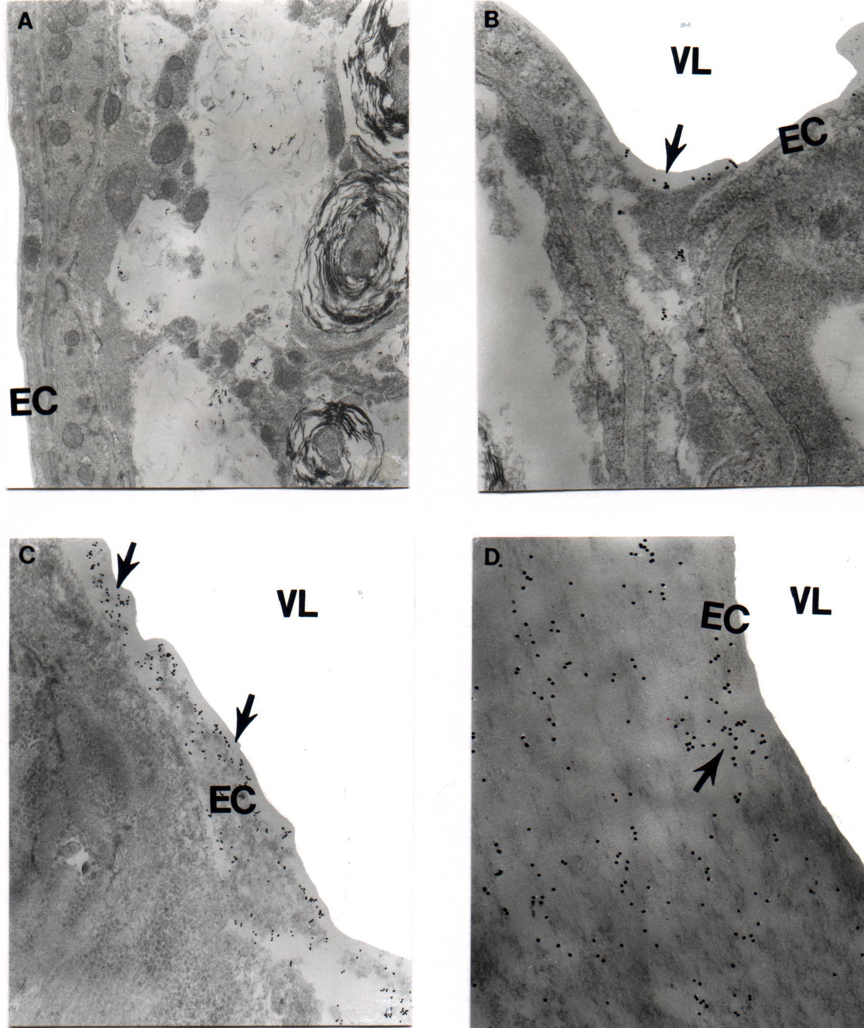
The distribution of chimeric mtDNA probes (colloidal gold 17 nm) in aged control (A and B) and YAC AbPP transgenic mice microvessels (C and D).

Slide 64

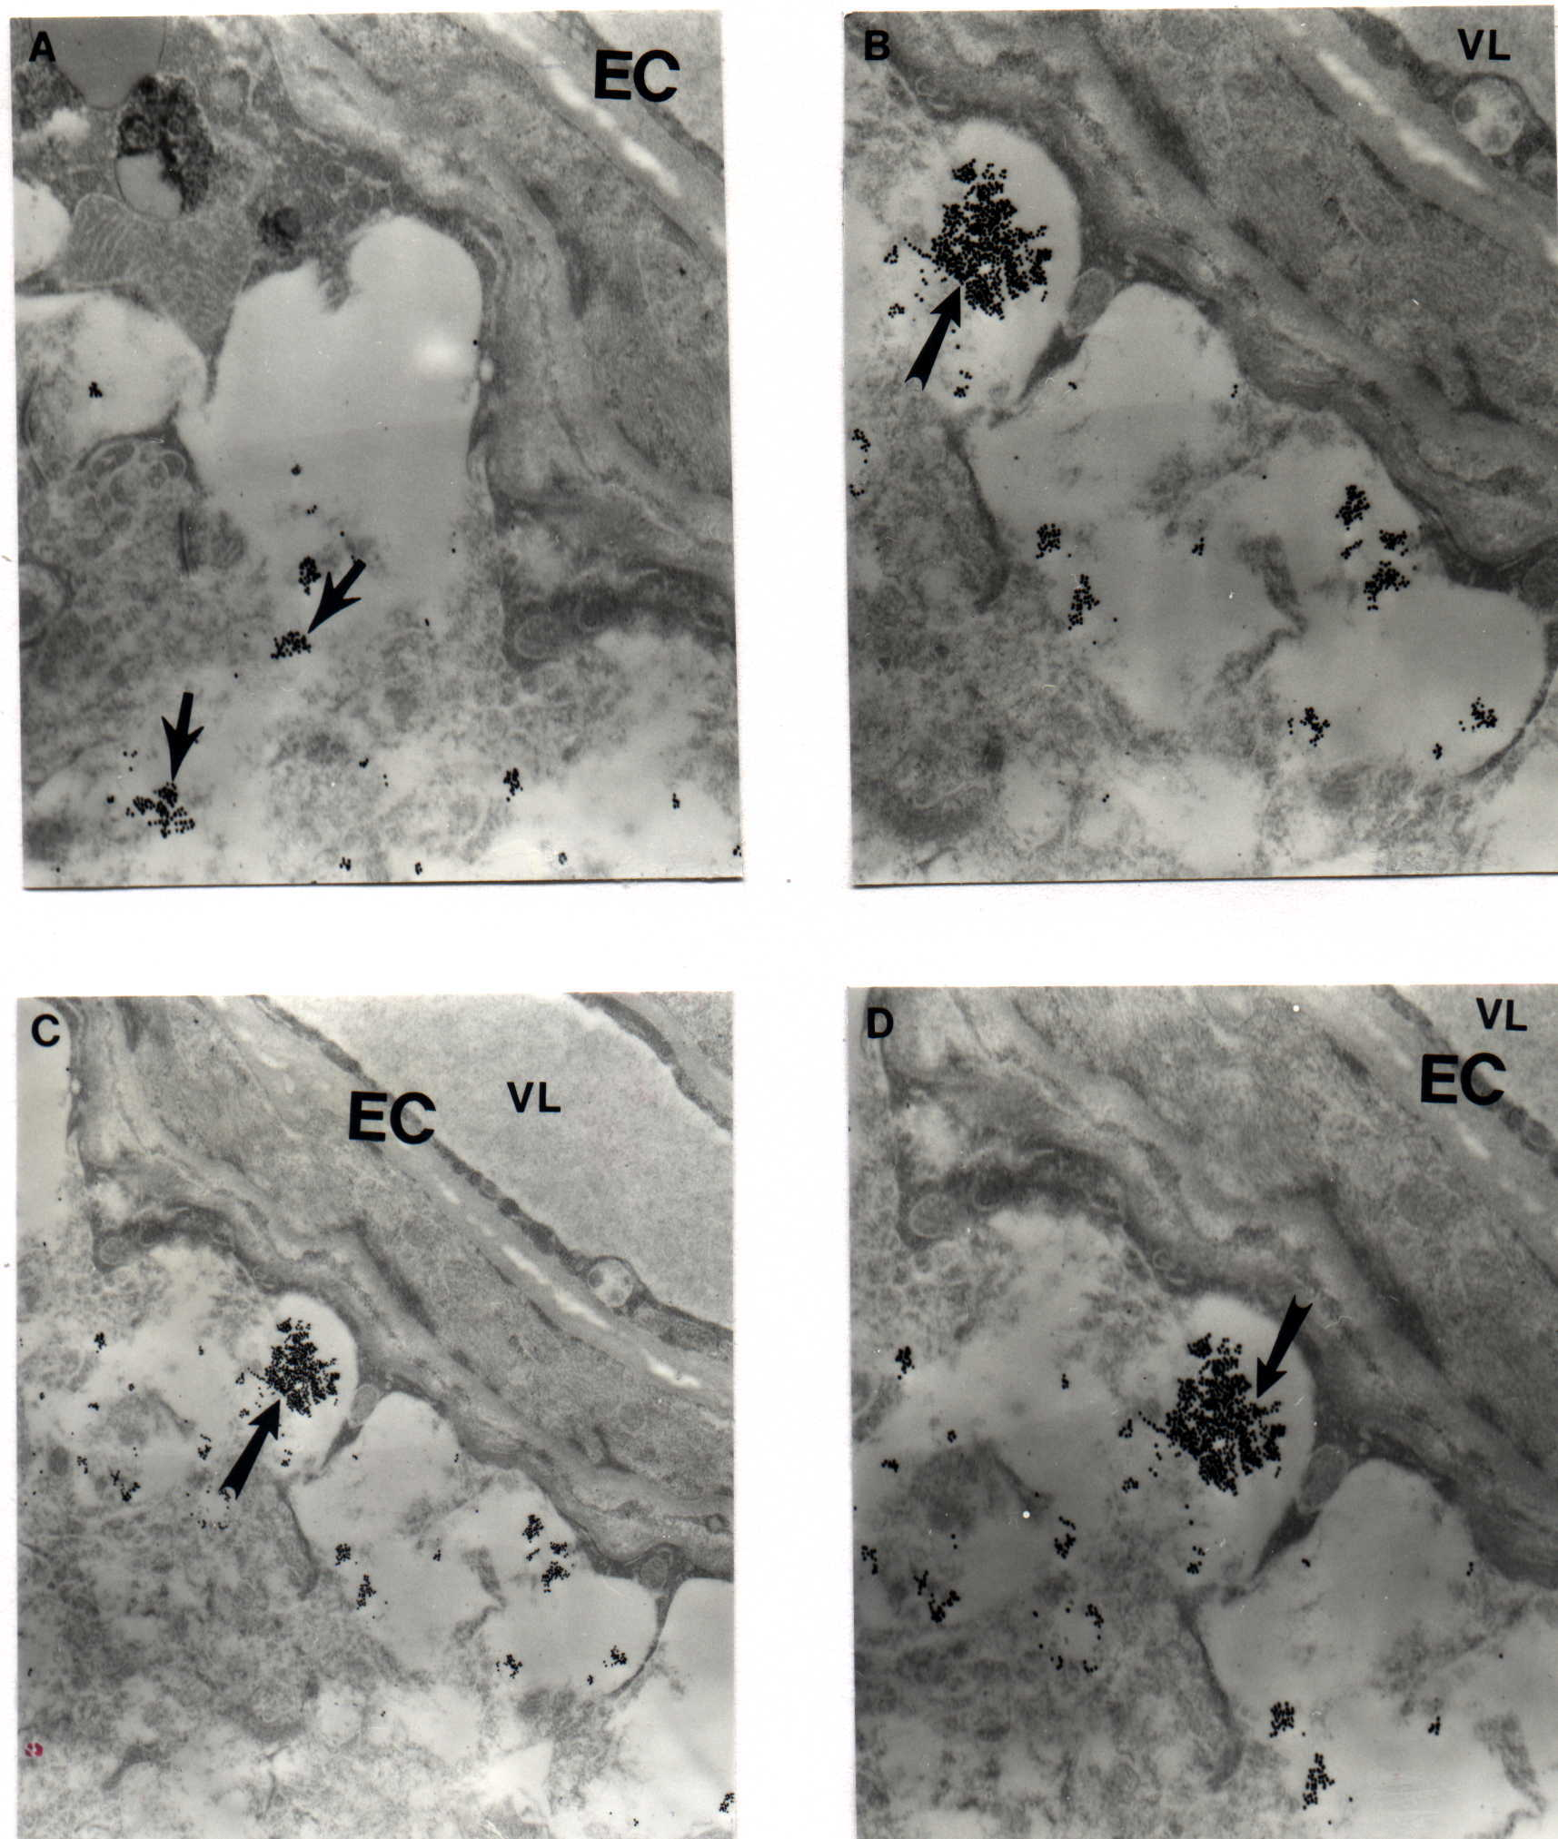
The ultrastructural features of APP immunostaining (colloidal gold, 17 nm) in vascular wall cell in YAC AbPP transgenic mice using CT-15 antibody (APP c-terminal). The vessel wall with atherosclerotic lesions is immunopositive and containing gold particles.

Slide 65
CONCLUSIONS:
  Our observations demonstrate for the first time that mitochondria in the vascular endothelium and neurons appear to be a central target for oxidative stress and play an important role during the maturation of AD-like pathology in YAC AßPP transgenic mice.
  Aliev G. et al. 2008;4(3):721-30; Aliev et al., 2009, 2010a-c and 2011a-b. Aliev G. et al., 2013a-d.

Slide 66
The effect of acetyl-L-Carnitine and R-alpha-Lipoic acid treatment in ApoE4 mouse as a model of human Alzheimer disease.

Slide 67
Hypothesis:
The E4 isoform of apolipoprotein E (ApoE) is involved in cardiovascular and cerebrovascular disorders and is the most prevalent risk factor for late onset or sporadic AD.
Aims:
ApoE4 transgenic mice are appropriate models for studying the pathogenesis and preclinical treatment of ApoE-related cognitive deficits associated with late onset AD.
Methods:
1. We measured age-dependent effects of the human ApoE4 on cerebral blood flow (CBF) using ApoE4 transgenic mice compared to age-matched wild-type (WT) mice by use of [14C] iodoantipyrene autoradiography.
2. Transmission electron microscopy (TEM) with colloidal gold immunocytochemistry and in situ hybridization by using human and mouse specific mitochondrial DNA probe.
3. Spatial memory and Temporal Memory Tests to Detect the Potential Therapeutic Effects of Mitochondrial Antioxidants.

Slide 68
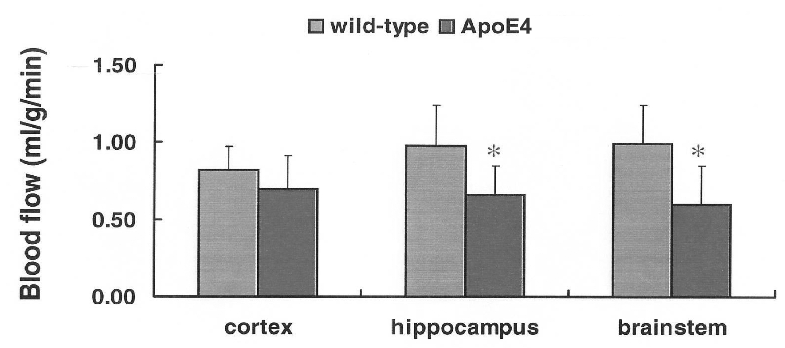
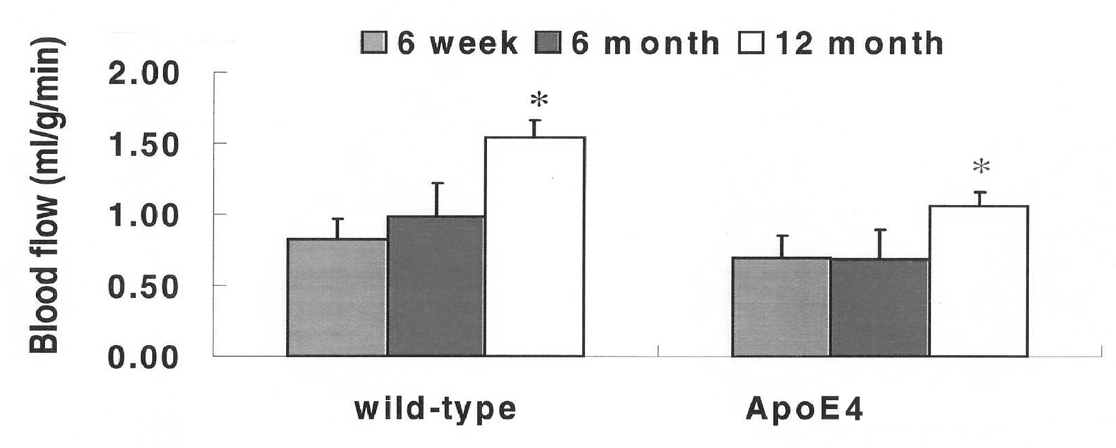
Regional blood flow in 6-week-old mice. ApoE4 is associated with decreased regional blood flow.
Effect of age on cortical blood flow in wild-type and ApoE4 mice

Slide 69
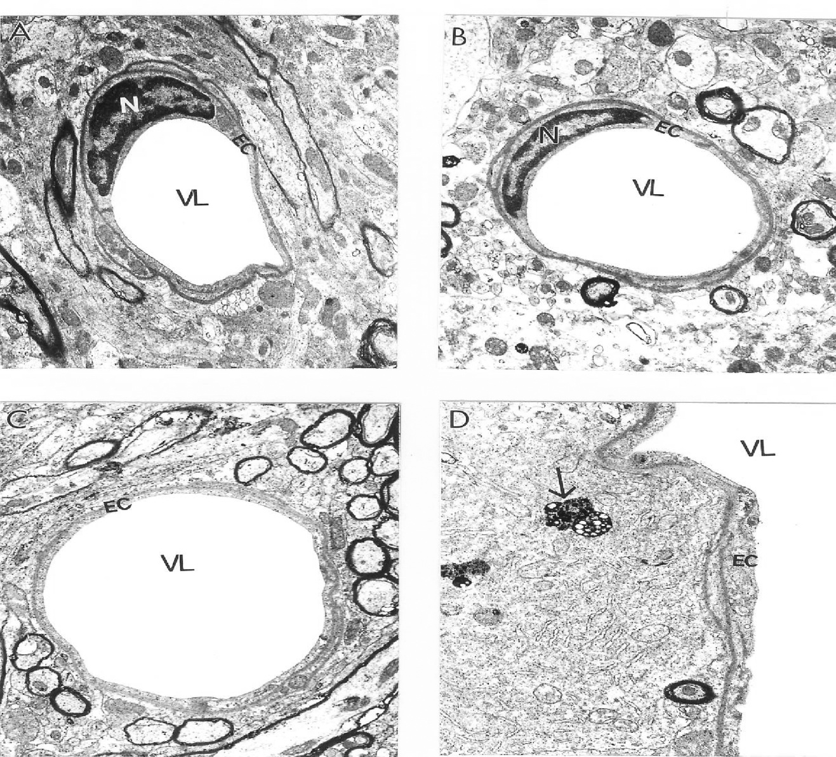
Vascular endothelium and perivascular cells from age-matched control mouse cortex and hippocampus did not show morphological changes in their ultrastructure. Only a single lipid droplet was seen in the matrix of a perivascular cells (indicated by single arrow). Magnification: A-X 10,000; B, C and D- X12, 000.
Notes:
R123 Fluorescence in old and young rat hepatocytes

Slide 70
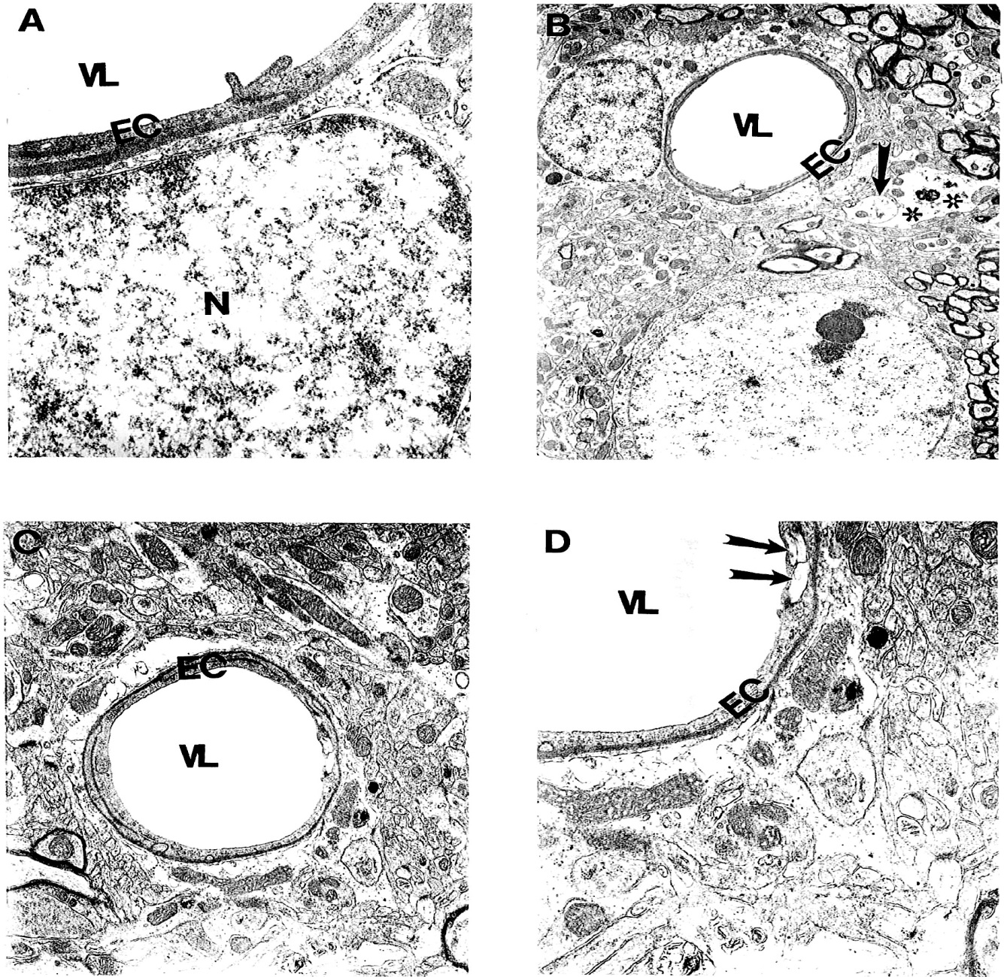
Microvessels from young (A, B) and aged (C-D) ApoE4 mice show the stress reaction of vascular endothelium. Destruction was also seen in the matrices of perivascular nerve terminals (arrow) and perivascular cells (double asterisk). Magnification: A) 25,000; B) 5,000; C) 10,000; D) 20,000.

Slide 71
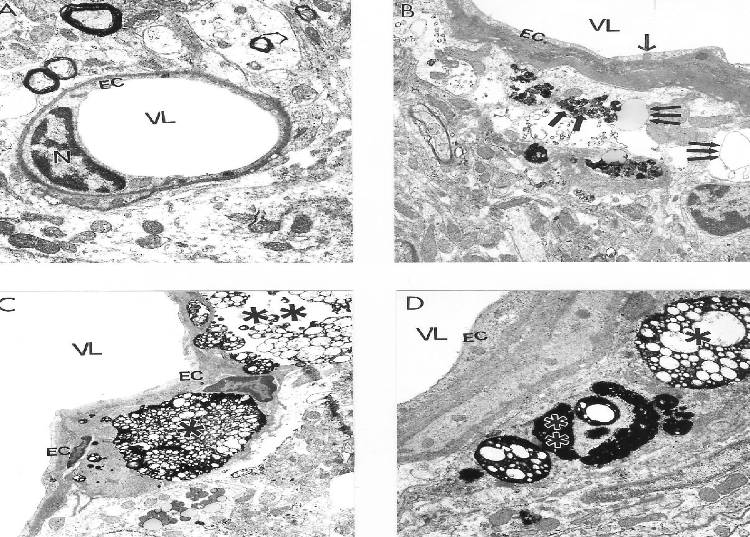
Comparative characteristics of brain microvessels from 22-month-old wild- type C57BL/6 control (A) and ApoE4 transgenic (B-D) mice. Wild-type mouse microvessels reveal minimal edema in perivascular regions and relatively few mitochondrial abnormalities. ApoE4 microvessels display dystrophic changes in the vascular endothelium (B) and an amyloid-like precipitate in perivascular areas (double arrow) that coexist with large vacuolar structures (triple arrow). Microvessels with atherosclerotic changes (C) in the perivascular area contain large foam cells (asterisk) and lipid droplets (double arrow). Large lipid droplets (single asterisk) and amyloid deposits (double asterisk) in the cytoplasm of perivascular cells (D). Magnification: A) 12,000; B) 8,000; C) 6,000; D) 12,000

Slide 72
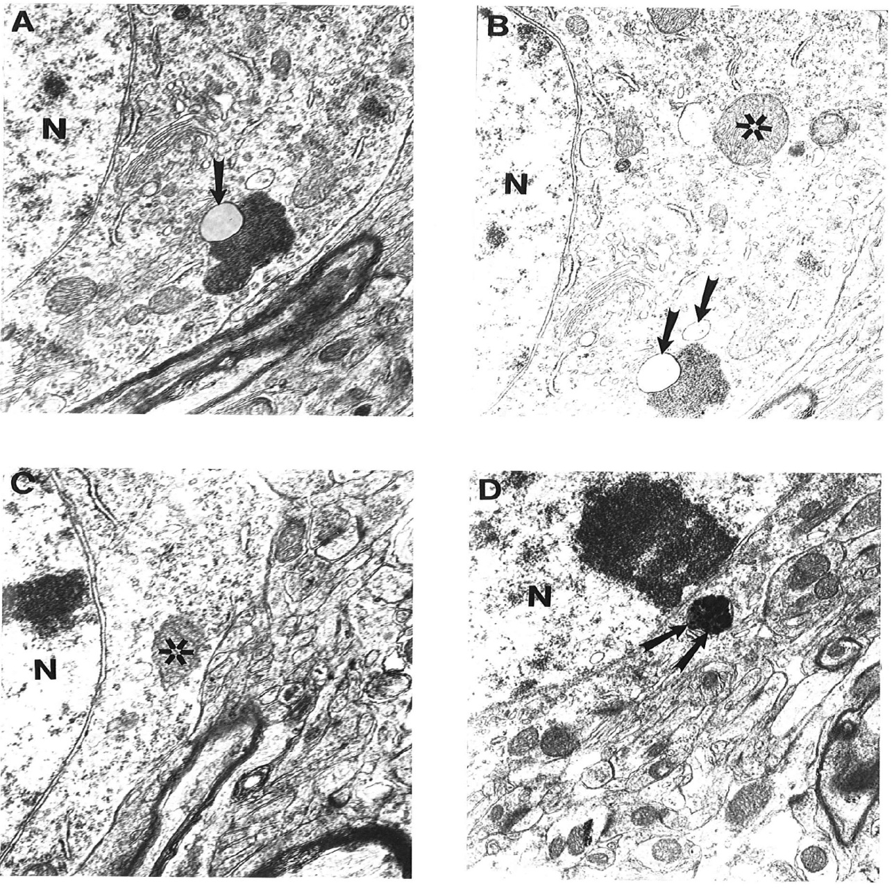
Ultrastructural feature of age-associated neuronal mitochondrial change in ApoE4 mice. Mitochondria-derived lysosomes associated with lipofuscin appears to be the main feature of mitochondrial damage. Asterisk: normal mitochondria. Arrowhead: mitochondria-derived lysosomes. Double Arrowhead: hypoxic mitochondria. Magnification: A and B) 20,000; C) 25,000; D) 15,000.

Slide 73
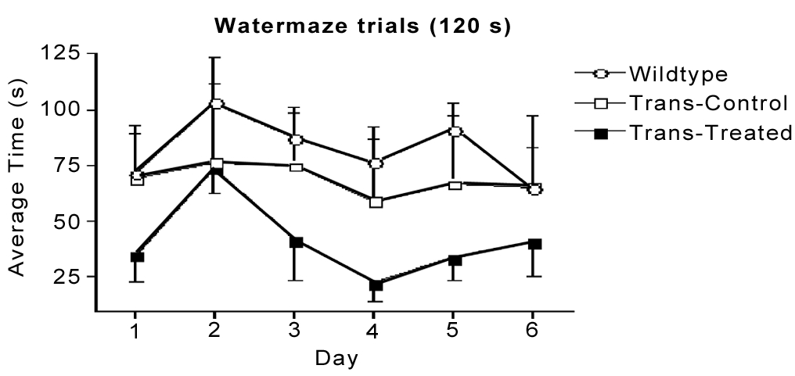
Average escape latency for 6 days (4 trials/day and 120s/trial) in the Morris water maze test.
Data are mean±SEM of 4 transgenic mice in each group and 8 wild-type mice at age of 12 months (5-months of treatment).

Slide 74

Average escape latency in a reversal test for 5 days. Data are mean±SEM of 4 transgenic mice in each group and 8 wild type mice at age of 12 months (5 months of treatment).

Slide 75

Results of time to find hidden platform in the reversal test presented as the average of the 4 trials for 4 consecutive days. Data are mean±SEM of 3 transgenic mice in each group (one mouse in each transgenic group died by this time) and 4 wild type mice at age of 22 months (15 months of treatment). ###p<0.001 apoE4 control vs. wild type, and *p<0.05 apoE4 treated vs. apoE4 control.

Slide 76

Results of time to find hidden platform in the reversal test presented as the average of the 4 days. Data are mean±SEM of 3 transgenic mice in each group and 4 wild type mice at age of 22 months (15 months of treatment).

Slide 77

Peak procedure (Skinner box) for measuring temporal memory
Peak rate measures learning and motivation.
Response rates in the peak procedure test. Combining the sound signaled trials and the light signaled trials obtained during the last 20 days of the test plotted response rate. Data are mean±SEM of 4 mice in each transgenic group and 8 wild-type mice at age 12 months (6-7-months of treatment).

Slide 78
SUMMARY:
  ApoE4 associated factors reduce CBF gradually to create brain hypoperfusion when compared to WT and the differences in CBF are greatest as animals age from 6-weeks to 12-months.
Transmission electron microscopy with colloidal gold immunocytochemistry showed structural damage in young and aged microvessel endothelium of ApoE4 animals extended to the cytoplasm of perivascular cells, perivascular nerve terminals and hippocampal neurons and glial cells.
These abnormalities coexist with mitochondrial structural alteration and mitochondrial DNA overproliferation and/or deletion in all brain cellular compartments.
Spatial memory and temporal memory tests showed a trend in improving cognitive function in ApoE4 mice fed selective mitochondrial antioxidants acetyl-L-Carnitine and R-α-Lipoic acid.

Slide 79
Conclusion:
Our findings indicate that ApoE4 genotype-induced mitochondrial changes and associated structural damage may explain age-dependent pathology seen in AD, indicating potential for novel treatment strategies in the near future.
a) Shenk J. et al., J. Neurol Sci. 2009 Aug 15;283(1-2):199-206. [Epub 2009 Apr 1].
b) Aliev G. et al. (Editors): Research Signpost, Inc. 2010, Chapter 14, PP. 297-316.
c) Aliev, G. “The Role of Oxidative Stress, Mitochondria Failure, and Cellular Hypoperfusion in the Context of Alzheimer Disease: Past, Present and Future”. Monograph Book: Nova Science Publishers, Inc., New York, 2013, ISBN: 978-1-61942-878-2. PP. 1-426. https://www.novapublishers.com/catalog/product_info.php?products_id=31801
d) Bragin V., Chemodanova M., Bragin I., Dzhafarova N., Mescher I., Chernyavskyy P., Obrenovich M.E., Palacios H.H. and Aliev G. A 60-month follow-up of a naturalistic study of integrative treatment for real-life geriatric patients with depression, dementia and multiple chronic illnesses. Open Journal of Psychiatry, 2012, vol.2, 129-140.
e) Aliev G, Ashraf GM, Kaminsky YG, Sheikh IA, Sudakov SK, Yakhno NN, Benberin VV, Bachurin SO.Implication of the nutritional and nonnutritional factors in the context of preservation of cognitive performance in patients with dementia/depression and Alzheimer disease. Am J Alzheimers Dis Other Demen. 2013 Nov;28(7):660-70. doi: 10.1177/1533317513504614. Epub 2013 Oct 1.
f) V.P. Reddy, J. Mehta and Aliev G. Role of α-Lipoic Acid and Acetyl-L-Carnitine in Dementia. In: Diet and Nutrition in Dementia and Cognitive Decline, Kings College, UK, 2014 (in press).

Slide 80
A 60-month follow-up of a naturalistic study of integrative treatment for real-life geriatric patients with depression, dementia and multiple chronic illnesses
We have compared the ApoE4 mouse study with our ongoing clinical study of clinically depressed demented and AD seniors with cardiovascular and/or other disease symptoms. The patients received Alpha-Lipoic Acid, Acetyl-L-Carnitine, Aminocare 10, Brain Longevity Substances (Aminocare Brain Longevity Forte (BLF), L-arginine, Potassium Gluconate, Omega-3 and Coenzyme Q-10,
along with diet changes, and our recently developed brain activation program.

Slide 81
Demographics | Patients | Percentage
Men | 79 | 50.64
Women | 77 | 49.36
 | Mean | Standard Deviation
Age | 73.65 | 5.43
Education (years) | 12.71 | 2.91
Duration of illnesses (months)
Depression | 39.00 | 22.87
Memory | 37.85 | 3.20
Diagnosis | Patients | Percentage of group
Anxiety | 130 | 83.33
Insomnia | 128 | 82.05
Hypertension | 133 | 85.26
High Cholesterol | 112 | 71.79
Coronary Artery Disease | 91 | 58.33
Diabetes | 56 | 35.90
Arthritis | 53 | 33.97
Stroke | 26 | 16.67
Head Trauma | 29 | 18.59
Thyroid disorder | 18 | 11.54
Cancer | 18 | 11.54
COPD | 15 | 9.62
Parkinsonism | 10 | 6.41
Renal Insufficiency | 10 | 6.41
Anemia | 6 | 3.85
Radiology | Patients | Percentage of group
Normal | 17 | 23.9
Abnormal | 54 | 76.1
Table 1. Demographics and clinical profile of patients.

Slide 82

Figure 1. Patient flow/testing diagram*. *Patients tested refers to those who took the MMSE during that time testing interval. Patient drop out includes patients who left treatment for any reason including illness, death, relocation and discontinuation of therapy.

Slide 83

Table 2: Cognitive Test Results

Slide 85

Data are presented as MEAN ± SEM

Slide 86


Slide 87


Slide 88


Slide 89

Alzheimer disease and Type 2 Diabetes mellitus:
Commonalities, linkage to tyrosine hydroxylase and probable nutritional strategies

Slide 90


Improved cognitive function
Lower risk of degenerative diseases

Slide 91
Summary & Conclusion:
Our clinical results show that the patients who receive mitochondrial antioxidants, multivitamin/multiminerals, Aminocare 10, and BLF present the maximum significant cognitive improvement at the end of 24, 36 and 60 months of the treatment.

Slide 92
REFERENCES:
1. Bragin V, Chemodanova M, Dzhafarova N, Bragin I, Czerniawski JL, Aliev G: Integrated treatment approach improves cognitive function in demented and clinically depressed patients. American Journal of Alzheimer’s Disease and Other Dementias. 2005; 20: 21-26.
2. Aliev G, Shenk JC, Fischbach K, Perry G. Stem cell niches as clinical targets: the future of anti-ischemic therapy? Nat Clin Pract Cardiovasc Med. 2008 Sep;5(9):590-1. doi: 10.1038/ncpcardio1295. Epub 2008 Jul 15.
3. Aliev G, Li Y, Palacios HH, Obrenovich ME: Oxidative stress induced mitochondrial DNA deletion as a hallmark for the drug development in the context of the cerebrovascular diseases. Recent Pat Cardiovasc Drug Discov. 2011; 6(3): 222-241.
4. Aliev, G. “The Role of Oxidative Stress, Mitochondria Failure, and Cellular Hypoperfusion in the Context of Alzheimer Disease: Past, Present and Future”. Monograph Book: Nova Science Publishers, Inc., New York, 2013, ISBN: 978-1-61942-878-2. PP. 1-426. https://www.novapublishers.com/catalog/product_info.php?products_id=31801
5. Bragin V., Chemodanova M., Bragin I., Dzhafarova N., Mescher I., Chernyavskyy P., Obrenovich M.E., Palacios H.H. and Aliev G. A 60-month follow-up of a naturalistic study of integrative treatment for real-life geriatric patients with depression, dementia and multiple chronic illnesses. Open Journal of Psychiatry, 2012, vol.2, 129-140.
6. Aliev G, Ashraf GM, Kaminsky YG, Sheikh IA, Sudakov SK, Yakhno NN, Benberin VV, Bachurin SO. Implication of the nutritional and nonnutritional factors in the context of preservation of cognitive performance in patients with dementia/depression and Alzheimer disease. Am J Alzheimers Dis Other Demen. 2013 Nov;28(7):660-70. doi: 10.1177/1533317513504614. Epub 2013 Oct 1.
7. Aliev G, Kamal MA, Shahida K, Gan SH, Firoz CK, Khan A, Abuzenadah A, Kamal W, Reale M. Alzheimer's Disease and Type 2 Diabetes Mellitus: The Link to Tyrosine Hydroxylase and Probable Nutritional Strategies. CNS Neurol Disord Drug Targets. 2013 Sep 18. [Epub ahead of print].

Slide 93
Goal
The first aspect centers on studies that show advancing age affects the mitochondrial DNA mutation and overproliferation in liver and brain, and these underlying processes have a role in aging, especially aged-associated diseases including tumor growth and metastases.
Notes:
93

Slide 94
Hypothesis
Upregulation of NO synthase (NOS) enzyme activity induces formation of a large amount of reactive oxygen species (ROS), this may be a key factor in mitochondrial damage and energy failure occurring during tumorigenesis.
Moreover, a predominant characteristic of tumors is a state of chronic hypoxia.
This most likely initiates the mitochondrial DNA overproliferation and/or deletion that then induces formation of large quantities of unwanted free radicals and concomitant energy deficiency.
Notes:
94

Slide 95

The endogenous NO modulates oxygen consumption under basal and stimulated conditions
Notes:
95

Slide 96

Formation of NO intermediate product
The persistent inhibition seems to be the result of oxidative stress generated from mitochondrial free-radical generation and involves S-nitrosylation.
Indeed, inhibition of the respiratory chain causes its reduction and the subsequent generation of superoxide anions
Notes:
96

Slide 97
The role of NO-induced mitochondrial failure
The role of NO induced mitochondrial failure in the pathogenesis of tumors, especially concerning tumor angiogenesis now has been widely accepted.
NO has both genotoxic and angiogenic properties.
Increased NO production may selectively support mutant p53 cells and may also contribute to tumor angiogenesis by upregulation of vascular endothelial growth factor a may provide radiation and multidrug resistance by upregulation the DNA-dependent protein kinase catalytic subunit.
These dual functions can be partly explained by the dose-dependency of NO in physiological and pathological conditions.
Notes:
97

Slide 98


Liver pathology: Neoplasia
Hepatocellular carcinoma
Metastatic carcinoma involving hepatic parenchyma

Slide 99

Ultrastructural features of NOS1 labeling in control (A) and metastatic liver tumor tissues (B-D)
NOS1 immunopositive EC (indicated by asterisk) were seen in control liver microvessels. Vacuoles are indicated by single arrow X 4 000
Tumor vessel endothelium (indicated by asterisk) showed no staining for NOS1 antibody. X 20,000.
NOS1 immunopositive white blood cells (indicated by asterisk) were attached to vessel endothelium in tumor growth regions. X 6,000.
NOS1 immunopositive myofibroblast (smooth muscle cell) were seen in metastatic liver tumor tissues. X 10,000
Notes:
99

Slide 100

Ultrastructural labeling of inducible NOS (NOS2) immunoreactivity in metastatic liver tumor tissues
Tumor vessel EC was positively stained with NOS2. X8, 000.
A high intensity of NOS2 immunopositive precipitate accumulated close to the luminal plasmalemma of the vascular EC in the tumor growth region. X8, 000.
NOS2 immunopositive hepatocytes (asterisk). Lipid-contained areas of the hepatocytes (double arrow) were free from immunopositive reaction. X 6, 000.
NOS2 immunopositive myofibroblast-like cells (asterisk). X 8, 000.
Notes:
100

Slide 101

Ultrastructural features of endothelial specific NOS (eNOS or NOS3) labeling in control (A) and metastatic liver tumors tissues (B-D)
A large number of NOS3 immunopositive EC (indicated by arrows) were seen in control liver microvessels. X5, 000.
NOS3 immunostaining was absent in EC (asterisk) in tumor vessels. X8, 000.
EC from tumor microvessels did not show the presence of any NOS3 immunopositive reaction. X10, 000.
NOS3 immunopositive hepatocytes (white asterisk) in metastatic liver tumors were seen. Lipid-enriched
areas were free from NOS3 positive precipitate (arrows). X8, 000.
Notes:
101

Slide 102

The distribution of NOS1-3 and ET-1 immunopositive gold particles in metastatic tumor vessel endothelium and hepatocytes
Clusters of NOS2 positive gold particles (20 nm, thick arrows) but not NOS3 (5 nm, single thin arrow) and ET-1 (10 nm, double arrow) were seen in tumor vessel endothelium. X100,000.
The expression of NOS1 (20 nm single arrow) was seen in the matrix of lipid laden hepatocytes in tumor growth area. NOS3(10 nm) and ET-1 (5 nm) positive gold particles indicated by double and thin single arrow. X100,000.
Clusters of ET-1(20 nm, single arrows) but not NOS1 (10 nm, double arrow) and NOS3 (5 nm, single thin arrow) positive gold particles in the cytoplasmic matrix of hepatocytes were seen. X100, 000.
EC from metastatic liver microvessels prepared as negative controls (through omission of the primary antibody) showed only the presence of single gold particles (10 nm, double arrow). X100, 000.
Notes:
102

Slide 103

Ultrastructural features of mitochondrial lesions in brain glioblastoma tissues
Vessel endothelium in tumor area. Mostly mitochondria show absence of mitochondrial cristae (arrows). 25,000.
Mitochondria derived lysosomes appeared to be permanent feature of astrocytes derived tumor cells (arrows). X 40,000.
Lipid laden tumor cells and surrounding cells shows damage of their mitochondria (arrows). X5,000.
Giant mitochondria (asterisks) in the matrix of astrocytes derived tumor cell. X40,000.
Notes:
103

Slide 104

Comparative characteristics of marginal (A-C) and central portion (D) of tumor tissues obtained from patients undergoing surgery with diagnosis of primary glioblastoma
A-C) Marginal area of tumor tissue shows heterogeneous distribution of damage in the structure of mitochondria.
Double and single arrows indicate the intact and damaged mitochondria. X 30-, 15- and 6,000 (A, B & C).
D) Central regions of tumor tissues show astrocytes with clusters of mitochondria-derived lysosomes. X6,000.
Notes:
104

Slide 105

Ultrastructural characteristics of control (A) and intermediate regions of brain tissues obtained from patients undergoing surgery with diagnosis of oligodendrioglioma
Vessel endothelium and their subcellular compartment did not show any damage in their ultrastructure. Mitochondria are intact (double arrow). EC-endothelial cell, N-cell nucleus. X 15,000.
Intermediate regions of the brain tissue show damage in their ultrastructure. Mitochondria are already transformed to the lysosomal structure (arrows). Perivascular nerves and perivascular pericytes (double arrow) did not show any abnormality. X10,000.
Mitochondria damage is also found in the cytoplasmic matrix of perivascular pericytes. X25,000.
Notes:
105

Slide 106

Features of spinal cord tumor growth and metastases
Activated polymorphonuclear leukocytes were attacking vessel endothelium. Mitochondria in EC were damaged (arrow). X 6,000.
Migration of tumor cell (TC) through endothelial layer. Damaged mitochondria show no cristae in their matrix (arrow). Tumor cells contain large number of hypoxic (electron dense) mitochondria (arrows). X 6,000.
Degranulated tumor cells with clusters of mitochondria-derived lysosomes (arrows). X4,000.
Tumor metastatic area shows the presence of tumor cells under the subendothelium. The cluster of mitochondria derived lysosomal structures (arrows) were seen in the matrix of tumor cells. X30,000. Abbreviations: ER-erythrocytes, EC-endothelial cells, VL-vessel
Notes:
106

Slide 107

In situ hybridization using the wild type mtDNA probe was detected using colloidal gold probe (17 nm)
Hybridization was detected in transgenic (a and b), but not control (c-d) mouse hippocampus.
The main source of mtDNA probes is in damaged mitochondria and mitochondria-derived lysosomes, but not in lipofuscin. X20,000 (a), 8,000 (b), 20,000 (c) and 25,000 (d).
Notes:
107

Slide 108

In situ hybridization
In situ hybridization using chimera mtDNA in Alzheimer’s disease (a and b) and Alzheimer’s
mice (c and d).
Hybridization was detected in AD (a & b), and Alzheimer’s mouse (c-d) brain microvascular endothelium where atherosclerotic lesions are seen.
The main source of mtDNA probes is in damaged mitochondria and mitochondria-derived lysosomes (arrows). X10, 000 (a), 10,000 (b), 30,000 (c) and 20,000 (d).
Notes:
108

Slide 109
Conclusion
Our study indicates that metastatic colorectal cancer and malignant brain cancer are characterized by overexpression of NOSs and that this may initiate mitochondrial damage in tumor cellular compartments.
The overexpression of NOSs coexists with elevated levels of ET-1, before cancer growth and/or before the destruction of tissue occurs (Shankar A. et al., 1998; Aliev G. et al., 2002c; Aliev et al., 2008, 2009. Aliev et al., 2013 and 2014–in press).
Notes:
109

Slide 110
1. Aliev G., Reddy V.P. and Cacabelos R. Role of Electron Microscopy-Immunocytochemistry and In Situ Hybridization in the Study of Oxidative Stress-Induced Mitochondrial Abnormalities and the Pathobiology of Neurodegeneration and Cancer. In: “Current microscopy contributions to advances in science and technology”, - Editor: Antonio Méndez-Vilas, Publisher: Formatex Research Center, -Volume 1, ISBN (13): 978-84-939843-5-9, 2012, PP. 366-385.
2. Aliev, G. “The Role of Oxidative Stress, Mitochondria Failure, and Cellular Hypoperfusion in the Context of Alzheimer Disease: Past, Present and Future”. Monograph Book: Nova Science Publishers, Inc., New York, 2013, ISBN: 978-1-61942-878-2. PP. 1-426. https://www.novapublishers.com/catalog/product_info.php?products_id=31801
3. Aliev, G., Obrenovich M.E., Tabrez S., Jabir N.R., Reddy V.P., Li Y., Burnstock G., Cacabelos R. and Kamal M.A. Link between Cancer and Alzheimer Disease via Oxidative Stress Induced by Nitric Oxide-Dependent Mitochondrial DNA Overproliferation and Deletion. Oxidative Medicine and Cellular Longevity. vol. 2013, Article ID 962984, 19 pages, 2013. doi:10.1155/2013/962984.
4. Aliev, G. Palacios H.H., Cacabelos P., Cacabelos R., Burzynski G., and S.R. Burzynski. Mitochondria Specific Antioxidants and their Derivatives in the Context of the Drug Development for Neurodegeneration and Cancer. Drug Des 2012, 2: 103, doi: 10.4172/2169-0138.1000103.
5. Aliev, G., Burzynski, G., Ashraf, G.Md., Jabir, N.R., Cacabelos R. Benberin V.V. and S.R. Burzynski. Implication of Oxidative Stress Induced Oncogenic Signaling Pathways as a Treatment Strategy for Neurodegeneration and Cancer. In: Laher, Ismail (Ed.): Systems Biology of Free Radicals and Antioxidants, Springer Berlin Heidelberg 2014 (in press).
6. Aliev, G., Kaminsky, Y.G. , Ashraf, G.Md., Jabir, N.R. , Bragin, V., Kosenko, E.A. , Klochkov, S.G., Benberin V.V. and S. O. Bachurin. Flavones from the Root of Scutellaria Baicalensis Georgi: Drugs of the Future in Neurodegeneration and Neuroprotection? In: Laher, Ismail (Ed.): Systems Biology of Free Radicals and Antioxidants, Springer Berlin Heidelberg 2014 (in press).

Slide 111
Future direction and potential clinical application
Therefore, we will further determine if the existence of an intimate, i.e. causal, relationship between NO induced oxidative stress, mitochondria lesions, ET-1 and vascular lesions occurs before the development and metastasis of colorectal cancer or malignant brain cancer.
By studying the relationship between the degree of mitochondrial lesions, NOS and nitrotyrosine expression, we believe that a better understanding of tumor pathogenesis will be gleaned. This may eventually lead to new and effective treatments.
For example, if the degree of pathology can be correlated with the quantity of the NOS expressed, then manipulating the systems metabolically may be ways which can lead to early death of the injured cancer cell mitochondria.
Notes:
111

Slide 112
Conclusion and Future Remarks:
Materials presented in this lecture indicates that the Nitric oxide- (NO-) dependent oxidative stress results in mitochondrial ultrastructural alterations and DNA damage in cases of Alzheimer disease (AD). However, little is known about these pathways in human cancers, especially during the development as well as the progression of primary brain tumors and metastatic colorectal cancer. One of the key features of tumors is the deficiency in tissue energy that accompanies mitochondrial lesions and formation of the hypoxic smaller sized mitochondria with ultrastructural abnormalities. We theorize that mitochondrial involvement may play a significant role in the etiopathogenesis of cancer. Moreover, this lecture also demonstrates a potential link between AD and cancer, and anticancer drugs are being explored for the inhibition of AD-like pathology in transgenic mice. Severity of the cancer growth, metastasis, and brain pathology in AD (in animal models that mimic human AD) correlate with the degree of mitochondrial ultrastructural abnormalities. Recent advances in the cell-cycle reentry of the terminally differentiated neuronal cells indicate that NO-dependent mitochondrial abnormal activities and mitotic cell division are not the only important pathogenic factors in pathogenesis of cancer and AD, but open a new window for the development of novel treatment strategies for these devastating diseases.

Slide 113
ACKNOWLEDGMENTS
FINANCIAL SUPPORT:
NIH
Alzheimer Association
The Philip Morris USA External Research Program
American Cancer Society
British Hearth Foundation
GALLY International Biomedical Research Institute Inc., San Antonio, TX, USA
Notes:
113

Slide 114

I am extremely grateful for my manager, Mr. Russell Pool and his continues excellent works throughout the preparation of this lecture.

Slide 115

I am extremely grateful for my loving daughter, Ms. Galina Alieva and her editorial works throughout the preparation of this lecture.

Slide 116


Slide 117


Slide 118
2008- San Antonio KENS-TV and Austin KVUE-TV Interview: New Discovery for Alzheimer’s Disease Research (http://www.kvue.com/news/state/stories/063008kvuealzheimersresearch- cb.d9aba6c.html http://www.mysanantonio.com/health/index.shtml and click: Medical video
UTSA Science Prof. quoted in LA Times story: Juvenon is a widely advertised “anti-aging” supplement.
Los Angeles Times - CA, USA.. agrees Dr. Gjumrakch Aliev, Professor of Cardiovascular and Neuropathology at the University of Texas at San Antonio. ...
See all stories on this topic also: New stem cell research has been reported by scientists at University of Texas 09/29/2008 Copyright © 2008 Diabetes Week via NewsRx.com; Angiogenesis Weekly 10/03/2008: New stem cell research has been reported by scientists at University of Texas Copyright © 2008 Angiogenesis Weekly via NewsRx.com. New stem cell research has been reported by scientists at University of Texas 10/02/2008 Blood Weekly Copyright © 2008 Blood Weekly via NewsRx.com. New stem cell research has been reported by scientists at University of Texas 09/30/2008 Science Letter. Copyright © 2008 Science Letter via NewsRx.com

Slide 119


Drug Designing Open Access
Related Journals
Journal of Clinical Trials
Journal of Pharmacovigilance
Journal of Developing Drugs

Slide 120
Drug Designing Open Access
Related Conferences
http://www.conferenceseries.com/

Slide 121
OMICS publishing Group Open Access Membership enables academic and research institutions, funders and corporations to actively encourage open access in scholarly communication and the dissemination of research published by their authors.
For more details and benefits, click on the link below:
http://omicsonline.org/membership.php

