Slide 1
OMICS International
OMICS International through its Open Access Initiative is committed to make genuine and reliable contributions to the scientific community. OMICS International signed an agreement with more than 1000 International Societies to make healthcare information Open Access.
Contact us at: contact.omics@omicsonline.org

Slide 2
OMICS Journals are welcoming Submissions
OMICS International welcomes submissions that are original and technically so as to serve both the developing world and developed countries in the best possible way.
OMICS Journals are poised in excellence by publishing high quality research. OMICS International follows an Editorial Manager® System peer review process and boasts of a strong and active editorial board.
Editors and reviewers are experts in their field and provide anonymous, unbiased and detailed reviews of all submissions.
The journal gives the options of multiple language translations for all the articles and all archived articles are available in HTML, XML, PDF and audio formats. Also, all the published articles are archived in repositories and indexing services like DOAJ, CAS, Google Scholar, Scientific Commons, Index Copernicus, EBSCO, HINARI and GALE.
For more details please visit our website: http://omicsonline.org/Submitmanuscript.php

Slide 3
Grzegorz Sowa

Slide 4
Biography
Dr. Grzegorz Sowa is an Associate Professor in the Department of Medical Pharmacology and Physiology at the University of Missouri (Columbia, MO). He received his Ph.D. in Biological Sciences from the Institute of Pharmacology, Polish Academy of Sciences, Krakow, Poland. He completed a postdoctoral fellowship in Neuroimmunology and Host Defense Laboratory, University of Minnesota (Minneapolis, MN) and in the Department of Pharmacology Yale University (New Haven, CT), where he later worked as Associate Research Scientist before joining University of Missouri in 2005. He is a recipient of the Scientist Development Grant and Grant-in Aid from the American Heart Association as well as an RO1 grant from the NIH. He has published in various peer reviewed journals, including British Journal of Pharmacology, Biochemical Pharmacology, PNAS, JBC, Circulation Research, ATVB, Biochemistry, AJP-Cell Physiology, Molecular Cell Proteomics, FEBS Letters and Cancer Research. He has also reviewed for numerous peer-reviewed journals and is a member of the Editorial Board for Frontiers in Vascular Physiology, Journal of Pharmaceutical Technology and Drug Research and International Journal of Bioorganic Chemistry & Molecular Biology.

Slide 5
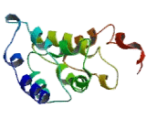
Research Interest
The main focus of Dr. Grzegorz Sowa’s research is to understand the role of a membrane spanning protein caveolin-2 in regulating cell function. In particular, he is interested in molecular and cellular mechanisms via which caveolin-2 regulates tumor progression, angiogenesis and inflammatory processes.

Slide 6
Membrane Proteins and Their Functions
A membrane is a collage of different proteins embedded in the fluid matrix of the lipid bilayer
Proteins determine most of the membrane’s specific functions
Peripheral proteins are not embedded
Integral proteins penetrate the hydrophobic core and often span the membrane

Slide 7
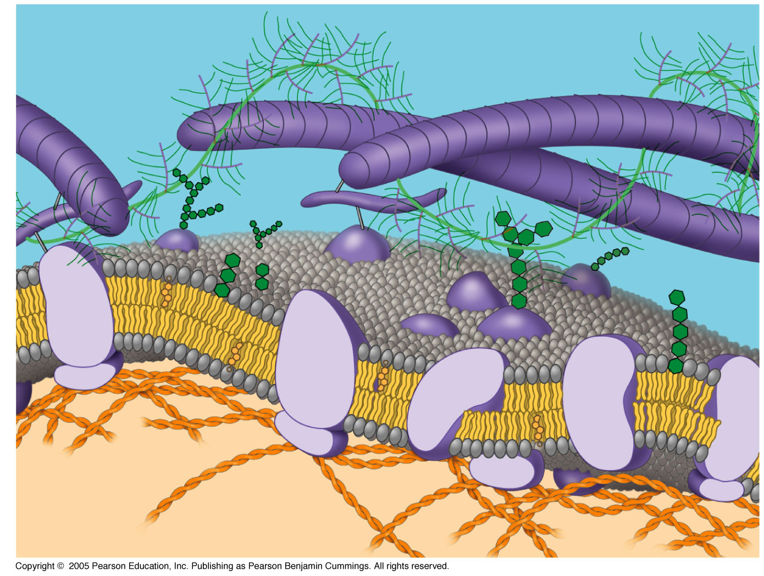
Membrane Protein Function

Slide 8
Protein function
Plasma membrane proteins serve diverse functions including:
Transport
Enzymatic activity
Signal transduction
Intercellular joining
Cell-cell recognition
Attachment to the cytoskeleton and extracellular matrix

Slide 9
Carbohydrates diversify membranes
Membrane carbohydrates are only found on the outside (external) face of membranes
Attach to lipids or protein (glycolipid/ glycoprotein)
Enable cells to distinguish/ recognize one another

Slide 10
Signature
Grzegorz Sowa

Slide 11
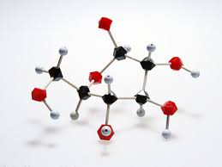
Medicinal chemistry Related Journals
Drug Designing: Open Access
Biochemistry & Pharmacology
Advances in Pharmacoepidemiology & Drug Safety

Slide 12
Medicinal chemistry Related Conferences
3rd International Conference on Medicinal Chemistry &
Computer Aided Drug Designing
3rd International Conference and Exhibition on Pharmacognosy, Phytochemistry & Natural Products

Slide 13
OMICS International Open Access Membership
OMICS International Open Access Membership enables academic and research institutions, funders and corporations to actively encourage open access in scholarly communication and the dissemination of research published by their authors.
For more details and benefits, click on the link below:
http://omicsonline.org/membership.php

