Slide 1

















Executive-Editor
Journal of Geophysics & Remote Sensing
Dr. Guoquan Wang
Assistant Professor Department of Earth and Atmospheric Sciences University of Houston USA

Slide 2


Biography
09/2011----Present: Assistant Professor 08/2006— 08/2011: Assistant Professor, Department of Geology, University of Puerto Rico at Mayaguez, PR. (Tenured on July 1, 2011) 07/2004—07/2006: Research Associate, Applied Geophysical Science Laboratories, College of Arts and Sciences, North Carolina A&T State University, NC. 01/2004—06/2004: Visiting Research Scholar, Multidisciplinary Center for Earthquake Engineering Research (MCEER), University of New York at Buffalo, NY. 06/2001—12/2003: Postdoctoral Scholar, Institute of Geophysics, Department of Geosciences, University of Munich, Germany.

Slide 3


Research Interest
Coastal hazards (e.g., faulting, subsidence, wetland loss) in the Gulf Coast area
Caribbean neotectonics
GPS seismology, strong earthquake ground motion
Applications of GPS and LIDAR technologies in natural hazards studies Geological hazard risk analysis and mitigation
Field and structural monitoring and instrumentation
Numerical modeling---Numerical 3D simulation (e.g., Parallel Numerical Simulation, MPI and Finite Difference Method)
Super-Computer

Slide 4







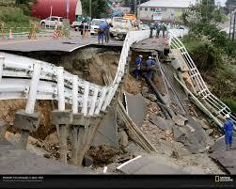
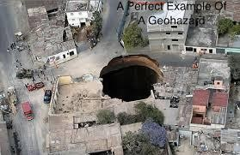
GeoHazards
Geohazards take an increasing toll of lives, disrupt
livelihoods and cost more more money each year

Slide 5
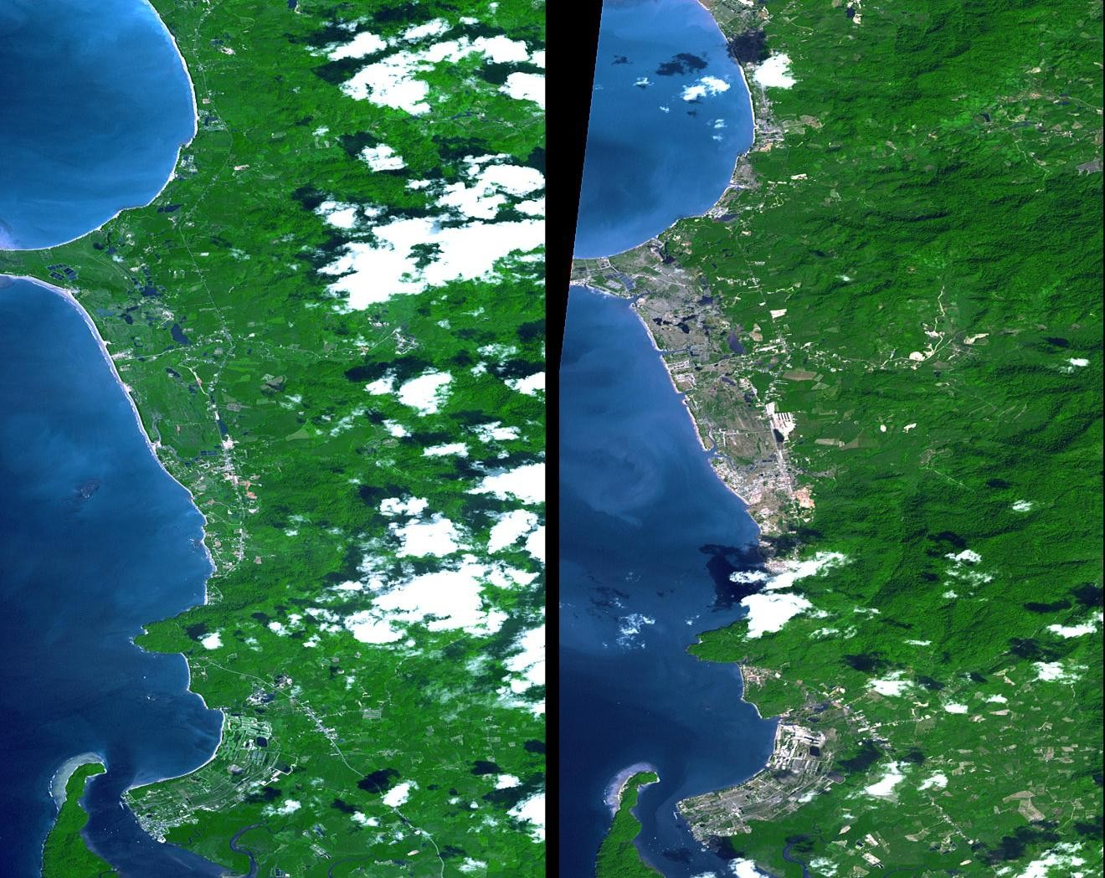
Natural and Human-Induced Extreme Events
GEOHAZARDS
•Volcanoes
•Earthquakes and Tsunamis
•Landslides/Mudslides CLIMATIC HAZARDS
•Floods
•Drought
•Hurricanes/Cyclones INDUSTRIAL/OTHER
HAZARDS
•Oil Spills
•Nuclear Accidents
•Meteor Impacts
Phuket, Thailand: Before and after the 2004 tsunami

Slide 6
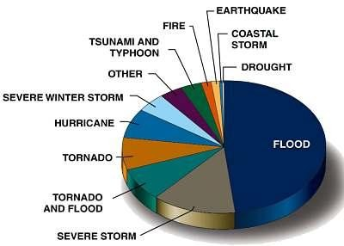
Cost Breakdown of Disasters

Slide 7
Natural and Human-Induced Extreme Events
Extreme events, whether natural or human-induced, can cause significant environmental change, not to mention their devastating impacts on peoples’ lives
In 2005, there was an 18% rise in disasters that killed 91
900 people
There were 360 natural disasters in 2005 compared to 305 in 2004: the number of floods increased by 57% in 2005 and droughts by about 47%
The 2004 Indian Ocean tsunami accounted for 92%, and the 2005 South Asian earthquake, for 81% of the deaths in each respective year

Slide 8
Earthquakes and Tsunamis
According to long-term records (since about 1900), we can expect about 18 major earthquakes (7.0 - 7.9 on the Richter scale) and one great earthquake (8.0 or above) in any given year
The number of earthquakes and tsunamis resulting in fatalities has
increased approximately in proportion to global populations
The growth of giant urban cities near regions of known seismic
hazard is a new experiment for life on the Earth
Tsunamis are a threat to life and property for all coastal residents

Slide 9
IGOS - Geohazard
Most destructive known earthquakes in the World
Date | Location | Deaths | M | Comments
January 23, 1556 | China, Shansi | 830,000
July 27, 1976 | China, Tangshan | 255,000 (official) | 8 | Estimated death toll as high as 655,000.
August 9, 1138 | Syria, Aleppo | 230,000
May 22, 1927 | China, near Xining | 200,000 | 8.3 | Large fractures.
December 22, 856 | Iran, Damghan | 200,000
December 16, 1920 | China, Gansu | 200,000 | 8.6 | Major fractures, landslides.
March 23, 893 | Iran, Ardabil | 150,000
September 1, 1923 | Japan, Kwanto | 143,000 | 8.3 | Great Tokyo fire.
October 5, 1948 | USSR (Turkmenistan, Ashgabat) | 110,000 | 7.3
December 28, 1908 | Italy, Messina | 70,000 to 100,000 | 7.5 | Deaths from earthquake and tsunami.
September, 1290 | China, Chihli | 100,000
November, 1667 | Caucasia, Shemakha | 80,000
November 18, 1727 | Iran, Tabriz | 77,000
November 1, 1755 | Portugal, Lisbon | 70,000 | 8.7 | Great tsunami.
December 25, 1932 | China, Gansu | 70,000 | 7.6
May 31, 1970 | Peru | 66,000 | 7.8 | Great rock slide, floods.
1268 | Asia Minor, Silicia | 60,000
January 11, 1693 | Italy, Sicily | 60,000
May 30, 1935 | Pakistan, Quetta | 30,000 to 60,000 | 7.5 | Quetta almost completely destroyed.
February 4, 1783 | Italy, Calabria | 50,000
June 20, 1990 | Iran | 50,000 | 7.7 | Landslides.

Slide 10
Earthquakes with 1,000 or more
deaths from 1998 to 2001
Date | Location | Latitude | Longitude | Deaths | M | Comments
Feb 04, 1998 | Afghanistan- Tajikistan Border Region | 37.1 N | 70.1 E | 2,323 | 6.1 | 818 injured, 8,094 houses destroyed, 6,725 livestock killed.
May 30, 1998 | Afghanistan- Tajikistan Border | 37.1 N | 70.1 E | 4,000 | 6.9 | Many thousands injured and homeless.
Jul 17, 1998 | Papua New Guinea, Near N. Coast | 2.96 S | 141.9 E | 2,183 | 7.1 | Thousands injured, about 9,500 homeless and about 500 missing as a result of a tsunami with maximum wave heights estimated at 10 meters.
Jan 25, 1999 | Colombia | 4.46 N | 75.82 W | 1,185 | 6.3 | Over 700 missing and presumed killed, over 4,750 injured and about 250,000 homeless.
Aug 17, 1999 | Turkey | 40.7 N | 30.0 E | 17,118 | 7.4 | At least 50,000 injured, thousands homeless. Damage estimate at 3 to 6.5 billion USD.
Sep 20, 1999 | Taiwan | 23.7 N | 121.0 E | 2,297 | 7.6 | Over 8,700 injured, over 600,000 homeless. Damage estimate at 14 billion USD.
Jan 26, 2001 | India | 23.3 N | 70.3 E | 19,988 | 7.7 | 166,812 injured, 600,000 homeless.

Slide 11
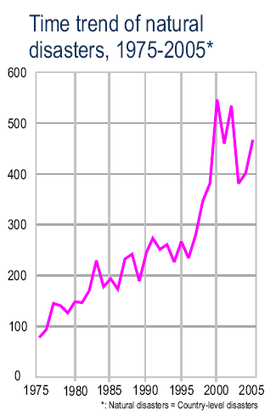
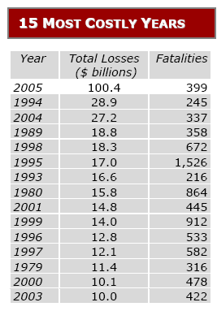
UN International Strategy for Disaster Reduction (2006). 2005 Disasters in Numbers
Hazards & Vulnerabilty Research Institute (2006). 2005 U.S. Hazard Losses. University of South Carolina.

Slide 12
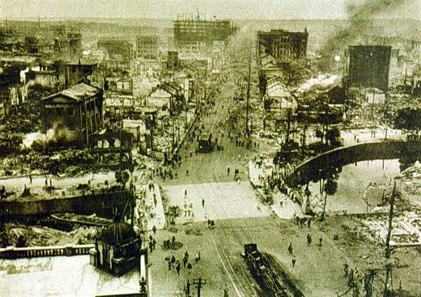
Kanto earthquake (Tokyo) 1.09.1923, M=8.2

Slide 13
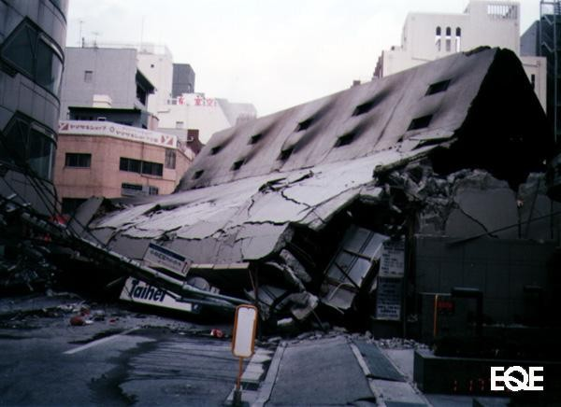
Kobe earthquake (Japan) 16.01.1995, M=6.8

Slide 14
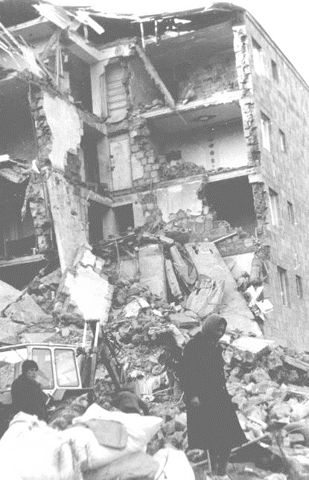
SPITAK EARTHQUAKE (ARMENIA) 7.12.1988, M=6.8
http://www.hleb.net/armenia/internet/index.html

Slide 15
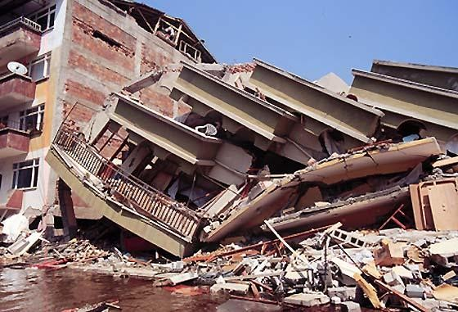
Izmit earthquake (Turkey) 17.08.1999, M=7.8

Slide 16
SURFACE DISPLACEMENT FOR RADAR DATA
Mantle convection theory, continent drift theory, as a base of horizontal and vertical movement of the earth surface.
Earthquake mechanism theories: dilatancy theory, elastic rebound theory.
Strong motion after the shock.

Slide 17

The model of ground displacement:
a - dilatancy model; b - elastic rebound theory.
1- stress, 2- cleavage stress.

Slide 18
Satellite and In-situ observations
 | Satellite observations | In-situ observations
 | Ground displacement before the shock | Tilt, strain, GPS, water level
 | Allweather surface temperature | Meteorological observations
 | Ion density and temperature in F-layer, 180-300 km | EM ground observations
 | Gas concentration | Gas concentration
 | Oxygen luminescence | Oxygen luminescence
 | Atmospheric temperature, pressure and humidity | Meteorological observations
 | Aerosol | Aerosol

Slide 19


OMICS International Open Access Membership
OMICS International Open Access Membership enables academic and research institutions, funders and corporations to actively encourage open access in scholarly communication and the dissemination of research published by their authors.
For more details and benefits, click on the link below:
http://omicsonline.org/membership.php

