Slide 1
OMICS Group
OMICS Group International through its Open Access Initiative is committed to make genuine and reliable contributions to the scientific community. OMICS Group hosts over 400 leading-edge peer reviewed Open Access Journals and organizes over 300 International Conferences annually all over the world. OMICS Publishing Group journals have over 3 million readers and the fame and success of the same can be attributed to the strong editorial board which contains over 30000 eminent personalities that ensure a rapid, quality and quick review process. OMICS Group signed an agreement with more than 1000 International Societies to make healthcare information Open Access.
Contact us at: contact.omics@omicsonline.org

Slide 2
OMICS Journals are welcoming Submissions
OMICS Group welcomes submissions that are original and technically so as to serve both the developing world and developed countries in the best possible way.
OMICS Journals are poised in excellence by publishing high quality research. OMICS Group follows an Editorial Manager® System peer review process and boasts of a strong and active editorial board.
Editors and reviewers are experts in their field and provide anonymous, unbiased and detailed reviews of all submissions.
The journal gives the options of multiple language translations for all the articles and all archived articles are available in HTML, XML, PDF and audio formats. Also, all the published articles are archived in repositories and indexing services like DOAJ, CAS, Google Scholar, Scientific Commons, Index Copernicus, EBSCO, HINARI and GALE.
For more details please visit our website: http://omicsonline.org/Submitmanuscript.php

Slide 3
Hector O Ventura
EB PPT

Slide 4
BIOGRAPHY
Dr. Hector O. Ventura, MD is the Section Head, Cardiomyopathy and Heart Transplant Center at the Ochsner Clinic Foundation, New Orleans, Louisiana. He is also a Professor, Cardiology, University of Queensland School of Medicine, Ochsner Clinical School, Brisbane, Australia as well as a Professor of Medicine at the Tulane University School of Medicine in New Orleans. He completed an internship and residency at the Central Military Hospital in Buenos Aires, followed by research fellowships in arterial hypertension and cardiovascular diseases, an internship, and an internal medicine residency at the Ochsner Medical Institutions in New Orleans.

Slide 5
RESEARCH INTEREST
Arterial hypertension following cardiac transplantation, the effect of digitalis on mortality in heart failure, Lipid profiles after cardiac transplantation.

Slide 6
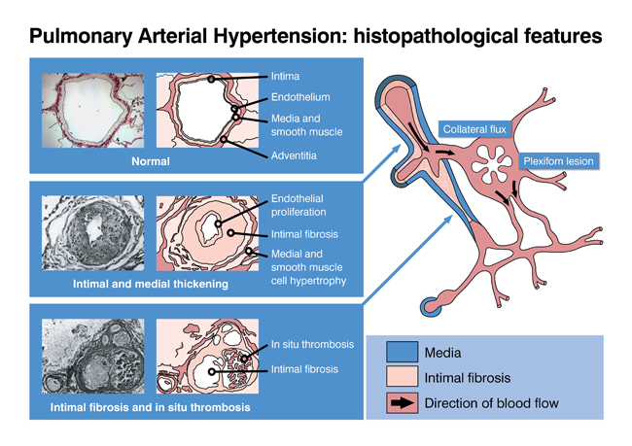

Slide 8
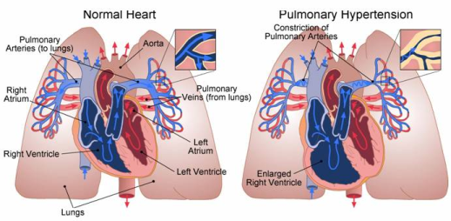

Slide 9
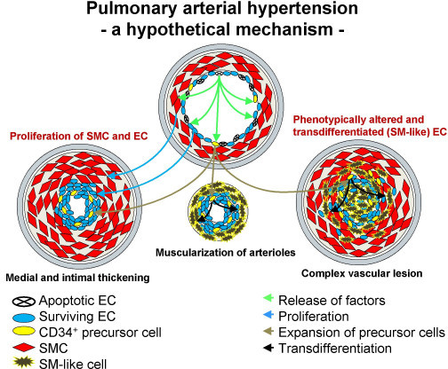

Slide 10
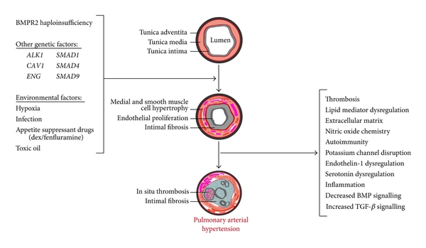

Slide 13
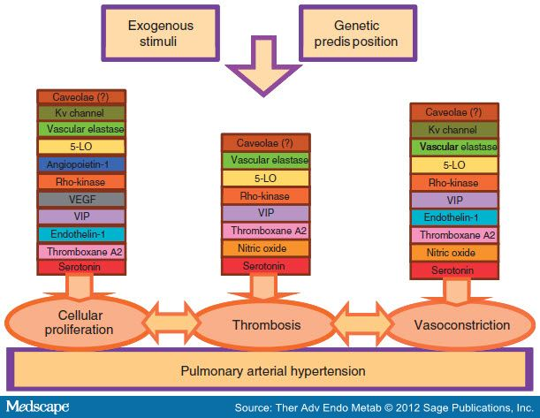

Slide 14
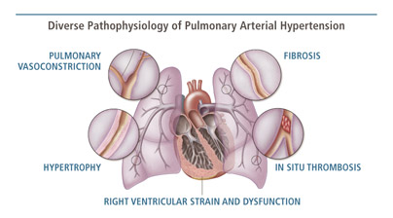

Slide 15
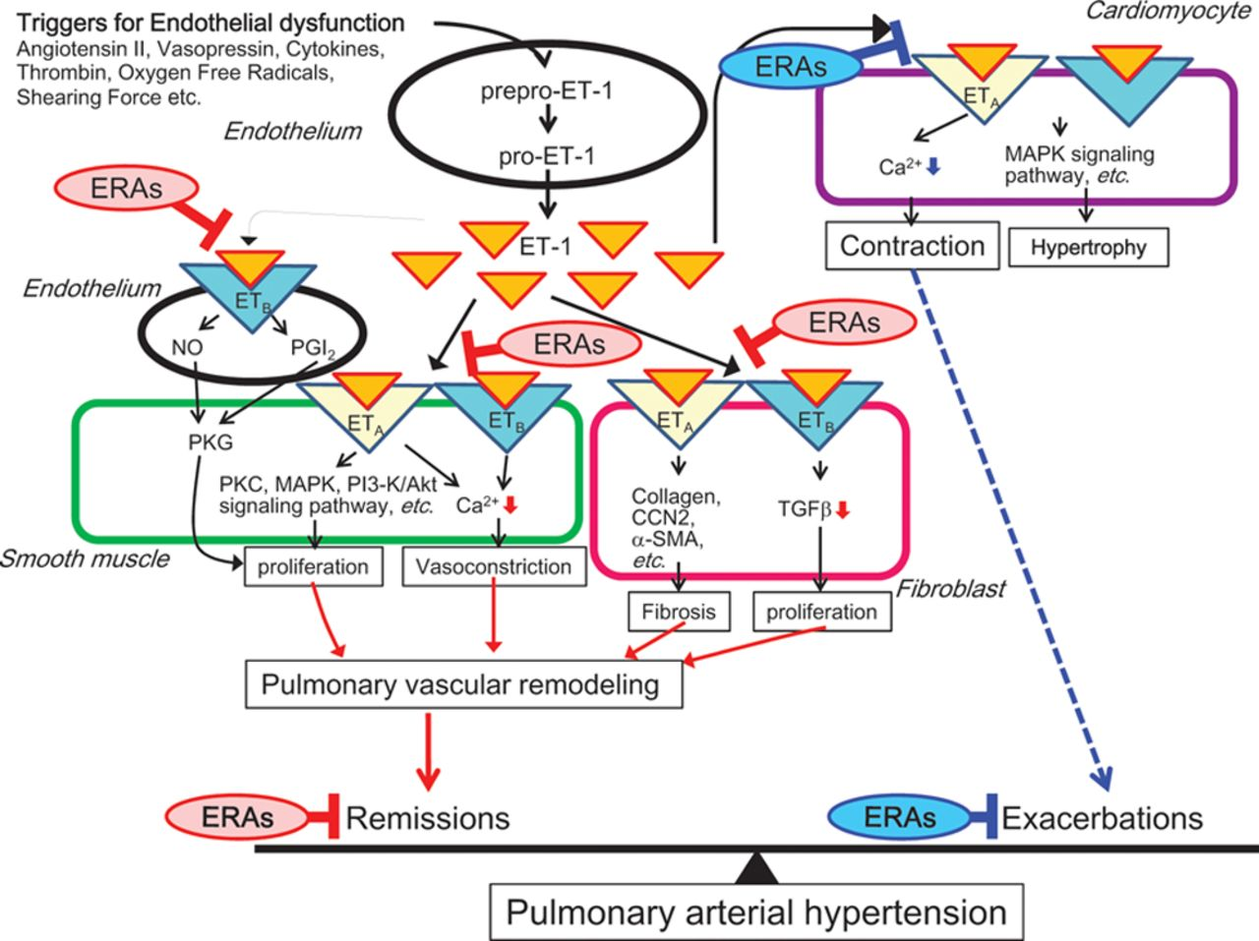

Slide 17
SIGNATURE
Hector O Ventura

Slide 18
Journals
Drug Designing
Drug Metabolism & Toxicology
Bioequivalence & Bioavailability

Slide 19
OMICS Group Open Access Membership
OMICS publishing Group Open Access Membership enables academic and research institutions, funders and corporations to actively encourage open access in scholarly communication and the dissemination of research published by their authors.
For more details and benefits, click on the link below:
http://omicsonline.org/membership.php

