Slide 1
Hideharu Shintani
EB PPT

Slide 2
BIOGRAPHY
Hideharu Shintani, PhD, Guest Professor; born in Osaka, Japan, Feb. 23, 1948; Family, Miharu Amagai, Feb. 10,1949; 2 children. Present Address, 1-10-60,Minamidaira, Hino 191-0041, Tokyo, Japan; Education, BA, Kyoto U., 1972, MS, 1974, PhD, 1977. Carrier, Researcher National Institute of Health Sciences (NIHS), Tokyo, 1977-87, Senior Researcher 1987-92, Director of Department 1992-2009, Guest Professor of Chuo University, School of Science, 2009-, Research Associate at Texas Tech University, Department of Chemistry, Lubbock, 1986-87; Academic Activity, Director of Antibacterial and Antifungal Society Japan, Editorial Board of Biocontrol Science, J. Radiation Sterilization, and Trends in Biomaterial & Artificial Organs. A Chairman of the Japanese Government Committee entitled Sterilization and inactivation of endotoxin and prion by gas plasma exposure. Book publication, Author: Bioinstrumentation and Biosensors, 1990, Ohio Science Workbook Polymers, 1994, Analytical Applications of Immobilized Enzyme Reactors, 1994, Sterilization Systems 1995, Adsorption and its Application in Industry and Environmental Protection, 1998; editor: Handbook of Analytical Application of Capillary Electrophoresis, 1996. Sterilization and Disinfection by Plasma –Sterilization Mechanisms, Biological and Medical Applications, 2011; Member AAMI, ISO (Japan Delegate 19991-). Home 1-10-60, Hino Tokyo Japan, Office: Chuo University, School of Science, Bunkyo-ku, Kasuga l-chome, 13-27, Tokyo 112-0003, Japan

Slide 3
RESEARCH INTEREST
Gas plasma sterilization
HPLC, Ion chromatography
Analytical Chemistry
Pharmaceutical Science
Sterilization Validation

Slide 4
RECENT PUBLICATIONS
Sterilization mechanism of nitrogen gas plasma: induction of secondary structural change in protein. Sakudo A, Higa M, Maeda K, Shimizu N, Imanishi Y, Shintani H. Microbiol Immunol. 2013 Jul;57(7):536-42. doi: 10.1111/1348-0421.12061.
Confirmation of the sterilization effect using a high concentration of ozone gas for the bio-clean room. Iwamura T, Nagano K, Nogami T, Matsuki N, Kosaka N, Shintani H, Katoh M. Biocontrol Sci. 2013;18(1):9-20.
Dengue virus presence and surveillance in Okinawa (Review). Sakudo A, Onodera T, Shintani H, Ikuta K. Exp Ther Med. 2012 Jan;3(1):15-17. Epub 2011 Oct 21.
Validation study and routine control monitoring of moist heat sterilization procedures. Shintani H. Biocontrol Sci. 2012 Jun;17(2):57-67. Review.

Slide 5
Validation of sterilization procedures and usage of biological indicators in the manufacture of healthcare products. Shintani H. Biocontrol Sci. 2011 Sep;16(3):85-94. Review.
Methods of rapid microbiological assay and their application to pharmaceutical and medical device fabrication. Shintani H, Sakudo A, McDonnel GE. Biocontrol Sci. 2011 Mar;16(1):13-21. Review.
Fundamentals of prions and their inactivation (review). Sakudo A, Ano Y, Onodera T, Nitta K, Shintani H, Ikuta K, Tanaka Y. Int J Mol Med. 2011 Apr;27(4):483-9. doi: 10.3892/ijmm.2011.605. Epub 2011 Jan 25. Review.

Slide 6
HPLC

Slide 20
HPLC detection and characteristics with sensitivity
Detection | Application | Characteristics
RI | all | Low sensitivity, not applicable to gradient elution
UV | Almost all except alkane, saturated alkyl | Most popular, 10-100 times more sensitive than RI
Fluorescence | Compound with fluorescence in nature or derivatization to compounds with fluorescence | Selective and sensitive, 10-50 time more sensitive than UV
ECD | Compounds with relatively lower oxidation-reduction potential | Selective and sensitive, 10-50 time more sensitive than UV. Sensitivity is almost identical to Fluorescence.
Ms | all | Most sensitive. Expensive. Handling is complicated.

Slide 21
Pretreatment method for the analysis of compounds in complicated matrix
Procedure | Reagent | Characteristics
Liquid-liquid extraction | Resemble polar solvent to identical compounds of interest | Much solvent use. Evaporation required. Recovery loss is possible. Troublesome.
Manual type solid phase extraction | Column and solvent selected as identical to the interest of compounds of analysis | Due to handle treatment, pressure variation causes. Pressure variation leads to recovery variation
Automated type solid phase extraction | Identical to Manual type solid phase extraction | Due to computer handling, no pressure variation, so reproducibility is quite high
Dialysis | Dialysis reagent | Membrane equilibrium between dialysis inner and outer. Commercially available but not so popular

Slide 22
Utility of HPLC

Slide 23
Pharmaceutica Analytica Acta Related Journals
Pharmaceutical Regulatory Affairs
Pharmacovigilance

Slide 24
Pharmaceutica Analytica Acta Related Conferences
For further details regarding the conference please visit
http://www.conferenceseries.com/pharmaceutical-sciences-meetings/

Slide 25
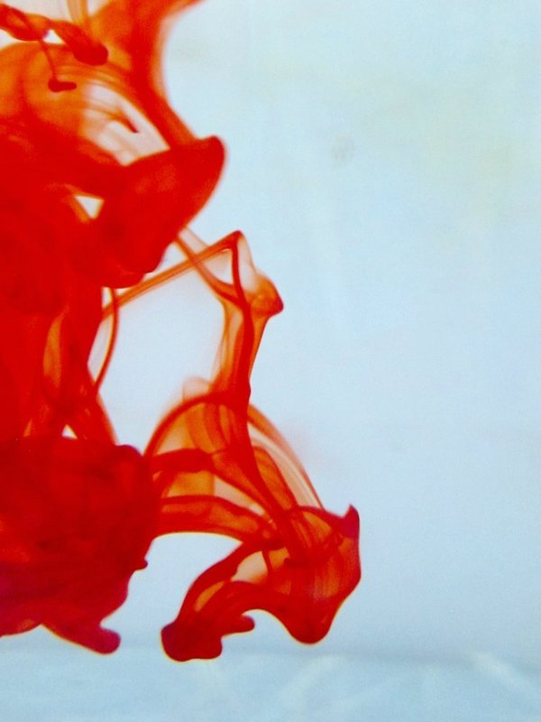
OMICS International Open Access Membership
Open Access Membership with OMICS international enables academicians and research institutions, funders and corporations to actively encourage open access in scholarly communication and the dissemination of research published by their authors.
For more details and benefits, click on the link below:
http://omicsonline.org/membership.php

Slide 26
SIGNATURE
Hideharu Shintani
University of Chuo
School of Science
1-13-27, Kasuga, Bunkyo, Tokyo 112-0003
Japan

