Slide 1
Hilary Cheng, Ph.D.
College of Management Yuan Ze University

Slide 2
Research Interest
Service Management, e-Business
Operations Management, Managerial Decision Modeling
Enterprise Resource Planning
Business Venturing
Business Analytics and Data Visualization

Slide 3

The Performance Evaluation of Japanese Hotels:
An Application of Data Envelopment Analysis Model
Yuan Ze University Hilary Cheng, Yi Chuan Lu, Hitoshi Katsukura

Slide 4
Research Background
The Performance Evaluation of Japanese Hotels:
DEA Model
Scale of Hotel industry in Japan㸯９９６−㸰㸮㸯㸮
11200
11000
10800
10600
10400
10200
10000
9800
9600
9400
9200
9000
1996 1998
Unit: a hundred million yen
2000
2002
2004
2006
2008
2010

Slide 5

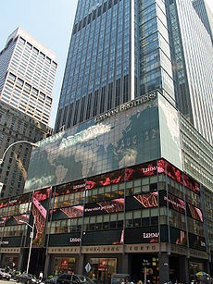
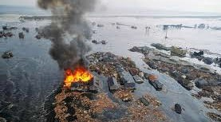
Research Background
The Performance Evaluation of Japanese Hotels:
DEA Model
The number of foreign visitors after 2000
10000000
9000000
8000000
7000000
6000000
5000000
4000000
3000000
2000000
1000000
0
2000
2001
2002
2003
2004
2005
2006
2007
2008
2009
2010
2011
Unit: person

Slide 6
Research Motivation
The Performance Evaluation of Japanese Hotels:
DEA Model
It is not yet starting to collect data in hotel industry by Japanese government.
We can see the Sales Ranking of Hotel or Ryokan (Japanese-style hotel), but not support for hotel industrial management.
Koike (2012) research about accommodation environment in Japan. But not yet started to disclose about efficiency of International Tourism Hotel.

Slide 7
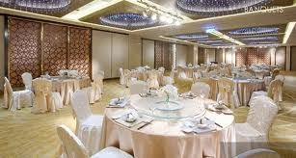

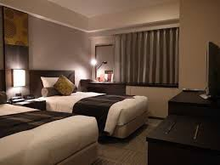
Target:
ŊůŵŦųůaŵŪŰůaŭ TŰŶųŪŴŮ ŉŰŵŦŭ Ūů ŋaűaů
The Performance Evaluation of Japanese Hotels:
DEA Model
ŅŦŧŪůŪŵŪŰů Űŧ ŊůŵŦųůaŵŪŰůaŭ TŰŶųŪŴŮ ŉŰŵŦŭ Ūů ŋaűaůŦŴŦ
‧Minimum number of rooms: more then 15 rooms
‧It is essential to have a certain level of number of customer
‧Western style of restaurant and kitchen
‧It is essential to have a certain level of area as party venue and restaurant
‧Sign for foreign tourists炷English sign, room, evacuation route等炸 We do not focus on Ryokan (Japanese-style hotel)
TũŦ ńũaųaŤŵŦųŪŴŵŪŤ Űŧ ŊůŵŦųůaŵŪŰůaŭ TŰŶųŪŴŮ ŉŰŵŦŭ Ūů ŋaűaů
ˬRŰŰŮ ŴŦŤŵŪŰů˭ˬFŰŰť aůť ŅųŪůŬ ŴŦŤŵŪŰů˭ˬPaųŵy ŴŦŤŵŪŰů˭

Slide 8


Research Object Collecting Data
The Performance Evaluation of Japanese Hotels:
DEA Model
OHTA PUBLISHING COMPANY
JAPAN HOTEL ALMANAC 2003-2010
Sales Ranking 300(2001-2008) Number of registrations：5714
International Tourism Hotelقin Japanك Number of registrations：1108ق2008ك Data 2001-2008

Slide 9
What is DEA?
The Performance Evaluation of Japanese Hotels:
DEA Model
Evaluation Efficiency
Performance = Productivity
Output
Input
Input
DEA Model
Output
a b c d
e f g h
Decision Making

Slide 10
Research Method
The Performance Evaluation of Japanese Hotels:
DEA Model
Data Envelopment Analysis Model
Input Input Input 1 2 3
Input Input 4 5
CCR
Overall efficiency
DEA
Analysis
BCC
Technical efficiency
CCR/BCC
Scale efficiency
Output

Slide 11
Cluster Analysis
The Performance Evaluation of Japanese Hotels:
DEA Model
CCR
Overall efficiency
BCC
Technical efficiency
Cluster Analysis
Classify Data
CCR/BCC
Scale efficiency

Slide 12

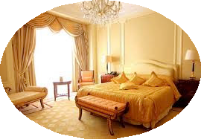



Input Variable
The Performance Evaluation of Japanese Hotels:
DEA Model
Sales management
Variable
contents
Input1 Input2 Input3 Input4 Input5
ˬNumber of Room˭
ˬNumber of Employee˭
ˬNumber of Restaurant Seat˭
ˬNumber of Bar Seat˭
ˬNumber of Party seat˭
Output1 ˬTotal Revenue˭
Service management
Human management

Slide 13
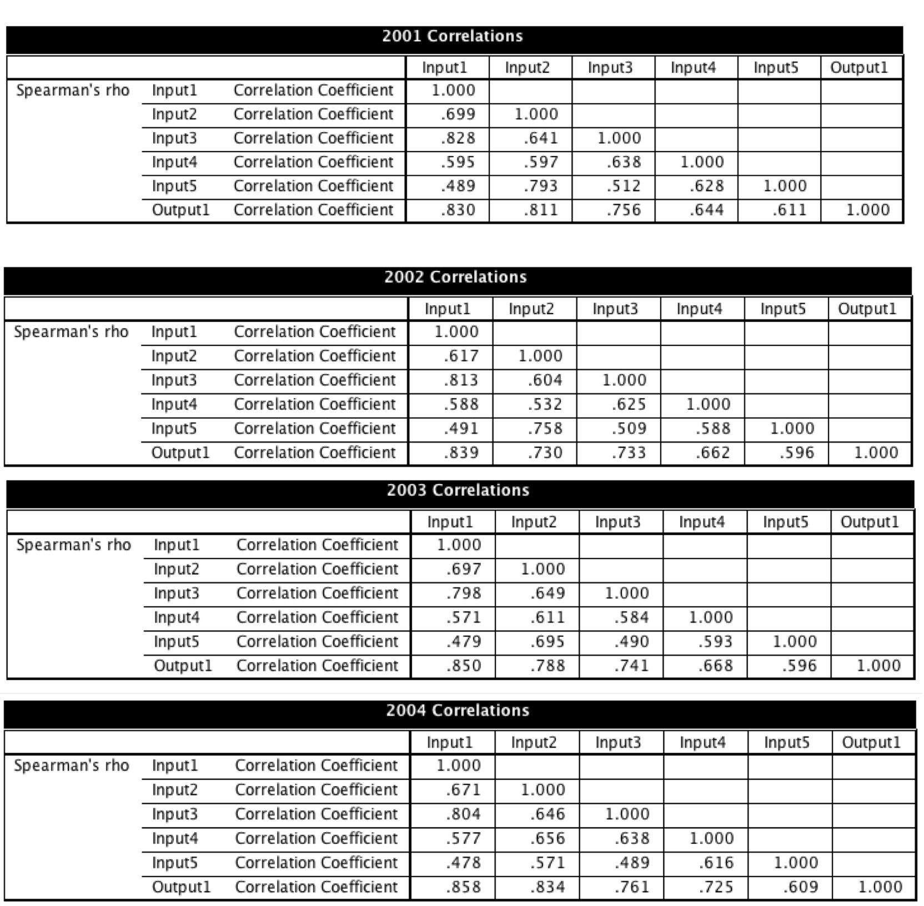

Correlation analysis 01-04
The Performance Evaluation of Japanese Hotels:
DEA Model

Slide 14
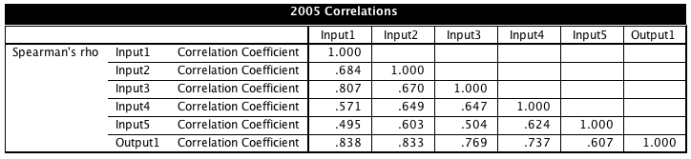

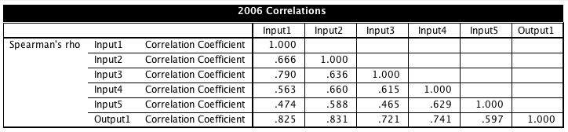

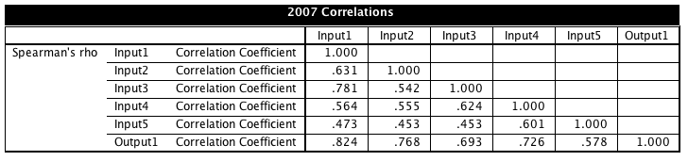

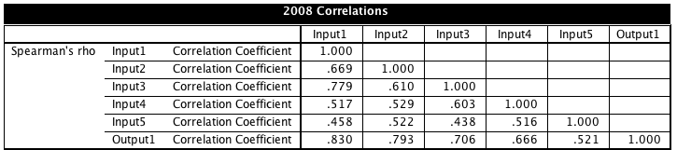

Correlation analysis 05-08
The Performance Evaluation of Japanese Hotels:
DEA Model

Slide 15
Result of CCR
The Performance Evaluation of Japanese Hotels:
DEA Model
CCR Score
nit nam | 2001 | 2002 | 2003 | 2004 | 2005 | 2006 | 2007 | 2008 | Average
H01 | 0.922 | 0.943 | 0.908 | 1.000 | 1.000 | 1.000 | 1.000 | 1.000 | 0.972
H02 | 1.000 | 1.000 | 1.000 | 1.000 | 1.000 | 1.000 | 1.000 | 1.000 | 1.000
H03 | 0.949 | 0.963 | 0.989 | 0.880 | 0.904 | 0.822 | 0.923 | 0.852 | 0.910
H04 | 1.000 | 0.914 | 1.000 | 1.000 | 1.000 | 1.000 | 1.000 | 1.000 | 0.989
H05 | 1.000 | 1.000 | 1.000 | 1.000 | 1.000 | 1.000 | 1.000 | 1.000 | 1.000
H06 | 1.000 | 0.897 | 0.914 | 0.958 | 0.993 | 0.960 | 0.930 | 0.842 | 0.937
H07 | 0.906 | 0.884 | 0.870 | 0.855 | 0.921 | 0.990 | 1.000 | 0.947 | 0.921
H08 | 0.996 | 1.000 | 1.000 | 1.000 | 1.000 | 1.000 | 1.000 | 0.937 | 0.992
H09 | 0.608 | 0.721 | 0.644 | 0.647 | 0.745 | 0.941 | 0.910 | 0.877 | 0.762
H10 | 0.871 | 0.884 | 0.851 | 0.898 | 0.810 | 0.813 | 0.829 | 0.830 | 0.848
H11 | 0.887 | 0.857 | 0.890 | 0.918 | 0.934 | 0.930 | 0.954 | 0.943 | 0.914
H12 | 1.000 | 1.000 | 1.000 | 1.000 | 1.000 | 1.000 | 1.000 | 1.000 | 1.000
H13 | 0.840 | 0.787 | 0.742 | 0.788 | 0.826 | 0.846 | 0.920 | 0.962 | 0.839
H14 | 0.862 | 0.802 | 0.769 | 0.807 | 0.807 | 0.795 | 0.745 | 0.679 | 0.783
H15 | 1.000 | 1.000 | 1.000 | 1.000 | 1.000 | 1.000 | 1.000 | 1.000 | 1.000
H16 | 0.878 | 0.726 | 0.794 | 0.856 | 0.794 | 0.750 | 0.753 | 0.677 | 0.778
H17 | 1.000 | 0.998 | 0.968 | 1.000 | 1.000 | 1.000 | 1.000 | 1.000 | 0.996
H18 | 0.919 | 1.000 | 1.000 | 1.000 | 1.000 | 1.000 | 0.973 | 0.917 | 0.976
H19 | 0.970 | 0.990 | 0.871 | 0.872 | 1.000 | 0.992 | 1.000 | 1.000 | 0.962
H20 | 0.687 | 0.719 | 0.871 | 0.923 | 0.993 | 1.000 | 0.902 | 0.881 | 0.872
H21 | 1.000 | 1.000 | 1.000 | 1.000 | 1.000 | 1.000 | 1.000 | 1.000 | 1.000
H22 | 0.460 | 0.444 | 0.507 | 0.708 | 0.651 | 0.661 | 0.597 | 0.663 | 0.586
H23 | 0.694 | 0.748 | 0.735 | 0.819 | 0.784 | 0.767 | 0.873 | 0.781 | 0.775
H24 | 0.863 | 0.732 | 0.825 | 0.859 | 0.843 | 0.773 | 0.777 | 0.768 | 0.805
H25 | 0.550 | 0.534 | 0.689 | 0.690 | 0.670 | 0.623 | 0.607 | 0.601 | 0.621
H26 | 0.935 | 0.918 | 1.000 | 0.986 | 1.000 | 1.000 | 1.000 | 1.000 | 0.980
H27 | 1.000 | 1.000 | 1.000 | 1.000 | 1.000 | 0.999 | 0.913 | 0.912 | 0.978
H28 | 1.000 | 1.000 | 1.000 | 1.000 | 1.000 | 1.000 | 1.000 | 1.000 | 1.000
H29 | 0.643 | 0.612 | 0.561 | 0.612 | 0.674 | 0.614 | 0.552 | 0.563 | 0.604
H30 | 0.768 | 0.726 | 0.765 | 0.870 | 0.904 | 0.853 | 0.768 | 0.772 | 0.803
H31 | 0.899 | 0.841 | 0.895 | 0.825 | 0.910 | 0.938 | 0.871 | 0.929 | 0.888
H32 | 0.769 | 0.812 | 0.770 | 0.823 | 0.760 | 0.753 | 0.657 | 0.701 | 0.756
H33 | 0.830 | 0.644 | 0.901 | 0.863 | 0.927 | 0.975 | 0.739 | 0.804 | 0.835
H34 | 0.929 | 0.837 | 0.876 | 0.952 | 0.943 | 1.000 | 1.000 | 0.886 | 0.928
H35 | 1.000 | 1.000 | 1.000 | 1.000 | 1.000 | 1.000 | 1.000 | 1.000 | 1.000
H36 | 0.637 | 0.695 | 0.707 | 0.689 | 0.641 | 0.623 | 0.607 | 0.574 | 0.646
H37 | 0.474 | 0.476 | 0.585 | 0.643 | 0.628 | 0.624 | 0.549 | 0.491 | 0.559
H38 | 0.896 | 0.841 | 0.856 | 0.836 | 0.790 | 0.737 | 0.833 | 0.806 | 0.824
Best DMU
ˬH02˭ˬH05˭ˬH12˭
ˬH15˭ˬH21 ˭ˬH28˭
ˬH35˭
Improvement is required DMU
ˬH37˭

Slide 16
Result of BCC
The Performance Evaluation of Japanese Hotels:
DEA Model
BCC
nit nam | 2001 | 2002 | 2003 | 2004 | 2005 | 2006 | 2007 | 2008 | Average
H01 | 1.000 | 1.000 | 1.000 | 1.000 | 1.000 | 1.000 | 1.000 | 1.000 | 1.000
H02 | 1.000 | 1.000 | 1.000 | 1.000 | 1.000 | 1.000 | 1.000 | 1.000 | 1.000
H03 | 1.000 | 1.000 | 1.000 | 1.000 | 1.000 | 1.000 | 1.000 | 0.981 | 0.998
H04 | 1.000 | 1.000 | 1.000 | 1.000 | 1.000 | 1.000 | 1.000 | 1.000 | 1.000
H05 | 1.000 | 1.000 | 1.000 | 1.000 | 1.000 | 1.000 | 1.000 | 1.000 | 1.000
H06 | 1.000 | 0.911 | 0.961 | 0.972 | 1.000 | 0.968 | 0.932 | 0.844 | 0.949
H07 | 0.948 | 0.901 | 0.913 | 0.862 | 0.924 | 0.994 | 1.000 | 0.952 | 0.937
H08 | 0.996 | 1.000 | 1.000 | 1.000 | 1.000 | 1.000 | 1.000 | 0.956 | 0.994
H09 | 0.649 | 0.815 | 0.725 | 0.681 | 0.815 | 0.972 | 0.927 | 0.963 | 0.818
H10 | 0.889 | 0.888 | 0.860 | 0.918 | 0.817 | 0.823 | 0.833 | 0.853 | 0.860
H11 | 0.902 | 0.932 | 0.983 | 0.938 | 0.947 | 0.931 | 0.963 | 0.974 | 0.946
H12 | 1.000 | 1.000 | 1.000 | 1.000 | 1.000 | 1.000 | 1.000 | 1.000 | 1.000
H13 | 0.849 | 0.790 | 0.755 | 0.796 | 0.842 | 0.853 | 0.923 | 0.963 | 0.846
H14 | 0.944 | 0.885 | 0.837 | 0.861 | 0.844 | 0.820 | 0.760 | 0.708 | 0.832
H15 | 1.000 | 1.000 | 1.000 | 1.000 | 1.000 | 1.000 | 1.000 | 1.000 | 1.000
H16 | 0.896 | 0.730 | 0.802 | 0.876 | 0.819 | 0.760 | 0.755 | 0.680 | 0.790
H17 | 1.000 | 1.000 | 0.982 | 1.000 | 1.000 | 1.000 | 1.000 | 1.000 | 0.998
H18 | 0.967 | 1.000 | 1.000 | 1.000 | 1.000 | 1.000 | 0.973 | 0.925 | 0.983
H19 | 1.000 | 1.000 | 0.921 | 0.946 | 1.000 | 1.000 | 1.000 | 1.000 | 0.983
H20 | 0.708 | 0.739 | 0.880 | 0.924 | 0.994 | 1.000 | 0.951 | 0.898 | 0.887
H21 | 1.000 | 1.000 | 1.000 | 1.000 | 1.000 | 1.000 | 1.000 | 1.000 | 1.000
H22 | 0.492 | 0.493 | 0.535 | 0.747 | 0.700 | 0.709 | 0.672 | 0.727 | 0.634
H23 | 0.816 | 0.781 | 0.766 | 0.836 | 0.797 | 0.775 | 0.946 | 0.870 | 0.823
H24 | 1.000 | 0.784 | 0.881 | 0.909 | 0.870 | 0.787 | 0.849 | 0.845 | 0.866
H25 | 0.711 | 0.585 | 0.751 | 0.766 | 0.747 | 0.691 | 0.739 | 0.714 | 0.713
H26 | 1.000 | 1.000 | 1.000 | 1.000 | 1.000 | 1.000 | 1.000 | 1.000 | 1.000
H27 | 1.000 | 1.000 | 1.000 | 1.000 | 1.000 | 1.000 | 0.970 | 0.969 | 0.992
H28 | 1.000 | 1.000 | 1.000 | 1.000 | 1.000 | 1.000 | 1.000 | 1.000 | 1.000
H29 | 0.739 | 0.648 | 0.679 | 0.705 | 0.699 | 0.641 | 0.699 | 0.709 | 0.690
H30 | 0.916 | 0.893 | 0.993 | 1.000 | 0.996 | 0.940 | 1.000 | 1.000 | 0.967
H31 | 1.000 | 1.000 | 1.000 | 1.000 | 1.000 | 1.000 | 1.000 | 1.000 | 1.000
H32 | 0.871 | 0.921 | 0.942 | 0.966 | 0.870 | 0.870 | 0.911 | 0.972 | 0.915
H33 | 1.000 | 0.901 | 1.000 | 1.000 | 1.000 | 1.000 | 1.000 | 1.000 | 0.988
H34 | 1.000 | 1.000 | 1.000 | 1.000 | 1.000 | 1.000 | 1.000 | 1.000 | 1.000
H35 | 1.000 | 1.000 | 1.000 | 1.000 | 1.000 | 1.000 | 1.000 | 1.000 | 1.000
H36 | 1.000 | 1.000 | 1.000 | 1.000 | 1.000 | 1.000 | 1.000 | 1.000 | 1.000
H37 | 0.854 | 0.794 | 0.995 | 0.964 | 0.821 | 0.821 | 0.852 | 0.872 | 0.871
H38 | 1.000 | 1.000 | 1.000 | 1.000 | 1.000 | 1.000 | 1.000 | 1.000 | 1.000
Best DMU
ˬ H01 ˭ ˬ H04 ˭ ˬ H0 5˭
ˬH026 ˭ˬH31 ˭ˬH34˭
ˬH36˭ˬH38˭
Improvement is required DMU
ˬH22˭

Slide 17
Result of CCR/BCC
The Performance Evaluation of Japanese Hotels:
DEA Model
CCR/B
nit nam 2001 2002 2003 2004 2005 2006 2007 2008
H01 0.922 0.943 0.908 1.000 1.000 1.000 1.000 1.000
H02 1.000 1.000 1.000 1.000 1.000 1.000 1.000 1.000
H03 0.949 0.963 0.989 0.880 0.904 0.822 0.923 0.868
H04 1.000 0.914 1.000 1.000 1.000 1.000 1.000 1.000
H05 1.000 1.000 1.000 1.000 1.000 1.000 1.000 1.000
H06 1.000 0.984 0.951 0.986 0.993 0.991 0.998 0.998
H07 0.956 0.980 0.953 0.992 0.997 0.995 1.000 0.996
H08 1.000 1.000 1.000 1.000 1.000 1.000 1.000 0.979
H09 0.938 0.885 0.888 0.951 0.914 0.969 0.982 0.911
H10 0.980 0.996 0.990 0.977 0.991 0.987 0.995 0.973
H11 0.983 0.920 0.905 0.978 0.986 0.999 0.991 0.967
H12 1.000 1.000 1.000 1.000 1.000 1.000 1.000 1.000
H13 0.990 0.996 0.983 0.991 0.981 0.992 0.997 0.999
H14 0.913 0.906 0.919 0.937 0.956 0.969 0.980 0.958
H15 1.000 1.000 1.000 1.000 1.000 1.000 1.000 1.000
H16 0.979 0.994 0.990 0.977 0.969 0.988 0.997 0.995
H17 1.000 0.998 0.986 1.000 1.000 1.000 1.000 1.000
H18 0.950 1.000 1.000 1.000 1.000 1.000 1.000 0.992
H19 0.970 0.990 0.946 0.922 1.000 0.992 1.000 1.000
H20 0.970 0.973 0.990 0.999 0.999 1.000 0.948 0.981
H21 1.000 1.000 1.000 1.000 1.000 1.000 1.000 1.000
H22 0.936 0.900 0.948 0.947 0.931 0.932 0.887 0.912
H23 0.851 0.958 0.959 0.980 0.984 0.990 0.922 0.898
H24 0.863 0.934 0.936 0.944 0.970 0.983 0.916 0.909
H25 0.774 0.912 0.917 0.901 0.898 0.902 0.821 0.842
H26 0.935 0.918 1.000 0.986 1.000 1.000 1.000 1.000
H27 1.000 1.000 1.000 1.000 1.000 0.999 0.941 0.941
H28 1.000 1.000 1.000 1.000 1.000 1.000 1.000 1.000
H29 0.869 0.944 0.826 0.868 0.964 0.957 0.790 0.794
H30 0.838 0.813 0.771 0.870 0.908 0.907 0.768 0.772
H31 0.899 0.841 0.895 0.825 0.910 0.938 0.871 0.929
H32 0.883 0.882 0.818 0.852 0.874 0.865 0.721 0.722
H33 0.830 0.715 0.901 0.863 0.927 0.975 0.739 0.804
H34 0.929 0.837 0.876 0.952 0.943 1.000 1.000 0.886
H35 1.000 1.000 1.000 1.000 1.000 1.000 1.000 1.000
H36 0.637 0.695 0.707 0.689 0.641 0.623 0.607 0.574
H37 0.555 0.600 0.588 0.666 0.765 0.760 0.645 0.562
H38 0.896 0.841 0.856 0.836 0.790 0.737 0.833 0.806
Average
0.972
1.000
0.912
0.989
1.000
0.987
0.984
0.998
BestDMU
0.931
0.986
0.966
1.000
ˬH02˭ˬH05˭ˬH12˭
ˬH15˭ˬH21 ˭ˬH28˭
ˬH35˭
0.991
0.941
1.000
0.985
0.998
0.993
0.978
Improvement is required DMU
0.983
1.000
0.924
0.941
0.930
ˬH37˭
0.870
0.980
0.986
1.000
0.875
0.830
0.888
0.826
0.846
0.928
1.000
0.646
0.641
0.824

Slide 18
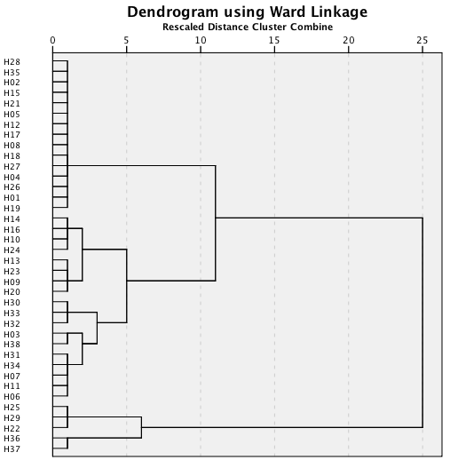
Cluster Analysis
The Performance Evaluation of Japanese Hotels:
DEA Model
G1
Using Data
DMU Data Result of CCR, Result of BCC,
Result of CCR/BCC
Cluster Analysis
* Ward method, Quadrance
G2
G3
G4 G5

Slide 19


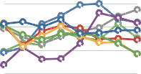




Result of Cluster Analysis
The Performance Evaluation of Japanese Hotels:
DEA Model
1.000
Group1 CCR
1.000
Group1 BCC
1.000
Group1 CCR/BCC
G1
0.850
0.850
0.850
0.700
0.700
0.700
0.550
0.550
0.550
0.400 | 0.400 | 0.400
2001 2002 2003 2004 2005 2006 2007 2008 | 2001 2002 2003 2004 2005 2006 2007 2008 | 2001 2002 2003 2004 2005 2006 2007 2008
H02 | H05 | H12 H15 | H21 | H28 | H02 | H05 | H12 H15 | H21 | H28 | H02 | H05 | H12 H15 H21 H28
H19 | H26 | H27 |  |  | H19 | H26 | H27 |  |  | H19 | H26 | H27
H35
H01
H04 H08
H17
H18
H35
H01
H04 H08
H17
H18
H35 H01 H04 H08 H17
H18
1.000
Group2 CCR
1.000
Group2 BCC
1.000
Group2 CCR/BCC
G2
0.850
0.850
0.850
0.700
0.700
0.700
0.550
0.550
0.550
0.400 | 0.400 | 0.400
2001 2002 2003 2004 2005 2006 2007 2008 | 2001 2002 2003 2004 2005 2006 2007 2008 | 2001 2002 2003 2004 2005 2006 2007 2008
H10 | H14 | H16 H24 | H09 | H13 | H10 | H14 | H16 H24 | H09 | H13 | H10 | H14 H16 H24 H09 H13
H20 | H23 |  |  |  | H20 | H23 |  |  |  | H20 | H23
1.000
Group3 CCR
1.000
Group3 BCC
1.000
Group3 CCR/BCC
G3
0.850
0.850
0.850
0.700
0.700
0.700
0.550
0.550
0.550
0.400 |  |  | 0.400 |  |  |  |  | 0.400
2001 2002 2003 2004 2005 2006 2007 2008 |  |  | 2001 2002 2003 2004 2005 2006 2007 2008 |  |  |  |  | 2001 2002 2003 2004 2005 2006 2007 2008
H03 H38 H06 H07 | H11 | H31 | H03 | H38 | H06 H07 | H11 | H31 | H03 | H38 | H06 H07 H11 H31
H34 H30 H32 H33 |  |  | H34 | H30 | H32 H33 |  |  | H34 | H30 | H32 H33
Group4 CCR
1.000
Group4 BCC
1.000
Group4 CCR/BCC
1.000
G4
0.850
0.850
0.850
0.700
0.700
0.700
0.550
0.550
0.550
0.400 | 0.400 | 0.400
2001 2002 2003 2004 2005 2006 2007 2008 | 2001 2002 2003 2004 2005 2006 2007 2008 | 2001 2002 2003 2004 2005 2006 2007 2008
H22
H25
H29
H22
H25
H29
H22
H25
H29
Group5 CCR |  | Group5 BCC | Group5 CCR/BCC
1.000 | 1.000 |  | 1.000
G5
0.850
0.850
0.850
0.700
0.700
0.700
0.550
0.550
0.550
0.400 | 0.400 | 0.400
2001 2002 2003 2004 2005 2006 2007 2008 | 2001 2002 2003 2004 2005 2006 2007 2008 | 2001 2002 2003 2004 2005 2006 2007 2008
H36
H37
H36
H37
H36
H37

Slide 20


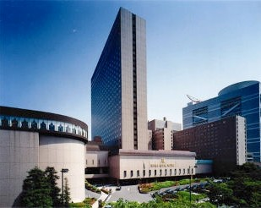





The Performance Evaluation of Japanese Hotels:
DEA Model
Result of DEA Data
RANKING | 2001 | 2002 | 2003 | 2004 | 2005 | 2006 | 2007 | 2008
REVENUE | 2 | 2 | 2 | 2 | 2 | 2 | 2 | 2
CCR | 1 | 1 | 1 | 1 | 1 | 1 | 1 | 1
BCC | 1 | 1 | 1 | 1 | 1 | 1 | 1 | 1
CCR/BCC | 1 | 1 | 1 | 1 | 1 | 1 | 1 | 1
RTS | C | C | C | C | C | C | C | C
Input 1
Number of Rooms
2000
 | 2001 | 2002 | 2003 | 2004 | 2005 | 2006 | 2007 | 2008
AI | 987 | 987 | 987 | 988 | 986 | 973 | 973 | 973
CCR TI | 987 | 987 | 987 | 988 | 986 | 973 | 973 | 973
BCC TI | 989 | 987 | 987 | 988 | 986 | 973 | 973 | 973
1500
1000
500
0
2001 2002 2003 2004 2005 2006 2007 2008
Unit: 室
RTS = Returns to Scale,
I = Increasing, C = constance, D = Decreasing
Input 2
Number of Employees
1500
 | 2001 | 2002 | 2003 | 2004 | 2005 | 2006 | 2007 | 2008
AI | 1203 | 1203 | 1182 | 1190 | 1284 | 1261 | 1240 | 1050
CCR TI | 1203 | 1203 | 1182 | 1190 | 1284 | 1261 | 1240 | 1050
BCC TI | 1269 | 1203 | 1182 | 1190 | 1284 | 1261 | 1240 | 1050
1000
20000
Revenue
500
15000
REVENUE | 2001 | 2002 | 2003 | 2004 | 2005 | 2006 | 2007 | 2008
Room | 4122 | 3819 | 3573 | 3684 | 3523 | 3746 | 3894 | 3512
F&B | 7877 | 7367 | 7045 | 7264 | 7108 | 7148 | 7003 | 6474
Party | 9795 | 9118 | 8957 | 8969 | 8721 | 8313 | 8868 | 8384
Other | 16203 | 15872 | 15184 | 15063 | 15408 | 15704 | 16191 | 15841
0
2001 2002 2003 2004 2005 2006 2007 2008
Unit: 人
10000
Input 3
Number of Restaurant sheets
5000
1500
 | 2001 | 2002 | 2003 | 2004 | 2005 | 2006 | 2007 | 2008
AI | 1297 | 1297 | 1297 | 1420 | 1486 | 1498 | 1486 | 1233
CCR TI | 1297 | 1297 | 1297 | 1420 | 1486 | 1498 | 1486 | 1233
BCC TI | 1261 | 1297 | 1297 | 1420 | 1486 | 1498 | 1486 | 1233
0
2001 2002 2003 2004 2005 2006 2007 2008
Unit: 万円
1000
Room F&B Party
Other
500
0
2001 2002 2003 2004 2005 2006 2007 2008
Unit: 席
Output1
Total Revenue
1000
Input 4
Number of Bar sheets
40000
30000
20000
10000
0
TOTAL | 2001 | 2002 | 2003 | 2004 | 2005 | 2006 | 2007 | 2008
REVENUE | 27882 | 26523 | 25912 | 27139 | 26876 | 26728 | 27302 | 25736
750
 | 2001 | 2002 | 2003 | 2004 | 2005 | 2006 | 2007 | 2008
AI | 686 | 686 | 686 | 560 | 561 | 561 | 561 | 561
CCR TI | 686 | 686 | 686 | 560 | 561 | 561 | 561 | 561
BCC TI | 756 | 686 | 686 | 560 | 561 | 561 | 561 | 561
500
Unit: 万円
250
2001 2002 2003 2004 2005 2006 2007 2008
0
2001 2002 2003 2004 2005 2006 2007 2008
Unit: 席
DEA Result
Input 5
3000
Number of Party sheets
1.000
DEA RESULT | 2001 | 2002 | 2003 | 2004 | 2005 | 2006 | 2007 | 2008
CCR | 1.000 | 1.000 | 1.000 | 1.000 | 1.000 | 1.000 | 1.000 | 1.000
BCC | 1.000 | 1.000 | 1.000 | 1.000 | 1.000 | 1.000 | 1.000 | 1.000
CCR/BCC | 1.000 | 1.000 | 1.000 | 1.000 | 1.000 | 1.000 | 1.000 | 1.000
2000
 | 2001 | 2002 | 2003 | 2004 | 2005 | 2006 | 2007 | 2008
AI | 2670 | 2670 | 2670 | 2670 | 2670 | 2670 | 2670 | 1910
CCR TI | 2670 | 2670 | 2670 | 2670 | 2670 | 2670 | 2670 | 1910
BCC TI | 2670 | 2670 | 2670 | 2670 | 2670 | 2670 | 2670 | 1910
0.750
1000
0.500
0
0.250
2001 2002 2003 2004 2005 2006 2007 2008
Unit: 席
0
2001 2002 2003 2004 2005 2006 2007 2008
0 ≦ CCR, BCC, CCR/BCC ≦ 1.000
CCR BCC CCR/BCC
AI
CCR TI
BCC TI
AI=Actual Input, TI=Target Input

Slide 21



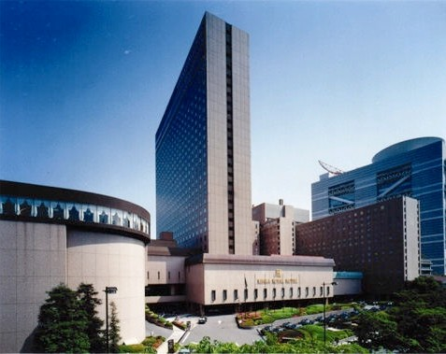
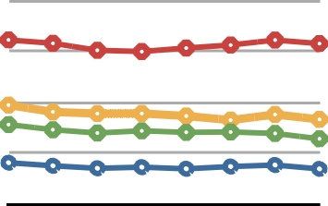

The Performance Evaluation of Japanese Hotels:
DEA Model
Result of DEA Data H02
RANKING | 2001 | 2002 | 2003 | 2004 | 2005 | 2006 | 2007 | 2008
REVENUE | 2 | 2 | 2 | 2 | 2 | 2 | 2 | 2
CCR | 1 | 1 | 1 | 1 | 1 | 1 | 1 | 1
BCC | 1 | 1 | 1 | 1 | 1 | 1 | 1 | 1
CCR/BCC | 1 | 1 | 1 | 1 | 1 | 1 | 1 | 1
RTS | C | C | C | C | C | C | C | C
RTS = Returns to Scale,
I = Increasing, C = constance, D = Decreasing
Revenue
20000
15000
10000
5000
0
REVENUE | 2001 | 2002 | 2003 | 2004 | 2005 | 2006 | 2007 | 2008
Room | 4122 | 3819 | 3573 | 3684 | 3523 | 3746 | 3894 | 3512
F&B | 7877 | 7367 | 7045 | 7264 | 7108 | 7148 | 7003 | 6474
Party | 9795 | 9118 | 8957 | 8969 | 8721 | 8313 | 8868 | 8384
Other | 16203 | 15872 | 15184 | 15063 | 15408 | 15704 | 16191 | 15841
2001 2002 2003 2004 2005 2006 2007 2008
Room F&B Party
Unit: 万円
Other

Slide 22
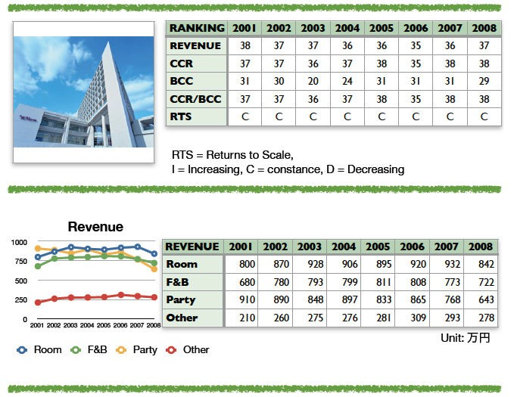

The Performance Evaluation of Japanese Hotels:
DEA Model
Result of DEA Data H37

Slide 23
Conclusion
The Performance Evaluation of Japanese Hotels:
DEA Model
DEA Model Method
We set: Input
ˬNumber of Room˭
ˬNumber of Employee˭
ˬNumber of Restaurant Seat˭
ˬNumber of Bar Seat˭
Output
ˬNumber of Party seat˭
Total 38 International Tourism Hotels
We found:
Best DMU
ˬH02˭ˬH05˭ˬH12˭ˬH15 ˭
ˬH21˭ˬH28˭ˬH35˭
Improvement is required DMU
ˬH37˭
5 types of efficiency groups

Slide 24
The Performance Evaluation of Japanese Hotels:
DEA Model

