Slide 1

Parallel Computation of Non-Bonded Interactions in Drug Discovery: Nvidia GPUs vs. Intel Xeon Phi
Jianbin Fang, Ana Lucia Varbanescu, Baldomero Imbernón, José M. Cecilia, and Horacio Peréz-Sánchez
Bioinformatics and High Performance Computing Research Group
http://bio-hpc.eu
Universidad Católica San Antonio de Murcia (UCAM)

Slide 2
Drug Discovery and Virtual Screening
Non-bonded interactions kernel implementations
  Cell Broadband Engine
  GPU
  Cluster; MPI/OpenMP
  Intel Xeon Phi
Conclusions and outlook

Slide 3
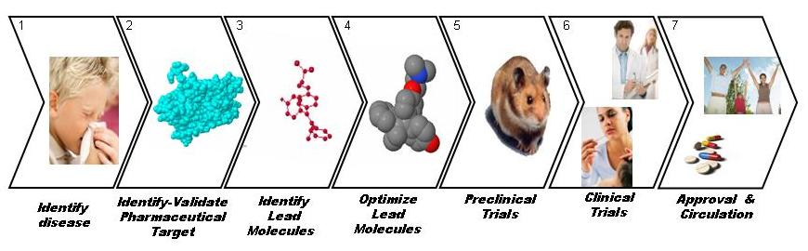
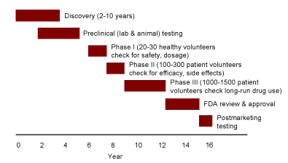
DRUG DISCOVERY PROCESS

Slide 4
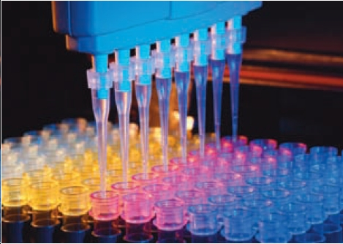
Methods for ligand database screening:
  Screening in laboratory:
    Automatized,
    but expensive
    and time-consuming

Slide 5


Slide 6
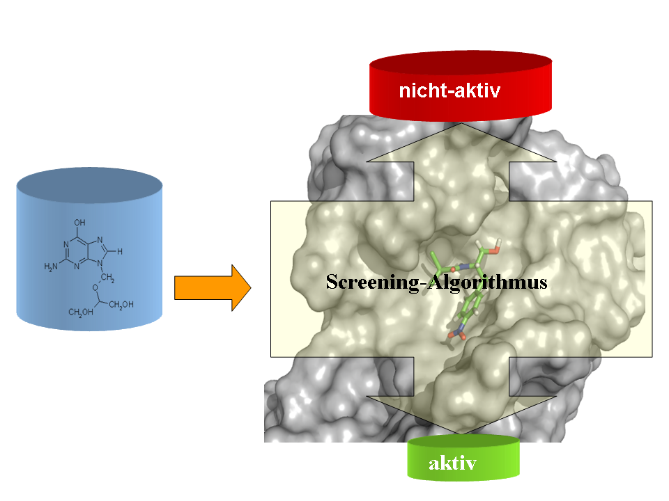
Methods for ligand database screening:
  Screening in laboratory:
    Automatized,
    but expensive
    and time-consuming
  Virtual Screening
  Search for leads
  As pre-stage for exp. tests

Slide 7
Methods for ligand database screening:
Definition of Virtual Screening
Use of high-performance computing to analyze large databases of chemical compounds in order to indetify possible drug candidates.
W.P. Walters, M.T. Stahl and M.A. Murcko, “Virtual Screening-An Overview”, Drug Discovery Today, 3, 160-178 (1998))
  Screening in laboratory:
    Automatized,
    but expensive
    and time-consuming
Databases of chemical compounds used
ZINC database
  free database of commercially-available compounds for virtual screening
  contains over 13 million purchasable compounds in ready-to-dock, 3D formats
  http://zinc.docking.org/, Irwin and Shoichet, J. Chem. Inf. Model. 2005;45(1):177-82
In-house generated libraries
Chemical synthesis of interesting compounds
Experimental determination of activities
  Virtual Screening
  Search for leads
  As pre-stage for exp. tests

Slide 8
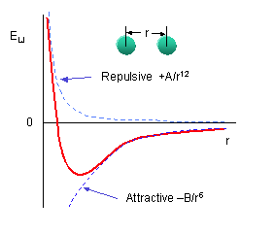
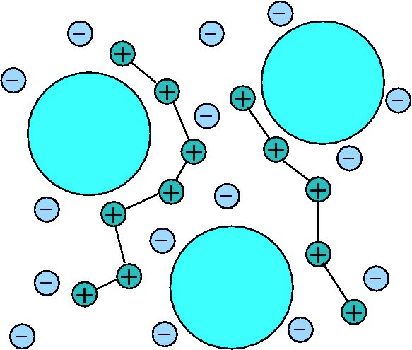
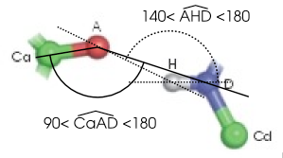
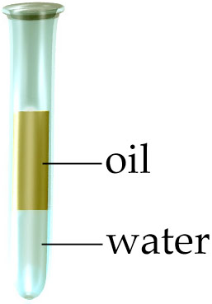
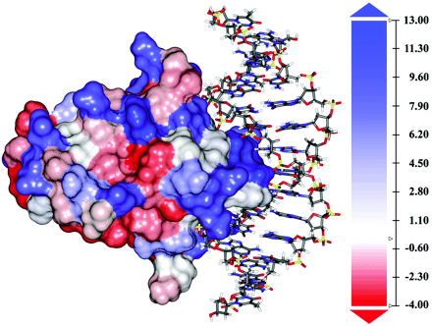
Scoring functions used in most VS methods (“biomolecular dwarfs”)
NON-BONDED INTERACTIONS
Van der Waals (VDW) + Electrostatics (ES)
~16x
+ Hydrogen Bonds (HBOND)
+ Solvation (SASA)

Slide 9
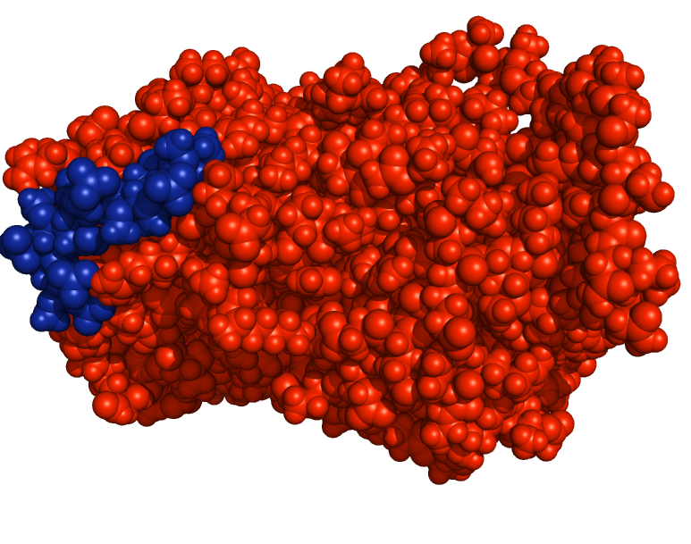
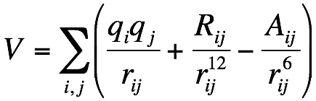
CALCULATION OF PROTEIN-LIGAND INTERACTIONS IS EXPENSIVE!!!
Virtual Screening of a database of one million of compounds in a 100 node cluster can take between one and six months or even more, depending on the accuracy of the VS method used
In most Virtual Screening methods
up to 80 % of the time is spent
in the calculation of Non-bonded interactions
Non-bonded interactions Kernels
For the description of the interaction between two molecules (protein and ligand)
we need to calculate the interactions between each particle of the ligand with all particles
of the protein
FULL KERNEL
STUDY CASE: ELECTROSTATIC INTERACTIONS

Slide 10
Drug Discovery and Virtual Screening
Non-bonded interactions kernel implementations
  Cell Broadband Engine
  GPU
  Cluster; MPI/OpenMP
  Intel Xeon Phi
Conclusions and outlook

Slide 11
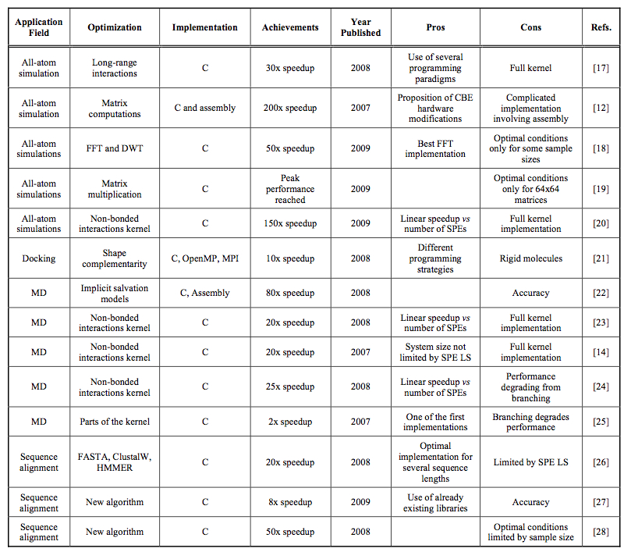
PREVIOUS RESULTS. CELL BROADBAND ENGINE
2007-2009
Pérez-Sánchez and Wenzel. Optimization methods for virtual screening on novel computational architectures.
Curr Comput Aided Drug Des (2011) vol. 7 (1) pp. 44-52

Slide 12
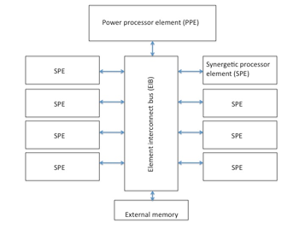
Cell Broadband Engine (CBE)
250 GFLOPS theoretical performance single float
approx 1/10 double prec
256KB Local Storage per SPE
Vector operators
Branching limitation
Notes:
- datos de consumo y dinero
- mostrar los clusters que tienen cell blades, como el bsc (quizas) y el roadrunner? y el puesto de la lista de top 500
- mostrar datos dinero y numero spes de las cell blades
- si es posible mostrar datos de futuro tambien
- MOSTRAR AQUI O EN OTRO SITIO LAS LIMITACIONES DE PROGRAMACION: 256K, IFS, GRANULARITY

Slide 13
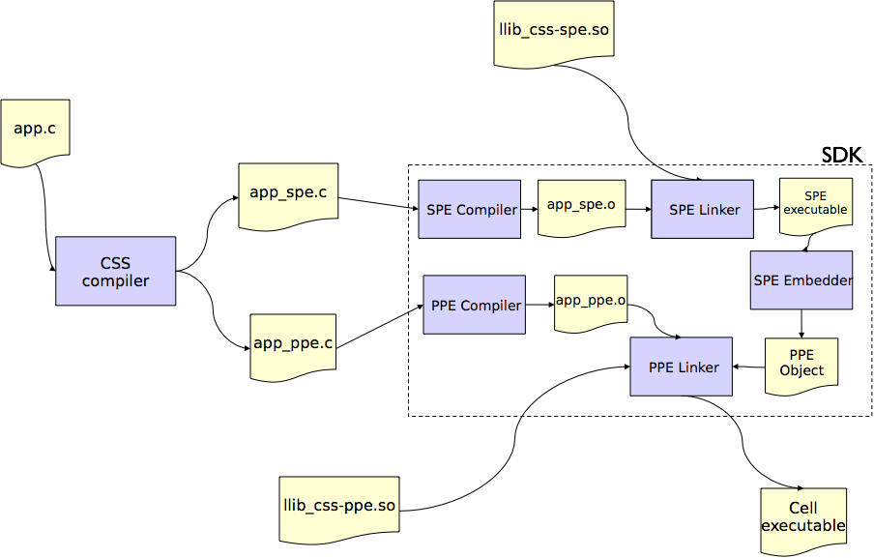


Cell Superscalar (CSS)
metacompiler for C and Fortran. Linux
no separate files for both PPU and SPU
code annotation
autoparallelization, loop unrolling
developed at BSC and sponsored by IBM
Notes:
- no mierdas de semafortos y otros inconvenientes, aqui solo DMA
- mostrar entonces las minimas caracteristicas que necesita
- se descarga de
- viene de ocotopiler no se que, utilizado en el mare nostrum
- quizas mostrar en otra diapositiva como funciona, con el diagrama de interconversion de ppu y enlazado etc

Slide 14
Code vectorization
SPE vector operators
similar to SIMD extensions for x86
our choice: four 32-bit single-precision floating point numbers
vec_res.x = v1.x + v2.x;
vec_res.y = v1.y + v2.y;
vec_res.z = v1.z + v2.z;
vec_res.w = v1.w + v2.w;
vector float v1, v2, vec_res;
vec_res = spu_add(v1,v2);
Lots of operators:
spu_sub
spu_mul
spu_splats
spu_rsqrte
............

Slide 15


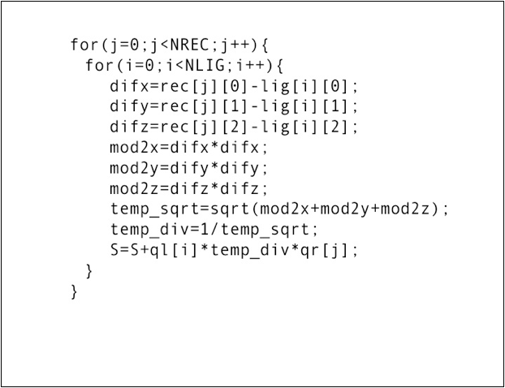

PPE implementation, non vectorized code
Docking example; Receptor - Ligand interaction
(NREC(j) and NLIG(i) particles)
...
...
loop is done NLIG x NREC times
Notes:
- en las condiciones mas optimas, para la ejecucion de este trozo sin optimizacion en la SPE, cual seria el speedup?

Slide 16
SPE implementation, vectorized code
for(j=0;j<NLIG/4;j++){ // "j" is related with nparticles of ligand / 4
sum_inv_dist = spu_splats(zero);
for(i=0;i<NREC;i++){ // "i" is related with nparticles of receptor
temp_Rjx = spu_splats(Rjx[i]);
temp_Rjy = spu_splats(Rjy[i]);
temp_Rjz = spu_splats(Rjz[i]);
temp_qr = spu_splats(qr[i]);
difx=spu_sub(Rix_v[j],temp_Rjx);
dify=spu_sub(Riy_v[j],temp_Rjy);
difz=spu_sub(Riz_v[j],temp_Rjz);
prodx=spu_mul(difx,difx);
prody=spu_mul(dify,dify);
prodz=spu_mul(difz,difz);
mod2=spu_add(spu_add(prodx,prody),prodz);
inv_dist=spu_rsqrte(mod2);
q_inv_dist=spu_mul(inv_dist,temp_qr);
sum_inv_dist=spu_add(sum_inv_dist,q_inv_dist);
}
sum_inv_dist = spu_mul(ql_v[j],sum_inv_dist);
sum_Ei=spu_add(sum_Ei,sum_inv_dist);
}
calculated for 4 Lig atoms at the same time
...
calculated for 4 Lig atoms at the same time
...
we get 1/d directly, for 4 Lig atoms
charges ...
loop is done (NLIG x NREC)/4 times

Slide 17
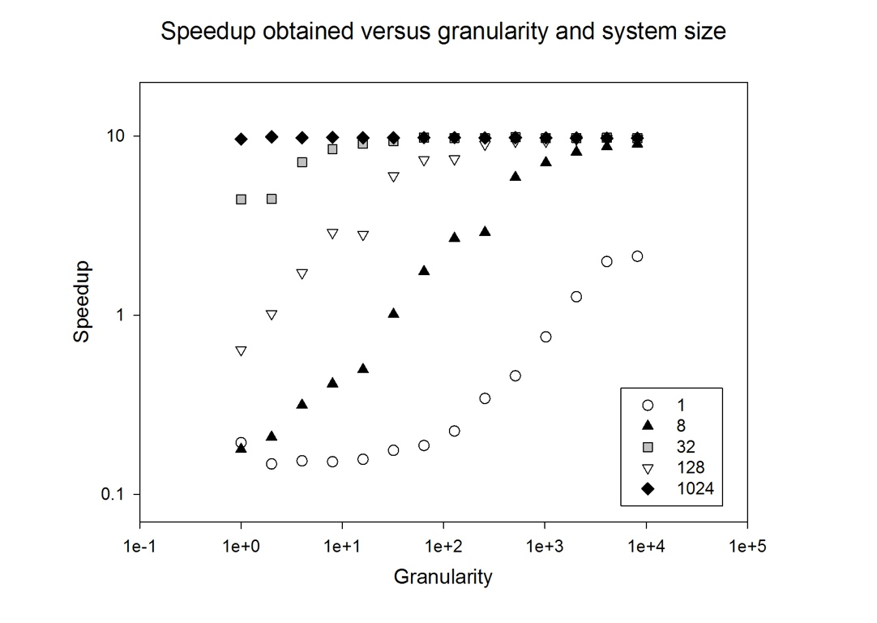
Notes:
- indicar que aqui se trata del codigo vecgorizado y optimizado
- ERRATA: 32 y 128 hay que cambiarlos. quizsa deberia enviar una lista de erratas, como alguno de los otros fallos que hay en el texto, o quizas me la suda ocmpletamente
- OJO, QUE NO SE VEAN LAS NOTAS AL MOSTRAR Y PARA LA PRESENTACION
- que unidades son la granularidad? numero de pasos?
- indicar que lo optimo es entonces hacer los ifs y la simulacion en la PPU para moleculas gordas (1024 hata el limite, comentarlo y lo del doublle buffering), y enviar este calculo a la SPE. SI no, al emplear ifs, se reduce el speeduo

Slide 18
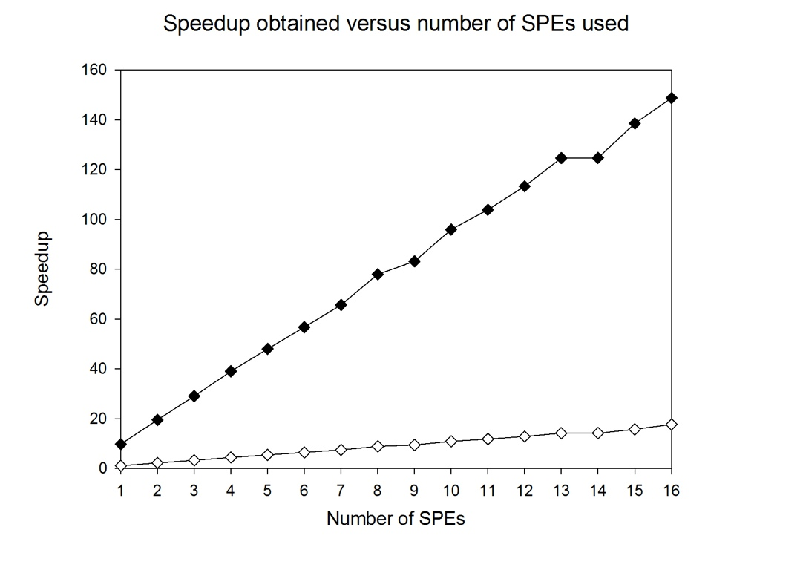
Notes:
- esto debe ser codigo, sin y con optimizacion, debe venir despues de las dos diapostivias de los codigos
- poner las caracteristicas de este sistema. 128 particulas
- ver si tengo los resultados para 1 SPE, grafica de granularidad, para diversos tamaños

Slide 19
Drug Discovery and Virtual Screening
Non-bonded interactions kernel implementations
  Cell Broadband Engine
  GPU
  Cluster; MPI/OpenMP
  Intel Xeon Phi
Conclusions and outlook

Slide 20
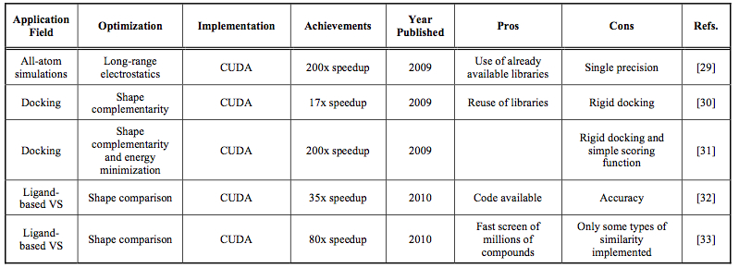
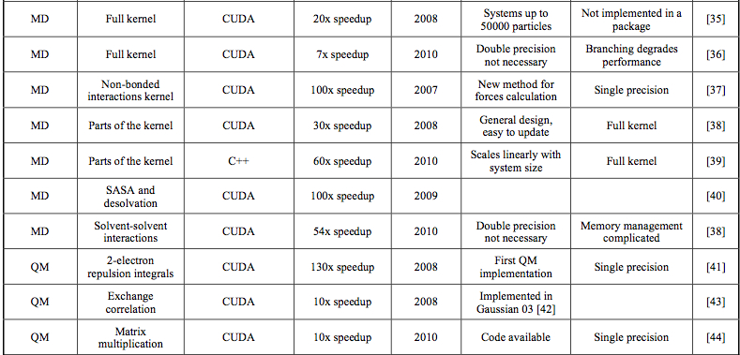

PREVIOUS RESULTS. GPUs
2007-2010
Pérez-Sánchez and Wenzel. Optimization methods for virtual screening on novel computational architectures.
Curr Comput Aided Drug Des (2011) vol. 7 (1) pp. 44-52

Slide 21
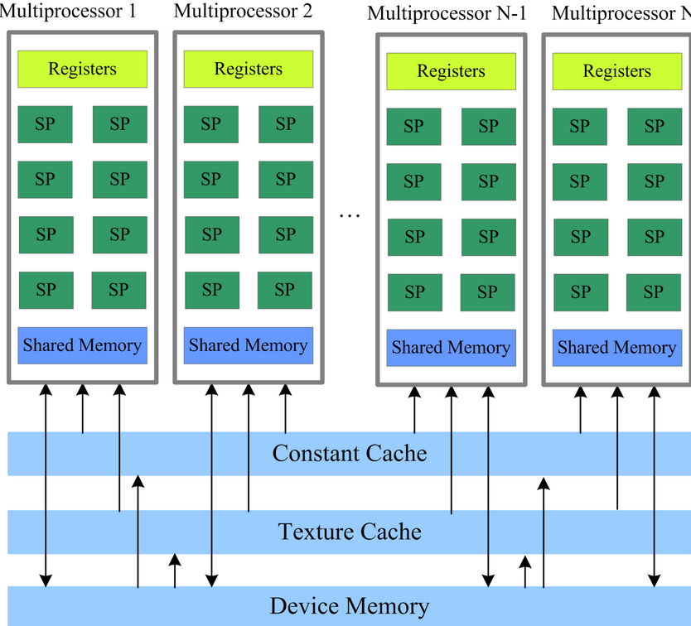
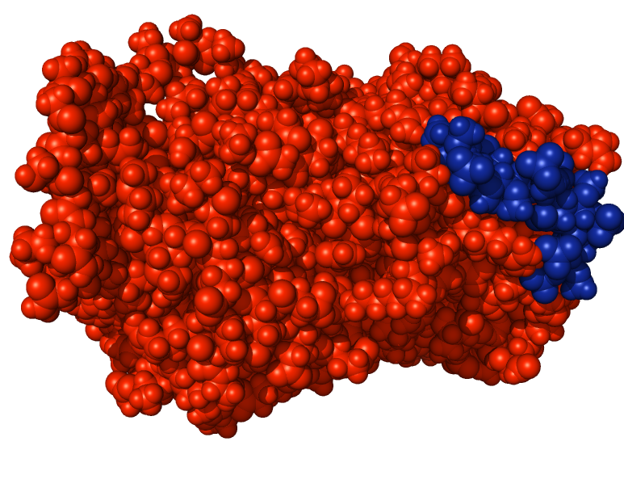
LIG
REC

Slide 22
GPU IMPLEMENTATION
REC
REC
LIG
CUDA design for X thread blocks (with X=1 ) with n threads layout
LIG
As many thread blocks as the number of nrec atoms divided by the number of threads within a block, this number is a configuration parameter of our application
As many threads as nrec atoms, each thread computes the energy calculations with the entire ligand data.
We group atoms of the ligand molecule in tiles, and thus threads can collaborate in order to bring that information to the shared memory

Slide 23
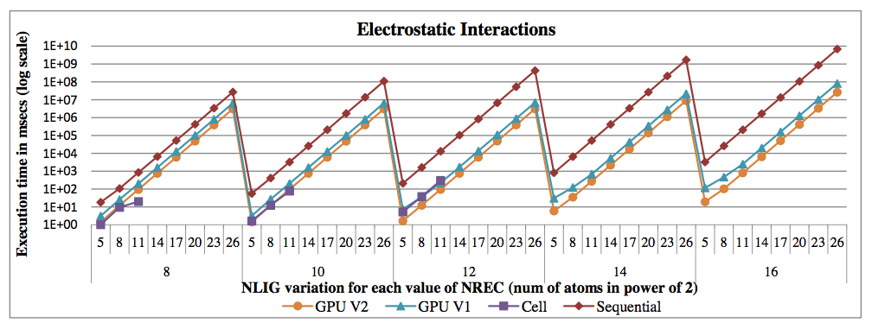
GPU IMPLEMENTATION
LIG
REC
CUDA 4.0 and NVIDIA Tesla C2050; max speedup around 213x
speedup factor between GPU and CPU increases with nrec or/and nlig; number of thread blocks running in parallel is higher; GPU resources are fully used. However, it remains flat for a configuration greater than 256 threads per block.

Slide 24
Drug Discovery and Virtual Screening
Non-bonded interactions kernel implementations
  Cell Broadband Engine
  GPU
  Cluster; MPI/OpenMP
  Intel Xeon Phi
Conclusions and outlook

Slide 25
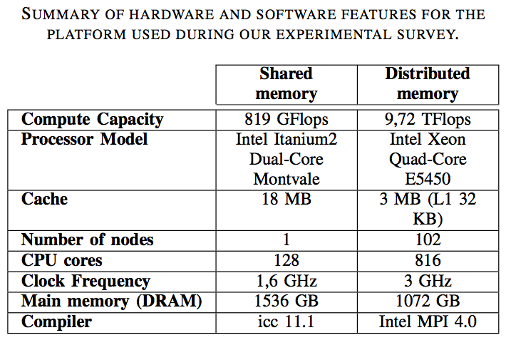

DISTRIBUTED AND SHARED MEMORY IMPLEMENTATIONS
Centro de Supercomputación de la
Fundación Parque Científico de Murcia

Slide 26
HYBRID OPENMP-MPI IMPLEMENTATION
Communication and computation can be overlapped by asynchronous send/receive instructions
  Data sent with MPI_Isend and MPI_Irecv
  As soon as a nlig packet is received by a node, processors start computations while waiting for further data
Code is also vectorized
  x86 SSE instructions set
  nlig info is copied four times into 128 bytes vectors

Slide 27
PERFORMANCE COMPARISON
Performance: Supercomputing Center (SC) similar to GPU for Virtual Screening kernels
Price: SC (M€) >>> GPU (K€) !!! (do you want to spare thousands of euros???)
Power consumption: SC >>> GPU !!! (do you want to be green???)
YOU ARE WASTING YOUR TIME AND MONEY !!! INVEST YOUR SC BUDGET IN GPUs !!!

Slide 28
Drug Discovery and Virtual Screening
Non-bonded interactions kernel implementations
  Cell Broadband Engine
  GPU
  Cluster; MPI/OpenMP
  Intel Xeon Phi
Conclusions and outlook

Slide 29
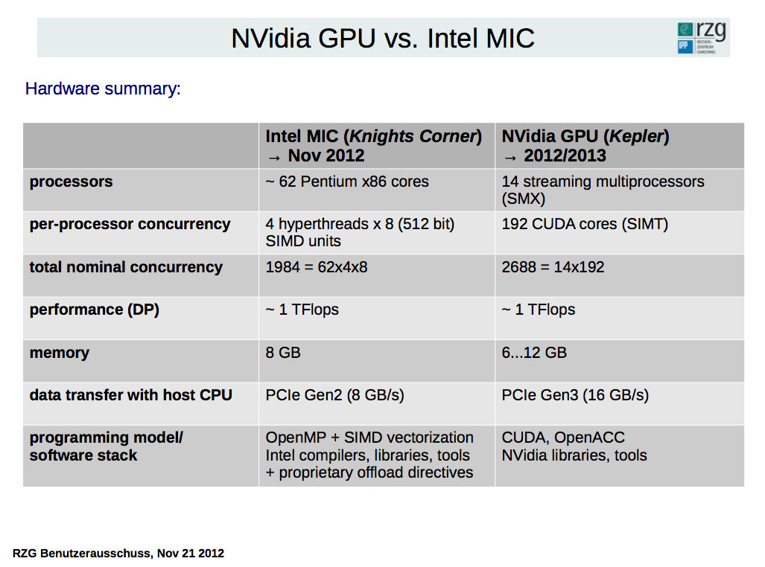
PERSPECTIVES
  EXPLOIT NOT ONLY GPUS BUT HETEROGENEOUS PARALLEL SYSTEMS AS A WHOLE SYSTEM FOR DRUG DISCOVERY
  BE ALSO ENERGY EFFICIENT; design algorithms accordingly
  THANKS TO GPU COMPUTING POWER; IMPROVE ACCURACY AND REALISM OF CURRENT VIRTUAL SCREENING METHODS
  APPLY OUR IMPLEMENTATIONS AND VIRTUAL SCREENING PROGRAMS TO A BROADER RANGE OF DRUG DISCOVERY PROBLEMS AND CONTRIBUTE TO THE DISCOVERY OF NEW DRUGS

Slide 30
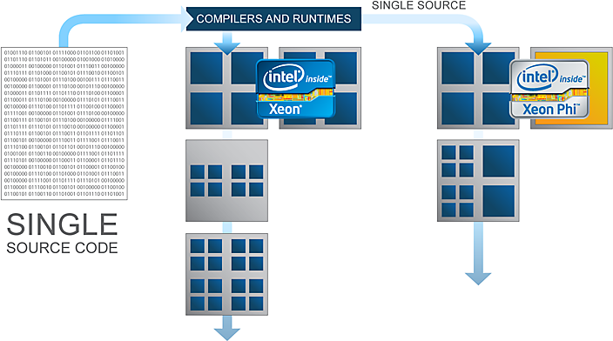
Programming Xeon Phi
Ease-of-use and programmability are
selling points of XeonPhi, what is the truth?
2 running modes
  offload mode - the main application is running on the host, and it only offloads selected (highly parallel, computationally intensive) work to the coprocessor
  native mode - the application runs independently, on the Xeon Phi only, and can communicate with the main processor or other coprocessors through the system bus.
Programming models
  Pthreads, OpenMP, OpenCL, …
  C/Fortran
  MPI
Libraries
  MKL, …

Slide 31
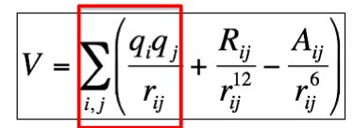
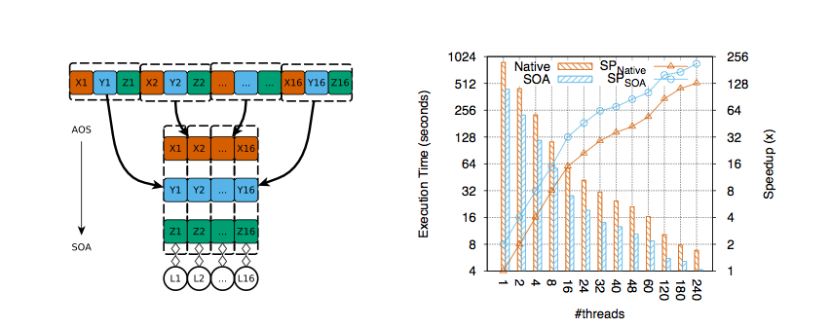
Intel Xeon Phi: Vectorization
A straightforward way to parallelize our kernel using OpenMP is to add an omp parallel construct over the outer loop and rearrange data structures
Native (Array of Structures, AOS)
(Structure of Arrays, SOA)
AOS; 128x
SOA; 256x

Slide 32
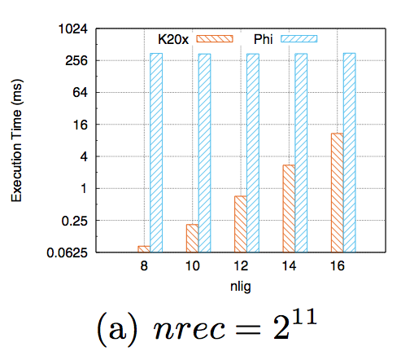
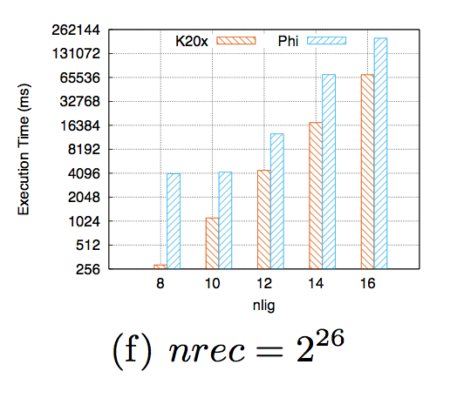
Performance: Phi and GPU
GPU/Phi gap reduction
~16x
~4x
2048 receptor particles
larger systems
6.7*10⁷ receptor particles
Single precision calculations for relatively small sized systems are more suitable for GPUs (K20x completely out- performs Xeon Phi)
For large systems, they achieve a similar order of magnitude performance

Slide 33
Drug Discovery and Virtual Screening
Non-bonded interactions kernel implementations
  Cell Broadband Engine
  GPU
  Cluster; MPI/OpenMP
  Intel Xeon Phi
Conclusions and outlook

Slide 34
Conclusions
– Porting legacy (sequential) code in OpenMP for Xeon Phi comes almost for free. However, optimizing the outcome is relatively time-consuming, as a thorough understanding of the architectural features of the processor is mandatory.
– On Xeon Phi, it is essential to select suitable data structures (SOA instead of AOS, for caching) to enable the full utilization of the SIMD units. By comparison, GPUs like Nvidia K20x prefer the AOS-style data structures.
– Nvidia K20x significantly outperforms Intel Xeon Phi on Virtual Screening when using single-precision floating-point data elements. We expect the performance for double precision computations to be much closer.

Slide 35
Outlook
Evaluate the double precision computation for both the GPU and the Xeon Phi
Aiming to use a unified programming model, we will evaluate an OpenCL solution for VS on both GPUs and Xeon Phi, thus evaluating the impacts of the chosen programming model on the overall performance of the application
Extension to other Virtual Screening Kernels (Van der Waals, Hydrogen Bonds, etc)
Characterize Phi Power Consumption in an heterogeneous computing environment

Slide 36


COLLABORATORS
Jianbin Fang, TUDelft
Ana Lucia Varbanescu, University of Amsterdam

Slide 37
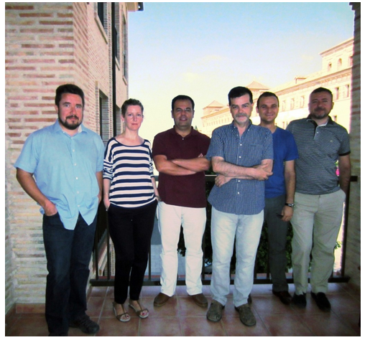
BIOINFORMATICS AND HIGH PERFORMANCE COMPUTING RESEARCH GROUP (UCAM, Murcia, Spain)
http://bio-hpc.eu
1 Full time research associate
5 Full time associate professors
4 PhD students
Collaboration with more than 20 international research groups

Slide 38






Acknowledgments

Slide 39


OMICS International
www.omicsonline.org
OMICS International (and its subsidiaries), is an Open Access publisher and international conference Organizer, which owns and operates peer-reviewed Clinical, Medical, Life Sciences, and Engineering & Technology journals and hosts scholarly conferences per year in the fields of clinical, medical, pharmaceutical, life sciences, business, engineering, and technology. Our journals have more than 3 million readers and our conferences bring together internationally renowned speakers and scientists to create exciting and memorable events, filled with lively interactive sessions and world-class exhibitions and poster presentations. Join us!
OMICS International is always open to constructive feedback. We pride ourselves on our commitment to serving the Open Access community and are always hard at work to become better at what we do. We invite your concerns, questions, even complaints. Contact us at contact.omics@omicsonline.org. We will get back to you in 24-48 hours. You may also call 1-800-216-6499 (USA Toll Free) or at +1-650-268-9744 and we will return your call in the same timeframe.
Contact us at: contact.omics@omicsonline.org

Slide 40

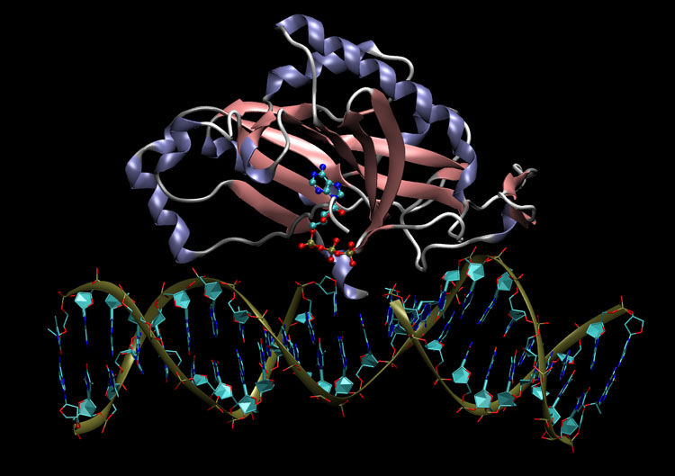
Drug Designing Open Access
Related Journals
Journal of Clinical Trials
Journal of Pharmacovigilance
Journal of Developing Drugs

Slide 41
Drug Designing Open Access
Related Conferences
http://www.conferenceseries.com/

Slide 42
OMICS publishing Group Open Access Membership enables academic and research institutions, funders and corporations to actively encourage open access in scholarly communication and the dissemination of research published by their authors.
For more details and benefits, click on the link below:
http://omicsonline.org/membership.php

