Slide 1
OMICS international
OMICS International through its Open Access Initiative is committed to make genuine and reliable contributions to the scientific community. OMICS International hosts over 700 leading-edge peer reviewed Open Access Journals and organizes over 1000 International Conferences annually all over the world. OMICS International journals have over 10 million readers and the fame and success of the same can be attributed to the strong editorial board which contains over 50000 eminent personalities that ensure a rapid, quality and quick review process. OMICS International signed an agreement with more than 1000 International Societies to make healthcare information Open Access.
Contact us at: contact.omics@omicsonline.org

Slide 2
OMICS Journals are welcoming Submissions
OMICS International welcomes submissions that are original and technically so as to serve both the developing world and developed countries in the best possible way.
OMICS Journals are poised in excellence by publishing high quality research. OMICS International follows an Editorial Manager® System peer review process and boasts of a strong and active editorial board.
Editors and reviewers are experts in their field and provide anonymous, unbiased and detailed reviews of all submissions.
The journal gives the options of multiple language translations for all the articles and all archived articles are available in HTML, XML, PDF and audio formats. Also, all the published articles are archived in repositories and indexing services like DOAJ, CAS, Google Scholar, Scientific Commons, Index Copernicus, EBSCO, HINARI and GALE.
For more details please visit our website: http://omicsonline.org/Submitmanuscript.php

Slide 3
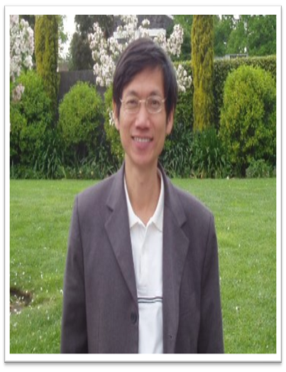
Editor
Journal of Fundamentals of Renewable Energy and Applications
Huann-Ming Chou
Professor / Dean
College of Engineering
Kun Shan University
China

Slide 4
Biography:
PhD in National Cheng Kung University Taiwan Graduate College of Mechanical Engineering,
Masters in National Cheng Kung University Taiwan Graduate College of Mechanical Engineering,
Bachelors in National Cheng Kung University Taiwan Department of Mechanical Engineering.

Slide 5
Research Interest:
Mechanical heat, Energy Technology, Advance of Heat and Flow for Information equipment Advanced Heat Transfer

Slide 6
Journal of Fundamentals of Renewable Energy and Applications
Related Journals
International Journal of Waste Resources
Hydrology: Current Research
Innovative Energy & Research
Advances in Recycling & Waste Management
Journal of Nuclear Energy Science & Power Generation Technology

Slide 7
Journal of Fundamentals of Renewable Energy and Applications Related Conferences
2nd International Congress and Expo on Biofuels & Bioenergy
Global Energy Summit & Expo

Slide 8
OMICS International Open Access Membership
OMICS International Open Access Membership enables academic and research institutions, funders and corporations to actively encourage open access in scholarly communication and the dissemination of research published by their authors.
For more details and benefits, click on the link below:
http://omicsonline.org/membership.php

