Slide 1
OMICS International
OMICS International through its Open Access Initiative is committed to make genuine and reliable contributions to the scientific community. OMICS International signed an agreement with more than 1000 International Societies to make healthcare information Open Access.
Contact us at: contact.omics@omicsonline.org

Slide 2
OMICS Journals are welcoming Submissions
OMICS International welcomes submissions that are original and technically so as to serve both the developing world and developed countries in the best possible way.
OMICS Journals are poised in excellence by publishing high quality research. OMICS International follows an Editorial Manager® System peer review process and boasts of a strong and active editorial board.
Editors and reviewers are experts in their field and provide anonymous, unbiased and detailed reviews of all submissions.
The journal gives the options of multiple language translations for all the articles and all archived articles are available in HTML, XML, PDF and audio formats. Also, all the published articles are archived in repositories and indexing services like DOAJ, CAS, Google Scholar, Scientific Commons, Index Copernicus, EBSCO, HINARI and GALE.
For more details please visit our website: http://omicsonline.org/Submitmanuscript.php

Slide 3
Hugo R. Arias
EB PPT

Slide 4
BIOGRAPHY
Hugo R Arias Associate Professor Department of Pharmaceutical Sciences College of Pharmacy Midwestern University Glendale AZ 85308 USA Assistant Professor of Pharmaceutical Sciences Department of Pharmaceutical Sciences College of Pharmacy Western University of Health Sciences Pomona CA USA Research Assistant Professor Department of Pharmacology and Therapeutics College of Medicine University of Florida Gainesville FL USA Adjunct Investigator National Council of Scientific and Technological Research CONICET Argentina Assistant Investigator National Council of Scientific and Technological Research CONICET Argentina Professional Assistant National Council of Scientific and Technological Research CONICET Argentina. He has received a PhD in Biochemistry from the National Southern University Bahía Blanca Argentina in 1990. He has received a Master of Science in Biochemistry from the National Southern University Bahia Blanca Argentina in 1982. He has completed his BA of Science in Biochemistry in the National Southern University Bahía Blanca Argentina in 1982. He has completed his diploma of Chemist in the National Southern University Bahía Blanca Argentina in 1980.

Slide 5
RESEARCH INTEREST
Cys-loop ligand-gated ion channels- Nicotinic acetylcholine receptors - Agonists, competitive antagonists, noncompetitive antagonists, positive and negative allosteric modulators Thermodynamics of ligand-receptor interactions, Drug addiction Depression and antidepressants Alzheimer’s disease. Modulation of angiogenesis by nicotinic receptors.

Slide 6
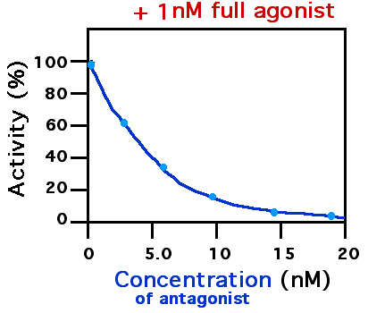
Antagonists, Overview
Definition
“An antagonist is a substance that does not provoke a biological response itself, but blocks or reduces agonist-mediated responses”
Antagonists have affinity but no efficacy for their cognate receptors
Binding of antagonist to a receptor will inhibit the function of a partial agonist, an agonist or inverse agonist at that receptor
Antagonists mediate their effects by binding to the active site or to allosteric sites on receptors or they may interact at unique binding sites not normally involved in the biological regulation of the receptor's activity.
Antagonist activity may be reversible or irreversible depending on the longevity of the antagonist–receptor complex which in turn depends on the nature of antagonist receptor binding.

Slide 7
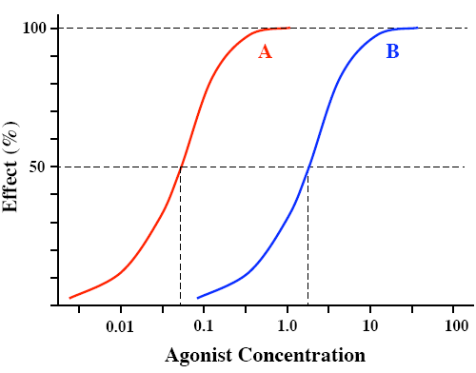
Antagonists, 1-Competitive reversible antagonist
It binds to same site on receptor as agonist
inhibition can be overcome by increasing agonist concentration (i.e., inhibition is reversible)
No significant depression in maximal response (E_{max} ??)
The agonist dose-response curve will be shifted to the right (without a change in the slope of the curve)
Maximal response occurs at a higher agonist concentration than in the absence of the antagonist
It primarily affects agonist potency
Clinically useful
Example: Prazosin at α adrenergic receptors
Agonist
Antagonist + Agonist
EC_{50A}
EC_{50B}

Slide 8
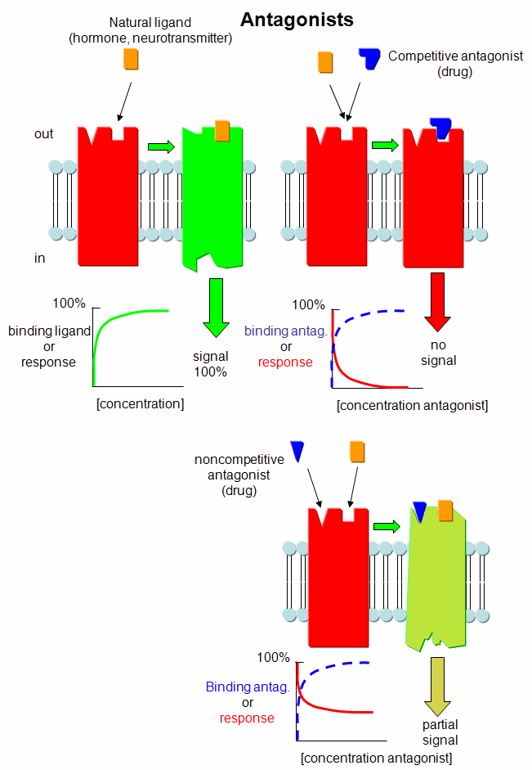

Slide 9
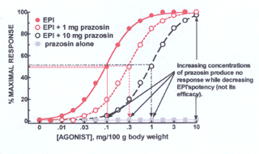
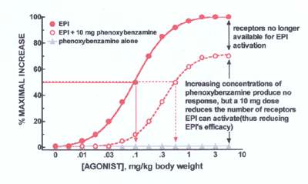
Antagonists, contd.
Competitive reversible antagonist vs Competitive irreversible antagonist

Slide 10
Competitive Antagonists, In Motion
Antagonist
Receptor
Antagonist-Receptor
Complex
DENIED!

Slide 11
Non-competitive Antagonist, In Motion
Antagonist
Agonist
Receptor
DENIED!
‘Inhibited’-Receptor

Slide 12
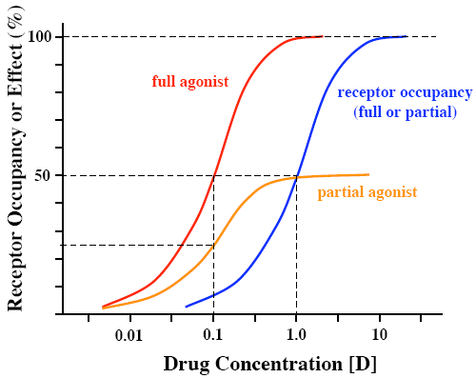
Drug Receptor Interactions, Full vs Partial Agonist
Full agonist
“Drug with high efficacy enough to elicit a maximal tissue response”
Partial agonist
“Drug with intermediate level of efficacy, such that even when 100% of the receptors are occupied, the tissue response is submaximal”
exhibits similar potency (EC₅₀), but lower efficacy (E_{max})
produces concentration-effect curves that resemble those observed with full agonists in the presence of an irreversible antagonist
compared to full agonist both can exhibit identical receptor affinity (the blue curve)
the failure of partial agonists to produce a maximal response is not due to decreased receptor affinity → partial agonists competitively inhibit the responses produced by full agonists
many clinical agents used as antagonists are actually partial agonists
For example, pindolol, a β-adrenoceptor "partial agonist," may act as either an agonist (if no full agonist is present) or as an antagonist (if a full agonist such as isoproterenol is present). Propranolol is devoid of agonist activity, i.e., it is a pure antagonist

Slide 13
Antagonists, 2- Competitive irreversible antagonist
It binds to same site on receptor as agonist
The antagonist possesses reactive group which forms covalent bond with the receptor → the antagonist dissociates very slowly, or not at all
inhibition cannot be overcome by increasing agonist concentration (i.e., inhibition is irreversible)
Maximal response is depressed (i.e., E_{max} is decreased)
The agonist dose-response curve will be shifted to the right (the slope of the curve will be reduced)
Agonist potency may or may not be affected
The only mechanism the body has for overcoming the block is to synthesize new receptors
Experimental tools for investigating receptor functions
Example: phenoxybenzamine at α adrenergic receptors

Slide 14
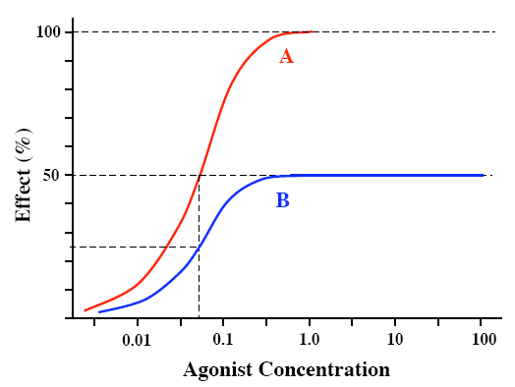
Antagonists, 3- Non-competitive antagonist
It does not bind to the same receptor sites as the agonist. It would either:
bind to a distinctly separate binding site from the agonist →decreased affinity of the receptor for the agonist, “allosteric inhibition”,
prevent conformational changes in the receptor required for receptor activation after the agonist binds → “allosteric inhibition”,
or alternatively block at some point the chain of events that leads to the production of a response by the agonist
Inhibition cannot be overcome by increasing agonist concentration (irreversible)
Agonist maximal response will be depressed
Agonist dose-response curve will be shifted to the right (the slope of the curve will be reduced)
Agonist potency may or may not be affected
Agonist
Antagonist + Agonist
Example: the noncompetitive antagonist action of crystal violet (CrV) on nicotinic acetylcholine receptors is explained by an allosteric mechanism in which the binding of CrV to the extracellular mouth of the resting receptor leads to an inhibition of channel opening

Slide 15
Antagonists, contd.
Physiologic (functional) antagonist
Physiologic antagonism occurs when the actions of two agonists working at two different receptor types have opposing (antagonizing) actions
Example 1: Histamine acts at H₁ receptors on bronchial smooth muscle to cause bronchoconstriction, whereas adrenaline is an agonist at the β₂ receptors bronchial smooth muscle, which causes bronchodilation.
Example 2: histamine acts on receptors of the parietal cells of the gastric mucosa to stimulate acid secretion, while omeprazole blocks this effect by inhibiting the proton pump
Chemical antagonist
Chemical antagonism occurs when two substances combine in solution → the active drug is lost
Example : Chelating agents (e.g., dimercaprol) that bind heavy metals, and thus reduce their toxicity
Pharmacokinetic antagonist
Pharmacokinetic antagonist effectively reduces the concentration of the active drug at its site of action
Example: phenobarbital accelerates the rate of metabolic degradation of warfarin

Slide 16
SIGNATURE
Hugo R. Arias

Slide 17
Journals
1.Analytical & Bioanalytical Techniques
http://omicsonline.org/analytical-bioanalytical-techniques.php
2.Chromatography & Separation Techniques
http://omicsonline.org/chromatography-separation-techniques.php

Slide 18
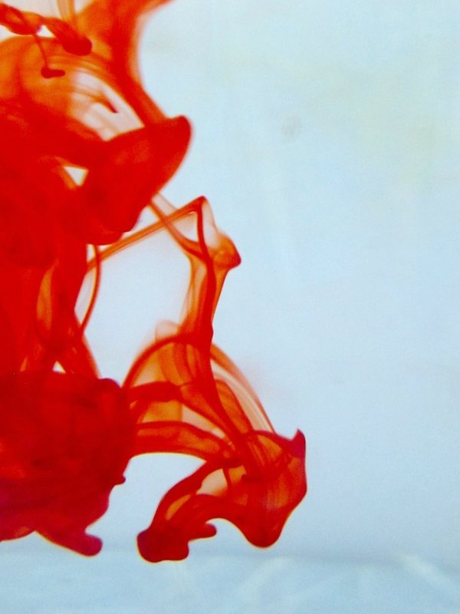
OMICS International Open Access Membership
OMICS International Open Access Membership enables academic and research institutions, funders and corporations to actively encourage open access in scholarly communication and the dissemination of research published by their authors.
For more details and benefits, click on the link below:
http://omicsonline.org/membership.php

