Slide 1
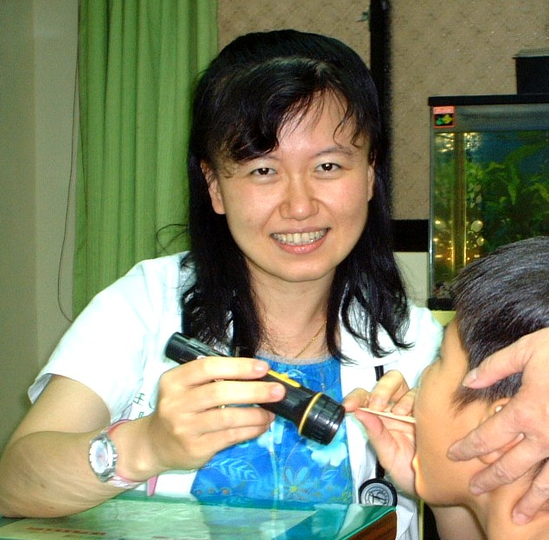
I-Jen Wang MD, PhD
is a pediatrician and environmental epidemiologist
Department of Pediatrics, Taipei Hospital, Ministry of Health and Welfare,
#127, Su-Yuan Road, Hsin-Chuang District, New Taipei City 242, Taiwan.
Phone: +886-2-2276-5566 ext. 2532
Fax: +886-2-2998-8028
E-mail: wij636@gmail.com
Notes:
1

Slide 2
Present Position
1. Department of Pediatrics, Taipei Hospital, Ministry of Health and Welfare, Taipei, Taiwan
2. College of Medicine, National Yang-Ming University
3. College of public health, China Medical University
4.Instructor of Taiwan Academy of Pediatric Allergy Asthma and Immunology
5.Scientific advisor to Research Committee in Taipei Hospital Ministry of Health and Welfare

Slide 3
Research Interest
Environmental exposures and childhood allergic diseases
Environmental epigenetics, gene and environment interactions
Biomarkers for allergic diseases
Seroprevalence and vaccination strategy
Outbreak investigation, Health impacts of melamine contaminated food products.

Slide 4
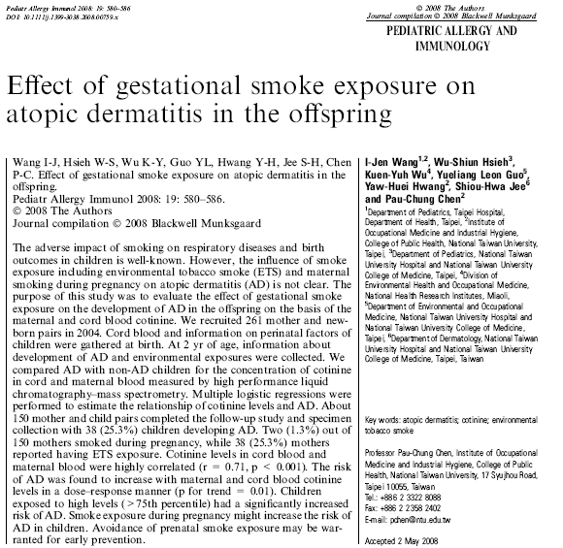
Smoke exposure during pregnancy might increase the risk of AD in children.
Avoidance of prenatal smoke exposure may be warranted for early prevention.
Notes:
4
In our previous studies, we also found prenatal smoke exposure may increse the risk of AD in the offspring
109 (cotinine <0.16ng/ml), 36 (cotinine 0.16~14 ng/ml)

Slide 5
GSTM1 and GSTP1 polymorphism may be responsible for children differences in susceptibility to AD with regard to gestational smoke exposure.
Notes:
5
In our previous studies, we also found prenatal smoke exposure may increse the risk of AD in the offspring
109 (cotinine <0.16ng/ml), 36 (cotinine 0.16~14 ng/ml)

Slide 6
The effect of prenatal tobacco smoke exposure on the risk for AD may be mediated through DNA methylation.
Methylated TSLP 5′CGI may be a potential epigenetic biomarker for environmentally associated atopic disorders.

Slide 7
The research results have been published:
Wang IJ, Wang SJ, Yan DC, Lin SJ, Chiang BL. Hyper-IgM Syndrome with Hypoxic Ischemic Encephalopathy --- A Case Report. J Microbiol Immunol Infect. 2003 Sep;36(3):215-7.
Wang IJ, Lu MY, Chiang BL, Lin WC, Lin DT, Lin KH. Epstein-Barr Virus Associated Hemophagocytosis Syndrome and Lymphoproliferative Disorder in a Child with Wiskott-Aldrich Syndrome after Bone Marrow Transplantation. Pediatr Blood Cancer. 2005 Sep;45(3):340-3. (SCI: 25/94 in TQ, Impact Factor: 2.134)
Wang IJ, Lin YT, Yang YH, Chen CL, Tsai YH, Chiang BL, Hwang KC. The Correlation of Age and Allergens in Atopic Dermatitis. Ann Allergy Asthma Immunol. 2004 Oct;93(4):334-8. (SCI: 8/17 in Allergy, Impact Factor:2.221)
Wang IJ, Guo YL, Hwang KC, Hsieh WS, Chuang YL, Lin SJ, Chen PC. Genetic and Environmental Risk Factors for Pediatric Atopic Dermatitis. Acta Paediatr Taiwan. 2006 Sep-Oct;47(5):238-42. (SCI: 89/107; Impact Factor: 0.747)
Wang IJ, Hwang KC, Tsai YH, Wu YN, Chao SJ, Chen TE, Huang LM.
Rubella Seroprevalence among Young Women in Taipei County after Routine Measles, Mumps, and Rubella Immunization Program. Acta Paediatr Taiwan. 2006 Jan-Feb;47(1):14-7. (SCI: 89/107; Impact Factor: 0.747)
Wang IJ, Huang LM, Chen HH, Hwang KC, Chen CJ. Seroprevalence of Rubella Infection after National Immunization Program in Taiwan:Vaccination Status and Immigration Impact. J Med Virol. 2007 Jan;79(1):97-103. (SCI:16/30; Impact Factor:2.47)
Wang IJ, Lee PI, Huang LM, Chen CJ, Chen CL, Lee WT. The correlation between neurological evaluations and neurological outcome in acute encephalitis: a hospital-based study. Eur J Paediatr Neurol. 2007 Mar;11(2):63-9. (SCI: 25/70; Impact Factor: 1.369)
Wang IJ, Guo YL, Weng HJ, Hsieh WS, Chuang YL, Lin SJ, Chen PC. Environmental risk factors for early infantile atopic dermatitis. Pediatr Allergy Immunol. 2007 Aug;18(5):441-7. (SCI: 11/ 94; Impact Factor: 2.676)
Wang IJ, Hsieh WS, Wu KY, Guo YL, Hwang YH, Jee SH, Chen PC. The effect of gestational smoke exposure on atopic dermatitis in the offspring. Pediatr Allergy Immunol. 2008 Nov;19(7):580-6. (SCI: 11/94; Impact Factor: 2.676)

Slide 8
The research results have been published:
Wang IJ, Hsieh WS, Guo YL, Jee SH, Hsieh CJ, Hwang YH, Chen PC. Neuro-mediators as predictors of pediatric atopic dermatitis. Clin Exp Allergy. 2008 Aug;38(8):1302-8. (SCI: 3/21 in AQ; Impact Factor: 4.084)
Wang IJ, Viscidi R, Hwang KC, Lin TY, Chen CJ, Huang LM, Chen HH, Chen CJ. Seroprevalence and risk factors for Human Papillomavirus in Taiwan. J Trop Pediatr. 2008 Feb;54(1):14-8. (SCI: 51/94 in TQ; Impact Factor: 1.224)
Wang IJ, Chen PC, Hwang KC. Melamine and nephrolithiasis in children in Taiwan. N Engl J Med. 2009 Mar 12;360(11):1157-8. (SCI: 1/153; Impact Factor: 53.486)
Cheng WC, Chen SK, Lin TJ, Wang IJ*, Kao YM, Shih DY. Determination of urine melamine by validated isotopic ultra-performance liquid chromatography/tandem mass spectrometry. Rapid Commun Mass Spectrom. 2009 Jun;23(12):1776-82. (SCI: 19/73 EA; Impact Factor: 2.846)
Wang IJ, Wu YN, Wu WC, Leonardi G, Sung YJ, Lin TJ, Wang CL, Kuo CF, Wu KY, Cheng WC, Chan CC, Chen PC, Lin SL. The association of clinical findings and exposure profiles with melamine associated nephrolithiasis. Arch Dis Child. 2009 Nov;94(11):883-7. (SCI: 12/86; Impact Factor: 2.65)
Lin TJ, Wang IJ , Tai YT. The concept of this aricticle has been distorted by the misinterpretation of the data. British Medical Journal. (28 July 2009) http://www.bmj.com/cgi/eletters/338/apr14_1/b1088. (SCI: ranking: 5/133 in PY; Impact Factor: 13.66)
Wang IJ, Lin TJ, Chen PC. Who should receive renal screening? [E-letter], British Medical Journal. (December 23, 2008), http://www.bmj.com/cgi/eletters/337/dec18_4/a2991(accessed January 12, 2009). (SCI: ranking: 5/133 in PY; Impact Factor: 13.66)
Wang IJ, Chen CJ, Chen PC. Treatment of melamine associated nephrolithiasis. [E-letter], Pediatrics (July1,2009), http://pediatrics.aappublications.org/cgi/eletters/123/6/e1099#44631 (accessed July 4, 2009). (SCI: 3/94; Impact Factor: 4.687)
Wei L , Lee KS , Siu MK , Tai YT , Lin JW , Hung KS , Chiu WT , Wang IJ, Lin TJ. Outcomes of Epidural Neuroplasty to Treat Lumbar Discogenic Pain- One-Year Follow-Up. Chinese J. Pain 2009;19(1): 08 ~ 16.
Chen HC, Tai YT, Wang IJ, Kung WM, Lin JW, Hung KS, Chiu WT, Lin TJ. Treatment of Chronic Discogenic Pain by Utilizing Both Nucleoplasty and Epidural Neuroplasty — One Year Follow-Up. Formos J Surg 2010;43:120-128.
Lin TJ, Huang CC, Wang IJ, Lin JW, Hung KS, Fan L, Tsao HH, Yang NS, Lin KJ. Validation of an Animal FDG PET Imaging System for Study of Glioblastoma Xenografted Mouse and Rat Models. Ann Nucl Med Sci 2010;23:77-83
Wang IJ, Guo YL, Lin TJ, Chen PC, Wu YN. GSTM1, GSTP1, prenatal smoke exposure, and atopic dermatitis. Ann Allergy Asthma Immunol. 2010 Aug;105(2):124-129. (SCI: 8/17 in Allergy, Impact Factor:2.221)
Wang IJ, Huang YC, Chen PC, Wu TN. Is Screening Cost-effective for Melamine-associated Nephrolithiasis? J Trop Pediatr. 2011 Apr;57(2):141-3. (SCI: 9/19 in YU; Impact Factor: 1.248)

Slide 9
The research results have been published:
Wang IJ, Tsai CH, Chen CH, Tung KY, Lee YL. Glutathione S-Transferase, incense burning, and asthma in children. Eur Respir J. 2011 Jun;37(6):1371-7. (SCI:4/46 in WE; Impact Factor: 5.922)
Wang IJ, Chen CC, Chan CC, Chen PC, Leonardi G, Wu KY. A hierarchical Bayesian approach for risk assessment of melamine in infant formula based on cases of related nephrolithiasis in children. Food Additives and Contaminants Part A-Chemistry Analysis Control Exposure& Risk Assessment. 2011 Apr;28(4):384-95. (SCI:24/128 in JY; Impact Factor: 2.23)
Wang IJ, Lin SL, Tsou KI, Hsu MC, Chiu WT, Tsai SH, Lee LM, Lin TJ. Congenital midline nasal mass: cases series and review of the literature. Turk J Pediatr. 2010 Sep-Oct;52(5):520-4. (SCI: 80/86 in TQ; Impact Factor: 0.41)
Wang IJ, Lin TJ, Kuo CF, Lin SL, Lee YL, Chen PC. Filaggrin polymorphism P478S, IgE level, and atopic phenotypes. Br J Dermatol. 2011;164(4):791-6. (SCI: 3/55 in GA; Impact Factor: 4.353)
Wang IJ, Huang LM, Guo YL, Hsieh WS, Lin TJ, Chen PC. Haemophilus influenzae type b combination vaccines and atopic disorders: A prospective cohort study. J Formos Med Assoc. 2012 Dec;111(12):711-8. (SCI: 76/153; Impact Factor: 1.125)
Wang IJ, Hsieh WS, Chen CY, Fletcher T, Lien GW, Chiang HL, Chiang CF, Wu TN, Chen PC. The effect of prenatal perfluorinated chemicals exposures on pediatric atopy. Environ Res. 2011;111(6):785-91. (SCI:19/193 in JA; Impact Factor: 3.5)
Su KW, Chen PC, Wang IJ*. Cord blood soluble Fas Ligand: a novel predictor for atopic dermatitis. Allergy and Asthma Proceedings. 2011 Sep-Oct; 32(5); 366-371(6) (SCI: 11/16 in Allergy; Impact Factor: 1.346).
CK Ng*,IJ Wang* SH Tsai, TN Lui, JW Lin, TJ Lin. Treatment of Cervicobrachialgia Utilizing Percutaneous Cervical Disc Nucleoplasty : One Year Follow-Up. Chinese J. Pain 2011;21(2):55~63 * contributed equally to this article.
Wang IJ; Wang IJ; Chen SL; Lu TP; Chuang Eric; Chen PC. Prenatal smoke exposure, DNA methylation, and childhood atopic dermatitis. Clin Exp Allergy. 2013 May;43(5):535-43. (SCI: 3/24 in Allergy; IF: 5.032)
IJ Wang, CH Tsai, NW Kuo, KY Tung, YL Lee. Home dampness, Beta2 adrenoceptor polymorphisms, and asthma in children. Environ Res. 2012 Oct;118:72-8. (SCI:19/193 in JA; Impact Factor: 3.5)

Slide 10
The research results have been published:
IJ Wang, CJ Hsieh, JL Caffrey, YS Lin, CC Lin, MH Lin, MS Tsai, WC Ho, PC Chen, TN Wu, FC Sung, RS Lin. Fetal growth, overweight, and atopic disorders in adolescence. International Journal of Obesity (under review) (SCI)
KW Su, IJ Wang.* Risk factors for allergic rhinitis. Respirology (in manuscript). (SCI: 27/43 in Respiratory System; Impact Factor:1.853)
Chia-Wen Huang, Ling-Na Shih, Charng-Fong Kuo, Shoei-Loong Lin, I-Jen Wang.* Klippel-Trenaunay-Weber Syndrome: Extradural Arachnoid Cyst, Nevus Flammeus, and Hemihypertrophy. Journal of Medicine and Health 2014;3(1): 97-102.
Wang IJ, Wen HJ, Chiang TL, Lin SJ, Chen PC, Guo YL. Maternal employment and atopic dermatitis in children: A prospective cohort study. British Journal of Dermatology 2013 Apr; 168(4): 794-801. (SCI: 3/55 in GA; Impact Factor: 4.353)
Yi-Hseun Lin, Chia-Yu Lin, Wang I-Jen, Yaw-Huei Hwang. Survey on Blood Lead Levels of the Preschool Children in Taiwan, 2011. Taiwan Journal of Public Health. 2012；31(3)：285-298. (TSSCI)
I-Jen Wang, Wen-Chiuo Wu, Shuei-Liong Lin. The Prevalence of Allergen Sensitization in Children in Taiwan. Allergy and Asthma Proceedings (in submission)
I-Jen Wang, Wen-Chiuo Wu, San-Chi Lin, Cui-Er Chen. The association of urine 8ohdg and atopic dermatitis. Pediatr Allergy Immunol (in submission)
Wang IJ and Consortium of guideline for diagnosis and treatment of childhood AD in Taiwan. Childhood atopic dermatitis in Taiwan. Invited review. J Formos Med Assoc. (in submission )
Wang IJ,Lin CC,Lin YJ,Hsieh WS,Chen PC. The effect of early life phthalate exposures on pediatric atopy. Environ Int.2014 Jan;62:48-54.
Hwang YH, Lin YS, Lin CY, Wang IJ. Incense burning at home and the blood lead level of preschoolers in Taiwan. Environ Sci Pollut Res Int. 2014 Jul 12. [Epub ahead of print]

Slide 11
Childhood Environment
& Allergic diseases Study (CEAS)
2010
Questionnaire: exposures, allergic diseases (ISAAC)
Biological samples : oral scrapes, skin prick test, urine and blood samples
Environmental samples: link to air pollution monitoring stations in Taipei for air pollutants levels
2013
Questionnaire: exposures, allergic diseases
Biological samples : urine, skin prick test
Environmental samples: air pollutants
Notes:
The TCEAS provides an extensive dataset
研究對象分佈地區主要為新莊及周邊地區，包含三重、蘆洲、五股、泰山、林口、樹林、土城、板橋、中和及永和等地區（圖2），個案總數為3040人，排除59位因為居住地址填寫異常、遺漏、無法判別及非新北市地區地址的研究對象與6位因為居住地址距離空氣品質監測站超過10 km以上的研究對象，共排除65位個案，最後參與研究人數為2975位。
11

Slide 12
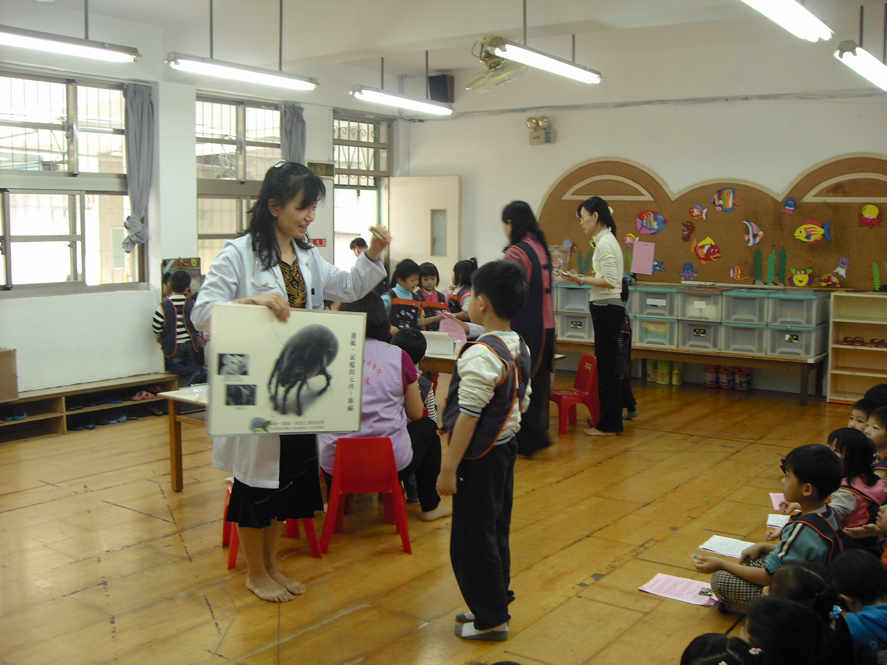
Notes:
為了提供社區兒童之健康照護,我幫忙幼稚園學童之全面巡迴健檢,並爭取經費進行幼稚園學童免費過敏原皮膚檢測及尿液篩檢活動,引起老師及家長之熱烈迴響,並入圍台灣兒童醫療貢獻獎 。
12

Slide 13
Air pollutions
Smoke
Chemicals
Microbiome
Probiotics
CEAS cohort
Allergens
Diet, Stress
Supplements
Genetic
Epigenetic
A longitudinal cohort study (3300 kindergarten children) to investigate the environment,
genetics, and children’s health in Children Environment and Allergic disease Study (CEAS).

Slide 14
Gene & Environment & Allergic diseases
Call for cooperations!
wij636@gmail.com
Notes:
14

Slide 15

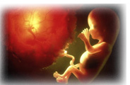
Allergy and Therapy Related Journals
Cell biology: Research & Therapy
Immunological Techniques in Infectious Diseases
Immunome Research

Slide 16

Allergy & Therapy
Related Conferences
3rd International Conference and Exhibition on Clinical & Cellular Immunology"

Slide 17
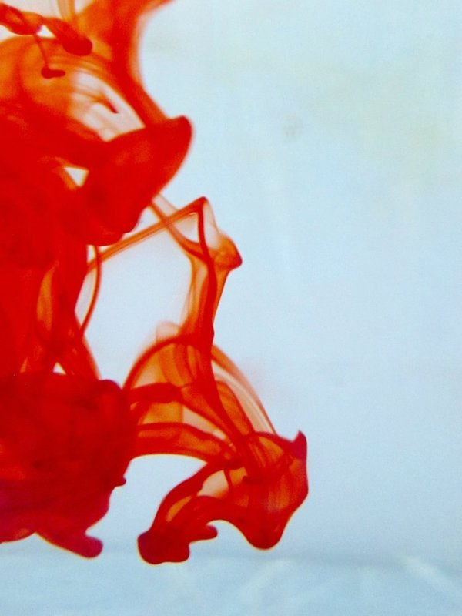

OMICS Group Open Access Membership
OMICS publishing Group Open Access Membership enables academic and research institutions, funders and corporations to actively encourage open access in scholarly communication and the dissemination of research published by their authors.
For more details and benefits, click on the link below:
http://omicsonline.org/membership.php

Slide 18

OMICS Journals are welcoming Submissions
OMICS Group welcomes submissions that are original and technically so as to serve both the developing world and developed countries in the best possible way.
OMICS Journals are poised in excellence by publishing high quality research. OMICS Group follows an Editorial Manager® System peer review process and boasts of a strong and active editorial board.
Editors and reviewers are experts in their field and provide anonymous, unbiased and detailed reviews of all submissions.
The journal gives the options of multiple language translations for all the articles and all archived articles are available in HTML, XML, PDF and audio formats. Also, all the published articles are archived in repositories and indexing services like DOAJ, CAS, Google Scholar, Scientific Commons, Index Copernicus, EBSCO, HINARI and GALE.
For more details please visit our website: http://omicsonline.org/Submitmanuscript.php

